Slide 2
About the EIU Power Brief
EIU Power Brief – Spring 2025
Clients and Friends:
Our Energy Industry Update (or EIU) is an important part of our thought leadership that we bring to you twice a year. The EIU typically features five or six subjects in which we do a deep dive identifying issues, events, and our thoughts on how it will impact clients.
With this inaugural issue of the EIU Power Brief, we are trying something new, different, and complementary to our Energy Industry Update. With this Power Brief, we will focus on current topics, briefly treated, providing our clients with information on trends on a more frequent basis in an accessible PowerPoint-style document, published before and after the EIU.
We hope that you enjoy this issue and the topics we discussed. If you like it (or don't like it), let us know. And if you have ideas for other topics that you would like us to cover either in this publication or in our flagship EIU, please let us know that as well.
Thank you for your interest in ScottMadden and our work.
Sincerely,
Gregory Litra
Head of Energy Research

Slide 3
Executive Summary
EIU Power Brief – Spring 2025
With a new U.S. presidential administration, the energy and utility sectors are experiencing meaningful shifts in policy and regulation. However, many of the same themes that preceded this change remain: accommodating demand growth, making needed capital investment, and ensuring affordable rates and reliability.
Capital expenditures are rising as utilities work to modernize the grid and to meet growing power demand—particularly from data centers, whose rapid expansion is increasingly fueled by artificial intelligence applications. At the same time, new nuclear developments in the United States and Canada signal renewed interest in carbon-free baseload capacity, driven in part by data center load growth.
Concerns about affordability and rate shock have driven interest in securitization. In several southeastern and south-central states, utilities have gained permission to securitize storm-related costs, mitigating financial burdens associated with extreme weather events such as hurricanes.
Industry watchers also expect major policy shifts under the new Trump administration, especially in environmental regulation and its pursuit of an “energy dominance” strategy. Meanwhile, for now, fossil power plant retirements are anticipated to continue in 2025 despite support of the new administration, although some utilities are deferring shutdowns to accommodate load growth and address grid reliability needs.
Finally, winter power system reliability remains a prominent concern. While ongoing industry efforts to address gas-power interdependence and other issues have been making incremental progress, system operators continue to warn of vulnerabilities in extreme weather events.

Slide 4
01. Capital Expenditures
02. Large Loads
03. New Nuclear Development
04. Storm Recovery Securitization
05. Reliability Concerns
06. Federal Policy Developments
07. Generation Retirements

Slide 5
Utilities Ramp up Capex Plans
01. Capital Expenditures
Rolling into 2025, Utilities Announce Capex Plans
  Electric and gas utilities have been announcing increased planned capital expenditures for the next 3 to 5 years. In a sample of utilities, the capex plan changes added from under 5% to nearly 40% of prior capex plans.
  While utility infrastructure to meet load growth needs was cited as a capex growth driver, other major drivers include grid modernization, transmission expansion, gas infrastructure, IT, and low-carbon generation and energy efficiency.
  With the focus on regulated asset investment, sampled utilities projected compound annual growth in rate base between approximately 7% and 10%.
Funding Incremental Investment
  Companies vary in their approach to funding incremental capex but expect generally funding with a 40/60 debt-equity mix. For example, Southern Company anticipates using 30%-40% equity or equity equivalents. PPL targets 44% equity. Duke and Exelon each expect to fund incremental capex with 40% equity.
Company | Capex Change (from Prior Plan) | Planned Capex | Drivers of Increase
DTE Energy | +$5B (+20%) | $30B (+8% CAGR) | +$3B in incremental renewables (voluntary renewables program, clean energy legislation) $1B in grid enhancements
Entergy Corp. | +$2.7B (+7.8%) | $37B (2025-28) | New gas gen in TX, MS, and LA Some grid, nuclear, and distribution investment Shifting capex to more favorable jurisdictions (MS, LA) TX, AR could be supported by economic incentives, regulatory mechanisms for data centers
PPL Corp. | +$5.7B over prior 2024-27 plan (+~40%) | $20B (2025-28) | +$1.3B in KY related to near-term generation needs and environmental compliance +$0.5B for KY system hardening and grid resiliency +$1.0B for PA storm hardening in distribution and $0.2B for data center growth in transmission +$0.6B of IT investments in corporate services $4.9B of 2028 capex for aging infrastructure, T&D system reliability and resiliency, and new KY generation
Southern Co. | +$14B over prior 2024-28 plan (+28.5%) | $63B (2025-29) (+7% rate base CAGR) | Aggregate planned spend: $50.3B for state-regulated electric (vs $38.7B prior) $9.2B for state-regulated gas (vs. $8.5B prior) $3.3B for long-term contracted investments (vs $1.3B prior) Potential $10B-$15B in regulated asset investment
Duke Energy Corp. | +$10B over prior 2024-28 plan (+13.7%) | $83B (2025-29) (7.4% rate base CAGR) | Underpinned by regulated investments reflected in integrated resource plans and multi-year grid programs Top capex spend: Grid (45%), regulated zero-carbon generation (27%), hydrogen-capable gas gen (12%), and gas LDC (6%)
Eversource Corp. | +$2.1B over prior 2024-28 plan (+9.5%) | $24.2B (2025-29) (excludes Aquarion) (8% rate base CAGR 2023-29) | 50% of increase for transmission, including electric sector modernization plan in MA (new substation and engineering work for future substations) 50% for electric distribution, gas, and IT Potential additional $1.5B-$2B for CT AMI, solar, EV, and LNG
Exelon Corp. | +$3.5B over prior 2024-27 plan (+10%) | $38B (2025-28) (7.4% rate base CAGR) | Transmission driving 80% of step-up in spend Excludes $10B-$15B of additional transmission capex in 2029+ for existing infrastructure, new business ($1B for high-density load), RTO-adjacent opportunities ($1B+ potential for MISO LRTP Tranche 2.1), and new gen
Sempra Energy | +$7.7B over prior 2024-28 plan (+16%) | $56B (2025-29) (10% rate base CAGR) | 90% of capex focused on regulated utilities; 75% to electric infrastructure Investment in modernization of regulated T&D platforms Capex plan increase primarily from TX growth
Sources: JP Morgan, Citi Research; company investor presentations

Slide 6
Supply Chain and Macro Uncertainty Muddy the Outlook
01. Capital Expenditures
Selected Tariff Targets and Levels (as of April 11, 2025)
Tariffs as a Wild Card
  The Trump administration has issued three executive orders regarding wide-ranging, across-the-board tariffs on Canadian, Mexican, and Chinese goods. More action is expected.
  Tariffs on steel, a critical input for grid equipment, could affect current capital cost estimates. No exceptions were made for steel not generally produced in the United States, such as certain chrome steel used in the oil and gas sector.
  The administration is also examining imported copper and timber/lumber as strategic or national security materials for potential action, including possible tariffs, with reports due in November 2025.
Inflation Reduction Act Funding in Question (Near Term)
  The administration’s freeze on the disposition of funds under the Inflation Reduction Act is being litigated. Regardless of the outcome, for now it has created uncertainty for projects and delays in commencing construction or purchasing materials.
Equipment Backlogs
  Even with rising capex, long lead times and backlogs continue to affect equipment availability. Utilities are increasingly competing with other energy users such as data centers for equipment.
  Manufacturers such as Hitachi, Siemens, and Schneider are investing in increased production capacity to meet strong demand.
  A recent IEA report noted that some utilities are entering into framework agreements in which equipment manufacturers commit to deliveries over a period up to five years, with pricing including both fixed and variable components. These agreements, however, depend upon regulatory enablers.
Target | Dates | Imports Affected | Applicable Rate
Canada | Announced Feb. 1; scheduled Feb. 4 but delayed 30 days; effective Mar. 4; 30-day exemptions granted Mar. 5-6; exemptions extended indefinitely | Up to $253B while exemptions are in effect | 25% non-energy; 10% energy and potash; to be replaced with 12% “reciprocal tariff” on non-USMCA imports excluding energy and potash later
Mexico | Announced Feb. 1; scheduled Feb. 4 but delayed 30 days; effective Mar. 4; 30-day exemptions granted Mar. 5-6; exemptions extended indefinitely | Up to $236B while exemptions are in effect | 25%; to be replaced with 12% “reciprocal” tariff excluding USMCA imports later
China | Announced Feb. 1; effective Feb. 4; increased Mar. 4 | $430B | 10% initially; increased to 20%, plus additional 125% under "reciprocal" tariffs
Steel and Aluminum | Announced Feb. 10; effective Mar. 12 | Ending steel exemptions $29B; ending aluminum exemptions $12B; expanding derivatives $44B | 25%
Copper | Investigation initiated Feb. 25; report due Nov. 22 | $17B | Unknown
“Reciprocal” | Announced Feb 13; recommendations due Apr. 1; signed Apr. 2; first 10% effective Apr. 5; country-specific increases delayed 90 days eff. April 9 except for China | $2.0T, excluding autos, auto parts, steel, aluminum, energy, Canada, and Mexico | 10% baseline (20% for EU); higher rates for certain jurisdictions including 125% on China
Semiconductors and Pharmaceuticals | Announced Jan. 27; rate specified Feb. 18; effective date unknown | Unknown (products and categories have not been specified) | 25%+
Note: Not shown above are proposed tariffs on autos, agricultural products; and timber, lumber, and derivatives
Sources: Tax Foundation; Bloomberg
Sources: Tax Foundation; Bloomberg; Conference Board; IEA, Building the Future Transmission Grid (Feb. 2025)

Slide 7
Data Centers Proliferate as Regulators Consider Options
02. Large Loads
U.S. Utility Power Demand from Data Centers
(Current and Forecast 2018-2029)
Operating and Planned Data Center Demand by Zone
(Top 10 by GW Demand)
Source: S&P Global Market Intelligence
Source: S&P Global Market Intelligence
Data Center Power Demand Expected to Double
  New large loads continue to drive electricity demand (see chart at top left). According to S&P, U.S. data center demand grew to ~46 GW in Q3 2024. An additional 59 GW of data center demand is expected to be added by 2029.
  Data center demand is expected to triple in PJM’s Dominion Energy zone. Multiple other markets may experience a doubling of demand; notable regions include the non-ISO West and the Southeast (see chart at top right).
  Forecasts contain a high degree of uncertainty. New AI models, such as DeepSeek, could lower energy costs and consumption. Conversely, the Jevons effect hypothesizes that in some cases, lower energy costs could increase overall demand.
Sources: S&P Global Market Intelligence; ScottMadden research

Slide 8
Growth Spurs Innovative Potential Operating Models
02. Large Loads
Flexibility May Enable Data Center Growth
  In addition to potentially developing new generation capacity, utilities and system operators are investigating the possible benefit of making large loads more flexible. For data centers, flexibility could entail shifting workloads, utilizing on-site generation, or adjusting operations.
  In October 2024, EPRI launched DCFlex—a data center flexibility initiative—with utilities, Google, Meta, and Nvidia. DCFlex will demonstrate how data centers can support and stabilize the electric grid through operational flexibility and facility asset utilization through five to ten large-scale flexibility “hubs.”
  In February 2025, a report from Duke University examined the impact of flexible large loads in 22 balancing authorities (see chart at right). The results found that “curtailment-enabled headroom”—or the system’s ability to integrate new load with minimal capacity expansion—could allow nearly 100 GW of new large loads with minimal grid impact.
Possible Headroom Enabled by 0.5% Flexible Large Load Curtailment
by Balancing Authority (GW)
Source: Duke Nicholas Institute
Sources: Electric Power Research Institute; Duke Nicholas Institute for Energy, Environment & Sustainability

Slide 9
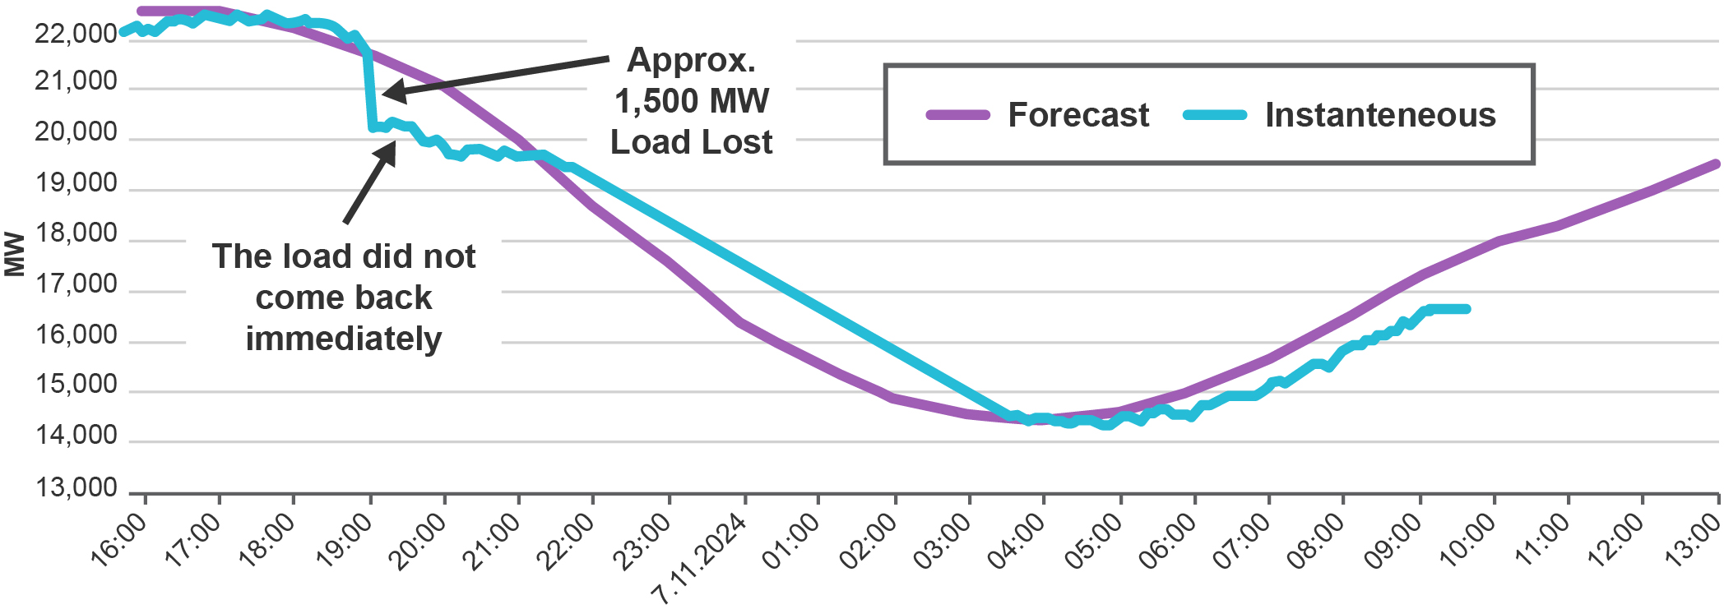
Large Load Growth Can Also Create Operational Challenges
02. Large Loads
Regulators Contemplate Large Loads
  FERC is addressing the co-location of large loads and generation. It is concerned about impacts on resource adequacy, even in a behind-the-meter, “islanded” configuration.
  In November 2024, FERC rejected amendments to an interconnection agreement that would have dedicated capacity from the Susquehanna nuclear power plant to serve an on-site data center. In February 2025, FERC initiated a “show cause” proceeding to review co-location issues in PJM.
  State regulators are exploring rate structures for prospective large loads that allow longer contract terms, minimum bill payments, and exit fees for large loads. Backup generation is also being scrutinized. In Minnesota, the PUC is requiring that Amazon obtain a certificate of need to justify 600 MW of diesel-fired backup generation.
Large Loads Spur Growing Operational Challenges
  In January 2025, NERC published an incident review highlighting the risk of voltage-sensitive load reductions.
    In July 2024, a transmission line fault occurred in an area of the Eastern Interconnection with a high concentration of data center loads.
    The voltage disturbance prompted ~1,500 MW of voltage-sensitive data center load to disconnect from the grid and connect to backup power systems (see chart at top right).
  Further, data collected and analyzed by Whisker Labs suggests reduced power quality—in the form of distorted power harmonics —for customers within 20 miles of major data center activity.
Impact of Customer-Initiated Load Reductions on Bulk Electric System
(July 10, 2024, Incident in Eastern Interconnection)
Source: NERC
“
From the October 2024 kickoff meeting of NERC’s Large Loads Task Force:
Large Data Centric Flexible Loads (LDCFL) in an area intentionally or unintentionally cycle in a way that creates a modal frequency in the grid that cannot be identified to the source in a timely manner, thus causing the grid to begin “self-isolation.” The isolation may be at an area, zone, or interconnection level depending on the number of LDCFLs contributing to the oscillation.
—David Ball, Senior Vice President Energy Delivery – American Electric Power
Sources: FERC; North American Electric Reliability Corporation;
Whisker Labs; Foley & Lardner; Minnesota Star-Tribune

Slide 10
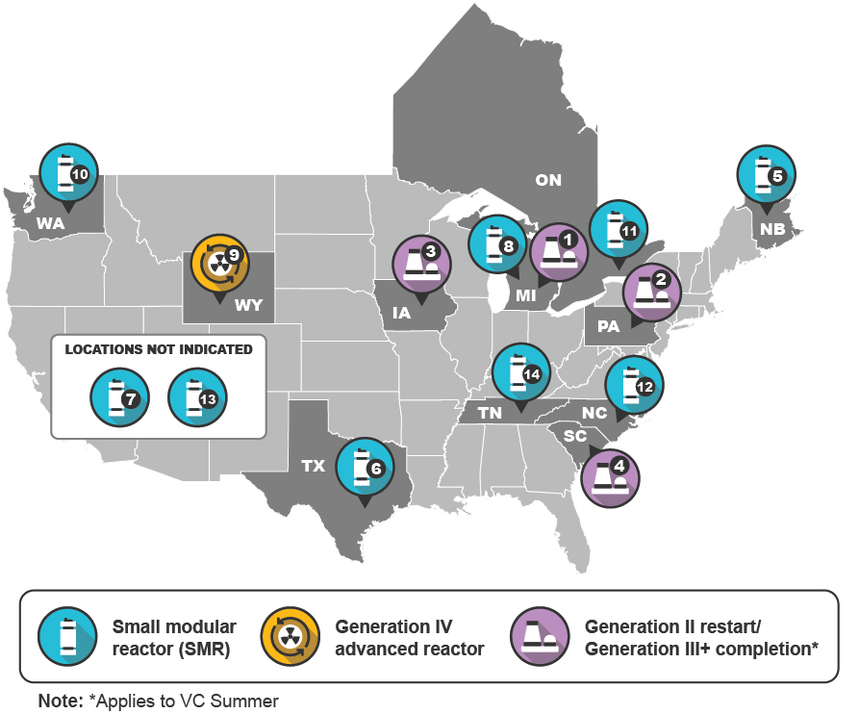
Activity in Proposed Nuclear Development
03. New Nuclear Development
 | Name | Total Anticipated Capacity (MW) | Parties | Key Dates
1 | Palisades | 800 | Holtec | Targeting online by Oct. 2025
2 | Three Mile Island Unit 1 (Crane Clean Energy Center) | 835 | Constellation/ Microsoft | Restart targeted for 2028
3 | Duane Arnold | 615 | NextEra Energy | Potential restart as early as late 2028; filed licensing change request
4 | VC Summer Units 2-3 | Up to 2,200 | Santee Cooper | Proposals to acquire and finish units due in May 2025
5 | Point Lepreau | 100 | NB Power/ARC | Expected grid connection in 2030
6 | Seadrift | 400 | Dow Chemical/ X-Energy | Construction starting in 2026; completion expected by 2030
7 | Kairos | 500 | Kairos/Google | First unit by 2030
8 | Palisades – SMR | 600 | Holtec | Procurement expected in 2025, construction in 2027, and operations in 2030 or early 2031
9 | Natrium Demonstration Project | 840 | TerraPower/ Microsoft | Non-nuclear construction began June 2024, nuclear construction pending NRC permit approval
10 | Energy Northwest | 960 | Energy Northwest/ X-Energy/Amazon | TBD
11 | Darlington | 1,200 | Ontario Power Generation/GE Hitachi/Aecon | First reactor to be completed by 2028, with additional SMRs coming online between 2034 and 2036
12 | Belews Creek | 1,500 | Duke Energy/ GE Hitachi | First 300-MW unit by 2034; one additional unit per year for 5 following years
13 | Additional X-Energy projects | 5,000 | Amazon | By 2039
14 | Clinch River | TBD | TVA | TBD
Selected Activity in Nuclear Power Development in
North America Since January 2024
Source: ScottMadden research
Sources: Industry news; company announcements

Slide 11
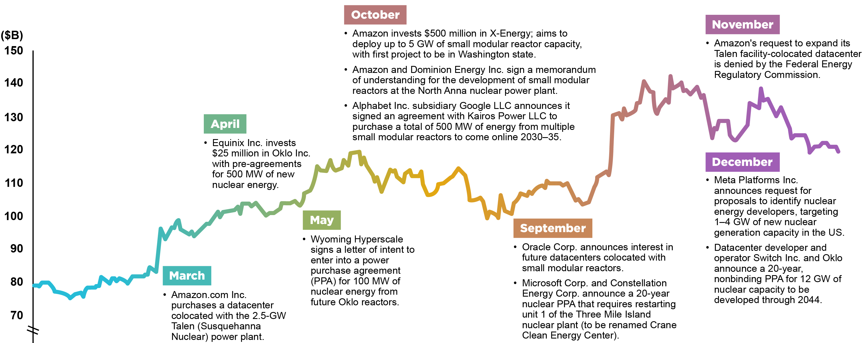
Data Centers and Other Large Loads Serve as Catalysts for Nuclear
03. New Nuclear Development
AI and Nuclear
The Natrium Demonstration Project, the reopening of Three Mile Island, Kairos Power, and X-Energy projects are associated with Microsoft, Google, and Amazon respectively, who are looking to power their ever-increasing power demand from AI and data centers.
Hyperscalers are attracted to nuclear because of its baseload and carbon-free characteristics, as most continue their commitments to carbon targets. They are considering both front-of-the-meter and behind-the-meter (e.g., Microsoft/ Crane Energy Center) arrangements.
Restarts of Duane Arnold, Palisades, and Darlington have been announced by utilities and independent power providers to meet rising demand, particularly from large loads, as projected demand increases. Completion of V.C. Summer Units 2-3 is being investigated.
Some tech companies are entering into multi-unit deals. Of note are announcements by Amazon with X-Energy for 5 GW of power and Google with Kairos for 500 MW that will be procured through power purchase agreements.
At the March 2025 CERAWeek, large energy users pledged to support tripling global nuclear capacity by 2050. However, stronger investment signals and policy frameworks are required to achieve that goal.
Selected 2024 Transactions Between Large Tech Companies and Nuclear Developers/Operators
vs. Market Capitalization for Selected Nuclear-Focused Companies
Notes: As of Jan. 6, 2025. Companies included in market capitalization total are Constellation Energy Corp.; Dominion Energy, Inc., NuScale Power Corp.; and Oklo Inc.
Source: S&P Global Market Intelligence
Sources: S&P Global Market Intelligence; Power magazine; International Atomic Energy Agency;
industry news; company announcements; ScottMadden research

Slide 12
Federal Policy and Support Remain Important
03. New Nuclear Development
Accelerating Development Through the ADVANCE Act
  Nuclear power, with its baseload and emissions-free characteristics, is enjoying bipartisan support both for decarbonization and energy security.
  With such bipartisan support, the ADVANCE Act was enacted in July 2024. The act aims to modernize U.S. Nuclear Regulatory Commission (NRC) licensing, incentivize competition, reduce fees, and streamline permitting of advanced reactors by:
    Directing NRC to reduce fees for first-time advanced reactor applications
    Creating a prize for the first advanced reactor deployment equivalent to the NRC licensing fees
    Directing NRC to develop guidelines that expedite licensing for reactors at existing nuclear plants and former fossil fuel sites
U.S. and Canadian Federal Support for Projects
  The Department of Energy (DOE) is providing funding or loan commitments for the Natrium Gen IV project as well as the Palisades (MI) Gen II restart. In mid-March, DOE authorized disbursement of $56 million of the possible $1.52 billion Palisades loan guarantee.
  The Trump administration has indicated support for nuclear power in at least two executive orders signed on January 20, 2025:
    EO 14154 (Unleashing American Energy): Agencies must identify any agency actions that have imposed “an undue burden on the identification, development or use of domestic energy resources,” including nuclear energy resources, and suspend, revise, or rescind those actions.
    EO 14156 (Declaring a National Energy Emergency): Agencies shall exercise any lawful authorities to facilitate development of domestic energy sources, which includes the transportation and refining of uranium.
  Canada has joined several other countries in targeting a tripling of nuclear capacity by 2050. The Canadian federal government is enabling this through regulatory support as well as funding. For example, in March 2025, the Canadian Minister of Energy and Natural Resources announced a $304 million loan to help fund design of a new, large-scale CANDU reactor. It is also providing $55 million to help fund SMR development in Ontario and Saskatchewan.
“
We are working to launch the long-awaited American nuclear renaissance, fission, and fusion.
—Chris Wright, Secretary, Department of Energy
Sources: J.P. Morgan; U.S. Dept. of Energy; Federal Register; Natural Resources Canada
Notes:
https://www.canada.ca/en/natural-resources-canada/news/2025/03/canada-invests-in-the-next-generation-of-canadian-made-clean-affordable-nuclear-energy0.html
https://www.neimagazine.com/analysis/canada-takes-a-global-lead-on-tripling-nuclear/?cf-view&cf-closed

Slide 13
Growing Trend: Storm Recovery Securitization
04. Storm Recovery Securitization
U.S. Jurisdictions with Cost Securitization Authorized
(Including Storm Costs)
Rising Storm Costs and Rate Impacts
  Hurricanes Debby, Milton, and Helene in 2024 refocused attention on how utilities can timely recover storm costs while maintaining energy affordability.
  Duke Energy has stated that restoration costs in NC, including capital expenditures, could be between $2.4 and $2.9 billion and has already filed petitions for recovery of costs in NC and Florida.
  Not addressed in this discussion are approaches to wildfires that are evolving across the country.
One Approach: Storm Recovery Securitization
  States began allowing utilities to use securitization, pooling various types of debt and selling it to a third party, widely in the mid-to-late 1990s during utility restructuring to recover costs for unprofitable or stranded assets.
  When utilities incur a large unexpected expenditure, they typically seek recovery of that through a rate case, which can entail a lag for cost recovery.
  Securitization of these costs allows utilities to spread costs over longer periods, helping to reduce “rate shock” for customers.
  Thirty-one states have securitization legislation with various eligible costs. Seventeen states have updated or passed securitization legislation since 2019, with hurricanes and winter storm recovery being the impetus for legislation in seven of them.
2021
(2)
2023
(0)
2021 (2)
2023 (0)
2019 (4)
2021 (4)
2009
(1)
2022 (1)
2006
(2)
2006 (14)
2006
(12)
2005/2019* (15)
 | Storm Recovery Cost Allowance
 | Stranded Assets or Other Various Securitizable Costs
Label Legend:
Year of passage of storm cost recovery securitization legislation (# of securitization/storm cost recovery petitions)
Source: ScottMadden research
Note: *Florida legislation in 2019 initiated shorter term surcharges in lieu of securitization, but securitization is still a legal option

Slide 14
Trends in Petitions for Storm Securitization
04. Storm Recovery Securitization
More than Half of Petitions Involve Winter Storm Uri or Florida
  There have been 57 storm cost recovery petitions observed since 2006 across the 12 states with storm recovery securitization legislation; approximately one-third (20) of these cases were in the aftermath of Winter Storm Uri.
    Forty-four of these cases have involved the securitization of storm recovery costs over longer periods ranging from 10 to 30 years.
    The remaining 13 cases are from after 2016 in Florida, where temporary surcharges, settlement agreements, and proceeds from the 2017 Tax Cuts and Jobs Act were used to offset or recover costs.
Winter Storm Uri and Economic Impacts
  Winter Storm Uri (in February 2021) resulted in nearly $16 billion in storm-related securitizations from investor-owned utilities, rural electric cooperatives, and the Electric Reliability Council of Texas itself, more than the previous 15 years combined, even after adjusting for inflation.
  Uri caused dramatic increases in natural gas spot prices (and by implication electricity prices) in Texas, Oklahoma, and Louisiana. Wholesale electricity prices rose as high as $9,000 per MWh in parts of ERCOT.
Note: *2025 cases in the state of North Carolina have yet to be resolved
Sources: Company websites, S&P Global, state public utilities commissions, ScottMadden research

Slide 15
Maturity Profile of Storm Securitizations
04. Storm Recovery Securitization
Securitized Bond Maturities
  The chart at left shows the overall securitized values of outstanding bonds by state based on years to final maturity date of the securitization. These securitizations include issuances by or for gas utilities as well as electric utilities.
  Of the observed storm cost recovery securitizations from 2006 through early 2025, Entergy Louisiana had the largest at $3.2 billion with a final maturity date in 2037, followed by Atmos Energy at $2 billion with a final maturity date in 2038.
  The states where utilities have the largest securitized storm cost recovery balances are Texas ($8.7 billion), Louisiana ($5.6 billion), and Oklahoma ($2.9 billion).
  The financial value of bonds due before 2040 is ~$13 billion, while the value of bonds due after 2040 is $8 billion.
  Key Takeaways
  Initially concentrated in hurricane-prone coastal states, storm securitization laws have since been enacted in midwestern and southeastern states in the wake of Winter Storm Uri, which led to significant utility costs.
  While securitization lowers monthly customer bills for storm cost recovery, the possible accumulation of multiple storm charges over time, combined with demographic shifts or economic softness, could increase ratepayer costs over time.
  Some utilities are carrying billions of dollars of securitized storm recovery costs as “temporary line items” for 10 to 30 years. If storm frequency and costs continue to grow, these securitized balances may accumulate over time.
*Notes: Amounts above do not denote a single lump sum payment due date but rather the overall value of principal that was securitized that must be paid by those dates (i.e., final maturity). Multiple state final maturity timelines reflect maturity dates for different utilities within a state’s regulatory jurisdiction.
Sources: Company websites, S&P Global, state public utilities commissions, ScottMadden research

Slide 16
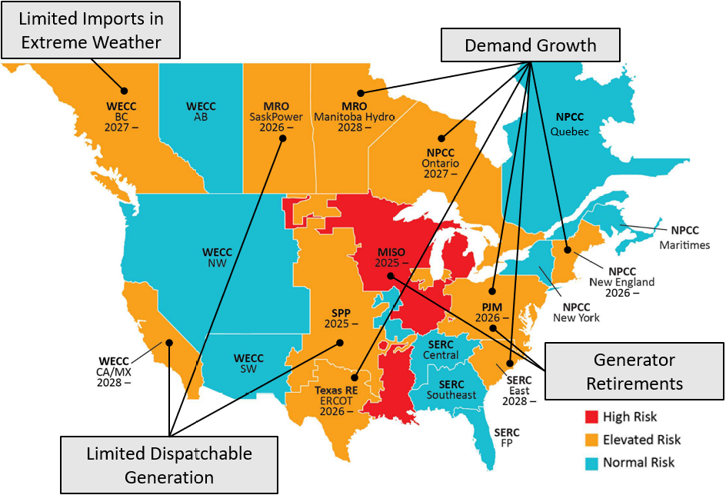
Bulk Power Markets Face Continued Risk
05. Reliability Concerns
North America Resource Adequacy Risk Summary (2025–29)
Potential Resource Shortfalls
  Electric industry leaders continue to sound the alarm on system performance during summer and winter peaks and extreme weather events. Some have raised the specter of outages.
  The confluence of demand and energy growth (electrification and large loads), thermal generator retirements, declining dispatchable resources, and continued gas-electric interdependence are increasing reliability risks in the bulk power system.
Winter of Particular Concern
  Winter is of concern for reliability in regions with high dependence on natural gas-fired generation.
  In what has become an annual event, NERC and FERC are looking at power system performance after a winter cold snap: this year examining events during January 19-24, 2025.
  NERC acknowledges improvement in cold weather preparation (particularly equipment winterization) but notes that areas such as improving load forecasting and monitoring fuel supplies and alternatives are keys to risk management.
  FERC approved NERC’s proposed cold weather emergency operating procedure (EOP-012) with direction for additional provisions. Those were expected to be finalized in March 2025.
  Gas and grid stakeholders have created the Natural Gas Readiness Forum to enhance reliability through better planning and operational coordination, especially in winter.
Limited Imports in Extreme Weather
Demand Growth
Generator Retirements
Limited Dispatchable Generation
Source: NERC
High Risk: Shortfalls may occur at normal peak conditions
Elevated Risk: Shortfalls may occur in extreme conditions
Normal Risk: Low likelihood of electric supply shortfall
Sources: NERC; FERC; NAES

Slide 17
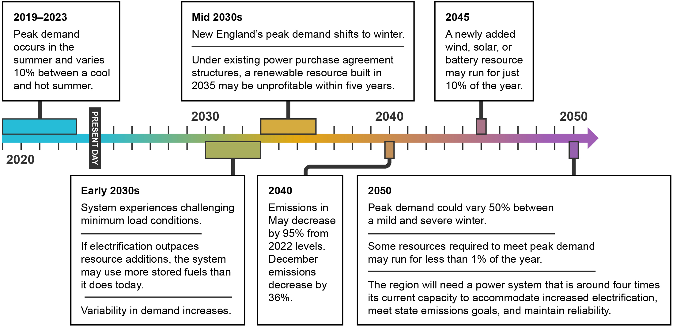
Focus on the U.S. Northeast
05. Reliability Concerns
ISO-New England Studies the Clean Energy Grid
  In October 2024, ISO-NE released a report on the economic and operational challenges of transitioning to a near-zero carbon power system, specifically the shift from dispatchable, fossil-fuel resources to a future where intermittent resources play a central role.
  Variability was a major theme, as was the potential need to quadruple ISO-NE’s resource capacity. Other key findings are shown at right.
NPCC Analyzes Integrated Power-Gas Systems During Extreme Cold Conditions: No New News?
  Separately, a Northeast Power Coordinating Council (NPCC) study of the New York/New England region for resilience during extreme winter weather found continued vulnerabilities. Some key findings included:
    Most gas-fired generators lack firm pipeline rights, leaving them vulnerable to curtailment. On-site liquid fuel storage is needed.
    During extreme cold, gas infrastructure is nearly fully utilized, restricting gas flow to generators.
    While low compression or line breaks are risks, unless they occur immediately upstream of a generator, operators have time to shut down or switch fuels.
    New England is highly dependent upon two LNG import terminals. Removing one forces generators to rely on oil.
    Retirements of oil-fired generation and fast-start resources could limit options during contingency or cold weather events.
Timeline of EPCET* Scenarios and Key Results
Key Findings from ISO-NE’s Clean Energy Transition Study
Most paths to a low-carbon grid involve high variability in demand and supply. Increased variability will require vastly different supply levels from year to year. Emissions reductions will be seasonal. Some months (spring/fall) will decarbonize years before others. Renewable-only build-outs may be vast. | Current revenue structures may not adequately compensate resources for their value to the future grid. Firm, dispatchable, zero-carbon generation (nuclear and synthetic natural gas-fired) could help address challenges. Challenging minimum load conditions and energy adequacy concerns may appear by the 2030s.
Sources: *ISO-New England, Economic Planning for the Clean Energy Transition (Oct. 24, 2024) (EPCET);
Levitan & Associates, Northeast Gas-Electric System Study (Jan. 2025)

Slide 18
The New Administration Makes Energy a Key Priority on Day One
06. Federal Policy Developments
Energy Objectives | Day One Actions | Additional Actions
Develop Domestic Energy | Signed an executive order declaring a national energy emergency: Directs federal agencies to use emergency authorities to facilitate the identification, leasing, siting, production, transportation, refining, and generation of domestic energy resources Only applies to: “crude oil, natural gas, lease condensates, natural gas liquids, refined petroleum products, uranium, coal, biofuels, geothermal heat, the kinetic movement of flowing water, and critical minerals” Signed an executive order facilitating development of Alaska’s energy resources. | DOE authorized export approvals for two new LNG facilities and granted additional time to commence exports to two additional LNG facilities. DOE Loan Program Office disbursed a $56.8M loan installment to Holtec International to support the restart of the 800 MW Palisades nuclear plant. Signed an executive order expanding list of critical minerals to include uranium and copper; authorized the use of the Defense Production Act to expand domestic mineral production capacity.
Drive Deregulation | Signed an executive order revoking Biden administration directives related to climate change and environmental justice initiatives, including the Justice40 initiative. Signed an executive order—titled ”Unleashing American Energy”—focused on reducing regulatory burdens. Select actions include: Directs federal agencies to review existing regulations that pose an undue burden on domestic energy development Restarts permitting of LNG export facilities Revises implementation of the National Environmental Policy Act (NEPA) Directs EPA to reconsider GHG endangerment finding Signed an executive order withdrawing the United States from the Paris Agreement and revokes the U.S. International Climate Finance Plan. | EPA announces “Biggest Deregulatory Action in U.S. History” with the agency launching review of multiple regulations, including: GHG emission limits on power plants Mercury and air toxics standards for coal-fired power plants GHG emission standards for light-, medium- and heavy-duty vehicles National ambient air quality standards for fine particulate matter EPA’s 2009 finding that GHG emissions endanger public health and harm the environment Signed an executive order stating that independent agencies, including FERC, must conform closely with White House priorities as any other agency in the executive branch.
Review the “Green New Deal” | Signed an executive order directing agencies to immediately pause the disbursement of IIJA and IRA funds. Policy provisions in the executive order indicate a focus on funding related to electric vehicle infrastructure and energy efficient appliances Additional clarity is expected as agencies submit recommendations to align funding with policy objectives Signed a memorandum temporarily withdrawing from disposition for wind energy leasing all areas within the Outer Continental Shelf and initiating an immediate review of federal wind leasing and permitting practices. | EPA terminated $20B in climate change grants issued under Greenhouse Gas Reduction Fund; as of late March 2025, a federal judge has issued a temporary restraining order preventing the EPA from reclaiming money. The USDA announced it would release previously obligated funding under the Rural Energy For America Program (REAP), Empowering Rural America (New ERA) and Powering Affordable Clean Energy (PACE) programs.
Energy Is a Top Priority of the New Administration
  As part of the effort to reduce inflation and drive economic growth, President Trump is focused on lowering energy costs. During the presidential campaign, President Trump stated, “Under my administration, we will be slashing energy and electricity prices by half within 12 months, at a maximum 18 months.”
  To achieve this goal, the administration is pursuing three broad energy objectives: (1) develop domestic energy, (2) drive deregulation, and (3) review the “Green New Deal” (see table above).
Notes: IIJA means Infrastructure Investment and Jobs Act; IRA means the Inflation Reduction Act of 2022
Sources: White House; DOE; EPA; Perkins Coie; McGuireWoods; NRECA; industry news; ScottMadden analysis

Slide 19



AI Dominance Means Turning Energy into Intelligence
06. Federal Policy Developments
Key cabinet officials are highlighting the need for increased electricity production to ensure growth of U.S. artificial intelligence capabilities.
“
Electricity becomes intelligence. We’re manufacturing intelligence in these AI data centers, and it’s whoever has got the most electricity wins. And China is adding electricity like crazy, and the U.S., we’ve got to catch up in our electricity production.
—Doug Burgum, Secretary, Department of the Interior
“
“
As we rapidly advance into this new age of AI, it is important that the United States lead the world in this field. Those looking to invest in and develop AI should be able to do so in the U.S., while we work to ensure data centers and related facilities can be powered and operated in a clean manner with American-made energy. Under President Trump’s leadership, I have no doubt that we will become the AI capital of the world.
—Lee Zeldin, Administrator, Environmental Protection Agency
AI is going to be truly transformative, many of the ways in which we can't even foresee today. We are already experiencing the impact, the benefits in consumer services and education invested; in business efficiencies… AI is an energy-intensive manufacturing industry. It takes massive amounts of electricity to generate intelligence. The more energy invested, the more intelligence produced.
—Chris Wright, Secretary, Department of Energy
Sources: Department press releases; Hugh Hewitt interview

Slide 20
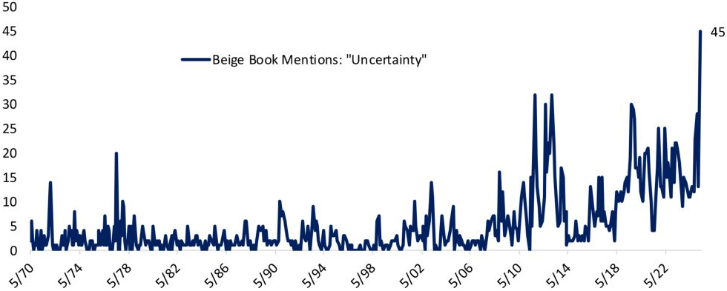
Impacts of Tariffs and Budget Reconciliation Remain Unclear
06. Federal Policy Developments
Tariffs Inject Uncertainty into the Economy
  Tariffs has become a key policy lever of the second Trump administration. Notable examples include:
    Tariffs enacted on Canada, Mexico, and China imports: the stated goal is to reduce illegal immigrants and drugs entering the United States.
    Tariffs enacted on steel and aluminum imports, including the elimination of country-specific exemptions
    “Reciprocal tariffs” were announced on April 2, 2025
  Broad tariffs and rapid adjustments have created significant uncertainty (see charts at right). Energy companies are scrutinizing supply chains and looking beyond tier one suppliers. In addition, utilities are seeking clarity on tariff collection and regulatory treatment.
  Meanwhile, Congress Contemplates Changes to IRA Tax Credits
  Congress plans to use the budget reconciliation process to enact policy priorities, including the extension of expiring tax cuts. Budget reconciliation allows Congress to enact certain fiscal legislation with a simple majority, thereby avoiding the Senate filibuster.
  In February 2025, the U.S. House of Representatives started the process by adopting a budget resolution for fiscal year 2025. The resolution requires at least $1.5 trillion of deficit reduction and allows up to $4.8 trillion of deficit increases.
  Deficit reductions may include eliminating or revising tax credits enabled by the IRA. When asked about potential changes, House Speaker Mike Johnson recently noted, “It’s gonna be somewhere between a scalpel and a sledgehammer.”
Mentions of “Tariff” in Federal Reserve Beige Book Since 2017
Sources: Bloomberg, Federal Reserve
Mentions of “Uncertainty” in Federal Reserve Beige Book Since 1970
Source: Bespoke Investment Group
Note: IRA means the Inflation Reduction Act of 2022
Sources: The Hill; Bloomberg; U.S. Federal Reserve Bank; Committee for a Responsible Federal Budget

Slide 21
More than 13 Gigawatts Scheduled for Retirement in Balance of 2025
07. Generation Retirements
Fossil Plant Retirements Expected to Continue
  EIA projected in February that 13.1 GW of utility and independent power producer (non-CHP) capacity is expected to retire in 2025, up 65% from the 7.5 GW retired in 2024.
  However, the situation is dynamic. The total above includes 2.1 GW of capacity in Maryland for which Talen Energy and PJM reached a reliability must-run (RMR) agreement. This arrangement is pending FERC approval.
  Preliminary projections for 2026 estimate ~6.5 GW of retirements.
  Carbon reduction goals and competition from cheaper renewables and natural gas are driving retirements, but some generation retirements have been delayed (see next page).
  It is unclear whether changing federal policies will affect the pace of retirements, absent economic and regulatory relief.
Selected Projected Plant Retirements (>100 MW) by State (as of Feb. 2025)
Transalta Centralia
(670 MW)
South Oak Creek
(616 MW)
JH Campbell
(1,331 MW)
Eddystone
(760 MW)
Intermountain Power
(1,800 MW)
Elwood Energy
(1,350 MW)
RM Schahfer
(722 MW)
RMR Pending
Johnsonville
(754 MW)
1,000+ MW
500-999 MW
<500 MW
 | Petroleum
 | Natural Gas
 | Coal
Sources: EIA; ScottMadden research
Sources: EIA; industry news; company announcements

Slide 22
Retirement Deferrals: “You Keep Me Hangin’ On”
07. Generation Retirements
Some Generators Defer Retirements
  Duke Energy, Rocky Mountain Power, and Georgia Power are among the utilities who have deferred generation retirements.
  Duke Energy and Georgia Power have pushed retirements from the 2020s to the 2030s, while Rocky Mountain Power pushed retirements from the 2030s to the 2040s or beyond.
  Power demand from data centers and electrification, as well as permitting and interconnection queue delays for renewables are the leading causes of deferrals.
Key Takeaways
  Utility plans to shutter ~60 GW of coal-fired plants by the end of this decade could shift, but a change in trajectory is unlikely, rather coming down to a shift in pace of closures.
  Additional reprieves are likely from the Trump administration's EPA, which is investigating rollbacks of regulations and their underpinnings, including:
    EPA’s greenhouse gas endangerment finding
    Power plant CO₂ emissions caps
    Regulations finalized last year updating its mercury and air toxics standards
Selected Deferred Power Plant Retirements as of March 2025
Duke Energy | Rocky Mountain Power (PacifiCorp) | Alliant Energy | Talen Energy | Georgia Power Company
Gibson (1.2GW) (IN): Units 1 and 2 delayed from 2035 to 2038 with cofiring | Hunter (1.5 GW) (UT): Extended by 3 years to 2045 Huntington (900 MW) (UT): Delayed from 2036 to 2045 Dave Johnston (586 MW) (WY): Units 1, 2, and 3 delayed indefinitely Jim Bridger (1,164 MW) (WY): Units 1 and 2 deferred indefinitely from 2039 Jim Bridger (700 MW) (WY): Units 3 and 4 deferred indefinitely from 2039, with carbon capture in 2030 Naughton (834 MW) (WY): Deferred indefinitely from 2036 after gas conversion in 2026 Wyodak (402 MW) (WY): Deferred indefinitely from 2039 | Columbia Energy Center (1,161 MW) (WI): Delayed to June 2026 to help offset reliability concerns Edgewater (380 MW) (WI): Delayed from 2025 to 2028 with switch to natural gas | Brandon Shores (1,273 MW) (MD): Delayed from 2025 to 2029 under RMR agreement pending FERC approval Herbert A. Wagner (~800 MW) (MD): Same as Brandon Shores above | Bowen (3.2 GW) (GA): Deferred beyond 2034 from 2027 Scherer (648 MW) (GA): Deferred until 2038 from 2028 Gaston (566 MW) (GA) (27.5% ownership): Extended from 2028 to the end of 2034 Yates (807 MW) (GA): Previously scheduled for potential retirement, will continue operating until 2038
Sources: EIA; S&P Global Market Intelligence; industry news; company announcements
Notes:
EPA actions: https://www.capitaliq.spglobal.com/apisv3/spg-webplatform-core/news/article?KeyProductLinkType=2&id=88003491
Brandon Shores, Wagner: https://www.capitaliq.spglobal.com/apisv3/spg-webplatform-core/news/article?KeyProductLinkType=2&id=87276735&redirected=1

Slide 23
Glossary
EIU Power Brief – Spring 2025
AMI – advanced metering infrastructure
CAGR – compound annual growth rate
CANDU – Canada deuterium uranium, a nuclear power generation technology that uses deuterium oxide (heavy water) as a moderator and coolant and uses natural (not enriched) uranium as a fuel
capex – capital expenditures
CHP – combined heat and power
Curtailment – the intentional reduction of instantaneous power from supply or demand resources to aid balancing of the electricity grid
DOE – U.S. Department of Energy
EIA – U.S. Energy Information Agency
EPA – U.S. Environmental Protection Agency
FERC – Federal Energy Regulatory Commission
Gen II reactors – Commercial nuclear reactors constructed during the 1970s, 1980s, and 1990s. These are light water reactors designed to use traditional active safety features involving electrical or mechanical operations. These reactors make up most of the current U.S. operating fleet.
Gen III/III+ reactors – Light water reactors with improvements in areas of fuel technology, thermal efficiency, modularized construction, safety systems, and standardized design. The most significant improvement of Gen III+ systems is the incorporation in some designs of passive safety features that do not require operator intervention, including gravity or natural convection to mitigate the impact of abnormal events. While there are only a handful of operating Gen III reactors worldwide, several Gen III+ reactors are newly operating and under construction.
Gen IV reactors – Advanced nuclear reactors aiming to significantly improve upon the safety, efficiency, sustainability, and proliferation and physical resistance of current nuclear power technologies. These reactors are part of an international effort, coordinated by the Generation IV International Forum, to create next-generation systems for commercial deployment in the 2030s and beyond.
GHG – greenhouse gas
IEA – International Energy Agency
IIJA – Infrastructure Investment and Jobs Act
IRA – Inflation Reduction Act
ISO – independent system operator
ISO-NE – ISO New England
IT – information technology
Jevons effect (or Jevons Paradox) – an economic theory positing that in the long term, an increase in energy efficiency will result in an increase in energy consumption rather than a decrease

Slide 24
Glossary (Cont.)
EIU Power Brief – Spring 2025
LDC – local gas distribution company
LNG – liquified natural gas
LRTP – long-range transmission plan
MISO – Midcontinent Independent System Operator
MRO – Midwest Reliability Organization
NEPA – National Environmental Policy Act
NERC – North American Electric Reliability Corporation
New ERA – The Empowering Rural America (New ERA) program is a loan-grant program under the IRA, funded by the USDA, and provided to rural electric cooperatives that helps rural Americans transition to clean, affordable, and reliable energy.
NPCC – Northeast Power Coordinating Council
NRC – U.S. Nuclear Regulatory Commission
NRECA – National Rural Electric Cooperative Association
PACE – The Powering Affordable Clean Energy (or PACE) program is a program under the IRA, pursuant to which the USDA’s Rural Utilities Service will forgive up to 60% of loans for renewable projects that use wind, solar, hydropower, geothermal, biomass, or energy storage.
PJM – PJM Interconnection LLC
PUC – public utilities commission
REAP – Rural Energy for America Program
RTO – regional transmission organization
Securitization – A financial process that takes an income-generating asset or pool of assets and packages them into a financial instrument that can be sold to investors. This process transforms illiquid assets (like loans, mortgages, or future revenues) into tradable securities.
SERC – SERC Reliability Corporation
SPP – Southwest Power Pool
T&D – transmission and distribution
Texas RE – Texas Reliability Entity
USDA – U.S. Department of Agriculture
WECC – Western Electricity Coordinating Council

Slide 25
Related Insights
EIU Power Brief – Spring 2025
Capital Expenditures | Capital Deployment Playbook: Helping Utilities Succeed in a Transforming Energy Sector Overcoming the Challenges of Large Capital Programs/Projects
Large Loads | Surging Large Loads: Challenges and Opportunities for the Electric Industry Utility Evolution Brings About the (Re)Integration of System Planning Processes
New Nuclear Development | Artificial Intelligence Use Cases in Power Generation Nuclear Power and Cryptocurrency Mining
Storm Recovery Securitization | Navigating Energy Affordability Through Innovative Rate Design Prioritizing Transmission and Distribution Investments
Reliability Concerns | Grid Reliability Is Changing Before Our Eyes Resource Adequacy – Time for a New Approach
Federal Policy Developments | Navigating an Inflation Reduction Act (IRA) Program with AI Energy Central Power Perspectives Podcast: The Future of Federal Energy Funding
Generation Retirements | Coal’s Accelerated Burn: Drivers for Coal Plant Closures Artificial Intelligence Use Cases in Power Generation

Slide 26
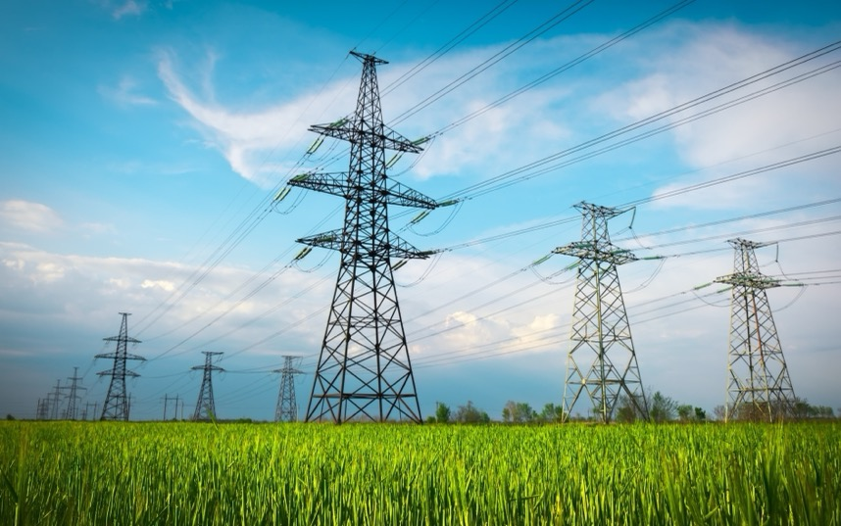
ScottMadden Energy Services
EIU Power Brief – Spring 2025
We have been serving the energy industry since 1983. Our industry-leading clients trust us with their most important challenges because they know we have seen and solved similar problems. Our consultants have earned this confidence through decades of experience in the field, and they are on the front lines of this changing landscape.
ScottMadden has worked in every business unit and every department in companies across the energy utility ecosystem. We focus on Transmission & Distribution, the Grid Edge, Generation, Rates & Regulatory, Natural Gas, and Energy Corporate Services. We have helped our clients develop and implement strategies, improve critical operations, reorganize departments and entire companies, and implement myriad initiatives.
Smart. Focused. Done Right®
We help you solve the right problem in the right way by combining in-depth knowledge and understanding of your business with our world-class functional expertise.
For more information on how ScottMadden can help you, please get in touch with us.

Slide 27

Energy Practice Focus Areas
EIU Power Brief – Spring 2025
OPERATIONAL TECHNOLOGY
AND AI ENABLEMENT
We help you transform OT operations by integrating advanced technologies, streamlining processes, and enhancing efficiency and service delivery. We enable you to transition from compliance-driven frameworks to more robust and secure operational models.
GENERATION
  We help you with every activity from strategic, capital, and business planning to the management of plant retirements. We can help you manage cost, benchmark your performance, organize and staff, and improve or turn around your plants.
RATES & REGULATION
We can assist you with regulatory strategy and litigation services, ranging from strategy development to rate design to demand forecasting to expert testimony. We offer economic and financial advisory services and help structure, negotiate, and finalize transactions.
GRID EDGE
Our grid edge services include business planning, governance and accountability models, procedure development, process redesign, project management, organization redesign, and regulatory filings. With our deep knowledge and experience in the evolving regulatory arena, we can guide you to proactively engage with regulators and customers through this transformation.
TRANSMISSION & DISTRIBUTION
With our electric and gas transmission and distribution services, we can help you with a wide range of offerings from strategic and business planning to benchmarking to operational excellence to program design and implementation, among many others.
NATURAL GAS
  We have deep experience in the gas business and provide a variety of services, including strategic analysis, business planning, operational and financial performance benchmarking, operations improvement, cost management, organization design and staffing, business process improvement, mergers and acquisitions, and rates and finance strategy.
ENERGY CORPORATE SERVICES
We help you assess and improve corporate functions by assisting with governance, operational improvements, technology, organization design, and service delivery design, implementation, and improvement.

Slide 28




Energy Practice: ScottMadden Knows Energy
EIU Power Brief – Spring 2025
Brad Kitchens
Andy Flores
Kevin Hernandez
Greg Litra
President and CEO
Partner and Energy Practice Leader
Partner
Partner and Head of
Energy Research
sbkitchens@scottmadden.com
919.781.4191
aeflores@scottmadden.com
404.814.0020
klhernandez@scottmadden.com
919.781.4191
glitra@scottmadden.com
919.781.4191

