Slide 1
Shared Services 101:
The Essentials for a Leading Practice Organization
Shared Services & Outsourcing Week
Workshop A
March 2024

Slide 2






Your Discussion Leads

Slide 3



Agenda
01
INTRODUCTION TO
SCOTTMADDEN
04
FUNDAMENTALS FOR
IMPLEMENTING SHARED SERVICES
02
SHARED SERVICES
OVERVIEW
05
STABILIZATION
SUCCESS FACTORS
03
ASSESSMENT
AND DESIGN

Slide 4

Introduction to ScottMadden

Slide 5

Who We Are
Introduction to ScottMadden
CORPORATE & SHARED SERVICES
ScottMadden is a management consulting firm with more than
40 years of deep, hands-on experience.
Experience
Our experienced team has been a pioneer in corporate
and shared services since the practice began decades ago.
We employ deep, cross-functional expertise to produce practical, measurable solutions.
Scope
We have completed thousands of projects since the early ’90s, including hundreds of large, multi-year implementations. Our clients range across a variety of industries from energy to healthcare to higher education to retail. Our areas of expertise span the spectrum of middle and back office corporate and shared services.
We deliver a broad array of corporate and shared services consulting services—from strategic planning through implementation—across many industries, business units, and functions.
Our knowledge, expertise, and experience are unmatched—no other firm has helped more clients with more unique solutions.
Services
We have helped our clients with assessment, strategy, design, implementation, technology, business case and roadmap, governance, program management, and change management.

Slide 6
Areas of Focus
Introduction to ScottMadden
BUSINESS SUPPORT SERVICES
  We help our clients improve service response to the business, including through the integration of various administrative services into their shared services model. Services often include real estate, facility maintenance, fleet, security, sales and marketing, insurance, customer service, research, and others.
INFORMATION TECHNOLOGY
From IT assessments and strategic direction to governance, cybersecurity, and risk and compliance management, we can help your organization get the most out of its IT investment. We also help you optimize your projects to focus on delivering business outcomes, not just installed technology.
FINANCE AND ACCOUNTING
  We help companies transform their finance and accounting operations. Through enterprise financial business services, strategic centers of expertise, intelligent automation solutions, hybrid insource/outsource delivery models, and other solutions, we help you increase value for your company.
MULTIFUNCTION/GBS
We move shared services to the next generation—integrating finance, HR, IT, supply chain, and/or other business services into a single, multifunction shared services or global business services operation with effective governance and management.
HUMAN CAPITAL MANAGEMENT
  We offer HR transformation (including HR shared services), analytics, HR systems (selection, implementation, and optimization), process design and continuous improvement, talent and employee engagement strategy and programs, and payroll—the services your organization needs to excel.
SUPPLY CHAIN
  We assist clients across the full range of supply chain processes and have the unique ability to create alignment between supply chain and its stakeholders. From crafting new supply chain strategies to restructuring your organization to improving your daily operations, we help you with every step.

Slide 7

Corporate and Shared Services Capabilities
Introduction to ScottMadden
Assess and Plan
Design
Build
Improve
  Strategic planning
  Feasibility analysis
  Benchmarking
  Statistical and analytical modeling
  Leading practices assessment
  Performance evaluation
  Project planning
  Leadership education and buy-in
  Staff evaluation
  Change readiness assessment
  Site visits
  Current state analysis
  Future state design
  Business case development
  Service delivery model design
  Work scope delineation
  Policy assessment
  Intelligent automation strategy
  Sourcing evaluation
  Organizational design
  Technology evaluation
  Transformation planning
  Implementation planning
  Change management
  Project management
  Service and transaction center build
  Detailed organizational design
  Staffing
  Policy harmonization
  Process redesign
  Technology design, selection, implementation, and support
  Education and training
  Facility design and setup
  Change management
  Sourcing implementation
  Metrics and dashboarding
  Analytics setup and deployment
  Operations improvement
  Governance
  Service expansion
  Cost reduction
  Process redesign
  Intelligent automation opportunities/implementation
  Technology upgrade
  Merger and acquisition integration
  Field resource development
  Voice-of-the-customer surveys
  Metrics and performance management

Slide 8

















































Representative Clients
Introduction to ScottMadden
Retail and
Consumer Products
Manufacturing and Industrial
Technology and Communications
Higher Ed., Public Sector, Non-profit
Energy and
Utilities
Healthcare
Professional
Services
Note: Representative sample; not all-inclusive of clients served. Excludes numerous well-known clients due to confidentiality agreements

Slide 9
Shared Services Overview

Slide 10

What Is Shared Services
Shared Services Overview

Slide 11

Who Should Consider Shared Services?
Shared Services Overview
Manufacturing
Industrial products
Consumer projects/ packaged goods
Financial services/banking
Technology
Healthcare/pharmaceuticals
Insurance
Retail and wholesale
Energy
Higher education
WHO
SIZE
INDUSTRIES
Normally large,
distributed organizations with multiple business units
Typical…
>$2.5 B in revenue
>10K employees
…But works with others
$400M to $270B in revenue
1.2K to more than 600K employees
Shared services is industry agnostic and has been adopted across many industries

Slide 12

Benefits of a Shared Services Model
Shared Services Overview
Improve Service Delivery and Transparency
Better customer experience
Standard processes
Common model for expansion
Performance metrics
Cost Control and Scalability
Skillset and work alignment
Economies of scale
Automation of process
Elimination of redundant work
Gain Control and Leverage Data
Improve reporting and analytics
Improve compliance
Better decision-making
End-to-End Accountability
Less rework caused by upstream process issues
Improved end-to-end process coordination
Focus on root-cause problem resolution

Slide 13
Benefits of Shared Services – HR Benchmarks
Shared Services Overview
HR shared services organizations operate at cost and staffing advantages, according to benchmarks from APQC and ScottMadden.
HR Cost per $1,000 Revenue
HR FTEs per $1B Revenue
Shared Services Organizations
All Delivery Models
Shared Services Organizations
All Delivery Models
12

Slide 14
Benefits of Shared Services – HR Benchmarks
Shared Services Overview
Top-performing HR shared services organizations have significantly better staffing ratios, including their employee service centers.
1.3x
1.5x
1.4x
13

Slide 15
Benefits of Shared Services – HR Benchmarks (Cont’d)
Shared Services Overview
Top-performing service centers operate at a large cost advantage and show better operational performance.
82%
First-Contact Resolution
Service Center Cost Comparison
Top-Performer Group vs.. Comparison Group
31
seconds
1.3x
Average
Speed To Answer
1.3x
6%
Service
Center
Employee
Turnover
1.3x

Slide 16
Benefits of Shared Services – Finance Benchmarks
Shared Services Overview
Finance shared services organizations demonstrate greater efficiency, according to benchmarks from APQC and ScottMadden.

Slide 17
Benefits of Shared Services – Finance Benchmarks (Cont’d)
Shared Services Overview
Top performing organizations operate at a larger cost advantage for finance overall as well as in their finance shared services organizations at the median.
  Top performers invest more in their service center per service center employee, which may enable their greater efficiency.

Slide 18
Benefits of Shared Services – Finance Benchmarks
Shared Services Overview
Top-performing finance shared services organizations have significantly better staffing ratios.
  Top performers are three times more efficient overall in staffing
  Top performers are 2.5x-3.9x more efficient in staffing major finance processes
Median number of FTEs that perform the following processes per $1 billion revenue
Perform planning/budgeting/forecasting
Perform general accounting
Manage taxes
Manage internal controls
Process accounts payable (AP)
Invoice customer
Manage treasury operations
Process accounts receivable (AR)
3.9x
3.7x
3.6x
3.4x
3.3x
3.0x
2.9x
2.5x
Top-Performer Group
Comparison Group

Slide 19
Benefits of Shared Services – Non-Labor Savings
Shared Services Overview
 | Category | Savings Type | Example Range of Benefits
 | Finance | Audit fee reduction T&E expense savings Dynamic discounting savings Working capital improvement | $100K – $3M
 | HR | Recruiting cost avoidance Training cost reduction Unemployment insurance liability avoidance | $50K – $2M
 | Administrative | Facility and utility cost reduction Office supply/mailing cost reduction Commuter services reduction Travel expense reduction | $40K – $3M
 | Other | Legal fee reduction Contract consolidation | $60K – $600K
  Additional soft-dollar savings and qualitative benefits include these items:
Reduced turnover
Reduced cycle times
Improved customer satisfaction
Reduced risk
Better compliance
Improved scalability
More flexibility
Faster decisions
Improved internal controls
Reduced time to fill jobs
Transaction error reduction
Source: ScottMadden clients

Slide 20
Leading Practice Tiered Delivery Model
Shared Services Overview
Shared Services
Center Delivery Model
TIER 0
Direct Access
CORPORATE
Customers
TIER 1
Problem Resolution
TIER 2
Advanced Issue Resolution/Complex Transactions
Executives
Managers
Buyers
Employees
Portal
IVR
TIER 1
Processing
TIER 3
Centers of Expertise
Email
Generative AI
Vendors
Audit
Government Agencies
Virtual
Agent/Chatbot
Integrated
Systems
Business Unit Support/Advisement

Slide 21
The Shared Services “Transformation Journey”
Shared Services Overview
A successful shared services transformation goes through a variety of stages to successfully transition to a leading practice service delivery model.
Design
Implementation
Stabilization
Continuous Improvement
Assessment
START
FINISH

Slide 22

Assessment and Design

Slide 23

Critical Steps in the Process
Assessment and Design
Assess Existing Operations
Obtain Leadership Alliance
CREATE THE RESULTING BUSINESS CASE
Design the Future Operating Model

Slide 24
Assessment: Current Operations
Assessment and Design
Governance
Organizational Structure
Work Activities
Roles and Responsibilities
Training and Development
Policies
Functional and Operational Processes
Infrastructure
Procedures
Tools and Job Aids
Functional Leadership
People and
Organization
Policy and
Process
Services
Customers
Shared Services Leadership
Data and
Knowledge
Tools and
Technology
Employees,
Vendors,
Etc.
Metrics
Reporting and Analytics
Knowledge Content
Operational Performance
Data Management/Security
ERP Systems
Intelligent Automation
Vendor Technologies
Applications
Self-Service
Workflow
Analytics
23

Slide 25
Assessment: Activities and Costs
Assessment and Design
FTEs
Labor Costs
A Work Activity Assessment can be an effective tool to understand time spent on, and cost of, activities. It can also help identify process challenges.
Total Labor Cost ($000s):
$84,445
Total FTE:
1,336
Key

Slide 26


Assessment: Voice of the Customer
Assessment and Design
Customer opinions can point the way toward opportunities for high-value improvements.
Satisfaction
with Offerings
Awareness
and Need
Satisfaction with Interaction
Use, importance, performance, and cost of services
Awareness of alternatives, needs, expectations, and service levels
Qualifications of service provider
Perception of service organization
Many organizations only receive feedback when customers are unhappy; a balanced view is much more insightful.

Slide 27
Design: Operating Model
Assessment and Design
Key considerations when developing a future operating model are culture fit, compliance risk, and acceptable expectations for cost and customer service.
Model | Description | Culture Fit | Compliance Risk | Cost | Customer Service
Outsourced Model | Outsourced Tier 1 and increased support for more Tier 2 functional work.
Global/ Business-Aligned Model | An in-sourced service center provides Tier 1 to all employees and Tier 2 support, general and aligned to the business.
In-Sourced Model | Support is provided internally by a single, global service center that provides support to all employees.
L
M
M
M
H
H
H
M
H
L
M
M
Customer satisfaction initially decreases as customers adapt to the new model; however, once customers experience the benefits of the model, satisfaction increases and stabilizes.
Notes:
Tier 1 and 2 support is general and offered to all employees, while Tier 2 support is split—some support is general, and some is aligned by business account.

Slide 28
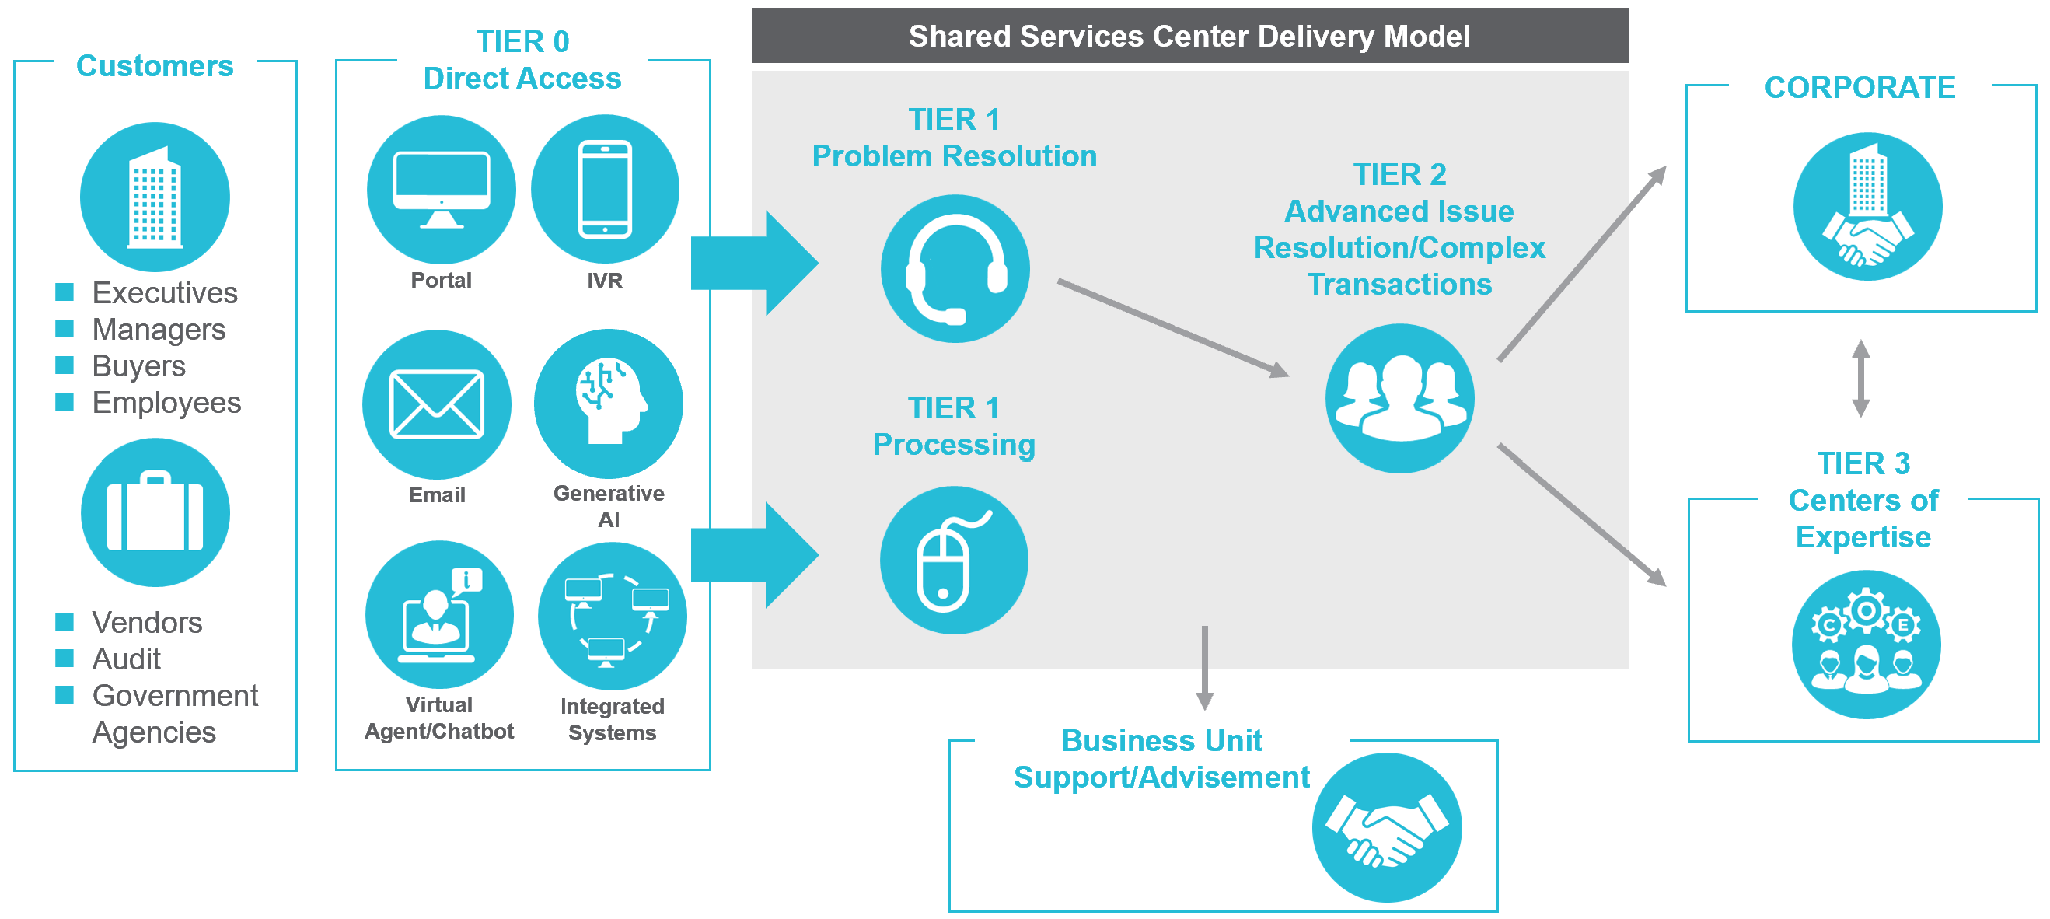
Design: Operating Model
Assessment and Design
Standard
Escalation Paths
Well-defined workflow and hand-off points
Single Source of Content
Centralized portal and knowledge base with robust search functionality
Customers
TIER 0
Direct Access
CORPORATE
Clear Scope and Simple Access
Employees and managers know where to go for service
TIER 1
Problem Resolution
TIER 2
Advanced Issue Resolution/Complex Transactions
Executives
Managers
Buyers
Employees
Portal
IVR
TIER 1
Processing
TIER 3
Centers of Expertise
Vendors
Audit
Government Agencies
Email
Generative AI
Virtual
Agent/Chatbot
Integrated
Systems
Defined Roles
Clearly defined roles and responsibilities that are aligned to the right channel of delivery
Business Unit Support/Advisement
Continuous Improvement
Process improvement driven by data
27

Slide 29
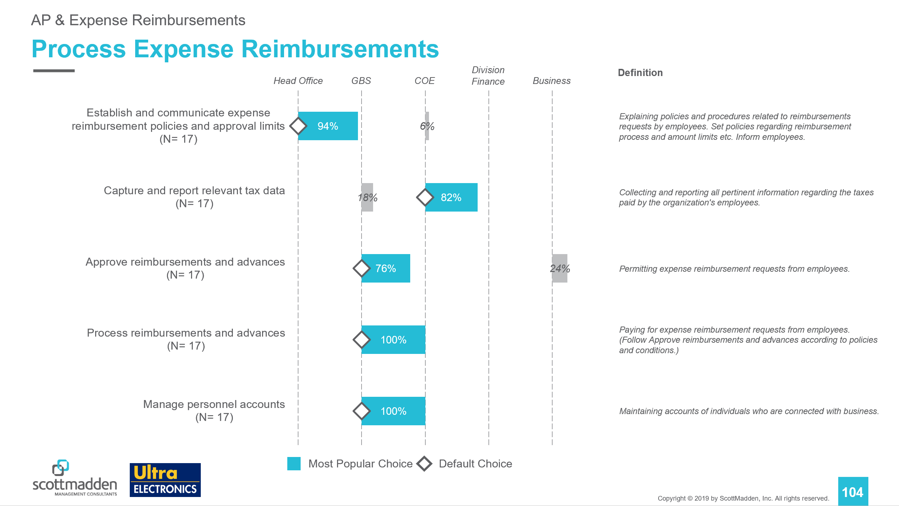
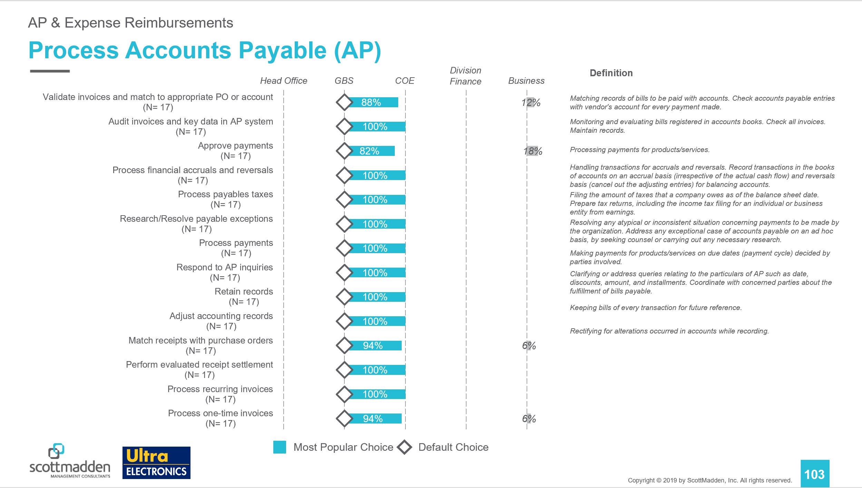
Design: Scope of Services
Assessment and Design
  Alignment of where discrete activities are placed within the service model is a key feature of design. Each function and each industry will place activities in the model based on their strategic objectives.
Service Tiers
Service Tiers
Activities
Activities
Less than 80% of respondents agreed on the placement of activities.
Greater than 80% of respondents agreed on the placement of activities.

Slide 30
Design: Organization Structure
Assessment and Design
Leading GBS organizational structures align around end-to-end processes, consolidate customer care under a single leader, and leverage an operations support group that can scale with the organization.
GBS VP
Process
Execution
Customer Care
Operations Support
  Several Highlights
  End-to-end process orientation
  Separate and accountable customer care
  Enhanced “Operations Support” to factor key elements of the GBS model (e.g., Global Process Owners)
Purchase-to-Pay
Hire-to-Rehire
Business
Analytics
Centers of Expertise
Centers of Expertise
Global Process Owners
Tier 1 Support
Customer Relationship Management
Transaction Processing
Transaction Processing
Data Management
Tier 2 Support
Record-Report
Order-to-Cash
Employee Development
Centers of Expertise
Centers of Expertise
Project Management
Continuous Improvement
Transaction Processing
Transaction Processing
Vendor Management

Slide 31
Design: Staffing Levels
Assessment and Design
Proposed staffing level changes address movement of transactional work and alignment of resources using insight from benchmarks, data from the Work Activity Survey, and organizational nuance.
Current Headcount
Transitions to Future State
Proposed Headcount
Learning & Development
(XX)
Shift 9.0 FTEs from Learning Operations
Learning & Development
(XX)
Talent Acquisition
(XXX)
Shift 17.0 FTEs from Coordinator, Onboarding, Project Manager
Talent Acquisition
(XXX)
Employee Relations
(XX)
No Changes in Headcount
Employee Relations
(XX)
Total Rewards
(XX)
Shift 10.0 FTEs from Benefits Operations
Total Rewards
(XX)
HR Delivery
(XX)
Increase of 36 FTEs
HR Delivery
(XX)
Field HR
(XX)
Increase of 1 FTE
Field HR
(XX)
Service Center
(0)
Increase of 61 FTEs
Service Center
(60)
Total
XXX
Decrease of XX Total Headcount
Total
XXX

Slide 32





Business Case: Preparation Steps
Assessment and Design
CALCULATE THE BENEFITS
Assess the
Current State
CREATE THE RESULTING BUSINESS CASE
IDENTIFY
THE COSTS
DEVELOP THE COST/BENEFIT AND SENSITIVITY ANALYSES
Develop the
Future State

Slide 33

Business Case: Benefits Quantification
Assessment and Design
In quantifying the benefits, reduction in headcount is often the largest and most important.
Site
Other Quantifiable Benefits
Technology
Vendors
Headcount Benefits (Labor)

Slide 34
Business Case: Soft Benefits
Assessment and Design
Beyond quantifiable benefits, there are also several intangible benefits that should be evaluated.
Increased customer orientation
  Balance of human interaction and self-service tools
  Enables continuous improvement through metrics, dashboards, and analytics
  Improved controls
  Increases internal controls across the business
  Reduces risks and increases transparency and compliance in processes
  Enablement of strategic decision making
  Improves scalability and nimbleness for acquisitions and major business changes
  Permits better and faster decisions based on company-wide metrics
  Enablement of further, indirect efficiency
  Reduces cycle times of processes for internal and external stakeholders
  Reduces overall operating costs while improving accuracy and speed of service

Slide 35





Business Case: Costs
Assessment and Design
Costs are typically spread among different areas and include one-time and recurring inputs.
Technology
Marketing and Training
Headcount Costs (Labor)
Consulting and Project Team
Site
B
D
A
C
E

Slide 36

The Path Forward
Assessment and Design
The shared services journey is transformational—it is a multi-year journey that can take different paths. Consider key challenges and the enablers you will need to be successful.
  Do business leaders support the model?
  Are you prepared to commit resources (people, investment dollars, etc.)?
  What pace of change will your organization’s culture accept?
Approach in “digestible” steps for your organization—determine how far, how fast.

Slide 37

Fundamentals for Implementing
Shared Services

Slide 38
Typical Implementation Work Streams
Fundamentals for Implementing Shared Services
After the business case and roadmap are complete, service centers are built and launched. Implementations typically consist of major work streams and corresponding key activities.
Typical Implementation Work Streams
Policy Standardization and Process Redesign
Organization
and Staffing
Communication, Change Management,
and Training
Technology
Facilities
Service Management
and Metrics
Program/Project Management
Form and manage teams | Provide tools and templates | Manage resources and progress | Identify and resolve issues
Work streams are distinct but closely integrated. Implementation activities become iterative as work streams progress.

Slide 39
Typical Timeline
Fundamentals for Implementing Shared Services
January
February
March
April
May
June
July
August
September
October
November
December
January
February
March
April
Planning and Organization
Current State Assessment
Future State Assessment
Strategic Roadmap
Form and Kick off Project Team
Develop Detailed Implementation Plan
Organizational Sizing and Detailed Job Definition
Staff Selection (Staged)
Policy Standardization
Process Redesign
Technology Evaluation, Selection, and Procurement
Technology Design, Build, Integration, Testing, and Implementation
Knowledgebase Content Build
Training Development
Training
Staff Development (Continues Post-Launch)
Marketing (Phase 1)
Project Management
Communication and Change Management
Facilities
Strategy and Roadmap Design
Policy and Process
Technology
Facilities
Launch (Phase 1)
Project Management
Organization and Staffing
Communication, Change Management, and Training

Slide 40
Project Management Tasks
Fundamentals for Implementing Shared Services
02
04
07
Define governance structure for decision making and testing
Develop project tools and templates
Identify and resolve issues and risks
06
Track and report on project status
01
Form implementation team
03
Define team charter and outline roles and responsibilities
05
Manage project
39

Slide 41




Forming the Right Team
Fundamentals for Implementing Shared Services
Typical Project Organization
Part-Time Participants and Subject Matter Experts
Steering Committee
Project Management
Core Team
Finance
HR
Consultants
Sub Teams
Internal Audit
Org and Staffing
Policy Harmonization
Process Redesign
Legal
Facilities
Supply Management
Technology
Knowledge Base Build
Training
Communications, Marketing, and Change Management

Slide 42

Policy and Process Considerations
Fundamentals for Implementing Shared Services
Policy harmonization and process standardization are essential steps toward maximizing the efficiency gains of a new service delivery model. Throughout the policy harmonization process, it is important to remember that policy development and redesign will drive process development.
POLICY
PROCESS
POLICY HARMONIZATION
focuses on development and standardization of “guidelines,” “standards,” and “rules” around identified topics.
PROCESS STANDARDIZATION
focuses on “how” a service is delivered.
Prepare Appropriately
Push Sufficiently
Roll Out Effectively

Slide 43
Organization and Staffing
Fundamentals for Implementing Shared Services
The design of the organization and planning for the selection of staff for the new organization must be done in advance of the actual selection process.
Organization Design Activities
Staffing
Activities
Determine business strategy
Develop organization design
Define and price positions
Outline staffing objectives
Develop selection process, guidelines, and tools
Form candidate pools
Evaluate and select people
Notify selected and
non-selected candidates
Communicate results to constituents
  Design tasks must be complete before moving to staffing. You should not jump back and forth over the wall.

Slide 44
Service Management Technologies Capabilities Overview
Fundamentals for Implementing Shared Services
Philosophy of Service
Supporting Technologies
  One number, one portal, and one email
  Answers from a knowledgebase relevant to caller
Customer First
Efficient, Self-Directed Work Teams
  Sharing of work through case management
  Increased accountability due to case management system
Performance Driven
  Metrics gathered through integrated channel management and through case management
Technology Driven
  Integrated technologies that reuse information and data
Continuous Improvement
  Flexible technologies that will grow

Slide 45

Customer Care Technology
Fundamentals for Implementing Shared Services
A shared services delivery model requires a foundation and investment in customer care technologies.
Computer Telephony Integration (CTI)
Telephony System (IVR, ACD, CTI)
  Enables employee data verification with HCM integration
  Supports higher resolution rate on first contact by routing calls to the most appropriate and available representative
Customer
Interactive Voice Response (IVR)
Automated Call Routing (ACD)
Case Management System (CMS)
  Provides one system to create, track, and review cases
  Offers flexible communication channels (e.g., text, live chat) with customers
  Enables 24/7 support to employees in different time zones or for non-office workers with virtual agent
  Supports better performance management with case metrics tracking and reporting
Employee Portal
Case Management System
Knowledge Base
Portal and Knowledge Base
  Offers chat (AI or person) for employee questions
  Provides a ”one-stop shop” for content
  Offers improved mobile accessibility and robust search function
  Lifts transactional burden across the function
E-Forms

Slide 46


What’s Really Out There... And Being Used
Fundamentals for Implementing Shared Services
 | Robotic Process Automation | Virtual Agents and Chatbots | Predictive Artificial Intelligence | Generative Artificial Intelligence
Approximate GBS Adoption | 65-75% | 30-45% | 15-25% | 15-25%
Characteristics of Data Input | Structured, rule driven, and static | Structured data with cognitive computing | Largely structured data with hidden patterns | Unstructured/structured data, driven by prompts
Nature of Ideal Process Fit | Digital repetitive steps Rule-based/logic driven Time consuming Documented Static rules | Customer-interfacing Requires access to solve Multiple languages required Multiple time zones required | Requires research Non-routine inquiries Formula-driven Requires pattern and detailed analysis | Generates content with open data searches Can point to inhouse data Language processing Complex Q&A
Process Candidate Examples | AP/AR management Billing and invoices Data entry/management | Customer service Vendor inquiries Delivery/scheduling | Document research (contracts) Forecasting (turnover) Problem solving patterns | Research Forecast Customer service Optimization
Data structure and integrity is essential across all IA.
Source: HfS research

Slide 47


Facility Design and Hybrid Work Models
Fundamentals for Implementing Shared Services
Trends in Facilities Design
Hybrid Work Models Pros and Cons
  Work “neighborhoods” to facilitate different types of work, including quiet spaces, collaboration areas, and touchdown spots for remote workers
  “Social hubs” to encourage cross-pollination of ideas and foster trusting relationships
  Enhanced technologies to facilitate collaboration and efficiency (e.g., video conference rooms and smart boards)
  Pros: Reduced facilities costs, increased productivity, hiring without geographic borders, recruiting with remote work as an option (not an obligation), happier employees, fewer negative impacts of commuting (e.g., stress)
  Cons: Communication can get messy, data security, working conditions vary outside of the office, isolation

Slide 48







Change Management Framework
Fundamentals for Implementing Shared Services
Successful change adoption is enabled through leaders’ ongoing commitment to “why” the change is happening and their continuous engagement with the people who are experiencing the change.
Successful change leaders are enabled through thoughtful, well-planned, and highly integrated initiatives and actions that make up the change management plan
ENABLERS
CHANGE MANAGEMENT PLAN
Oversight, Organization, & Controls
Sponsors & Stakeholders
Leader Engagement
Risk Management
Feedback & Pulsing
Communications
Education
and Training
Marketing
  Seek to understand the current workplace climate and employee experience through engagement surveys and existing data and interviews with leaders and key stakeholders
  Establish and commit to recurring connection points with key stakeholder groups to continually share information and gather feedback
  Facilitate and nurture change agent networks to drive ongoing education, awareness, and feedback gathering while enhancing the effectiveness of communications activities and materials
  Assess impact of overall change on stakeholder groups
  Design a change management plan that emphasizes transparency and ongoing communication
  Prepare messaging and leader support for key milestones and impacts
  Create and launch marketing campaign
  Conduct ongoing training and education
  Measure effectiveness and success of implementation activities and overall adoption
  Establish a long-term approach for maintaining monitoring activities, feedback gathering, and continuing education initiatives

Slide 49
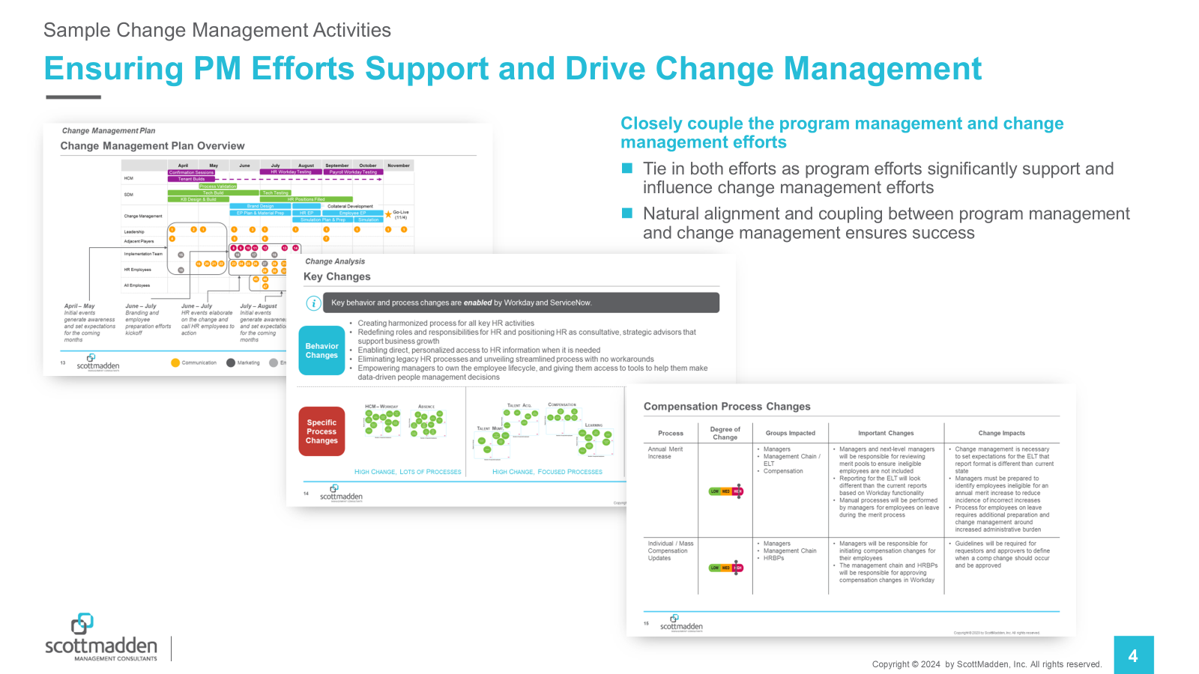
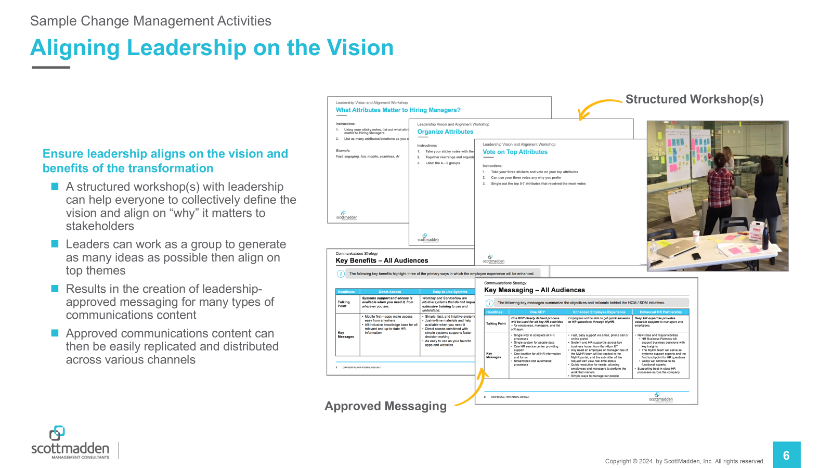
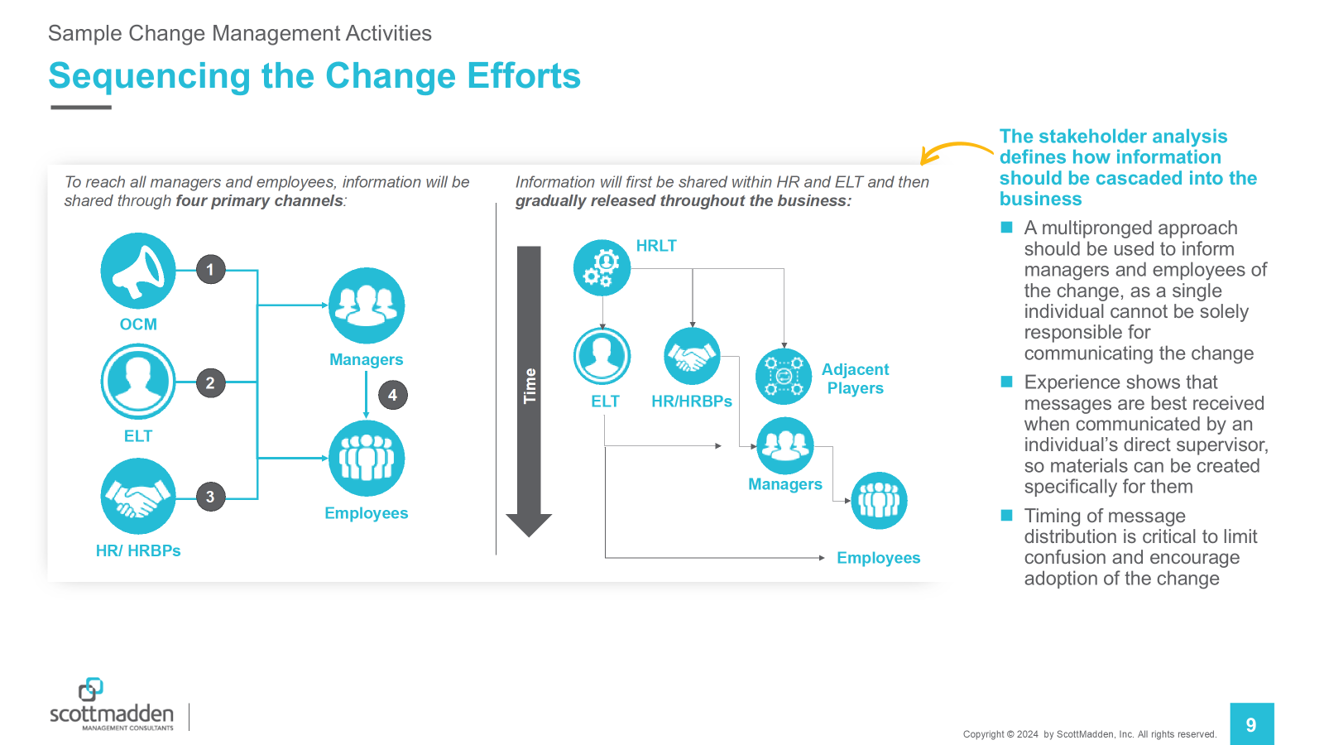
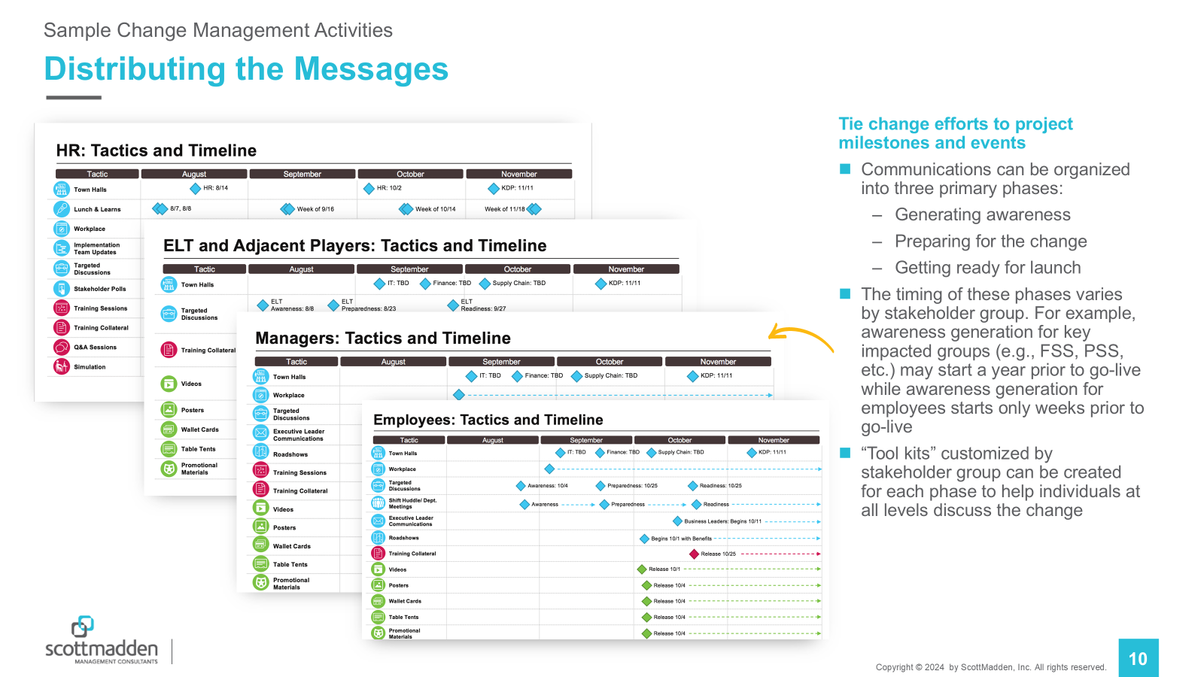
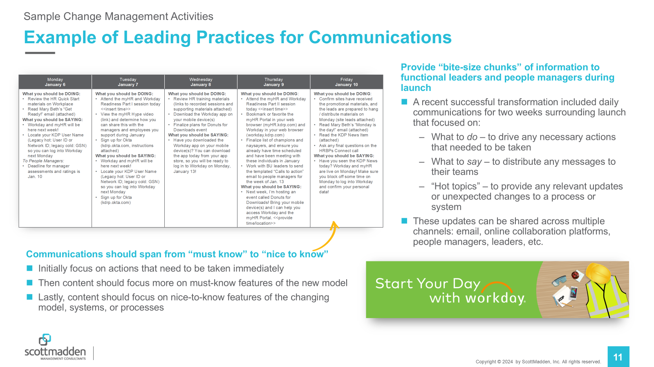
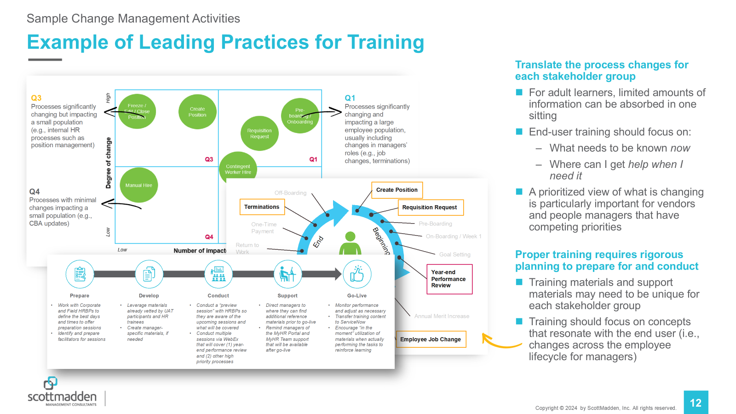
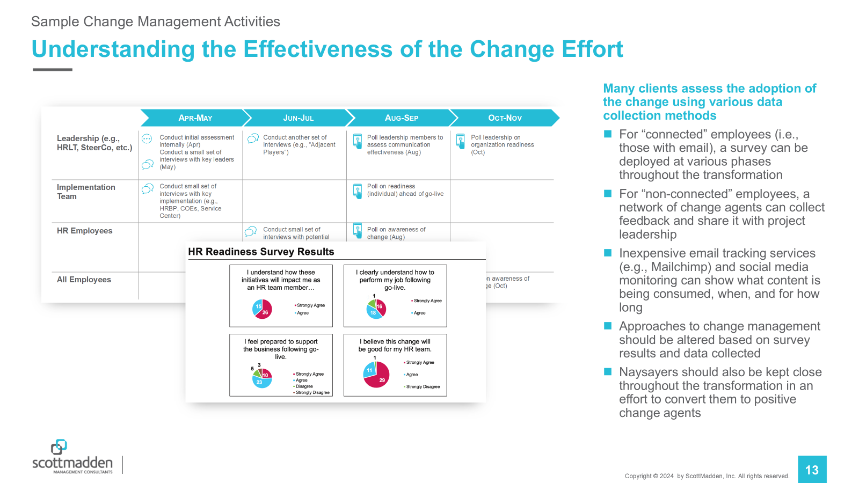
Change Management Planning and Execution
Fundamentals for Implementing Shared Services
Keep the list of change activities aligned and on track through a consolidated list of actionable items, organizing activities by the project milestone they support.
Provide clarity on changing roles and responsibilities to customers and stakeholders using a variety of tools to assist in acceptance and adherence to the new delivery model.

Slide 50
Training and Development
Fundamentals for Implementing Shared Services
Training, while critical, is often compromised to allow more time and/or resources for other tasks. Training is a key success factor and should never be underestimated or sacrificed.
Example Training and Development Approach
  Design training content for each topic/module
  Develop training materials
  Produce supporting documentation
Assess individual training needs by curriculum. Develop a detailed training plan and schedule by module.
  Compile material and finalize testing plan
  Train instructors and conduct training
  Create and compile course evaluations
Example Training Assessment
STAFF | General |  |  |  | Operations |  |  |  |  |  |  | Content |  |  |  |  | Technology
 | Company | Values and Culture | Service Delivery Model | Customer Service | Answering Calls | Retrieving Data | Entering a Case | Escalating an Issue | Transferring a Call | Closing a Case | Scheduling | Functions | Programs | Policies | Processes | KB Content | Telephony | CMS | KB | HRIS/Financial System | Document Management | Equipment | Desktop & Applications

Slide 51


Conduct a Service Delivery Simulation
Fundamentals for Implementing Shared Services
Issues will inevitably materialize despite vigilant planning and execution. To mitigate this impact, ScottMadden offers a Service Delivery Simulation, or “dress rehearsal,” that evaluates people, processes, and technologies in a realistic operational environment.
LEVERAGE A BUILDING BLOCK APPROACH FOR LIVE SCENARIO WALKTHROUGHS
Identifies technology gaps
Simulation Stress Test
Identifies process gaps
General Simulation Test
Prepares employees
for new roles
Academic Training
Discovers customer service risks
Educates role players on change

Slide 52
Stabilization Success Factors

Slide 53
Establish the Stabilization Plan
Stabilization Success Factors
After launching, it often takes three to six months to stabilize day-to-day operations.
  Set expectations with internal customers
  Establish stabilization objectives and metrics
  Schedule recurring stabilization sessions
  Establish a “tiger” team to address stabilization challenges
  Update internal customers on shared services performance
  and stabilization
  Officially end stabilization activities when appropriate
Stabilizing
Stable
Post-stabilization improvement
Launch
+3 months
+6 months

Slide 54
Ensure Strong Governance Is In Place
Stabilization Success Factors
The formality and participating members in an oversight committee are influenced by the size of the organization, the number and complexity of services, organizational culture, and hierarchy.
Shared Services Governance Board Characteristics
Represents business units, shared services, and critical support organizations (e.g., IT, HR, etc.) Ensures vision and strategies are aligned Directs the operational team and serves as a point of escalation
Governance Board
Business Unit A
Business Unit B
Business Unit C
Corp. HR
Shared Services Lead
Corp. IT
Key Benefits
Represents the shared services organization Allows customers to influence direction Controls spending and prioritizes initiatives Integrates with other business initiatives
Shared Services
Service Center
Centers of Expertise

Slide 55
Operational Support Team
Stabilization Success Factors
  The operational support team is as an internal resource for the continuous maintenance and improvement of the service center
  The operational support staff monitors service center performance, provides training to service center staff and customers, and ensures key systems and content are up to date and maintained
Shared Services Operations Team
Maintains service center metrics and reports
performance periodically.
Metrics/Reporting
Training and Change Management
Provides necessary training to new hires and existing employees on service
center processes.
Creates and maintains service center knowledgebase to ensure the most up-to-date information is available.
Knowledgebase Content
Quality Management
Oversees quality management activities, such as planning, assurance, and control.
Ensures key systems are meeting the needs of the service center.
System Management
Continuous Improvement
Identifies opportunities for service center improvement.

Slide 56

Transitioning to Continuous Improvement
Stabilization Success Factors
  Mindset toward continuous improvement (CI) starts with implementation and evolves through operations; the levers of delivery change through each phase
  Processes for identification and prioritization of requirements change through the transitions
Pre Go-Live
Operations
Levers of Delivery
Implementation
Stabilization
Continuous
Improvement
Governance/
Performance Management
Processes
Technology/Tools
Organization/Staffing
Skills/Training
Plan
READINESS
BUSINESS
RAPID CYCLES
NORMAL CYCLES
Design
Measure
Analyze
Plan
Fix/Refine
Deploy
Measure
Analyze
Plan
Enhance
Deploy
Build
Test
SIMULATION
ASSESSMENT
Deploy
Deliberate planning and development
Project-based staff
Tactical fixes and improvements
Transition of project staff to operations/CI Staff
Strategic improvements
CI staff

Slide 57
Wrap Up

Slide 58



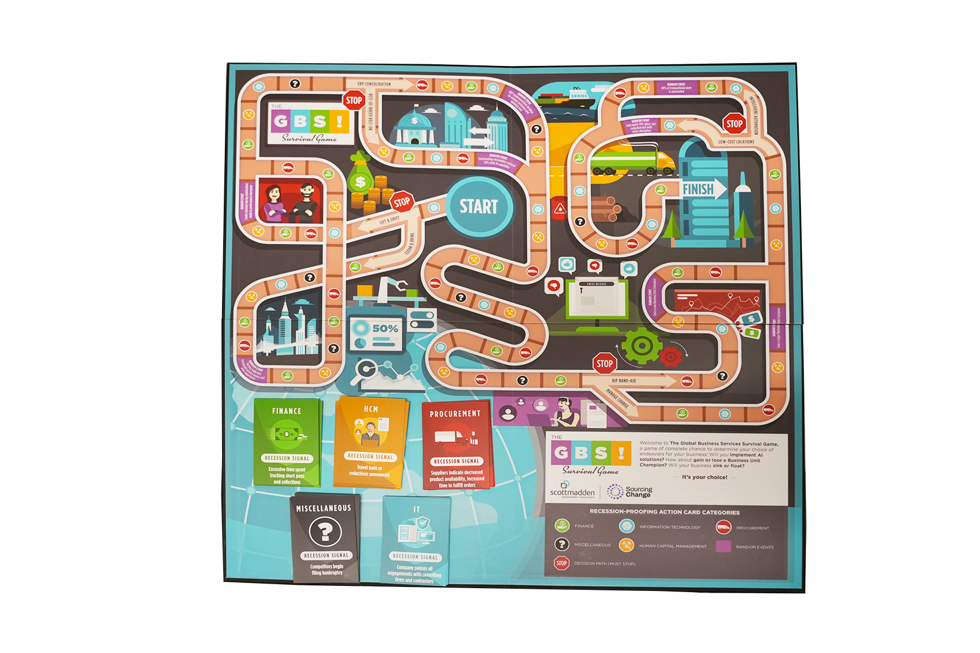
Wrapping Up
For those who have implemented and are wondering what’s next, attend our advanced session Workshop – Shared Services 501: “Taking Your Shared Services Operation to the Next Level” today.
Housekeeping items:
  Complete SSON’s workshop evaluation form to help us improve
  Request access to our complete workshop presentation
Hear from one of our clients:
  Tuesday, 2:20pm
Stop by ScottMadden’s booth to:
  Participate in our demo drive
  Drop a card to gain access to shared services insights and helpful resources
  Enter our booth drawing for a
  chance to win Apple Air Pods
  Play the “GBS Survival Game”
  Perform an HR Healthcheck with
  our experts
Thank you for participating in today’s workshop and enjoy the rest of the conference!

Slide 59

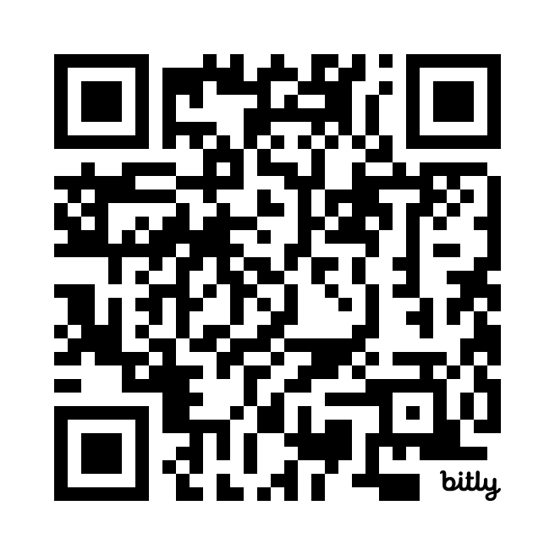



Get In Touch
Tell us how we did! Please complete the post-workshop survey found at the QR code to let us know your thoughts. Then, access to our workshop decks and content related to our solutions at our landing page.
Complete SSON's survey
Access our deck

