Slide 1
HR Optimization: Key Themes for Organizational Excellence
HR Shared Services and Outsourcing Week
November 2024

Slide 2



Your Discussion Leads

Slide 3

Agenda
01
INTRODUCTION
04
POLICY AND PROCESS
02
SERVICE DELIVERY MODEL
05
TECHNOLOGY AND DATA
03
PEOPLE AND ORGANIZATION
06
WRAP UP

Slide 4
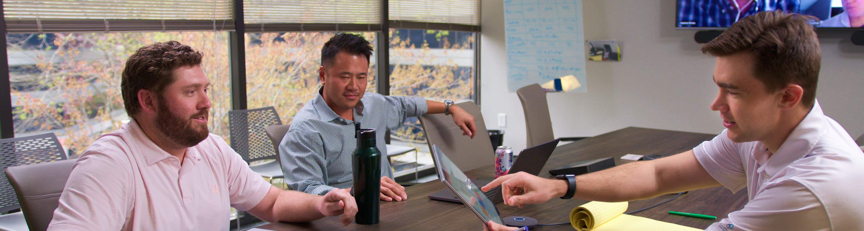

Introduction
ScottMadden
Overview
Key Themes
for Organizational Excellence

Slide 5

Who We Are
Introduction
CORPORATE & SHARED SERVICES
ScottMadden is a management consulting firm with more than
40 years of deep, hands-on experience.
Experience
Our experienced team has been a pioneer in corporate
and shared services since the practice began decades ago.
We employ deep, cross-functional expertise to produce practical, measurable solutions.
Scope
We have completed thousands of projects since the early ’90s, including hundreds of large, multi-year implementations. Our clients range across a variety of industries from energy to healthcare to higher education to retail. Our areas of expertise span the spectrum of middle and back office corporate and shared services.
We deliver a broad array of corporate and shared services consulting services—from strategic planning through implementation—across many industries, business units, and functions.
Our knowledge, expertise, and experience are unmatched—no other firm has helped more clients with more unique solutions.
Services
We have helped our clients with assessment, strategy, design, implementation, technology, business case and roadmap, governance, program management, and change management.

Slide 6

Corporate and Shared Services Capabilities
Introduction
Assess and Plan
Design
Build
Improve
  Strategic planning
  Feasibility analysis
  Benchmarking
  Statistical and analytical modeling
  Leading practices assessment
  Performance evaluation
  Project planning
  Leadership education and buy-in
  Staff evaluation
  Change readiness assessment
  Site visits
  Current state analysis
  Future state design
  Business case development
  Service delivery model design
  Work scope delineation
  Policy assessment
  Intelligent automation strategy
  Sourcing evaluation
  Organizational design
  Technology evaluation
  Transformation planning
  Implementation planning
  Change management
  Project management
  Service and transaction center build
  Detailed organizational design
  Staffing
  Policy harmonization
  Process redesign
  Technology design, selection, implementation, and support
  Education and training
  Facility design and setup
  Change management
  Sourcing implementation
  Metrics and dashboarding
  Analytics setup and deployment
  Operations improvement
  Governance
  Service expansion
  Cost reduction
  Process redesign
  Intelligent automation opportunities/implementation
  Technology upgrade
  Merger and acquisition integration
  Field resource development
  Voice-of-the-customer surveys
  Metrics and performance management

Slide 7

















































Representative Clients
Introduction
Retail and
Consumer Products
Manufacturing and Industrial
Technology and Communications
Higher Ed., Public Sector, Non-profit
Energy and
Utilities
Healthcare
Professional
Services
Note: Representative sample; not all-inclusive of clients served. Excludes numerous well-known clients due to confidentiality agreements

Slide 8
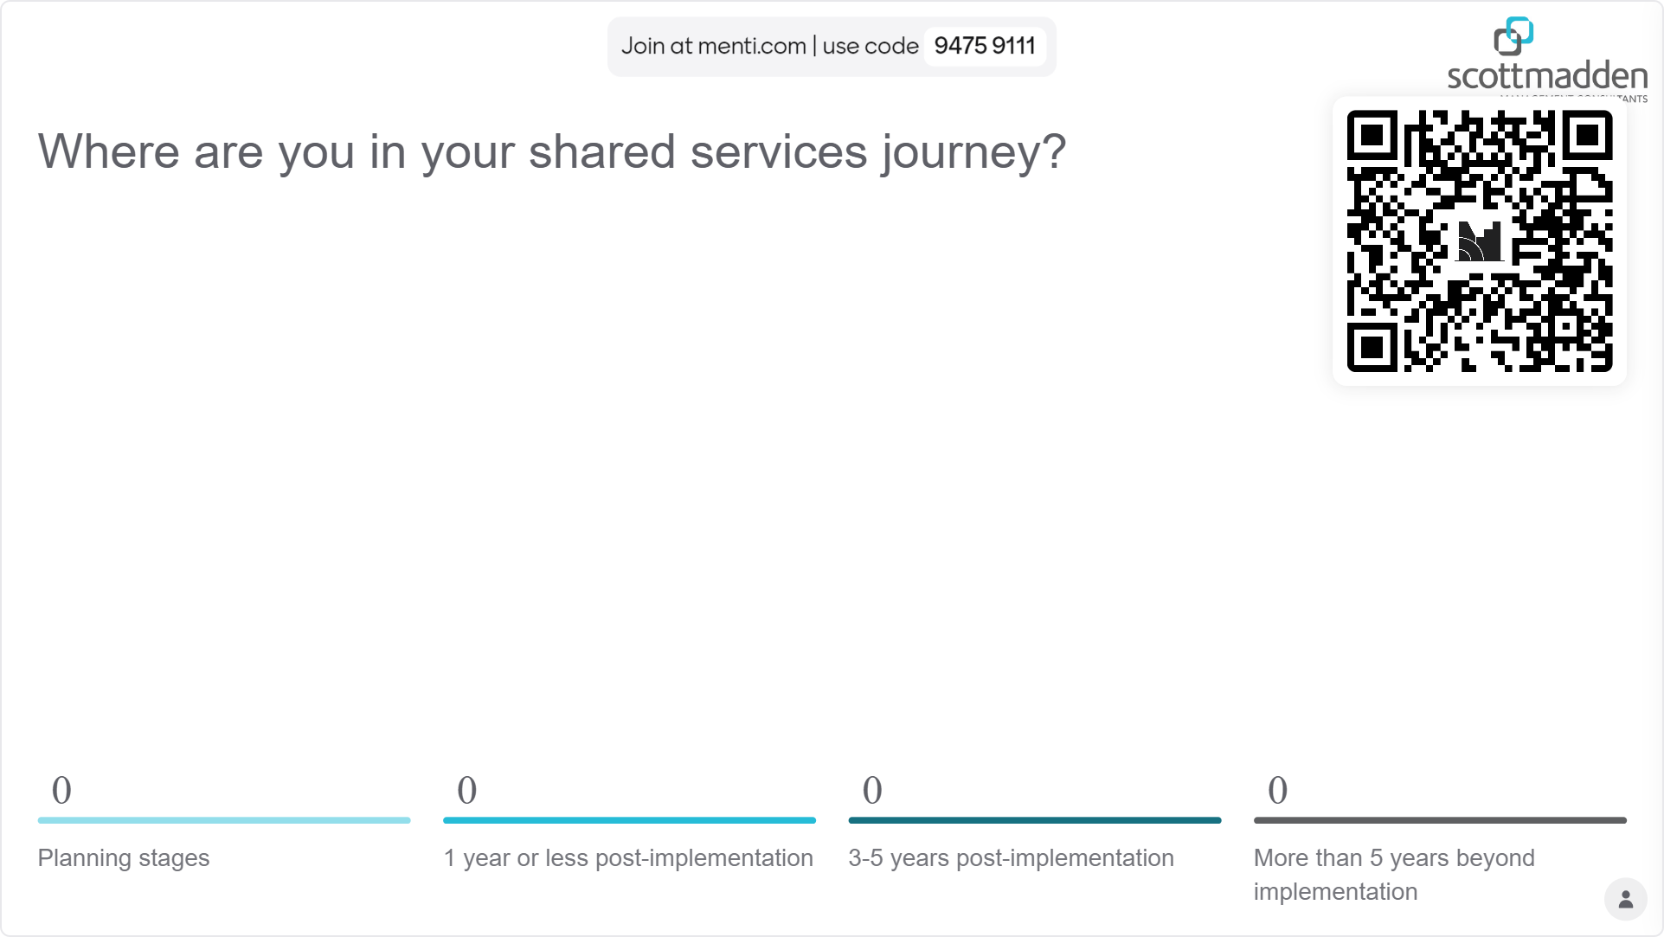
Live Poll!
Where are you in your shared services journey?
Multiple choice mentimeter question
Planning stages
1 year or less post-implementation
3) 3-5 years post-implementation
4) more than 5 years beyond implementation

Slide 9

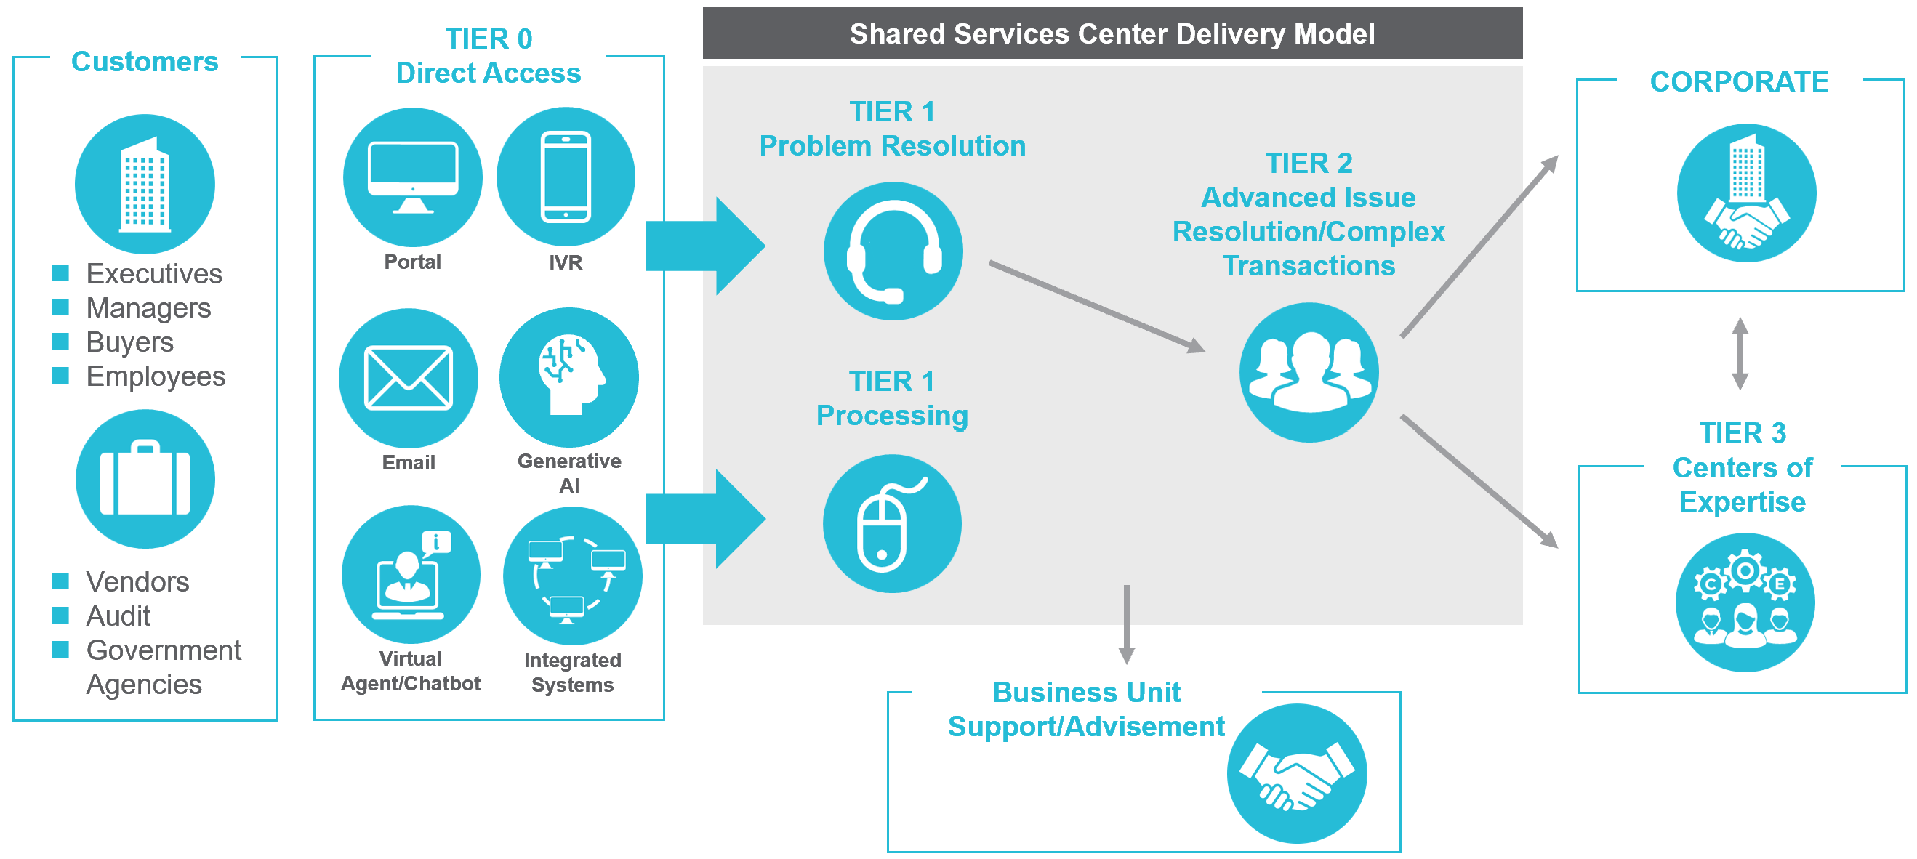
Leading Practices Shared Services Operating Model
Introduction
Single Source of Content
Centralized portal and knowledgebase with robust search functionality
Clear Scope and Simple Access
Employees and managers know where to go for service
Executives
Managers
Employees
Standard
Escalation Paths
Well-defined workflow and hand-off points
Vendors
Government agencies
Defined Roles
Clearly defined roles and responsibilities that are aligned to the right channel of delivery
Continuous Improvement
Process improvement driven by data
8

Slide 10

Benefits of a Shared Services Model
Introduction
Improve Service Delivery and Transparency
Better customer experience
Standard processes
Common model for expansion
Performance metrics
Cost Control and Scalability
Skillset and work alignment
Economies of scale
Automation of process
Elimination of redundant work
Gain Control and Leverage Data
Improve reporting and analytics
Improve compliance
Better decision-making
End-to-End Accountability
Less rework caused by upstream process issues
Improved end-to-end process coordination
Focus on root-cause problem resolution

Slide 11

Benefits of Shared Services – HR Benchmark Examples
Introduction
Top-performing service centers operate more efficiently and provide a better customer experience.
Customer Experience in HR
90%
20 secs
8%
First-Contact Resolution
Average Speed to Answer
Service Center Employee Turnover

Slide 12
Common Challenges and Mitigation Tactics
Introduction
COMMON CHALLENGES
Resistance
Silo Mentality
Lack of
Standardization
Internal Focus
Lack of
Accountability
Limited Innovation
and Stagnation
Poor Organization
or Skill Alignment
Limited
Current State
MITIGATION TACTICS
  Strong, sustained leadership and sponsorship
  Executive sanctioning of the new process
  Stretch goals and aggressive timing
  Effective measurement and rewards
  Leveraging leading practices
  Customer participation
  Work-focused; not functional teams
  Removing current state service delivery pathways (not aligned with future state) at the first opportunity
  Cascaded, frequent communication
  Willingness to spend time and effort in evaluation of current operations
  Visits to successful operations
  Detailed current state assessments and future state design
Notes:
Speaker: Courtney
Resistance: Long-standing relationships perceived at risk. Faculty does not want to give up ‘easy access’ to their trusted teams. Faculty fear their requests will be sent to a ‘black hole,’ never to be handled.
Silo Mentality: Core services are disconnected across functions (e.g., finance, HR, research, IT, etc.), as well as from colleges, creating disjointed service delivery and limited current state metrics.
Lack of Standardization: Failing to standardize policies, procedures, processes, systems, data, vendors, etc. across colleges, units, or departments.
Internal Focus: Driving the new shared services model from an internal perspective and not a customer perspective…push versus pull.
Lack of Accountability: Inability to develop and execute a clear accountability and ownership structure, hampering the overall implementation success. Infrastructure weakens and people tend to function in ways that are convenient versus right, putting success at risk.
Limited Innovation and Stagnation: Reluctance to radically challenge the status quo so that work is viewed and performed differently; inability to leverage technology; too much time spent studying or planning.
Poor Organization or Skill Alignment: Failing to make necessary organizational changes to support the new model, including adding new and/or different skills required by the model, especially in the field. Incumbents often do not possess these skills.
Limited Current State: Limiting current state analysis improves implementation speed but significantly limits the ability to baseline operations and substantiate improvements.

Slide 13
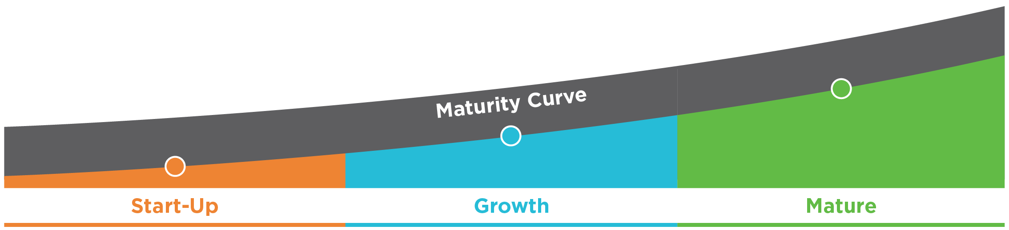
Opportunities Exist, Regardless of Your Maturity
Introduction
Policy harmonization
Process redesign
Service delivery model review
Organizational structure
Technology implementation
Governance model
Process redesign
Expansion opportunities
Leverage of leading practices and benchmarks
Training and staff retention
Other technology investments
Multifunction integration
Governance clarification
Continuous improvement
Expansion opportunities
Customer satisfaction
Leverage of leading practices and benchmarks
Career pathing
Technology optimization
Multifunction optimization
Notes:
Where we see things go wrong…
People and Organization
Limited or casual governance – weak change management
High turnover driven by redundant work with limited career paths
Functional focus – no cross-functional collaboration
Transactional focus – need to move up value chain
Fragmented operations in multiple locations
Policy and Process
Non-standard processes; lack of adherence to redesigned processes
Incomplete policy harmonization
Manual workarounds (often supported by Excel)
Functional silos – lack of end-to-end process standards, management, and ownership
Limited focus on process improvement
Data and Knowledge
Internally focused; no understanding of customer experience or needs
Low customer satisfaction
Ineffective performance metrics and reporting
Data security risks
Tools and Technology
Minimal integration between tools
Multiple ERPs and supporting applications
Limited use of available functionality
Low adoption of tools

Slide 14
Shared Services Optimization Framework
Introduction
Service Delivery Model
Organization and People
  Strategy and Governance
  Scope of Services
  Scope Expansion Strategy
  Sourcing Strategies
  Customer Experience
  Stakeholder Management
  Organizational Structure and Staffing Levels
  Roles and Responsibilities
  Staff Skills, Competencies, and Expertise
  Staff Development
  Career Pathing
  Team and Organizational Culture
Policy and Process
Technology and Data
  Policy and Process Harmonization
  End-to-End Process Orientation
  Compliance with Policies and Processes
  Documentation and Resources
  Continuous Improvement Framework
  Operational Processes
  Applications and Systems
  Metrics and Success Measures
  Reports, Dashboards, and Insights
  Customer Portal and Self-service
  Knowledgebase and Knowledge Management
  Automation

Slide 15


Service Delivery Model
Ensure the Right Governance Structure is in Place
Consider Scope Expansion
Re-evaluate
Existing Services

Slide 16



Dealing with Strategic Changes
Service Delivery Model
Changes in strategic direction are common as companies pivot to address market pressures.
Are your SSC operations pivoting and evolving to meet strategic needs? Do you have the right governance in place?
Local Operations
Are there processes that came into the center that, in hindsight, are not being effectively managed and should have remained local?
Acquisitions
While you were busy building and stabilizing your SSC, your company made acquisitions. Some of them may even have their own SSC operations…
Is now the time to integrate them and their standardized practices?
Outsource Providers
Outsourcing unstable or disparate processes is never a recipe for success
Are there processes that have stabilized under SSC control that would now be candidates for outsourcing?
Shared
Services
Are there outsourced processes that would be better managed by the SSC?

Slide 17
Establish Strong Governance
Service Delivery Model
A governance structure drives increased engagement and accountability within the shared services organization, creates an overall mechanism to manage and prioritize issues/opportunities, and adds visibility for leadership.
Post-implementation Governance Focus
Manage requests for future policy, process, or technology customizations
Manage requests for different employee populations to be treated in a different manner
Uncover and address service issues
Make critical decisions and set action items regarding changes to scope of services, new employee populations, etc.
Perform scheduled reviews of the performance metrics
Key Considerations
Match the governance structure to the potential for issues
  Small potential for differences = less formal and structured governance
  Large potential for differences = more formal and structured governance
Incorporate customers and partner representation
  Allows customers to influence direction of the service center and ensures responsiveness to business needs
Establish criteria for evaluating issues and making decisions

Slide 18
Governance vs. Execution
Service Delivery Model
  GOVERNANCE LAYER
Identify and prioritize the list that needs to be worked
Thematic issues
Prioritization of focus
Status of existing enhancements
Maintenance of cross-functional discussion/partnership
Company Leaders
Shared Services Leadership
Business Customers
Shared Services Operational Leaders
  EXECUTION LAYER
Support, assign resources, and drive completion against the list
Dividing the work/issues to be resolved across the teams
Identifying and documenting the steps to achieve/complete resolution on the issues
Driving and executing on the fixes/improvements
Providing status updates back to the governance layers
Continuous Improvement
HR Administration Services
Customer Care
End-user Technology Support

Slide 19




Continue to Drive Scope up the Value Chain
Service Delivery Model
TIER 0
Self-service
TIER 1
Generalist Support
TIER 2
Specialist Support
TIER 3
Centers of Expertise
For example: This trend is occurring in HR SSOs – higher value services:
Employee Relations
Labor Relations
Organizational Effectiveness
Business Analytics
Basic and frequently asked questions
Routine queries and reports
Simple transactions
Complex issues
Trouble shooting
Design of policy
Policy exceptions
75%-80%
of volume handled
15%-20%
of volume handled
0%-5%
of volume handled
Notes:
Customers
Vendors

Slide 20
End-to-End Process in Service Expansion
Service Delivery Model
Hire-to-Retire
Consider employee-facing work from an end-to-end view to:
Reduce handoffs
Drive consistency in service
Enhance the overall customer experience
Talent Acquisition
Onboarding
Example employee-facing services to consider
Workforce Administration
Benefits
Leaves
Terms
Workforce Development
Retirement Management
Offboarding/Exit Kits

Slide 21
Service Migration Approach
Service Delivery Model
Identify
Assess
Migrate
Finalize
Identify the pockets of transactional work across the organization that could drive further efficiency for the organization and better customer support
Consider the evaluation criteria
  Fit and complexity
  Level of effort
  Cost savings
Determine the timeline for migration
Determine the migration type
Complete work across workstreams, as needed by function
  Revise roles
  Set new organization structure and staffing
  Determine facilities needs
  Improve processes
  Revamp technology
Assess how the function is performing post-migration
Establish baseline metrics
Create reporting and metrics

Slide 22
ScottMadden Case Study
Employee Relations Transformation
OUTCOMES
Developed an enterprise governance structure to provide programmatic oversight of the new investigations program, including establishing risk levels to ensure the most severe investigations get the most enterprise attention and resources
A major healthcare system’s employee relations function had grown organically through M&A, and in a post-pandemic environment, was experiencing increased volumes, challenges, and complexities with their HR employee investigations processes. These challenges were leading to enterprise risk, legal and compliance exposure, and decreased employee morale.
KEY ACTIVITIES
Assessed the current operations, designed a new service delivery model, including a Center of Expertise (CoE), assigned cross-enterprise roles and responsibilities, designed a new organization structure with staffing needs, and created a business case, including recommended technology enablers
Reduced overall labor costs for the employee relations function while centralizing specialized resources to perform the work more efficiently and effectively than the previous decentralized model
Recommended approach to mitigate near-term employee investigation risks, including standing up the employee relations module in ServiceNow; designed a longer-term, phased rollout approach for the CoE
Created standardized processes for investigations and developed tools for clear and consistent decision-making, all tailored to fit the healthcare system’s specialized requirements
Planned and led implementation of the new CoE for two initial regions, including redesigning policies and processes, updating ServiceNow, and leading overall change management efforts
HR business partners, who have been overwhelmed by investigations work, now have more availability to help their business customers with more strategic work

Slide 23
Advantages and Disadvantages of Growth
Service Delivery Model
Advantages of Growth
Disadvantages of Growth
  The shared services model works to:
    Improve service delivery
    Lower total costs
  Economies of scale
  Synergies (e.g., onboarding of new employees)
  Standardization of processes and elimination of redundant processes
  Shared technology
  Shared management and administration
  Cross-training
  Additional advancement opportunities for shared services employees
  Improved customer service
  Allows business units to focus on core processes
  Investment requirements – upfront costs to transition and centralize technology, staff, equipment, and facilities
  Additional bureaucracy
  Size can hamper responsiveness
  Requires broader technical expertise at the top to manage additional functions
  Perception of kingdom-building
  Potential impacts to employees currently performing the work
Despite potential disadvantages, a successful shared services organization must continue to grow, evolve, and demonstrate additional relevance. Failure to do so will lead to stagnation
Notes:
Now that we have reviewed the benefits of shared services, we should compare the advantages and disadvantages of growth. The major advantage of growing shared services is the 30 years of proof that the shared services model works. Growing shared services has improved HR service delivery and lowered costs at companies across the globe. Shared services growth allows organizations to achieve more synergies and standardize more processes, which enables greater economies of scale. Shared services employees also benefit from expansion by getting exposure to additional cross-training and career advancement opportunities.
Although the advantages of shared services growth outweigh the disadvantages, organizations must consider the disadvantages of growth and ensure the disadvantages are addressed in the development and execution of the expansion strategy. Expanding shared services may require an up-front investment to transition the services from the business units to a shared services model. Organizations that successfully justify the investment by building the business case are more successful at expanding shared services than those that do not. After reviewing the benefits of shared services and weighing the advantages and disadvantages of growth, we can conclude that expansion is good.

Slide 24
Revisit What Sits Locally vs. Within Shared Services
Service Delivery Model
We often encounter instances where processes have been migrated that do not align with the established shared services model or fail to effectively meet customer needs.
Local Operations
Shared Services
Highly Specialized or Customized: Process requires a specialization, customization, or focused attention
Sensitive or Strategic: Process involves sensitive/confidential information or strategic decision-making
Low Volume or Frequency: Process has low volumes/ infrequent demand, making it less cost-effective to centralize
Clear Processes and Metrics: Process is well defined (and mostly standardized) with metrics and performance indicators
Repetitive/Routine Tasks: Processes have repetitive tasks that can be streamlined, automated, and centrally managed and are of sufficient volume to create economies of scale
Technology Enablement: Process can leverage technologies
such as ERP systems, automation tools, and digital platforms

Slide 25

Consider Outsourcing as a Strategy
Service Delivery Model
Outsourcing is an effective strategy employed by many (if not most) shared services organizations. Choosing the right time to outsource is critical to the strategy’s success.
Benefits to Outsourcing
Cost Savings: Outsourcing can reduce operational costs,
including labor, infrastructure, and overhead expenses
Access to Expertise: Gain access to specialized skills and
expertise not available in-house
Focus on Core Activities: Allows the organization to focus on
core business functions and strategic initiatives
Scalability: Easily scale operations up or down based on
business needs without the burden of fixed costs
Improved Efficiency: Outsourcing to specialized providers
often leads to increased efficiency and productivity
!
Caution
Outsourcing unstable or disparate processes transfers the problems elsewhere; control may be limited
Processes that are stable and standardized are ideal candidates for inclusion in an outsourcing strategy,
freeing up resources and focus for new opportunities and challenges

Slide 26
When Is It Time to Reconsider Your Outsourcing Arrangement?
Service Delivery Model
Enduring a painful and ineffective relationship with your outsourcing provider leads to ongoing challenges and potential loss of goodwill from your customers.
!
Signs that your outsourcing relationship is in trouble:
Poor Communication
Quality Issues
Missed Deadlines
Cost Overruns
Lack of Flexibility
Security Breaches
Dependency Risk
Cultural Misalignment
Legal or Compliance Issues
High Turnover
Customers will not differentiate between services provided by your SSC and those provided by your external BPO providers. Addressing issues with these providers is critical to the overall success of your operation

Slide 27
People and Organization
Evaluate Competencies and Upskill Staff
Cultivate Employee Engagement

Slide 28
Six Reasons to Focus on Competencies and Skillsets
People and Organization
As traditional models evolve and expand, organizations should evaluate their leadership and employee competencies to ensure talent requirements remain aligned.
1. Enable Performance Management
Ensure you have the right set of competencies and then measure against them for a comprehensive view of organizational capabilities.
4. Inform Training and Development
Determine the specific skills and knowledge areas where employees may benefit from additional training, coaching, or skill-building programs.
2. Identify Strengths and Gaps
Identify strengths and weaknesses in teams and individuals.
5. Facilitate Succession Planning
Identify high-potential individuals, develop talent pipelines, and prepare for future leadership and skill needs.
3. Align Skills with Roles
Match employees to roles and responsibilities that align with their strengths and expertise to increase performance and job satisfaction.
6. Drive Continuous Improvement
Address gaps by investing in skill development to enhance performance, efficiency, and overall effectiveness.
Notes:
1. Enable Performance Management – This helps establish performance expectations, set goals, and evaluate progress based on demonstrated competencies.
2. By assessing competencies such as technical skills, communication abilities, problem-solving aptitude, and leadership capabilities, you can pinpoint areas of expertise and areas that require improvement.
3. Align Skills with Roles - This alignment improves job satisfaction, performance, and overall effectiveness within the shared services organization.
5. Understanding the competencies of employees allows for better succession planning within the shared services organization.
6.

Slide 29
Optimizing the HR Business Partner Role Is Critical to the Model
People and Organization
HR Business Partners remain focused on business strategies
Manage Talent
Manage Budgets
Drive Performance
Optimize Local Knowledge
Traditional Model
Transformed Model
Re-aligned/Retained
STRATEGIC
5%
20%
ADVISEMENT & FUNCTIONAL
30%
60%
20%
~45% of administrative workload shifts to service center
TRANSACTIONAL
65%
Transformed
Notes:
One area where we see there to be a particular need to understand competencies and skillsets is with HRBPs in the new shared services model.
HRBPs used to have a large portion of their job devoted to transactional work. They’d answer basic HR questions, facilitate processes. There’d also be some advisement to managers on people-related business issues and triaging issues, but what where we need them to go is to reduce their role in transactional processes, and instead focus on key support the business needs such as managing talent, developing leaders, driving performance, and optimizing the work environment.
Whereas before their competencies were along the lines of ethical practice, HR knowledge, and relationship management, we’re now needing business acumen, critical evaluation, leadership, communication.

Slide 30
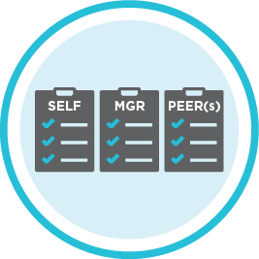
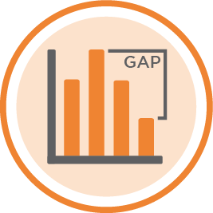

Evaluate the Organization’s Competencies
People and Organization
Developing a process or tool for measuring the organization’s level of proficiency across the competency framework can identify group and individual strengths and gaps. Results allow leadership to better align employees in their current roles, in growth opportunities, or in succession planning while highlighting needs for securing new talent.
ASSESS
Define competencies by level
Collect ratings from the employee and two additional raters (typically the manager or a peer)
IDENTIFY
Tabulate results tabulated by individual, career level, organization, or other demographic breakdowns
  PLAN
  Plan improvement opportunities for the organization
  Tailor personalized feedback based on individual results
Notes:
So competencies and skillsets are important, but how do you go about evaluating them? We have a proprietary tool, which we use in our recommended approach, which I’ll walk you through.
Step 1: Assess: Define competencies by level. Usually we start with SHRM industry competencies and customize them by company and organization. Then we use our tool to collect ratings from 3 sources: the employee themselves, and typically the manager and a peer.
Step 2: Identify: Discover your organization’s proficiency across key competencies to IDENTIFY skill gaps for the organization and with specific roles Results are from various perspectives – by individual, career level, organization.
Examples that we look for: newer competencies are lower (e.g., business acumen), gaps between manager vs. self-evaluation (expectations may be misaligned)
Step 3: Plan: We use this analysis to develop plans. For example, organizational development – which training courses are needed – but also what talent do I need to go out and get. Similarly, this might be something used at the individual level by the manager.

Slide 31
Case Study: HR Business Partner Competencies and Skills
People and Organization
Nine Society for Human Resource Management (SHRM) Competencies Evaluated:
Business Skills
Interpersonal Skills
Business Acumen
Critical Evaluation
Consultation
Communication
DE&I
Relationship Management
A recent higher education client realized HR Business Partner (HRBP) knowledge and skills varied across colleges and business units. With hopes of evaluating and eventually upskilling, ScottMadden issued a survey to all HRBPs to measure the organization’s level of proficiency in key HR competencies.
Leadership Skills
Technical Skills
Leadership Navigation
Ethical Practice
HR Expertise, which can be modified for non-HRBPs
Notes:
A recent example of evaluating HRBP competencies and skills was at a higher education client. Leadership was seeing a lot inconsistency in knowledge and skillset among HRBPs across colleges and business units. We conducted a survey using our tool to understand where the gaps were.

Slide 32
Build a Program to Address Skill Gaps
People and Organization
Developing a program to address identified skill gaps can help to ensure a consistent, top-quality level of service and knowledge from the team.
Curriculum options organized by competency and by level (early, mid/leader)
Attend scheduled trainings or use the self-paced track and engage with your cohort
Prove your skills on the job, as verified by leaders/peers, and receive a certificate of completion
PLAN
LEARN and ENGAGE
SHOW
31
Notes:
After running the comp builder, we developed a program curriculum. This included trainings and cohorts to complete the trainings with.
Developing a program to address identified skill gaps can help to ensure a consistent, top-quality level of service and knowledge from the team. We also find that the clarity of competencies and skills needed helps with engagement, our next topic.

Slide 33

Employee Engagement Is Critical
People and Organization
Engaged employees aren’t just more productive, they also tend to be more loyal and committed to their companies.
Notes:
Employee engagement is a hot topic of late. And Gallup reported that the first quarter of 2024 is the lowest percentage of engaged employees (30%) in more than a decade. According to a SHRM study, only 53% of employees consider their company a “great place to work”.
We see even larger declines in those under 35 years old, those who could work from home but work exclusively on-site, and those who work exclusively on-site.

Slide 34
Where Are Employees Asking for More?
People and Organization
Common Employee Challenges…
…Implications
“I’m more concerned with opportunities for development than any other aspects of my job”
.....….
90% of learning and development takes place on the job
...
“I like to be recognized for good work”
Lack of recognition or praise for doing good work is responsible for a 10%-20% difference in productivity
“I want a supervisor I can communicate with directly and openly”
...…...
The #1 reason people leave their jobs is directly related to their managers
“I am tired!”
...
Stress and work-life balance is also a top reason employees leave their jobs
Notes:
What are we hearing from employees?
They’re looking for development opportunities
They want to be recognized for their work
They don’t feel like they have supervisors they can communicate with. 70% of team engagement is determined solely by the manager
They want work-life balance and less stress

Slide 35
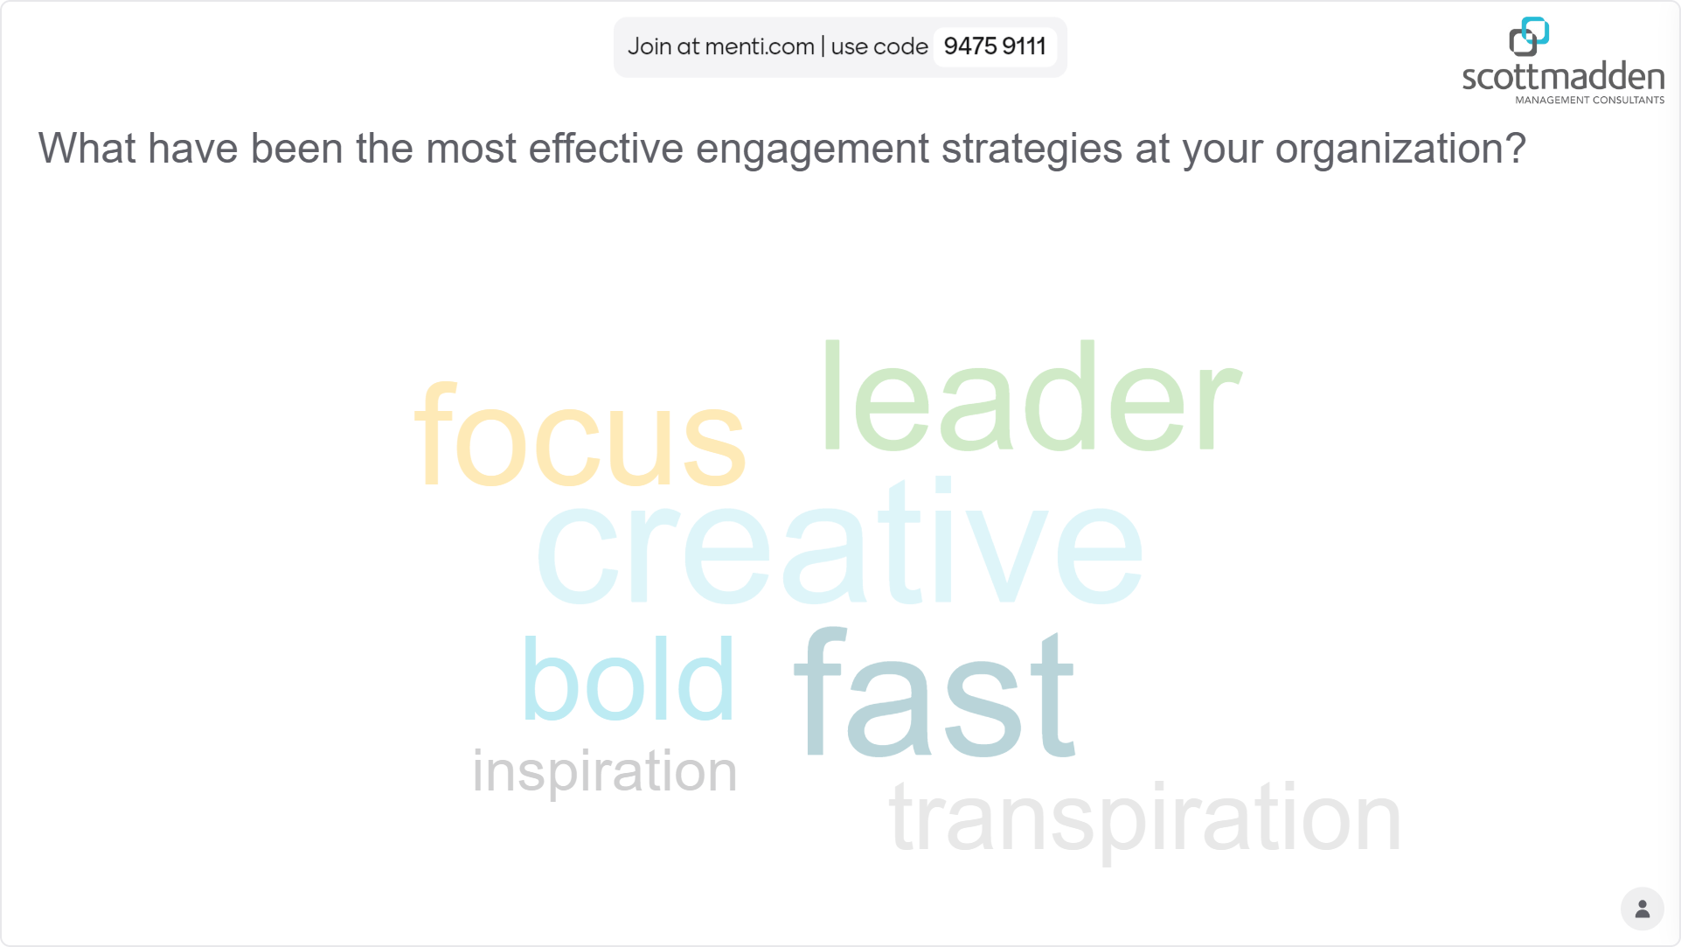
Live Poll!
People and Organization
What have been the most effective engagement strategies at your organization?

Slide 36

Engage Employees and Enhance the Employee Experience
People and Organization
Upward career potential, monetary incentives, and additional training opportunities are reported as top drivers for retaining staff among survey respondents.
What is the biggest driver for RETAINING
staff in your organization?
An Effective Leader:
  Provides a clear, concise, and overt statement on rewards
  Is helpful in markets where talent is difficult to attract
  Differentiates a company as an employer of choice and provides candidates a clear view
Source: ScottMadden Talent Management in Shared Services Survey
Notes:
In speaking of engagement, first I’ll talk to retaining employees, then more generally engaging them.
For retaining employees, we find that upward career potential is the primary driver, but monetary incentives and additional training opportunities are also significant. Of note, less mature organizations tend to use training as more of a level whereas more mature organizations have a greater reliance on monetary incentives.
*Less mature: SSOs in operation for less than five years; Mature: SSOs in operation for more than five years
**Large: SSOs with more than 300 employs; Medium: SSOs with 100-300 employees; Small: SSOs with less than 100 employees

Slide 37
Cultivating Employee Engagement
People and Organization
ScottMadden’s Talent Management Survey identifies communication, recognition, and culture-building events as favored engagement tactics.
Which tactics are most effective for ENGAGING
employees and building culture within your SSO?
“A great corporate culture [includes] open communication, mutual respect, shared goals, and a commitment to employee growth and development.”
BUILDING A GREAT CULTURE
Source: The 8 Elements of Great Company Culture. www. Greatplacetowork.com
Source: ScottMadden
Notes:
Speaking more generally to engagement, SSOs like to use regular communications and award and recognition programs. Small SSOs tend to use events, whereas large and medium SSOs use award and recognition more.
And there are some pretty creative programs out there, ones that combine monetary incentives with peer recognition. We’ve heard of companies with peer-to-peer programs where everyone is given $11000 to give to other employees, but they must include a note for why. Other companies have a system that allows for assigning points to peers that can be redeemed for cash.
If I’m advising on one area to improve employee engagement, recognition is where I’d start. It’s the easiest to add and it has tangible results. Encourage this to management and train them on it. If you can add programs that generate recognition and appreciation between employees, even better. Studies have tied recognition to a 9 % boost in productivity, regardless of awards associated with it.
Motivate staff for the long haul through:
Cultivating employee engagement
Enhancing the employee experience
Building culture through a
comprehensive inclusion strategy
Emphasizing career development
*Less mature: SSOs in operation for less than five years; Mature: SSOs in operation for more than five years
**Large: SSOs with more than 300 employs; Medium: SSOs with 100-300 employees; Small: SSOs with less than 100 employees

Slide 38

Policy and Process
Augment Process Design with User Experience Design

Slide 39
Process Improvement – The Next Step
Policy and Process
As your shared services organization matures and continuous improvement becomes a larger action area, it’s time to take a deeper look at processes that need attention. While this might involve designing processes that are added to the SSO’s function, it could also be focused on improving processes you already have.
Design New Processes
Processes that are added to the scope of the SSO because of evidence of success, trust, or a previously planned transition
Redesign Existing Processes
Processes conducted by the SSO today, including the particularly tough ones
Notes:
As you implement and mature as an organization, processes don’t go away. Design clear and functional processes for is a foundational step in any shared services implementation, but so is continuously improving processes after go-live. There are always processes that don’t make the initial cut list of items brought into the service center because of an assortment of reasons. And given, that you’re set up with more data to understand process productivity, as your organization matures you’re able to more clearly see what are the processes that need improving.
So let’s talk about how to optimize your process redesign. To take your processes to the next step, we recommend a full evaluation of the user experience.

Slide 40
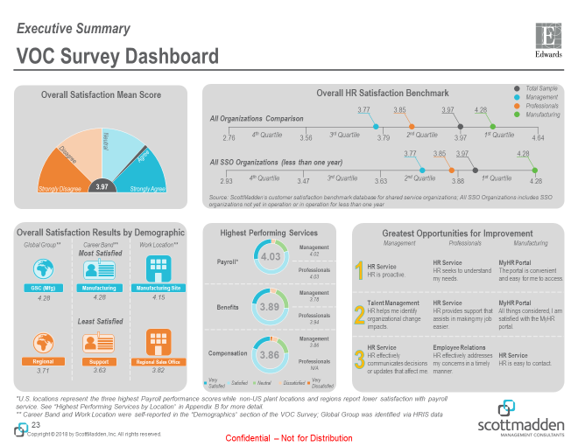
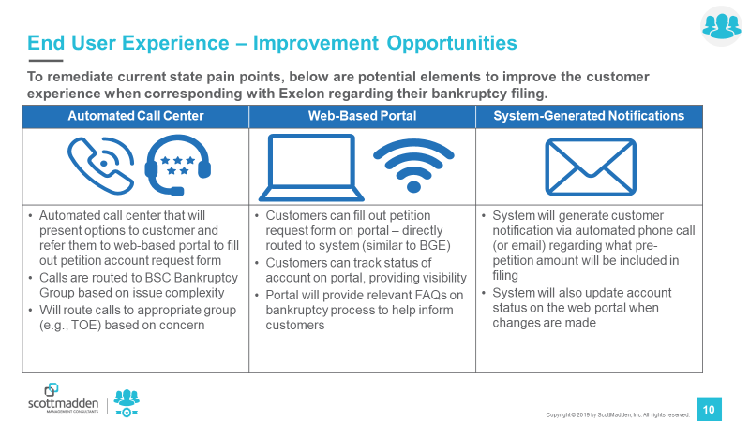
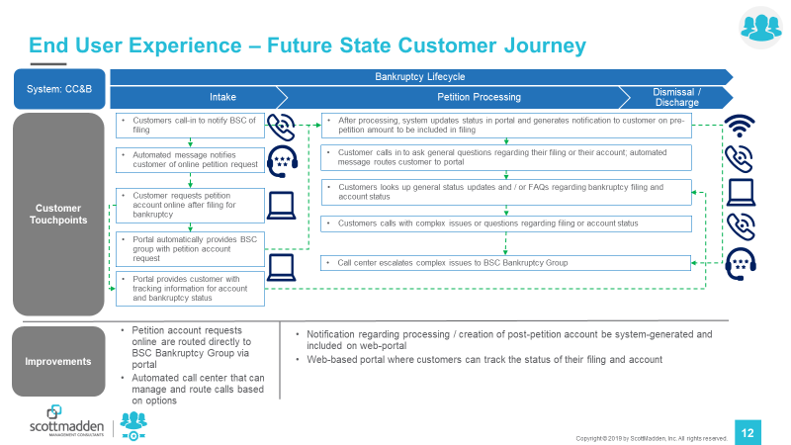
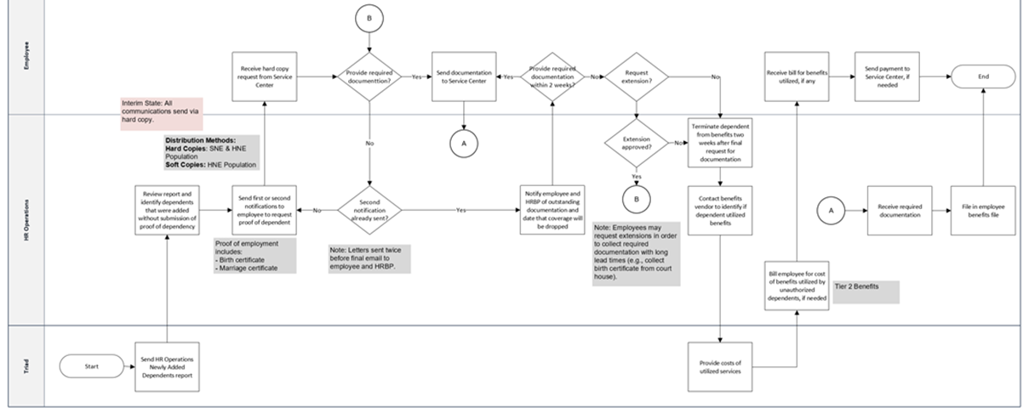
Adding User Experience (UX) to Traditional Process Design
Policy and Process
User experience is different from the traditional assessment and solutioning approaches. While still process-oriented, the customers are the focal point of the evaluation as opposed to the practitioners.
Traditional Assessment/Solutioning
User-Experience Assessment/Solutioning
  Volume and process data
  Stakeholder (practitioner/SME) interviews
  Process maps (visualize process)
  User-experience surveys (process focused)
  Customer interviews
  Journey maps (visualize customer actions and pain points)
Notes:
Let’s think about your normal process redesign. You’ll collect data on existing process performance, you’ll interview a couple SMEs about the process, if you’re a little more advanced you might have a survey. Then you construct a process map with SMEs, involve leadership where you need to address a couple particular pain points, validate it with stakeholders, and move to implementing. Am I right? And are all those parties involved usually within HR or some other corporate function? Yes, probably.
We’re going to take you through a few steps to insert into that traditional process that will vastly improve your processes and the satisfaction they receive.

Slide 41

Include Users in Design!
Policy and Process
A well-designed customer journey map, by persona (leaders, employees, etc.), is a great way to understand the user’s pain points, actions, and emotions.

Slide 42

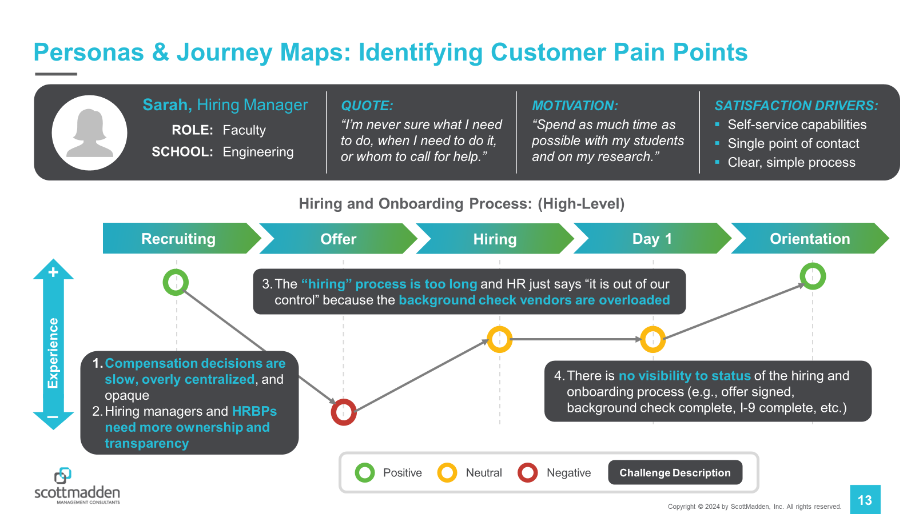
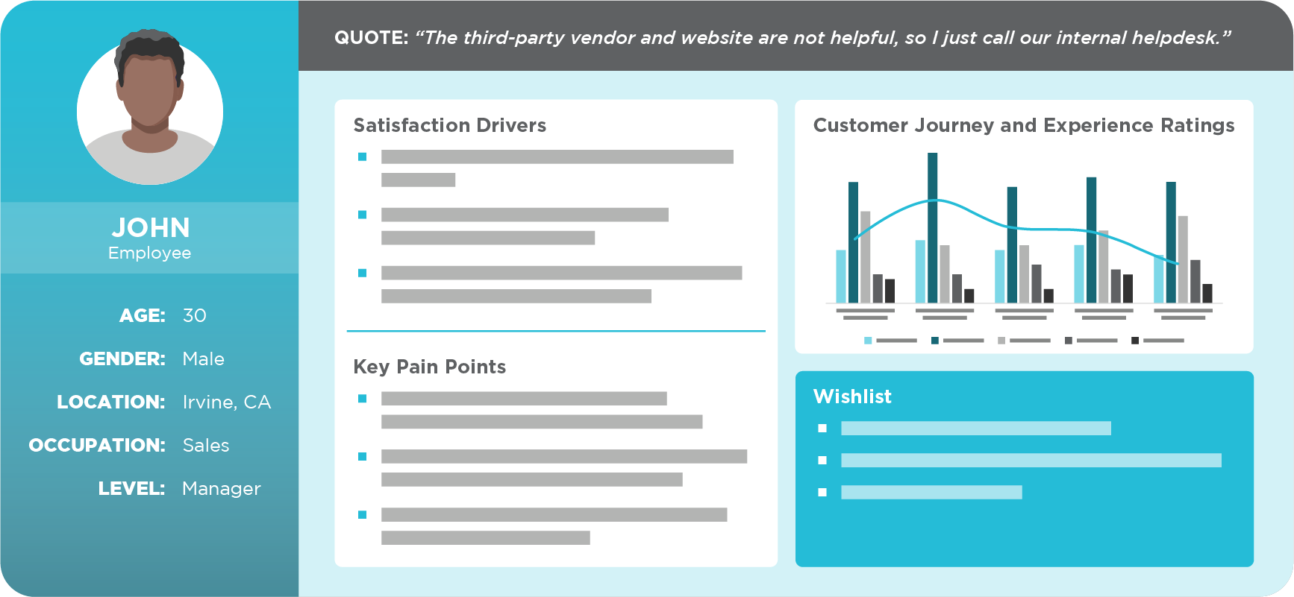
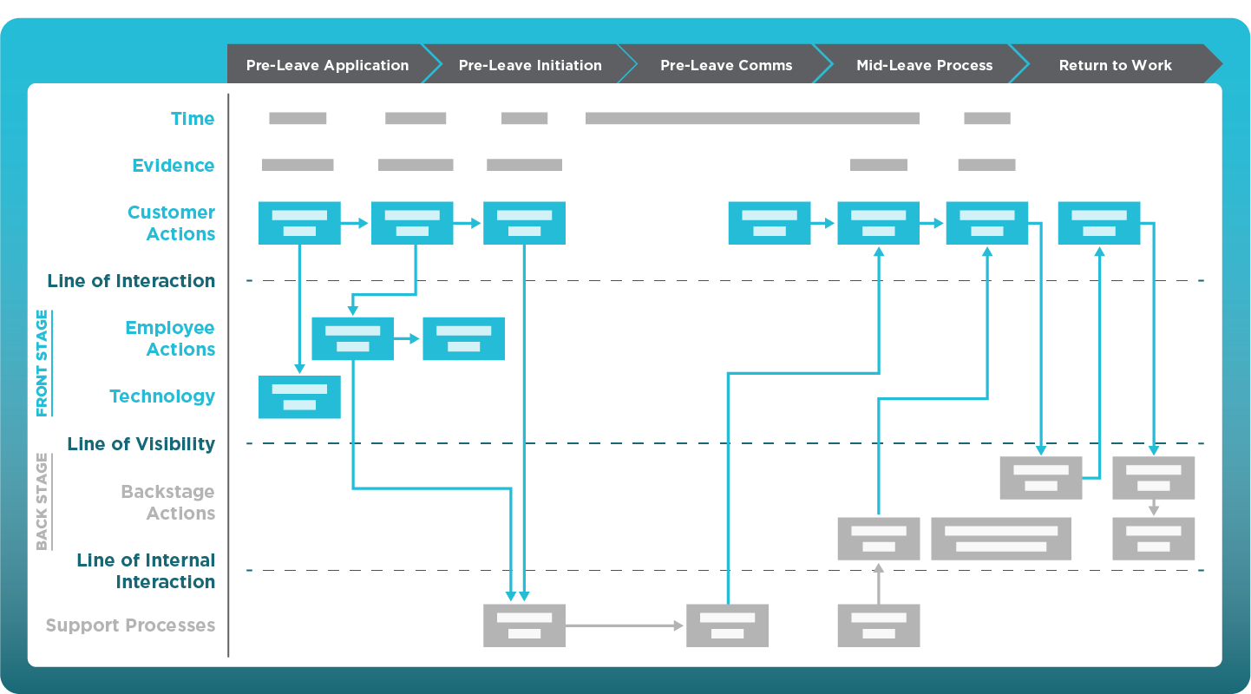
User Experience Design Key Steps
Policy and Process
Define Personas and Collect Information
Construct Journey Maps
by Persona
Service Blueprint
  Planning and research on users is the foundation of rethinking the process.
  Define the key stakeholders, or personas
  Collect data on the process; e.g., case data, customer satisfaction results, and administer process surveys
  Interview 3-5 people per persona
  Journey maps highlight the user experience, pain points, and opportunities for improvement.
  Break the process into high-level steps
  Rate experience at each step
  Call out key pain points
  Service blueprints provide an extra level of detail to support a user journey map.
  Add detail on customer actions, front stage actions, backstage actions, and support processes
User experience design should be incorporated into the traditional process design approach. Layer the journey maps into future state process maps before finalizing processes
41
Notes:
Define personas: These are not customer segments, but users of a service who’s emotions, goals, and objectives represent larger groups. For example, for the LOA process, you could start with two groups: employee with planned leave and employee with unplanned leave. Depending on your process, you might want to break it down by type of leave. That’s something you’ll adjust as you’re interviewing and collecting information.
Administer survey: Data is all methods, but if you have case data or customer satisfaction survey results, that’s great. We like to administer a UX survey. This is a less than 5 minute survey that’s focused on a particular process. For each step in the process, ask for levels of experience in each step, experience in each touchpoint with service delivery or systems, timing (how long did it take to complete), and free form comments.
Conduct interviews: Ideally 3-5 people per persona. You can do focus groups, but often individual interviews avoid group-think.
Construct journey maps: A journey map plots the experience of the customer across high-level process steps. So for the LOA process, your steps might be pre-leave application, pre-leave initiation, pre-leave communications, mid-leave process, return to work. Your interviews and survey data can be with these steps in mind. You’ll plot your average results, opportunities, and/or quotes underneath the steps. Note: Ideally you have quantitative data, but sometimes these maps are more qualitative. That’s ok.
Service blueprint: This is the stepping stone between journey mapping and traditional process maps, while maintaining focus on supporting the customer experience

Slide 43
Personas and Journey Maps: Identifying Customer Pain Points
Policy and Process
Sarah, Employee
QUOTE:
“The vendor and website are not helpful, so I just call our internal helpdesk regardless of my question.”
MOTIVATION:
“To be able to recover without concern over the LOA process and my LOA application status.”
SATISFACTION DRIVERS:
  Self-service capabilities
  Single point of contact
  Clear, simple process
LEVEL:
OCCUPATION:
PERSONA:
Manager
Sales
Unplanned LOA
Leave of Absence Process: (High-Level)
Pre-Leave Application
Pre-Leave Initiation
Pre-Leave Communications
Mid-Leave Process
Return to Work
+
3. Instructions were inconsistent and made it confusing to understand who I was supposed to talk to about RTW.
Experience
1. The portal solutions are unhelpful, and when I called the contact center, no one could answer my question and bounced me around.
2. I didn’t receive the decision until three days after I went out on LOA. The denial notification was also a threatening tone and unhelpful regarding next steps.
–
Positive
Neutral
Negative
Challenge Description

Slide 44
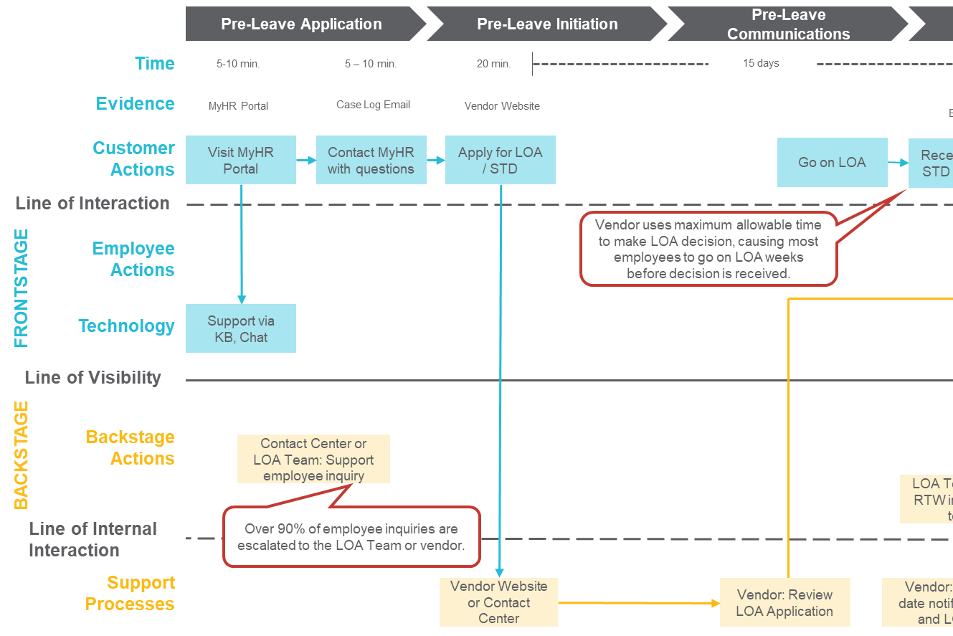
Service Blueprint: How It Works
Policy and Process
The key elements in every service blueprint include:
1
  Customer Actions
  Actions completed by the customer or actions/notifications resulting from other parts of the process (e.g., “Receive LOA decision”)
  Frontstage
  Actions from the customer support or technology interfaces (e.g., direct access) that the customer can see or interact with
  Backstage
  Actions from customer support, vendors, etc. that are not visible to the customer but support the frontstage activities
  Support Processes
  Processes that support the internal team or vendors in supporting the service delivery
1
2
2
3
3
4
4
Notes:
Think of the service blueprint as your pair to go with your journey map. Again, it’s very similar to a process map, but its customer experience focused. What that means is you’re easily able to tell which steps are more important to the user experience. This helps when you have some process lumps that are backstage; you can spend less time debating them.

Slide 45
User Experience Design Is Worth It
Policy and Process
While including users into process design may seem like more work, it is worth it.
Benefits of UX Design
Discover pain points and solutions
Create processes that make sense to all parties involved
Get to know your customer better
Establish a perception with your customer that you are working hard to alleviate challenges
Customers appreciate being involved and are often flattered that you chose them. Be respectful of their time and professional and your interaction will be a positive one.

Slide 46

Technology and Data
Discuss Supporting
Technologies
Explore Intelligent
Automation
Deep Dive into
Data and Analytics

Slide 47


Supporting Technologies Maturity Curve
Technology and Data
As organizations invest in solutions, they should ensure they are moving up the maturity curve
Consumer-grade solutions are desired by employees
A well-designed and integrated suite of solutions enhances the employe experience,
increases efficiency and productivity, and improves communication

Slide 48
Suite of Customer Self-service Tools
Technology and Data
Customer Inquiry Methods (Phone, Chat, Email)
Multichannel Management
ID, Authenticate, Route, Queue (Phone, Chat, E-mail)
Web Forms/
Self-service
Case Management System
Track, Respond to, Resolve Cases
Leaders, Employees, etc.
Inquiry Methods
Policy/
Process Content
Knowledgebase
Research Answers, Improve Enterprise Portal Content
Customer Care
ESS/MSS
Provide Support
for Self-service
Web Forms
HCM/HRIS
View Data, Perform Transactions
Web Reports
Ancillary HR Systems
Assist/Complete Transactions
Links
Employee Information
Employee Personnel Files
Retrieve and View Documents
Links
Vendor Sites
Notes:
Leverage and Align Shared Services Technologies
These are the technologies that support the infrastructure required to provide top-level service
We often find that institutions have old/archaic systems which results in challenges to the overall model. Make sure you prioritize technologies – now if planning and put on the road map, even if you’ve already implemented.
Example – U of S – tailored their IT system (BMC Footprint); after 18 months transitioned
Philosophy of Service → Supporting Technologies
Customer First → One number, one portal, one email; Answers from a knowledgebase relevant to caller
Efficient, Self-Directed Work Teams → Sharing of work through case management; Increased accountability due to case management system
Performance Driven → Metrics gathered through integrated channel management and through case management
Technology Driven → Integrated technologies that reuse information and data
Continuous Improvement → Flexible technologies that will grow

Slide 49
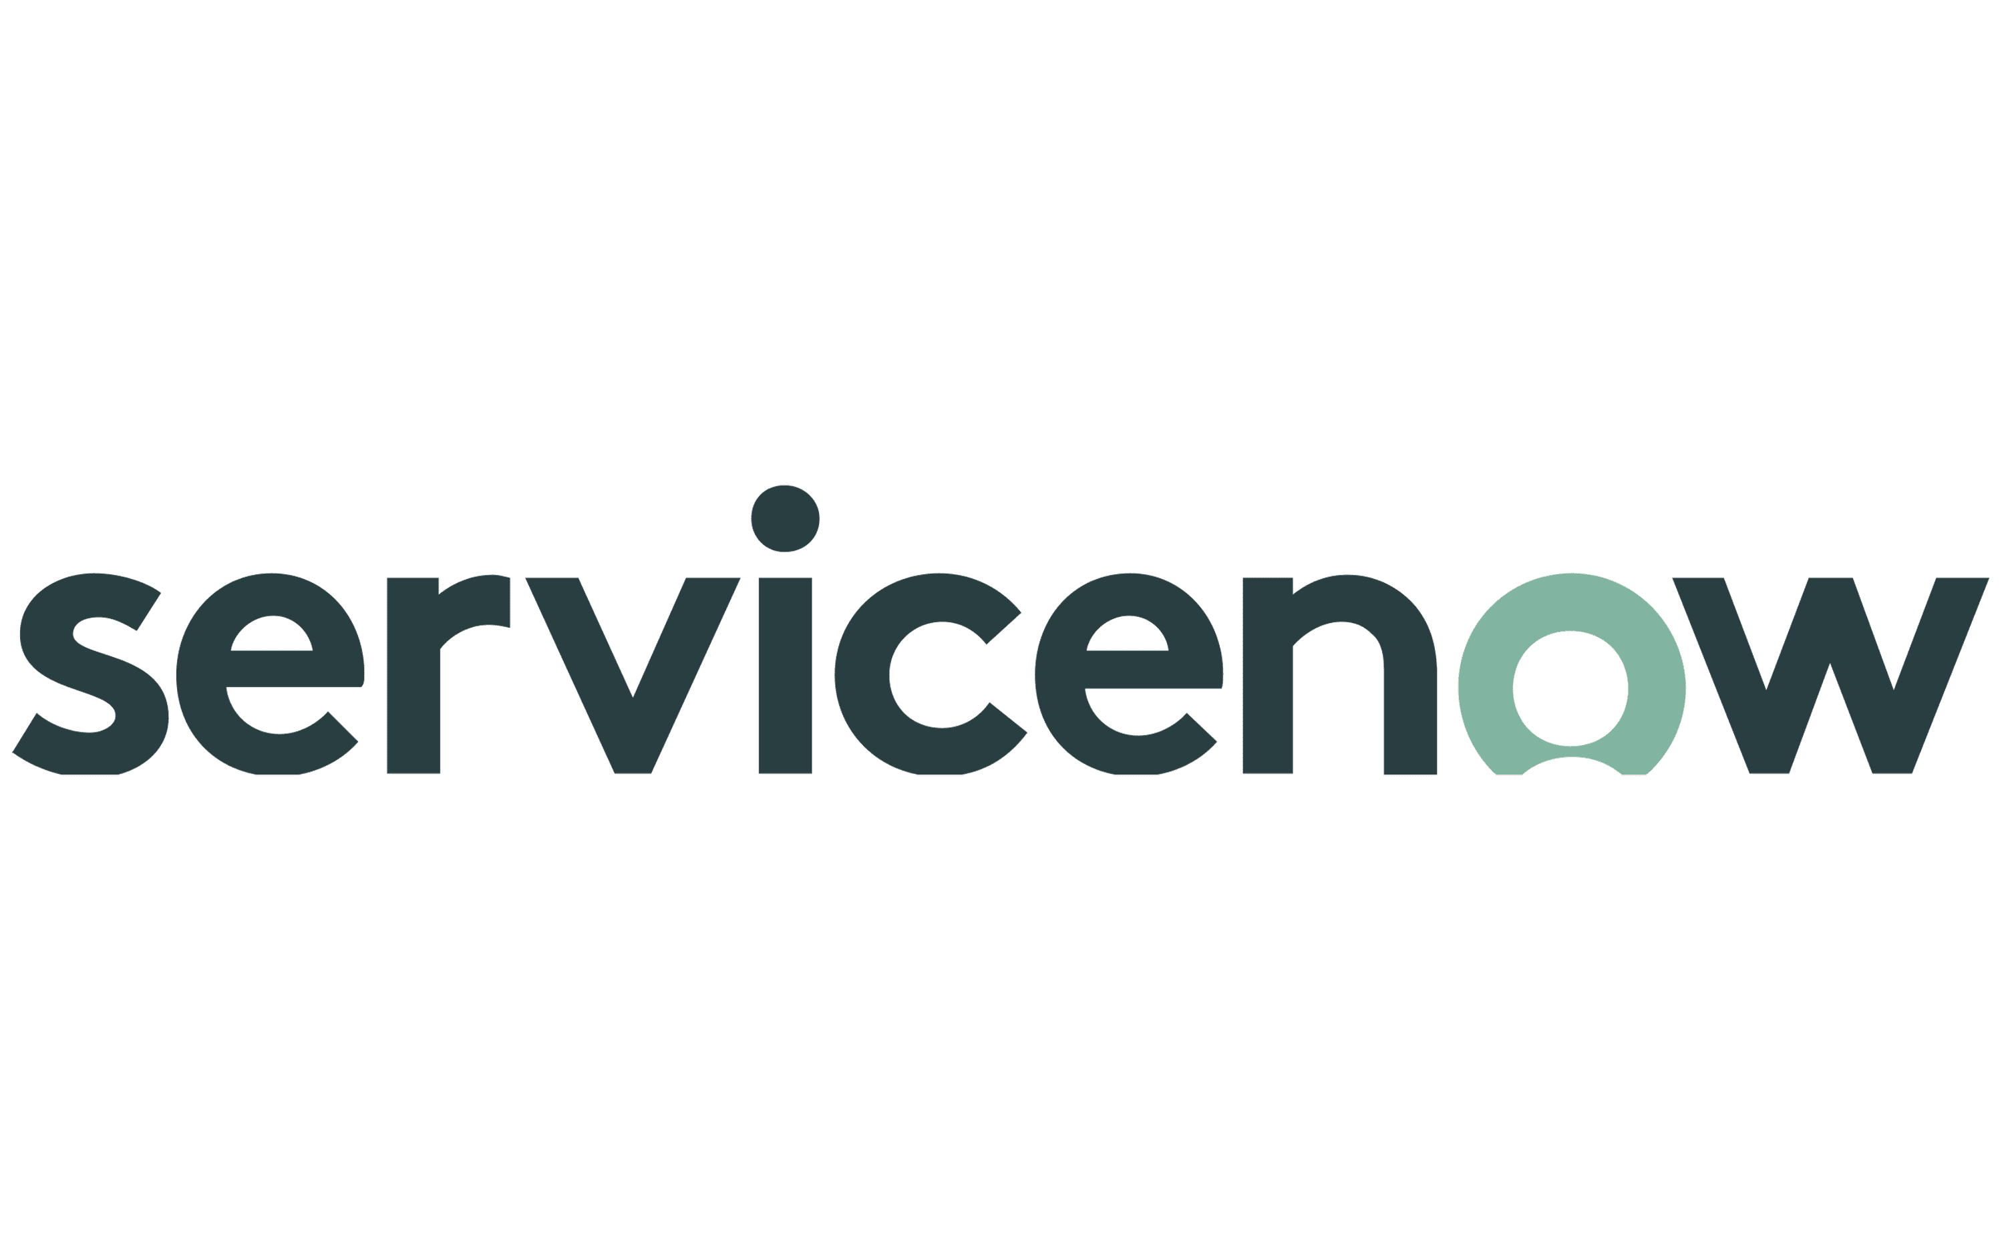

Suite of Customer Self-service Tools
Technology and Data
Customer Inquiry Methods (Phone, Chat, Email)
Multichannel Management
ID, Authenticate, Route, Queue (Phone, Chat, E-mail)
+ many more
Web Forms/
Self-service
Case Management System
Track, Respond to, Resolve Cases
Leaders, Employees, etc.
Inquiry Methods
Policy/
Process Content
Knowledgebase
Research Answers, Improve Enterprise Portal Content
Customer Care
ESS/MSS
Provide Support
for Self-service
Web Forms
HCM/HRIS
View Data, Perform Transactions
Web Reports
Ancillary HR Systems
Assist/Complete Transactions
Links
Employee Information
Employee Personnel Files
Retrieve and View Documents
Links
Vendor Sites
Notes:
Leverage and Align Shared Services Technologies
These are the technologies that support the infrastructure required to provide top-level service
We often find that institutions have old/archaic systems which results in challenges to the overall model. Make sure you prioritize technologies – now if planning and put on the road map, even if you’ve already implemented.
Example – U of S – tailored their IT system (BMC Footprint); after 18 months transitioned
Philosophy of Service → Supporting Technologies
Customer First → One number, one portal, one email; Answers from a knowledgebase relevant to caller
Efficient, Self-Directed Work Teams → Sharing of work through case management; Increased accountability due to case management system
Performance Driven → Metrics gathered through integrated channel management and through case management
Technology Driven → Integrated technologies that reuse information and data
Continuous Improvement → Flexible technologies that will grow

Slide 50



Suite of Customer Self-service Tools
Technology and Data
Customer Inquiry Methods (Phone, Chat, Email)
Multichannel Management
ID, Authenticate, Route, Queue (Phone, Chat, E-mail)
Web Forms/
Self-service
Case Management System
Track, Respond to, Resolve Cases
Leaders, Employees, etc.
Inquiry Methods
Policy/
Process Content
Knowledgebase
Research Answers, Improve Enterprise Portal Content
Customer Care
ESS/MSS
+ many more
Web Forms
Provide Support
for Self-service
HCM/HRIS
View Data, Perform Transactions
Web Reports
Ancillary HR Systems
Assist/Complete Transactions
Links
Employee Information
Employee Personnel Files
Retrieve and View Documents
Links
Vendor Sites
Notes:
Leverage and Align Shared Services Technologies
These are the technologies that support the infrastructure required to provide top-level service
We often find that institutions have old/archaic systems which results in challenges to the overall model. Make sure you prioritize technologies – now if planning and put on the road map, even if you’ve already implemented.
Example – U of S – tailored their IT system (BMC Footprint); after 18 months transitioned
Philosophy of Service → Supporting Technologies
Customer First → One number, one portal, one email; Answers from a knowledgebase relevant to caller
Efficient, Self-Directed Work Teams → Sharing of work through case management; Increased accountability due to case management system
Performance Driven → Metrics gathered through integrated channel management and through case management
Technology Driven → Integrated technologies that reuse information and data
Continuous Improvement → Flexible technologies that will grow

Slide 51
Suite of Customer Self-service Tools
Technology and Data
Customer Inquiry Methods (Phone, Chat, Email)
Multichannel Management
ID, Authenticate, Route, Queue (Phone, Chat, E-mail)
Web Forms/
Self-service
Case Management System
Track, Respond to, Resolve Cases
Leaders, Employees, etc.
Inquiry Methods
Policy/
Process Content
Knowledgebase
Research Answers, Improve Enterprise Portal Content
Customer Care
Benefit providers
Learning and development
ESS/MSS
Provide Support
for Self-service
Web Forms
+ many more
HCM/HRIS
View Data, Perform Transactions
Web Reports
Ancillary HR Systems
Assist/Complete Transactions
Links
Employee Information
Employee Personnel Files
Retrieve and View Documents
Links
Vendor Sites
Notes:
Leverage and Align Shared Services Technologies
These are the technologies that support the infrastructure required to provide top-level service
We often find that institutions have old/archaic systems which results in challenges to the overall model. Make sure you prioritize technologies – now if planning and put on the road map, even if you’ve already implemented.
Example – U of S – tailored their IT system (BMC Footprint); after 18 months transitioned
Philosophy of Service → Supporting Technologies
Customer First → One number, one portal, one email; Answers from a knowledgebase relevant to caller
Efficient, Self-Directed Work Teams → Sharing of work through case management; Increased accountability due to case management system
Performance Driven → Metrics gathered through integrated channel management and through case management
Technology Driven → Integrated technologies that reuse information and data
Continuous Improvement → Flexible technologies that will grow

Slide 52
Level of Technology Advancement in Shared Services
Technology and Data
Which best describes your organization’s
use of an employee portal?
What extent is shared services organization using intelligent automation opportunities?
Portal with static,
non-personalized
content
Top Performer Group
Comparison Group
Not using
Thinking about using
Conducting pilot to validate utility
Implemented
Not sure
Do not use
Portal with personalized
content with system integration
Sources: 2023 ScottMadden and APQC HR Shared Services Benchmarking Study
2022 ScottMadden and APQC Finance Shared Services Benchmarking Study
Notes:
A key enabler for SS is having a robust ee portal. Aspects that are important are the ability to provide personalized content and integrating with your HR systems so that employees can easily view information and initiate or perform basic transactions.
82% of all participants have a robust portal and 86% of top performing SSOs have a robust portal
TP also have higher usage of their portals, which ties back to lower Tier 1 staffing.

Slide 53
Intelligent Automation’s (IA) Impact on Organizations over the Years
Technology and Data
In recent years, corporate services has witnessed a significant adoption of IA technologies to streamline operations, automate repetitive tasks, and improve customer interactions.
Chatbots
Predictive AI
Chatbots for basic inquiries and support
Pattern recognition for decision support and discrepancy insight
2015
2016
2018
2019
2023
RPA
Conversational Agents
Generative AI
Integration with enterprise systems for end-to-end process automation
Cognitive query handling and personalized assistance
Content production, customer and market insight, better scenario playing
These solutions are becoming more and more and more integrated enhancing automation by
combining task execution, data analysis, and user interaction for more efficient and intelligent workflows.

Slide 54
What Is Different about Generative AI?
Technology and Data
Generative AI refers to a type of artificial intelligence that can create new content, such as text, images, audio, and video content, by learning from existing data patterns. It expands AI capabilities to generate realistic and creative outputs.
Generate dynamic and context-specific responses for chatbot
Language
Marketing (Content), Reporting, Training, Code Development, Gene Sequencing
Generate voiceovers for
videos, presentations, and audio recordings
Create personalized marketing content and campaigns
Visual
Video Generation, 3D Models, Design, Image Generation
Auditory
Audio Generation Transcription, Voice Recognition
Produce natural-sounding speech for voice-based customer interactions
Improve the accuracy of
image recognition systems
Create unique and realistic images for visual content
And more…
Notes:
Data integration – Narrative AI

Slide 55


Slide 56
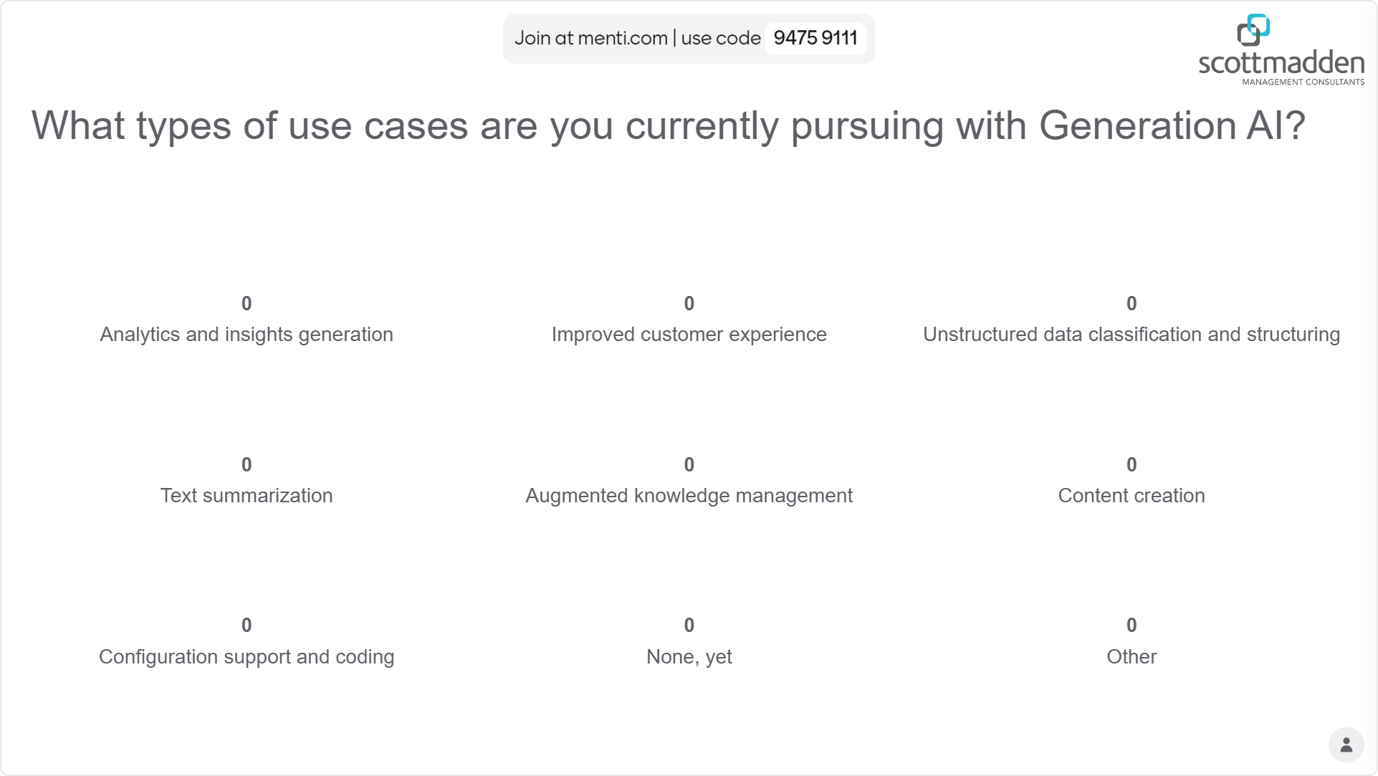
Live Poll!
Technology and Data
What types of use cases are you currently pursuing with Generation AI?

Slide 57

Robust Continuous Improvement and Analytics Functions
Technology and Data
Continuous improvement is the backbone of shared services, driving efficiency, elevating service quality, and creating sustained organizational value.
Notes:
Continuous improvement, powered by analytics, is the backbone of shared services, turning data insights into actionable enhancements that drive efficiency, elevate service quality, and create sustained organizational value

Slide 58
Operations Excellence (Continuous Improvement) Team
Technology and Data
Operations Excellence team responsibilities include:
  Supporting the service delivery model by identifying opportunities to enhance service center quality and improving processes and performance
  Assisting with special projects (e.g., enhancing service center technologies, improving processes, developing/delivering educational programs to the broader staff)
  Ensuring delivery quality and consistency across the service center organization
  Provides data-driven insights and reporting capabilities to inform strategic decisions and measure performance
  Insight Generation
  Issue Identification
  KPI Monitoring
  Dashboard Development
Operations Excellence
Team Core Competencies
  Advanced analytical and communication skills to
  support strategic initiatives
  Knowledge of markets/sectors
  and employee population needs
  Strategic thinking
  Advisement skills
  Focuses on streamlining and optimizing shared services processes
  Execution Excellence
  Documentation Maintenance
Operations Excellence
Process Improvement
Data and Analytics
Tools
  Manages the transition and adoption of new processes, systems, or structures
  Service Center Comms
  to Employees
  Internal Training Activities
  Maintains the knowledge repository, etc.
  Knowledgebase Management
  Report Management
Organizational Change Management

Slide 59
Operations Excellence (Continuous Improvement) Team
Technology and Data
Operations Excellence team responsibilities include:
  Supporting the service delivery model by identifying opportunities to enhance service center quality and improving processes and performance
  Assisting with special projects (e.g., enhancing service center technologies, improving processes, developing/delivering educational programs to the broader staff)
  Ensuring delivery quality and consistency across the service center organization
  Provides data-driven insights and reporting capabilities to inform strategic decisions and measure performance
  Insight Generation
  Issue Identification
  KPI Monitoring
  Dashboard Development
Operations Excellence
Team Core Competencies
  Advanced analytical and communication skills to
  support strategic initiatives
  Knowledge of markets/sectors
  and employee population needs
  Strategic thinking
  Advisement skills
  Focuses on streamlining and optimizing shared services processes
  Execution Excellence
  Documentation Maintenance
Operations Excellence
Process Improvement
Data and Analytics
Tools
  Manages the transition and adoption of new processes, systems, or structures
  Service Center Comms
  to Employees
  Internal Training Activities
  Maintains the knowledge repository, etc.
  Knowledgebase Management
  Report Management
Organizational Change Management

Slide 60

Data and Analytics
Technology and Data
Only 29% of respondents say they are good or very good at making positive changes based on people analytics…
Source: HR.Research Institute 2021

Slide 61
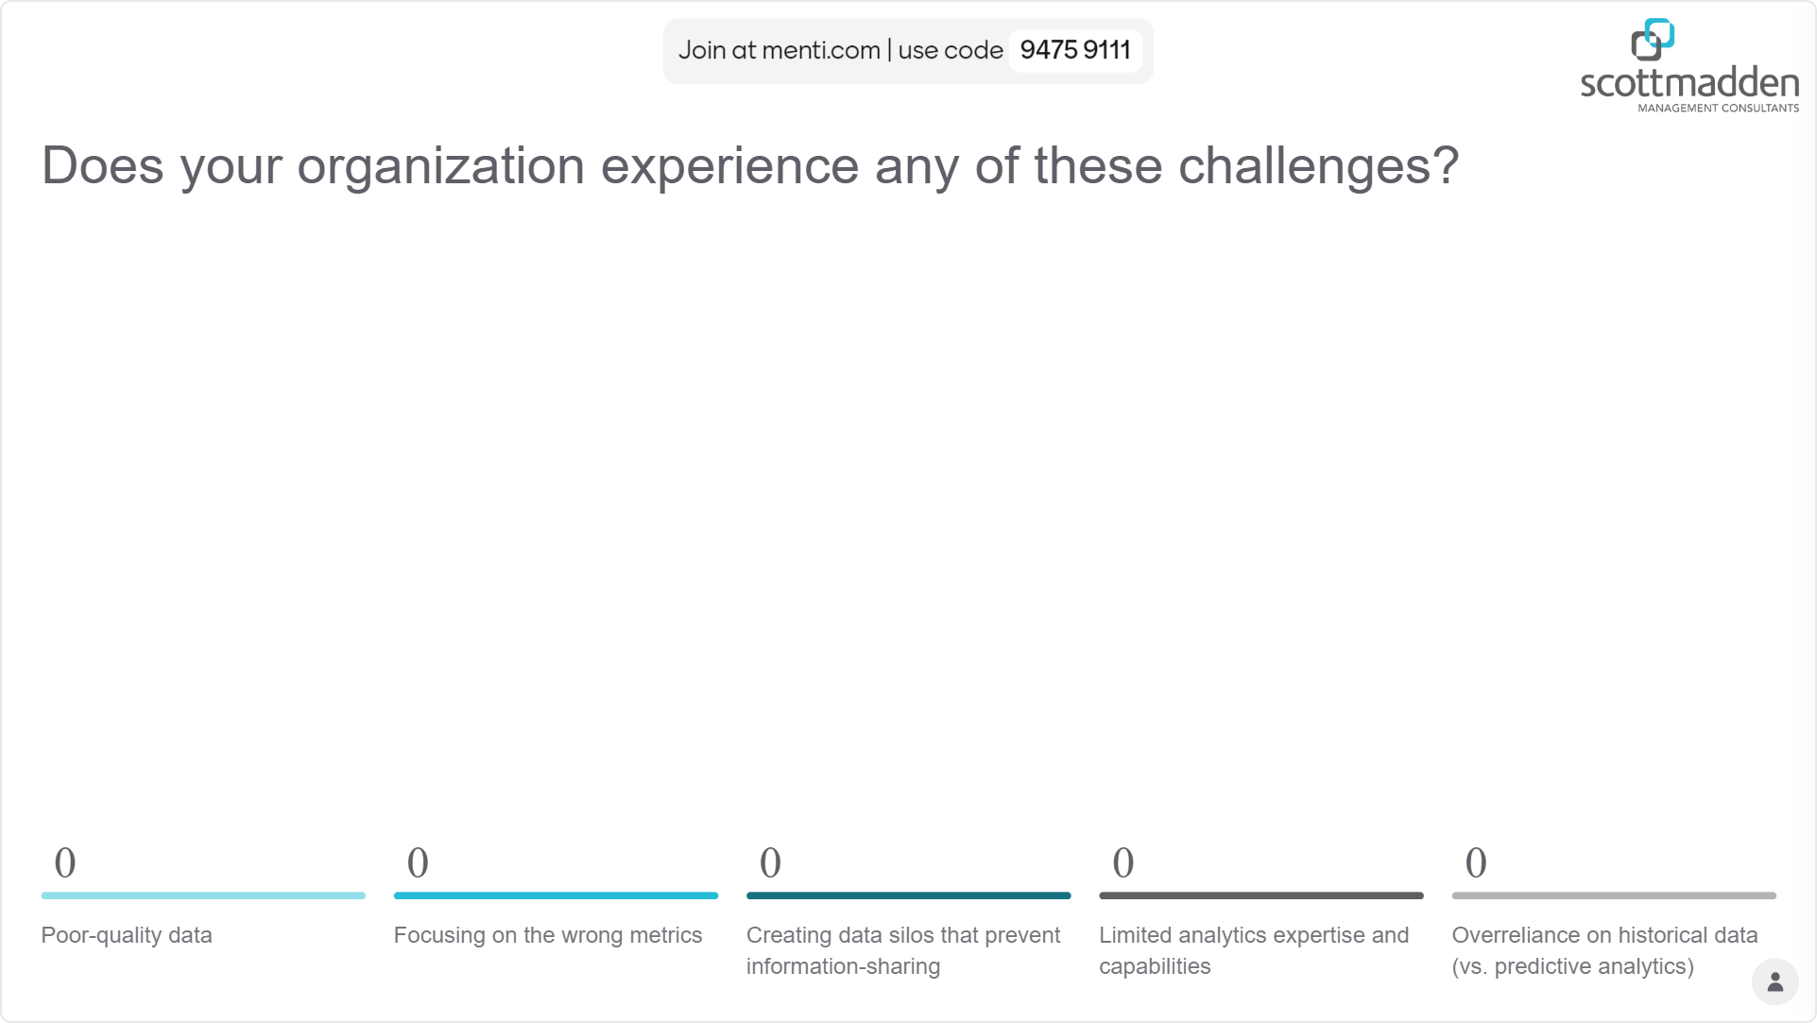
Live Poll!
Technology and Data
Does your organization experience any of these challenges?

Slide 62

Data and Analytics Functions Are Growing
Technology and Data
The People Analytics Trends 2023 study found that people analytics functions have grown by 43% on average between 2020 and 2023, with 90% of companies increasing or maintaining the size of their people analytics teams.
Source: HR.Research Institute 2021

Slide 63
Success Factors for Data and Analytics Functions
Technology and Data
Align Analytics with Business Strategy
Cultivate a Data-driven Culture
Democratize Access to
Reports and Dashboards
Develop a robust framework
Connect HR analytics with broader organizational goals
Establish KPIs that drive measurable impact on business outcomes and demonstrate the value of HR initiatives
Foster a culture that prioritizes data-driven decision-making
Encourage HR professionals to leverage analytics in their strategies and daily operations
Implement user-friendly reporting tools and interactive dashboards
Empower HR staff and leaders to independently access and analyze data
Promote transparency
Foster a collaborative environment for data-driven decision-making

Slide 64
Data and Analytics Function Maturity Curve
Technology and Data
Business Value
Strategic
Embeds advanced analytics and AI across the organization, driving data-driven culture and aligning people insights directly with business goals
Proactive
Utilizes predictive analytics to forecast trends, offering
insights that
support strategic decision-making
Reactive
Expands to descriptive analytics, addressing business questions as they arise and beginning to track key HR metrics
Foundational
Basic reporting capabilities are in place, with a focus on operational metrics and compliance
Time

Slide 65
Data and Analytics Function Maturity Curve
Technology and Data
Most People Analytics Functions are in these
stages of maturity
Business Value
Strategic
Embeds advanced analytics and AI across the organization, driving data-driven culture and aligning people insights directly with business goals
Proactive
Utilizes predictive analytics to forecast trends, offering insights that support strategic decision-making
Reactive
Expands to descriptive analytics, addressing business questions as they arise and beginning to track key HR metrics
Foundational
Basic reporting capabilities are in place, with a focus on operational metrics and compliance
Time

Slide 66
Data and Analytics Function Maturity Curve
Technology and Data
“Too many reports”
“Too much data”
“What should I be taking away?”
Business Value
Strategic
Embeds advanced analytics and AI across the organization, driving data-driven culture and aligning people insights directly with business goals
Proactive
Utilizes predictive analytics to forecast trends, offering
insights that
support strategic decision-making
Reactive
Expands to descriptive analytics, addressing business questions as they arise and beginning to track key HR metrics
Foundational
Basic reporting capabilities are in place, with a focus on operational metrics and compliance
Time

Slide 67
Data and Analytics Function Maturity Curve
Technology and Data
“Forward looking!”
“Insightful”
“Easy to digest”
Business Value
Strategic
Embeds advanced analytics and AI across the organization, driving data-driven culture and aligning people insights directly with business goals
Proactive
Utilizes predictive analytics to forecast trends, offering
insights that
support strategic decision-making
Reactive
Expands to descriptive analytics, addressing business questions as they arise and beginning to track key HR metrics
Foundational
Basic reporting capabilities are in place, with a focus on operational metrics and compliance
Time

Slide 68
Data and Analytics Function Maturity Curve
Technology and Data
“Wow – we are integrating insights into broader business planning!”
…anticipating future workforce needs based on projected business growth areas, using predictive models to identify skill gaps and workforce risks, etc.
Business Value
Strategic
Embeds advanced analytics and AI across the organization, driving data-driven culture and aligning people insights directly with business goals
Proactive
Utilizes predictive analytics to forecast trends, offering
insights that
support strategic decision-making
Reactive
Expands to descriptive analytics, addressing business questions as they arise and beginning to track key HR metrics
Foundational
Basic reporting capabilities are in place, with a focus on operational metrics and compliance
Time

Slide 69
Process for Selecting Metrics and Setting Targets
Technology and Data
Information must be gathered when identifying metrics and setting targets.
Gather Stakeholder Input
Select Metrics
Collect and Review Historical Data
Set Targets
Assess Results and Improve
Work performed by the function
Relevant strategic priorities
Key audiences for performance discussions
Relevant metrics:
  Team and individual productivity
  Function’s impact on the business
  Etc.
Analytics available today
Relevant time periods, seasonality, or trends
Impacts of external business drivers to the function
  Metrics identified that should have targets and acceptable targets documented
  External benchmarks are assessed for relevance
Metrics/targets assessed:
  Represent expected performance?
  Support business decisions?
  Meet stakeholder needs?
  Etc.
Operations Excellence team should work in partnership with the functions throughout the process

Slide 70
Metrics Should Address Multiple Objectives
Technology and Data
Leaders should select multiple, comprehensive metrics. Every metric does not need a target.
Productivity and Efficiency
Volumes of activities or tickets processed
Volumes per period, per FTE, per cost/revenue
Process cycle times or aging
Quality and
Reliability
Success rates of meeting service level agreements or other goals
Customer satisfaction results or other qualitative results
Error rates (per 1,000 transactions, etc.)
Service Value
Impacts to employees, user experience, or downstream internal business partners
Revenue increase, cost reduction, or cost avoidance
Strategic Initiatives
Direct impacts to strategic initiatives, e.g., revenue-enhancing RPA/AI
Other leadership priorities
Performance against targets should inform leaders how well the function is performing

Slide 71
Metrics and Dashboards Should Be Segmented by Audience
Technology and Data
Avoid a one-size-fits-all approach—different audiences have different needs that should be addressed by different sets of metrics and dashboards.
OPERATIONAL
Day-to-day performance metrics
Enable teams to work efficiently, leveraging indicators
Examples: Task completion rates, error rates, response times, etc.
MANAGEMENT
Subset of operational data
Provide visibility into performance and emerging trends
Examples: Summary view of
operational metrics
EXECUTIVE
Strategic, high-level metrics
Enable leaders to assess shared services’ contribution to overall organizational goals
Examples: Cost savings, strategic impact, and service level achievements
Segmenting metrics allows empowered functional decision-making
while elevating the pulse of the business to leadership

Slide 72
Dashboard Design Principles
Technology and Data
Users have a great experience viewing dashboards, when the dashboards include the following attributes:
SIMPLE
RELEVANT
INTERACTIVE
Clean and uncluttered
Calculations defined and labels concise
Visualizations highlight “key takeaways”
(e.g., graphs, tables, icons)
Dashboards tailored by audience
Metrics align with strategic objectives and operational goals
Context provided on benchmarks, targets, etc.
Drill-down capabilities enable investigation
Simple narratives provide context, explanations, and/or recommendations
Interactivity balanced with simplicity

Slide 73










Example – Executive Dashboard
Technology and Data
Illustrative metrics that could shape an executive-level, on-demand dashboard.
Executive Summary and Key Highlights
Total Salary Expenses
Engagement Score
Number of Arbitrations
Headcount
X
Hires
X
Terms
X
$XX M
XX
Workforce Composition
Time-to-Fill
Labor-related Expenses
Defined Contribution
Markets
Contract/Employee
Part-Time/Full-Time
Average
Benefits
Supplemental Pay
Sacramento
San Fran
Employee
Full-Time
Wages &
Salary
Paid Leave
Target
Santa Rosa
Part-Time
Insurance
Modesto
Contract
Turnover
Service Delivery
Diversity and Inclusion
Resolution Rate
Escalation Rate
CSAT
Average
X%
X%
X.X
Gender Identity
Background
Tenure (years)
Clinical
10+
%
%
1 - 5
Target
Average Time to Resolve a Case
X hours
Non-Clinical
%
%
Female
5 - 10
< 1
Male
Other
72

Slide 74
Example – Executive Dashboard
Technology and Data
Easy for executives to see key takeaways
Illustrative metrics that could shape an executive-level, on-demand dashboard.
Executive Summary and Key Highlights
Total Salary Expenses
Engagement Score
Number of Arbitrations
Headcount
X
Hires
X
Terms
X
$XX M
XX
Workforce Composition
Time-to-Fill
Labor-related Expenses
Defined Contribution
Markets
Contract / Employee
Part-Time/Full-Time
Average
Benefits
Supplemental Pay
Sacramento
San Fran
Employee
Full-Time
Wages &
Salary
Paid Leave
Target
Santa Rosa
Part-Time
Insurance
Modesto
Contract
Turnover
Service Delivery
Diversity and Inclusion
Resolution Rate
Escalation Rate
CSAT
Average
X%
X%
X.X
Gender Identity
Background
Tenure (years)
Clinical
10+
%
%
1 - 5
Target
Average Time to Resolve a Case
X hours
Non-Clinical
%
%
Female
5 - 10
< 1
Male
Other
73

Slide 75
Example – Executive Dashboard
Technology and Data
Illustrative metrics that could shape an executive-level, on-demand dashboard.
Executive Summary and Key Highlights
Total Salary Expenses
Engagement Score
Number of Arbitrations
Headcount
X
Hires
X
Terms
X
$XX M
XX
Workforce Composition
Time-to-Fill
Labor-related Expenses
Targets vs. actuals
highlighted
Targets vs. actuals
highlighted
Defined Contribution
Markets
Contract / Employee
Part-Time/Full-Time
Average
Benefits
Supplemental Pay
Sacramento
San Fran
Employee
Full-Time
Wages &
Salary
Paid Leave
Target
Santa Rosa
Part-Time
Insurance
Modesto
Contract
Turnover
Service Delivery
Diversity and Inclusion
Resolution Rate
Escalation Rate
CSAT
Average
X%
X%
X.X
Gender Identity
Background
Tenure (years)
Clinical
10+
%
%
1 - 5
Target
Average Time to Resolve a Case
X hours
Non-Clinical
%
%
Female
5 - 10
< 1
Male
Other
74

Slide 76
Example – Executive Dashboard
Technology and Data
Illustrative metrics that could shape an executive-level, on-demand dashboard.
Executive Summary and Key Highlights
Total Salary Expenses
Engagement Score
Number of Arbitrations
Headcount
X
Hires
X
Terms
X
$XX M
XX
Workforce Composition
Time-to-Fill
Labor-related Expenses
Key service delivery metrics summarized clearly
Defined Contribution
Markets
Contract / Employee
Part-Time/Full-Time
Average
Benefits
Supplemental Pay
Sacramento
San Fran
Employee
Full-Time
Wages &
Salary
Paid Leave
Target
Santa Rosa
Part-Time
Insurance
Modesto
Contract
Turnover
Service Delivery
Diversity and Inclusion
Resolution Rate
Escalation Rate
CSAT
Average
X%
X%
X.X
Gender Identity
Background
Tenure (years)
Clinical
10+
%
%
1 - 5
Target
Average Time to Resolve a Case
X hours
Non-Clinical
%
%
Female
5 - 10
< 1
Male
Other
75

Slide 77
What’s Next? … Here’s Five Things to Do
1.
Revamp your shared services strategy. Is there an opportunity in this climate to leverage your shared services operations as a catalyst for scale?
5.
Consider ScottMadden and our SSO Accelerator tool for an assessment that will generate recommendations to boost the value of your shared services organization.
3.
Consider the impact of technology to major decisions, including your expansion strategy, service delivery model, BPO contracts, and system implementations.
2.
Focus on innovations to shared services that enable efficiency, agility, and scale – all while maintaining or improving customer service.
4.
Create an inclusion strategy that builds a strong corporate culture and improves employee engagement.

Slide 78

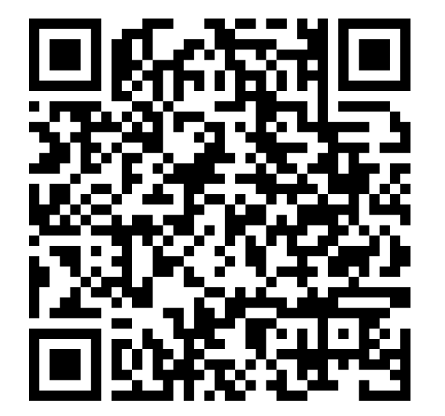
Wrapping Up
HOUSEKEEPING ITEMS
  Complete SSON’s workshop evaluation form to help us improve
  Request access to our complete workshop presentation
STOP BY SCOTTMADDEN’S BOOTH
  Drop a card to gain access to shared services insights and helpful resources
Download our presentation:
HEAR FROM ONE OF OUR CLIENTS
  Presentation Topic: How HR Led the Enterprise in Assessment of Workforce Efficiency
  Speaker: BrandSafway
  Thursday, November 14th at 9:55-10:45
Thank you for participating in today’s workshop and enjoy the rest of the conference!

Slide 79



Contact US

