Slide 1
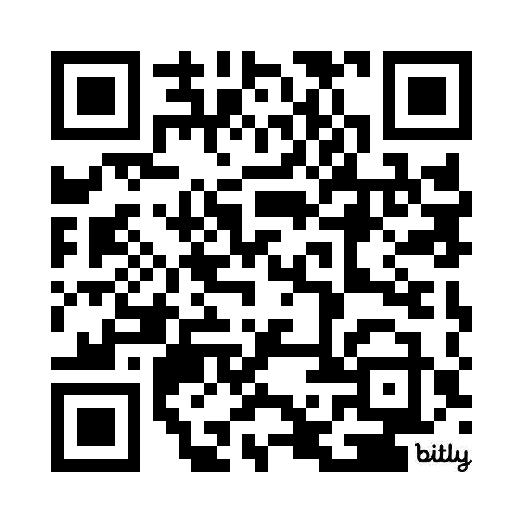

ScottMadden’s Corporate & Shared Services Practice
For digital access to this presentation as well as additional published ScottMadden content, please click the QR code.
Finance and Accounting Capabilities
October 2024

Slide 2

Who We Are
About ScottMadden
CORPORATE & SHARED SERVICES
ScottMadden is a management consulting firm with more than
40 years of deep, hands-on experience.
Experience
Our experienced team has been a pioneer in corporate
and shared services since the practice began decades ago.
We employ deep, cross-functional expertise to produce practical, measurable solutions.
Scope
We have completed thousands of projects since the early ’90s, including hundreds of large, multi-year implementations. Our clients range across a variety of industries from energy to healthcare to higher education to retail. Our areas of expertise span the spectrum of middle and back office corporate and shared services.
We deliver a broad array of corporate and shared services consulting services—from strategic planning through implementation—across many industries, business units, and functions.
Our knowledge, expertise, and experience are unmatched—no other firm has helped more clients with more unique solutions.
Services
We have helped our clients with assessment, strategy, design, implementation, technology, business case and roadmap, governance, program management, and change management.

Slide 3
Areas of Focus
About ScottMadden
BUSINESS SUPPORT SERVICES
  We help our clients improve service response to the business, including through the integration of various administrative services into their shared services model. Services often include real estate, facility maintenance, fleet, security, sales and marketing, insurance, customer service, research, and others.
INFORMATION TECHNOLOGY
From IT assessments and strategic direction to governance, cybersecurity, and risk and compliance management, we can help your organization get the most out of its IT investment. We also help you optimize your projects to focus on delivering business outcomes not just installed technology.
FINANCE AND ACCOUNTING
  We help companies transform their finance and accounting operations. Through enterprise financial business services, strategic centers of expertise, intelligent automation solutions, hybrid insource/outsource delivery models, and other solutions, we help you increase value for your company.
MULTIFUNCTION/GBS
We move shared services to the next generation—integrating finance, human resources, information technology, supply chain, and/or other business services into a single, multifunction shared services or global business services operation with effective governance and management.
HUMAN CAPITAL MANAGEMENT
  We offer HR transformation (including HR shared services), analytics, HR systems (selection, implementation, and optimization), process design and continuous improvement, talent and employee engagement strategy and programs, and payroll—the services your organization needs to excel.
SUPPLY CHAIN
  We assist clients across the full range of supply chain processes and have the unique ability to create alignment between supply chain and its stakeholders. From crafting new supply chain strategies to restructuring your organization to improving your daily operations, we help you with every step.

Slide 4

Corporate and Shared Services Capabilities
About ScottMadden
Assess and Plan
Design
Build
Improve
  Strategic planning
  Feasibility analysis
  Benchmarking
  Statistical and analytical modeling
  Leading practices assessment
  Performance evaluation
  Project planning
  Leadership education and buy-in
  Staff evaluation
  Change readiness assessment
  Site visits
  Current state analysis
  Future state design
  Business case development
  Service delivery model design
  Work scope delineation
  Policy assessment
  Intelligent automation strategy
  Sourcing evaluation
  Organizational design
  Technology evaluation
  Transformation planning
  Implementation planning
  Change management
  Project management
  Service and transaction center build
  Detailed organizational design
  Staffing
  Policy harmonization
  Process redesign
  Technology design, selection, implementation, and support
  Education and training
  Facility design and setup
  Change management
  Sourcing implementation
  Metrics and dashboarding
  Analytics setup and deployment
  Operations improvement
  Governance
  Service expansion
  Cost reduction
  Process redesign
  Intelligent automation opportunities/implementation
  Technology upgrade
  Merger and acquisition integration
  Field resource development
  Voice-of-the-customer surveys
  Metrics and performance management

Slide 5
Spotlight: Our Finance and Accounting Practice
About ScottMadden
Finance and accounting is a core specialty at ScottMadden and has been since our inception in 1983. As such, we have a dedicated finance and accounting practice that consults across geographies and industries, including aerospace, consumer products, defense, higher education, energy, entertainment, healthcare, manufacturing, pharmaceuticals, retail, technology, telecommunications, transportation, and others.
Whether we are designing and implementing new service delivery models, expanding existing operations, or evaluating outsourcing opportunities, we ensure our clients achieve the business value desired.
ScottMadden has extensive experience supporting clients across finance and accounting functions, including:
  Accounts payable, including travel and expense
  Billing, credit, collections, and cash application
  Payroll and time collection
  General accounting and fixed assets
  Tax and treasury
  Financial planning and analysis
  Budgeting and forecasting
In addition, we have dedicated expertise across end-to-end, cross-functional processes comprising:
  Procure-to-pay
  Record-to-report
  Order-to-cash
FINANCE AND ACCOUNTING SERVICES
Finance Transformation
  Finance transformation strategy
  Multifunction strategy and expansion planning
  Benchmarking and leading practices evaluation
  Service delivery model design or redesign
  Business case development
  Implementation planning/support/project management
  Analytics, metrics, and performance management
Digitization Strategy and Implementation
  RPA and Artificial Intelligence (AI) strategy and application
  RPA and AI opportunity identification and business case
  Vendor selection and implementation management
  Governance and vendor management
Financial and Service Management Systems
  Finance technology advisory services
  Systems requirements identification
  Vendor selection facilitation
  Configuration design
  Testing design and facilitation
Process Design and Continuous Improvement
  End-to-end process design
  Global process owner creation
  Continuous improvement program design
  Customer satisfaction program development
Other Strategic Initiatives
  Merger and acquisition integration
  Divestiture and transition services
  Cost reduction and operations improvement
  Service expansion

Slide 6
Spotlight: Our Intelligent Automation Services
About ScottMadden
Strategy Development: Create a comprehensive AI strategy aligned with business goals. This includes identifying key areas where AI can create value, set objectives, and define a roadmap for
AI implementation.
AI Maturity Assessment and Benchmarking: Evaluate an organization’s current AI maturity level and benchmark it against industry standards to identify areas for improvement and future opportunities.
01
07
Use Case Identification and Prioritization: Help clients identify potential AI use cases across different functions and prioritize them based on business impact, feasibility, and alignment with strategic goals.
AI Ecosystem and Partnership Development: Building and managing an ecosystem of partners, including technology providers, academic institutions, and startups, to enhance AI capabilities and accelerate innovation.
02
08
Operating Model Design: Help design an operating model that
supports AI initiatives, including organizational structure, roles and responsibilities, and processes for AI development and deployment.
AI Impact Measurement and ROI Analysis: Help organizations measure the impact of AI initiatives and analyze the return on investment (ROI) to ensure that AI strategies deliver tangible business value.
03
09
Technology and Architecture Planning: Plan the technology stack and architecture required to support AI initiatives, including data infrastructure, AI platforms, and integration with existing systems.
AI-Driven Innovation and R&D: Support organizations in driving innovation through AI by facilitating AI research and development initiatives, experimenting with new technologies, and creating innovative AI solutions.
04
10
Governance Implementation: Provide guidance on implementing AI governance frameworks and practices to ensure responsible use of AI, compliance with regulations, and mitigation of risks.
AI Deployment and Change Management: Assist in deploying AI solutions and manage the change associated with integrating AI into business processes, ensuring smooth adoption and maximizing
value realization.
05
11
AI Talent and Capability Building: Develop the skills and capabilities within an organization to effectively implement and manage AI initiatives, including training programs, hiring strategies, and talent development plans.
AI-Enabled Business Transformation: Leveraging AI to drive large-scale business transformation, including reimagining business models, optimizing operations, and enhancing customer experiences.
06
12

Slide 7


How We Differ from Our Competition
About ScottMadden
STRATEGY FIRMS
THE BIG FOUR
OUTSOURCING ADVISORY FIRMS
FUNCTIONAL CONSULTANCIES
SCOTTMADDEN
FOCUS
Strategy work Mergers and acquisitions Cost reduction | Strategy and implementation work Large system implementations Outsourcing and offshoring Long engagements | Advisory services regarding vendor-provided solutions | Functional program development and/or support (e.g., compensation, tax, and sourcing) Unique products | Strategy, design, and implementation work Efficient business services and operating models Full improvement and service delivery model lifecycle support Engagements scoped in manageable phases
Solutions focused on big picture but not always practical Not often involved in implementation | Off-the-shelf methodologies Client must adapt to consultant’s approach Large project teams Get in and stay in; take over | Sourcing analysis and solutions Standard methodologies Limited client involvement after data capture Neutral or vested interest as a provider | Advisory role Research and program-based solutions Implementation of unique technologies | Customized, practical solutions Small project teams Collaborative approach with clients Sale not mixed with delivery of work
Leverage reputation Teams comprised of mix of senior and junior resources Generalists Strong business acumen; weaker functional skills | Sales team is not involved in delivery Teams comprised of junior, inexperienced resources with oversight by senior resources | Sales team is not involved in delivery Teams comprised of junior resources with oversight by senior resources | Leverage reputation Deep, functional knowledge; narrower focus | Working partners meet with prospective clients Senior, experienced consultants with business acumen and functional knowledge
APPROACH
PROJECT TEAMS AND PEOPLE

Slide 8

















































Representative Clients
About ScottMadden
Retail and
Consumer Products
Manufacturing and Industrial
Technology and Communications
Higher Ed., Public Sector, Non-profit
Energy and
Utilities
Healthcare
Professional
Services
Note: Representative sample; not all-inclusive of clients served. Excludes numerous well-known clients due to confidentiality agreements.

Slide 9




ScottMadden’s Proprietary Toolbox
About ScottMadden
ScottMadden has dedicated research and data science and analytics functions. Our research team studies and maintains critical data on trends, metrics, and regulations that impact corporate and shared services organizations, while our data science and analytics team delivers complex analysis and automation using the latest techniques and technologies. Our toolbox includes many resources we will leverage when working with you.
ASSESSMENT TOOLS
RESEARCH
DATA SCIENCE & ANALYTICS
PROJECT ACCELERATOR
  Voice-of-the-customer surveys
  Work activity assessment
  Competency builder
  Spans and layers analysis
  Primary functional research
  Proprietary shared services benchmarking studies
  Leading practices database
  Country regulations database
  Data transformation, visualization, and business intelligence
  Intelligent automation
  Statistical modeling and machine learning
  Cloud computing
  Project management toolkit
  Templates and collateral materials
  Change management toolkit
  Global site selection database
We employ a variety of tools built over years of experience to support our work and develop the best solution to meet your needs.

Slide 10
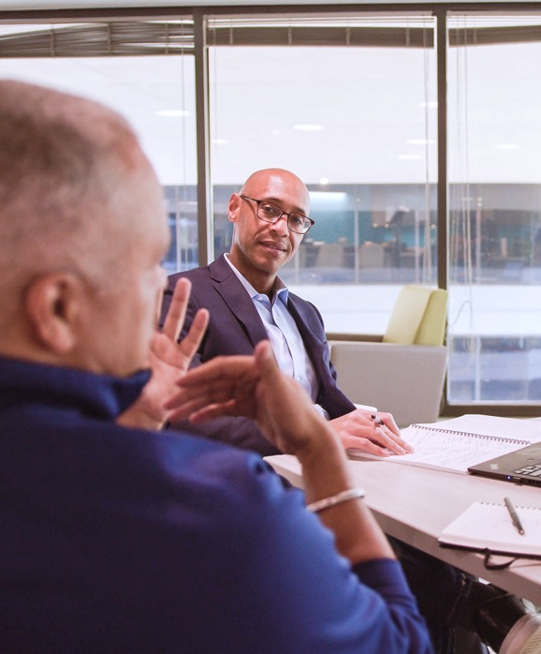
Why ScottMadden?
About ScottMadden
DEEP EXPERTISE
  ScottMadden has been a pioneer in corporate and shared services for decades
  We have completed thousands of projects since the early ’90s
  Our clients span a variety of industries from energy to healthcare to higher education to retail
PERSONALIZED APPROACH
  Before we begin any project, we sit down and listen to our clients’ needs and challenges
  We engage with our clients like no other firm does, working side by side to create practical, real results
  We don’t employ canned methodologies or cookie-cutter solutions
  We work to solve the right problem in the right way
PHILOSOPHY
  We are personally invested in every project and measure our success by our clients’ success
  We listen to our clients’ needs and put their best interests ahead of our own
  We work with integrity, tenacity, and a genuine passion for what we do
  We do what it takes to get it done right
Our expertise helps create the right solution.
Our experience ensures that it works.

Slide 11

Finance Transformation Case Studies

Slide 12

Finance Organizational Assessment
Finance Transformation Case Studies
CHALLENGE
  ScottMadden was engaged to design a financial shared services center to service two merging lumber and wood panel companies with operations in the United States and Canada. This included an evaluation of the current financial processes, technologies, and organizational roles, as well as an implementation sequencing and roadmap. The project also involved navigating two unique, and often conflicting, company cultures.
PROCESS
  Conducted more than 50 interviews with stakeholders and subject matter experts, deployed the Work Activity Assessment tool surveying 340 employees, and administered a Voice-of-the-Customer survey
  Documented highly fragmented work activities and disproportionate time on transactional tasks rather than analytical work
  Developed a finance delivery model that integrated and centralized finance operations, philosophies, technologies, and processes from the legacy organizations
RESULTS
  Developed a two-year roadmap to build an FP&A center of expertise (COE), a capital planning COE, and a transactional shared services center located in Memphis, TN
  Maximized usage of software tools such as Enterprise Performance Management and Optical Character Recognition
  Partnered with the client to complete a detailed finance delivery model design and implement the recommendations resulting from this assessment
SM757

Slide 13

Finance Shared Services Design and Implementation Planning
Finance Transformation Case Studies
CHALLENGE
  ScottMadden was engaged by a leading defense contractor to design and plan the implementation of a financial shared services center, which would include accounts payable, payroll, and general ledger accounting functions.
PROCESS
  Conducted a current state assessment of each function, including processes, organization roles and responsibilities, and technologies used. Assessment included development and deployment of a customer satisfaction survey
  Designed the future state service delivery model with the project team and executives. Identified initiatives required for implementation
  Designed interim processes to be used with the old financial system, as well as future processes that were aligned with the new system
  Developed a business case that detailed costs and benefits related to implementation
  Conducted executive review sessions to discuss the future state design, business case results, and timeline for implementation
  Developed an implementation plan to migrate in-scope functions from the business units to the shared services center
RESULTS
  Provided a clearer understanding of shared services’ objectives, benefits, and direction among business units
  Resulted in expected realization of nearly $1.5 million in annual savings
  Provided a baseline measure of customer satisfaction
  Developed a detailed plan and timeline for transition of functions to the shared services center
  Developed business processes based on leading practices
  Created a platform for future growth through migration of additional functions or acquisition of other companies
SM668

Slide 14

AI Setup to Navigate the Inflation Reduction Act (IRA) Program
Finance Transformation Case Study
CHALLENGE
  The New Empowering Rural America (New ERA) program was established under the Inflation Reduction Act (IRA). Due to the program's complexity and scale, applicants frequently requested clarifications. In response, the Rural Utilities Service (RUS) of the U.S. Department of Agriculture (USDA) regularly updated its processes and issued multiple frequently asked questions (FAQ) documents. While intended to provide guidance, this approach inadvertently created challenges for applicants. Organizations had to constantly review these program guidance documents to determine if their questions had been answered and to stay informed about the latest program modifications. This was highly manual, time-consuming, and prone to errors, making it difficult for applicants to keep up with program guidance efficiently.
PROCESS
  Consulted subject matter experts (SMEs) to understand program requirements and assess the benefits of an AI solution
  Gathered and reformatted relevant program documentation used to tune a large language model (LLM)
  Configured LLM prompts and tuning parameters using the formatted data and deployed the chatbot
  Tested the chatbot with SMEs to validate responses and the supplied document references
  Established solution governance to keep LLM reference information up-to-date and monitor response accuracy
RESULTS
  Reduced manual research time for program applicants by over 95%, representing up to 50 hours of staff time per new guidance document across organizations benefiting from the solution
  Minimized the risk of misinterpreting program requirements
  Eliminated delays from redundant questions
  Improved applicant knowledge and expertise on program requirements and updates
101079-1001:

Slide 15


Global Order-to-Cash Process Standardization
Finance Transformation Case Studies
CHALLENGE
  A global package delivery and supply chain company sought to evaluate and standardize its end-to-end Global Business Services (GBS) Accounts Receivable (AR) processes to ensure the department was “running like a business” to support the enterprise.
PROCESS
  Conducted interviews with AR operations staff, stakeholders, and customers to understand current AR processes, variations across countries, and country-specific regulations that influenced policy and process
  Evaluated AR operations against leading practices to highlight strengths and opportunities using our proprietary Leading Practice Assessment (LPA) tool
  Leveraged our Process Detail Assessment (PDA) tool to gather process information to enable documentation of current AR operations processes via process flows and narratives
  Drafted globally standard future state AR process flows and narratives
  Identified automation and other technology opportunities to enhance processes and increase efficiency
  Conducted four case studies with client peers to provide insight into similar AR challenges and solutions
RESULTS
  Comprehensive snapshot of operations and existing variations across countries
  Development of a phased implementation roadmap with detailed steps and timelines to successfully standardize global processes
  Creation of a ten-year business case that highlights costs and savings across three options to standardize global processes: 1) utilizing RPA and best-of-breed technology, 2) best-of-breed technology only, and 3) best-of-breed technology only in APAC, EMEA, and LATAM
  Creation of a repeatable process improvement methodology that can be leveraged across the enterprise
SM622

Slide 16

Procure-to-Pay Process Design and Implementation
Finance Transformation Case Studies
CHALLENGE
  ScottMadden was engaged by a global construction equipment manufacturer to design and implement new processes and technologies to support a procure-to-pay transformation in the United States.
PROCESS
  Created inventory of in-scope processes in procurement, accounts payable, and accounting
  Mapped current state processes by interviewing SMEs and reviewing existing documentation
  Drafted future processes based on leading practices and select business requirements; refined future processes with SMEs through workshops
  Completed all related documentation, including process flow charts, process narratives, and desktop procedures
  Supported all phases of technology design and implementation, including requirements definition, technology configuration, test planning and execution, defect resolution, and data migration
  Created training plan and developed training materials based on new process and procedure documentation
  Scheduled and delivered training to the shared services organization and business groups
  Facilitated rollout and cutover activities
RESULTS
  Standard processes and a standard technology platform were in place for the company’s U.S. operations
  The organization realized process improvements of greater efficiency, increased quality, and direct access
  The company obtained the scalability needed to integrate procure-to-pay functions in a recent acquisition
SM736

Slide 17

ERP Vendor Selection
Finance Transformation Case Studies
CHALLENGE
  ScottMadden was engaged by a privately owned beverage manufacturing and distribution company to identify ERP primary requirements by analyzing their financial, supply chain, manufacturing, and distribution processes. We then made a recommendation on an ERP vendor that best met those requirements.
PROCESS
    Interviewed SMEs across each of the end-to-end business processes and analyzed the current state, including technology, process, data, and financial pain points, to establish requirements to include on the RFP
    Assessed down-stream impacts of each pain point by building root-cause analyses, finding issues and dependencies that occur across multiple processes
    Examined the root-cause and pain-point takeaways and summarized them into major themes and trends, cross-referencing each trend to existing ERP capabilities
    Quantified impacts of pain-point themes against potential improvement areas to develop business and user priorities. Identified a short list of vendors with the potential to satisfy the established criteria
    Issued the RFP explicitly stating each of the client’s requirements, including capability, price, scalability, flexibility, implementation methods, and customer service requirements, etc.
    Evaluated each of the vendors using a custom-built grading tool, which examined each of the RFP responses against the weighted criteria, allowing the client to objectively determine their new ERP vendor
RESULTS
    The down-stream impact assessment found ERP pain points and additional process observations, allowing the client to enhance their processes to be best-in-class outside of the technology
    The impact weighting allowed the client to invest money and time into the most crucial areas, which will ultimately deliver savings by simplifying their technology landscape
    The client was satisfied with an objective selection in an ERP that will continue to enable the firm’s growth as they build more manufacturing plants, acquire more businesses, expand operations to other countries, and expand product depth and breadth
SM737

Slide 18




Brad DeMent
Trey Robinson
Partner
Partner
3565 Piedmont Road, NE
2626 Glenwood Ave.
Building 4, Suite 500
Suite 480
Atlanta, GA 30305
Raleigh, NC 27608
bdement@scottmadden.com
treyrobinson@scottmadden.com
404.814.0020
919.781.4191
678.524.2496
919.522.1740

