Slide 1
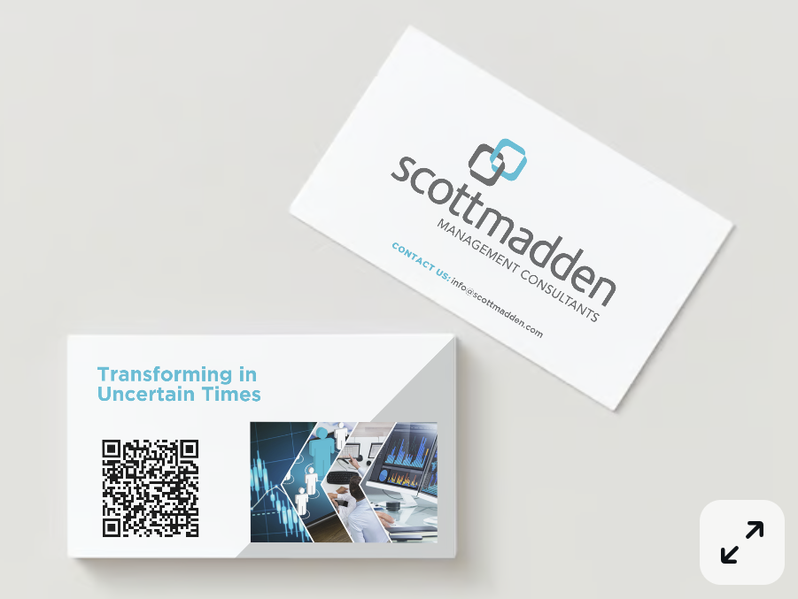
HR Event Planning
Events
  Workday Rising, Sept 26-29, Lead is Rodrigo Adissi
    Any other attendees?
    Themes: Workforce management, Talent management, AI, DEI
  HR Technology, Oct 10-13, Lead is Jon Luk
    Any other attendees?
    Themes: AI, Talent Management, Employee Experience & Journey, Systems & Strategies
Social coordination for each event
  Workday
    Buzz around AI, workforce and talent management, DEI, and so many other themes are hot in the HR space. We’re excited to join leaders in the industry and explore cutting-edge solutions relating to these themes at #WorkdayRising! Reach out to @Rodrigo if you are attending and stay tuned for updates from the event!
  HR Technology
    It’s a pivotal time for organizations to future-proof their HR strategies. @JonLuk will represent ScottMadden at the upcoming #HRtech event, where sessions are designed to help you make sense of today’s ever-growing and complex HR tech ecosystem. Reach out to him if you are attending, or interested in learning how we can help you navigate the changing landscape and drive your business forward.
      Ask for both events if for a photo from the conference and a few key takeaways we can share during the conference!
Transforming in Uncertain Times business card content
HiHello
  Review instruction guide

