Slide 1

Supply Chain Analytics and Organization Design
Jason Payton
Jason Davis

Slide 2

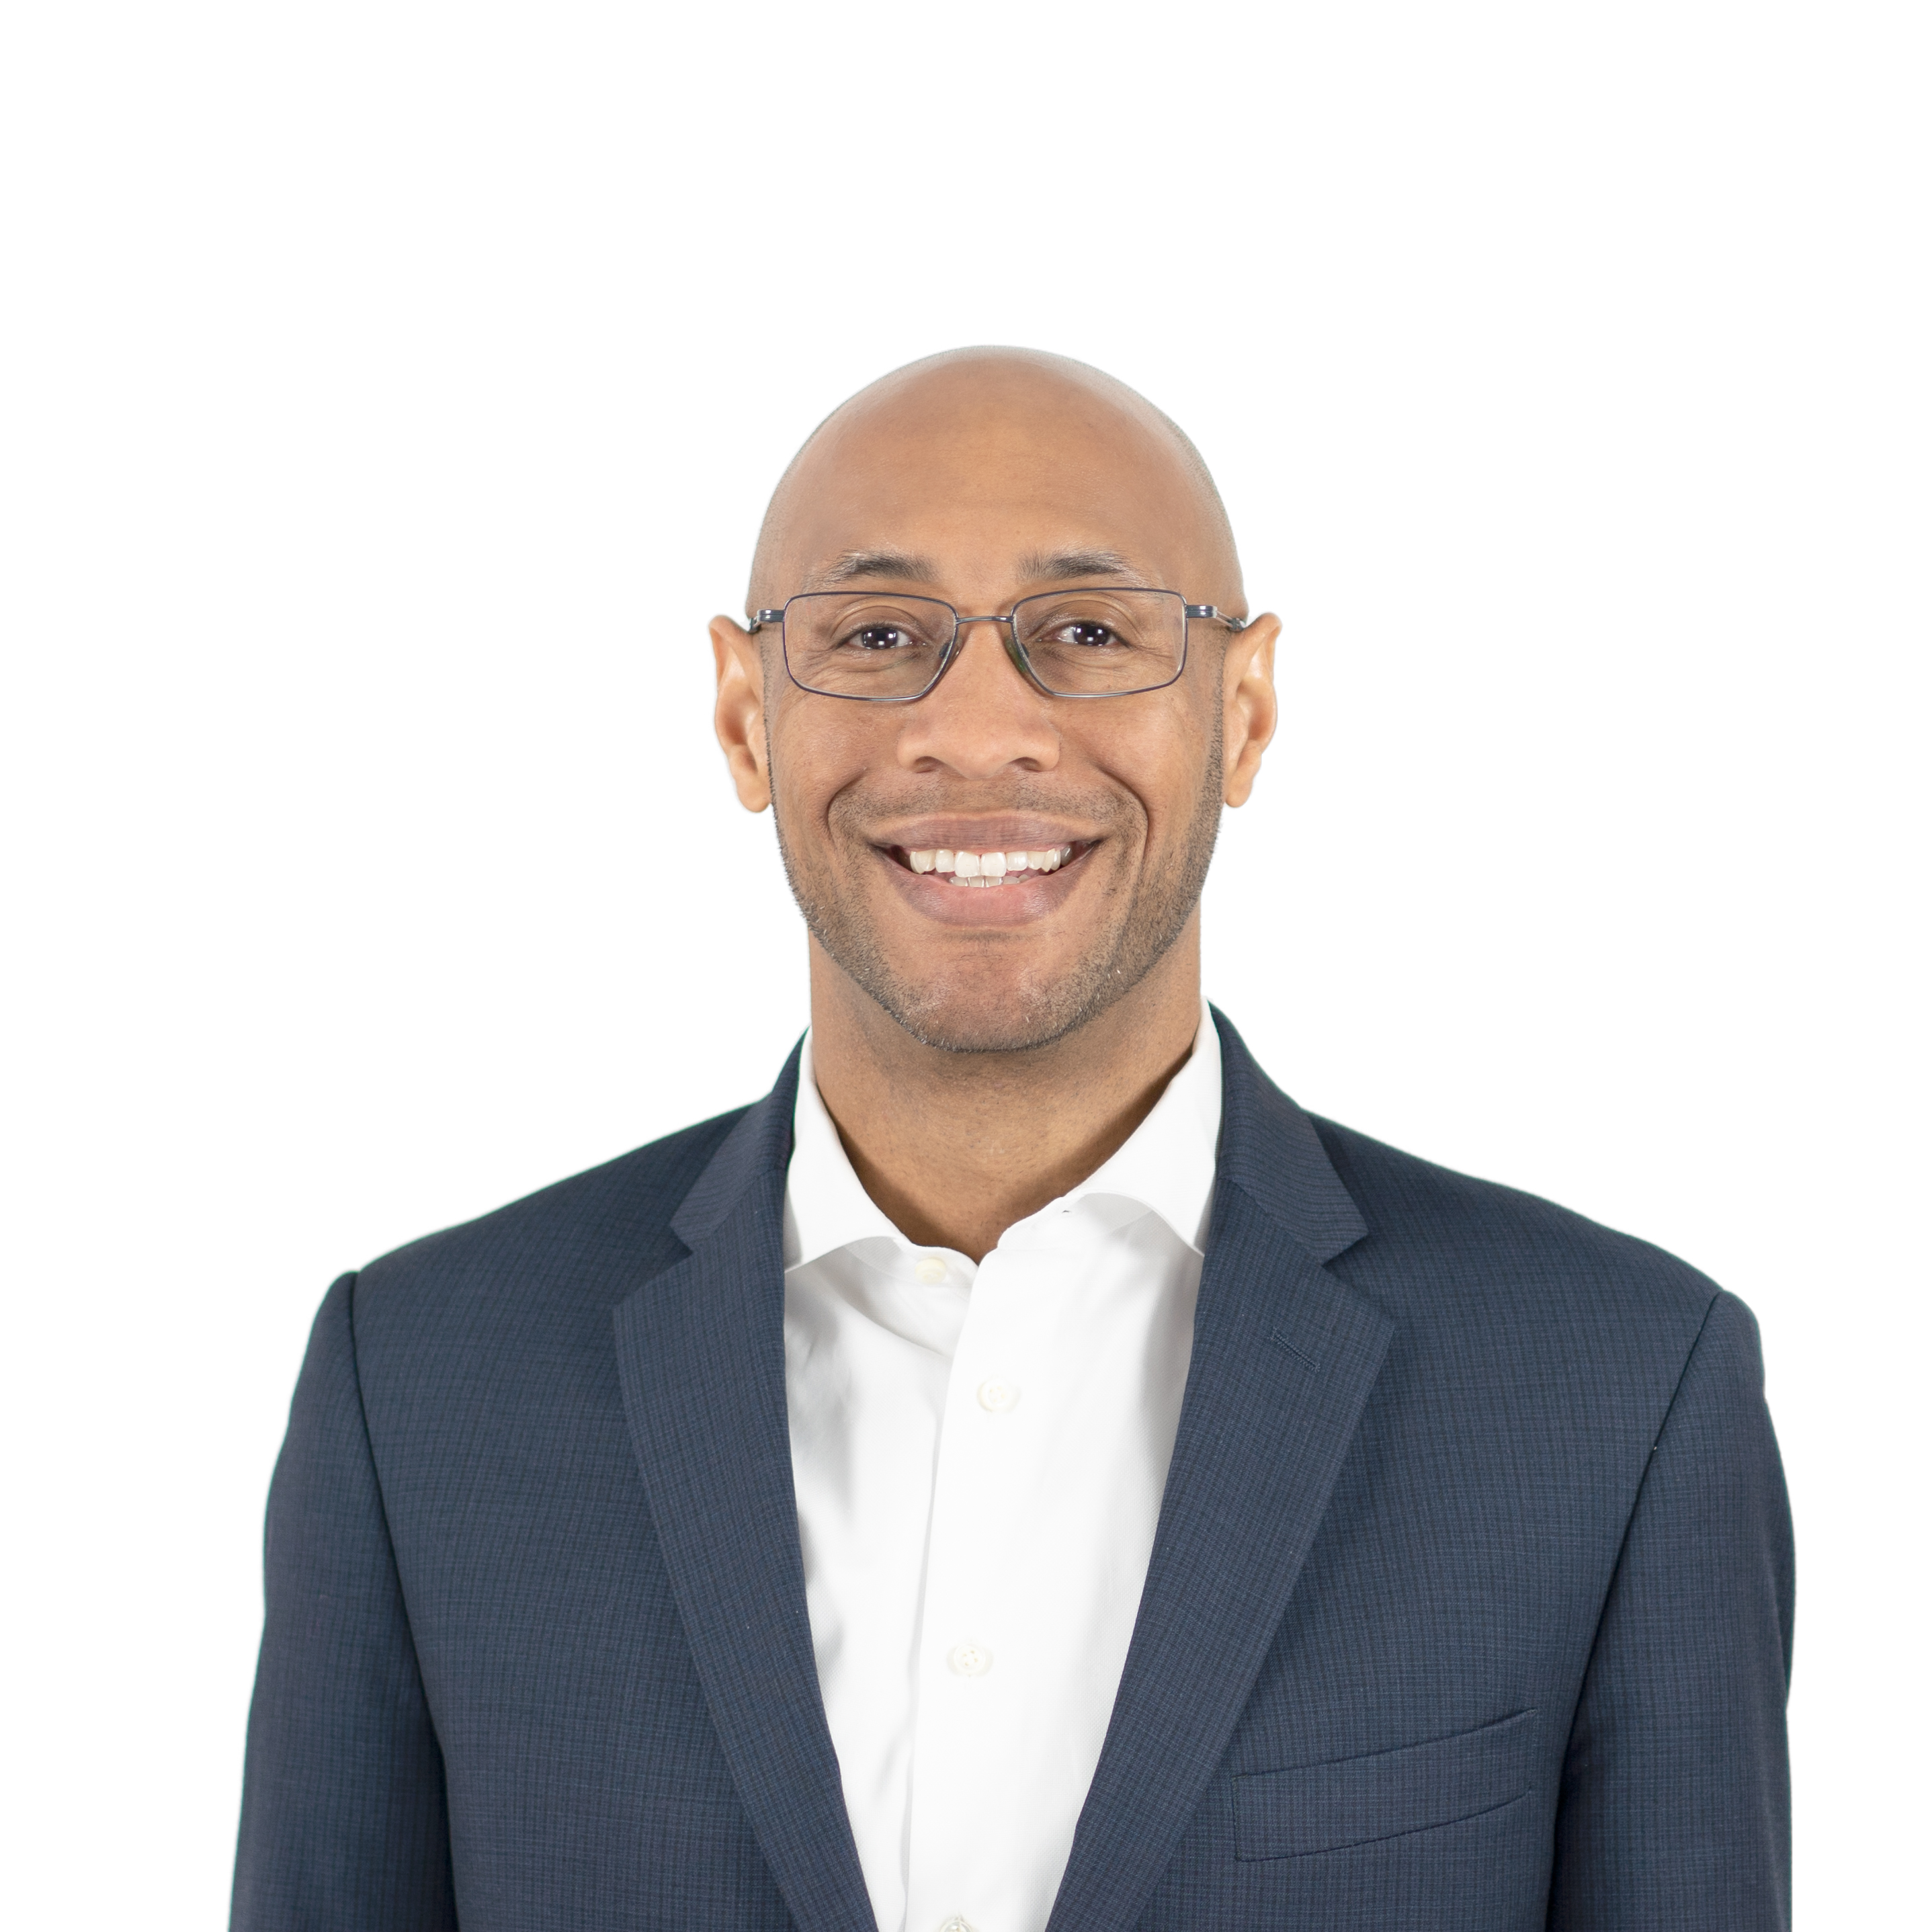


Your Presenters
Jason Davis
Jason Payton
Partner
Partner
ScottMadden, Inc.
ScottMadden, Inc.

Slide 3
Topics
01
PROBLEM STATEMENT | Introduction of key questions and terms in this presentation
OPERATING MODEL AND ORGANIZATION DESIGN PRINCIPLES | What are the key types of work activities? How does a leading practice operating model enable effective service delivery?
DATA MANAGEMENT | What type of problems can my data solve? How can I make my data work for me? How do I build my team to succeed?
PRACTICAL APPLICATIONS | Critical spare parts Category analysis Advanced analytics COE
02
03
04

Slide 4

About ScottMadden
CORPORATE & SHARED SERVICES
ScottMadden is a management consulting firm with more than
40 years of deep, hands-on experience.
Experience
Our experienced team has been a pioneer in corporate
and shared services since the practice began decades ago.
We employ deep, cross-functional expertise to produce practical, measurable solutions.
Scope
We have completed thousands of projects since the early ’90s, including hundreds of large, multi-year implementations. Our clients range across a variety of industries from energy to healthcare to higher education to retail. Our areas of expertise span the spectrum of middle and back office corporate and shared services.
We deliver a broad array of corporate and shared services consulting services—from strategic planning through implementation—across many industries, business units, and functions.
Our knowledge, expertise, and experience are unmatched—no other firm has helped more clients with more unique solutions.
Services
We have helped our clients with assessment, strategy, design, implementation, technology, business case and roadmap, governance, program management, and change management.

Slide 5

Our Supply Chain Practice
We’ve been helping supply chain organizations update their entire end-to-end supply chain processes for nearly two decades. Our solutions provide lasting improvements and allow our clients to better serve their customers—whether internal customers in the business units or external customers such as suppliers.
Supply Chain Practice
OUR WORK IN SUPPLY CHAIN
Through our deep expertise and practical know-how, we assist clients across the full range of supply chain processes and have the unique ability to create alignment between the supply chain function and its customers and stakeholders.
OUR FOCUS
Our teams bring a proven approach to service delivery design and supply chain optimization. We work hand-in-hand with you to assess current operations, models, and processes, design practical solutions, and implement changes to improve your supply chain operations.
Our end-to-end supply chain areas of experience:
  Demand planning and forecasting
  Strategic procurement
  Materials management
  Operational procurement
  Logistics
  Accounts payable

Slide 6
Our Supply Chain Practice (Cont’d)
Procurement Service Delivery
  Procurement transformation strategy
  Service delivery assessment
  Business case development
  Delivery model and COE design
  Technology selection and implementation
  Customer service optimization
Procure-to-Pay (P2P) Process
  P2P process design and improvement
  Functional technology selection and implementation
  Metrics design and implementation
  Global process owner and governance
Supply Chain Practice
Logistics & Materials Management
  Inventory planning and optimization
  Facility location selection and design
  Facility management improvement
  Storage space optimization
  Lean warehousing
  Automatic identification and data capture (AIDC) opportunity evaluation
  Transportation management
  Network design
Enterprise Supply Chain Services
  Supply chain strategy
  Demand planning improvement
  Spend analysis and market research
  Strategic sourcing execution
  Category management program design
  Supplier relationship management
  Process and governance design
  Organization design and staffing
  Leading practices assessments
  Change management support
  Outsourcing evaluation and execution

Slide 7
Problem Statement
How do I set my organization up for success, while leveraging advanced analytics and emerging capabilities of existing and new fit-for-purpose solutions?
Key Questions
How should I organize to get the most out of emerging technologies?
What are the benefits of a center of expertise versus functional alignment?
Does my analytics team enable other strategic priorities?
Key Definition
Advanced analytics refers to techniques and tools used to analyze data in complex and sophisticated ways
Includes predictive and prescriptive modeling, machine learning, artificial intelligence, data mining, and complex event processing to...improve decision-making, increase operational efficiency, enhance customer experiences, and drive innovation
Organization/operating model concept
Advanced analytics tools

Slide 8
OPERATING MODEL AND ORGANIZATION DESIGN PRINCIPLES

Slide 9
Defining Work Activity Types
Functional/Advisory
Expertise in a select area
Utilizes analysis, judgement, collaboration, leading practices
Policy and program design
Leading practice operating models are structured by the type of work.
  Drive efficient processes
  Match skills to work
  Enable scalability and flexibility
Complex Issues/Transactions
Specialized services, requiring in-depth process knowledge
May involve research, problem solving, and collaboration
Escalated issues and transactions
Increasing complexity
Basic Issues/Transactions
Wide range of routine inquiries and transactional activities
Rules-based, leverages standard processes, repeatable
Customer service and transaction processing separated
Functional/Advisory
Expertise in a select area
Utilizes analysis, judgement, collaboration, leading practices
Policy and program design
Direct Access
Front-end channel for customers and suppliers
Leverages technology for program/process information and initiation of support requests

Slide 10

Supply Chain Operating Model
Functional/ Advisory
Complex Issues/ Transactions
Basic Issues/ Transactions
Business Units
Direct Access
Planning Inputs
Service Center`
Centers of Expertise
Direct Access
Basic Complex
Analytics
Strategic Procurement
Programs
Planning
Reporting
Materials/ Services
Support
Requests
Information
Support requests
Issue Resolution
Suppliers
Transactions
Warehouses/Storerooms
Materials and Equipment
Inventory management
Warehouse operations
Transportation
Notes:
Straightforward access for customers and suppliers
Clearly-defined roles and responsibilities, aligned to right delivery channel
Single source of content
Continuous improvement, driven by data

Slide 11
Organization Design and Staffing Principles
These principles reflect the tenets of leading practice operating models.
Organization Design
Staffing
Aligned with business strategy
Clear accountability
Customer facing
Efficient but connected
Designed based on the work
Skillsets aligned with job responsibilities
Agile to adjust to changing conditions
Workload determines staffing
  Design precedes staffing (avoid jumping back and forth over the wall).

Slide 12
Organization Design Details
1. Plan
2. Analyze
3. Design
  Understand company’s strategy and goals
  Assess alignment between strategy and organization design
  Conduct workload analysis
  Design the structure for each level
Success Factors
  Ensure there is a clear understanding of business strategy before making assumptions about the work
  Build cross-functional teams for the work activity analysis to understand possible work transfers
  Develop strong communications and change management plans
  Set a realistic timeline

Slide 13

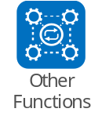


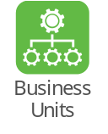

Service Delivery Strategy – Options for Analytics
Centralized
Hybrid
Decentralized
Description | Analytics in enterprise COE or another central group High visibility and control | Baseline guidelines, controls, QA Core team provides services for areas unable to support their own needs | Analytics in local business functions Can have business or function-specific COEs
Enterprise Role | Almost entirely enterprise-led Typically IT, but can also be another centralized business function | Direction and leadership Orchestration and QA Optional design and services | Little/no involvement at enterprise level Informal ad hoc coordination
Challenges | Less responsive Development time reduces impact opportunity | Potential conflicts between central and local efforts | Varying quality Potential impact on other groups Uncoordinated activities

Slide 14
DATA MANAGEMENT

Slide 15
What are We Trying to Solve?
User Experience
1 | Provide end-to-end visibility of purchases
2 | Determine delivery date for materials
3 | Answer purchasing-related FAQs
4 | Enable guided buying for employees
5 | Integrate all supplier-facing functions
Cost Savings/Avoidance
6 | Secure eligible early payment discounts
7 | Track contract milestones and discounts
8 | Identify unmanaged spend
9 | Forecast and update demand
Asset Optimization
10 | Recommend stocking levels
11 | Optimize warehouse space and layout
12 | Select optimal route and carrier
13 | Analyze warehouse network
Decision Support
14 | Identify qualified suppliers
15 | Source equipment for system upgrades
16 | Identify early-stage material needs
17 | Select best-fit contract language
  Recommend stocking levels
Refine opportunities to ensure they have clear, measurable outcomes
Group use cases into meaningful categories to help inform expected benefits
  Identify early-stage material needs
  Forecast and update demand
  Determine delivery dates for materials

Slide 16
Gen AI Requires a Data-Driven Operating Model
Potential Use Cases
  Identify long-lead material
  Select optimal route and carrier
  Optimize space
  Track contract discounts
  Recommend stocking levels
  Determine delivery dates
Infrastructure Needed
  Frictionless access
  Clear documentation
Governance Needed
  Data transfer and encryption
  Decision making governance
  Scalable architecture
  Policy and standards
  Consistent structure
  Data cleansing
Notes:
Lead: BH
Gen AI requires a data-driven operating model where we bring all this together
Organizations have potential uses for Gen AI, but without a reliable and scalable data management structure, the full benefits of advanced analytics and AI will be elusive.

Slide 17
What Does This “Technical Infrastructure” Look Like?
Decision Making Value
Low
High
Sources
Storage & Transformation
Solutions
Tools
Models
Source DB
Extract
AI
Dash-boards
Analytics
Users
Data Warehouse
Visualization
Reports
Transform
Automation
Bots
File Share
Load
Low Code
Portals
Vendor
Apps
How this work is performed and where it is managed has a large impact on maturity.
Notes:
Time: 7mins
Lead: BH
Source Databases/File Sharing: Excel, Access, CSV files, downloads, vendor master files, vendor product data, etc.
ETL – high effort with high payoff, requiring business SME input and data skills
Storage may be decentralized
Portfolio of solutions, including AI
Take a simple case – the internal HR Policy Chatbot;

Slide 18





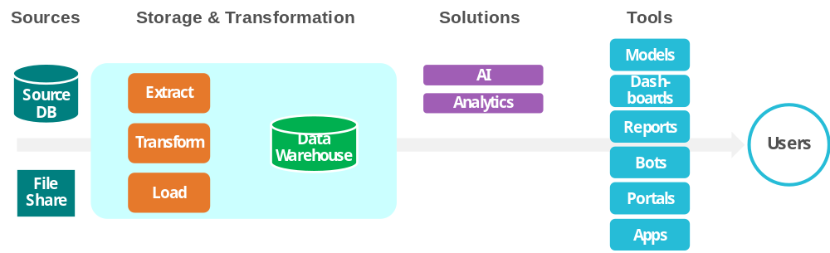
Bringing It All Together…Organization and Technology
Function
Users
Organization
Data Management
Deployment
Supply Chain
Centralized
Parts Analysis
SMEs
Human Resources
Hybrid
Network Analysis
Managers
Accounting
Decentralized
Forecasting Demand
Executives
Data Journey
Work with IT to enable sources and deploy the best-fit technologies.
Notes:
Time: 7mins
Lead: BH
Source Databases/File Sharing: Excel, Access, CSV files, downloads, vendor master files, vendor product data, etc.
ETL – high effort with high payoff, requiring business SME input and data skills
Storage may be decentralized
Portfolio of solutions, including AI
Take a simple case – the internal HR Policy Chatbot;

Slide 19

And What If I Invest in a “Data Operating Model”
  Setting up the right foundation will take time up front…
User Experience
Cost Savings/Avoidance
Asset Optimization
Decision Support
USE CASES
Data Structure
  …but will enable the delivery of solutions at scale that build on one another
TIME
Notes:
Lead: JD
Important to think about the larger picture
Once you do the work of structuring the data structure, set up, ownership, governance, reduces the work for future use cases. Start to feel the ’fly wheel’ effect. It all starts with the foundation.

Slide 20
PRACTICAL APPLICATIONS

Slide 21
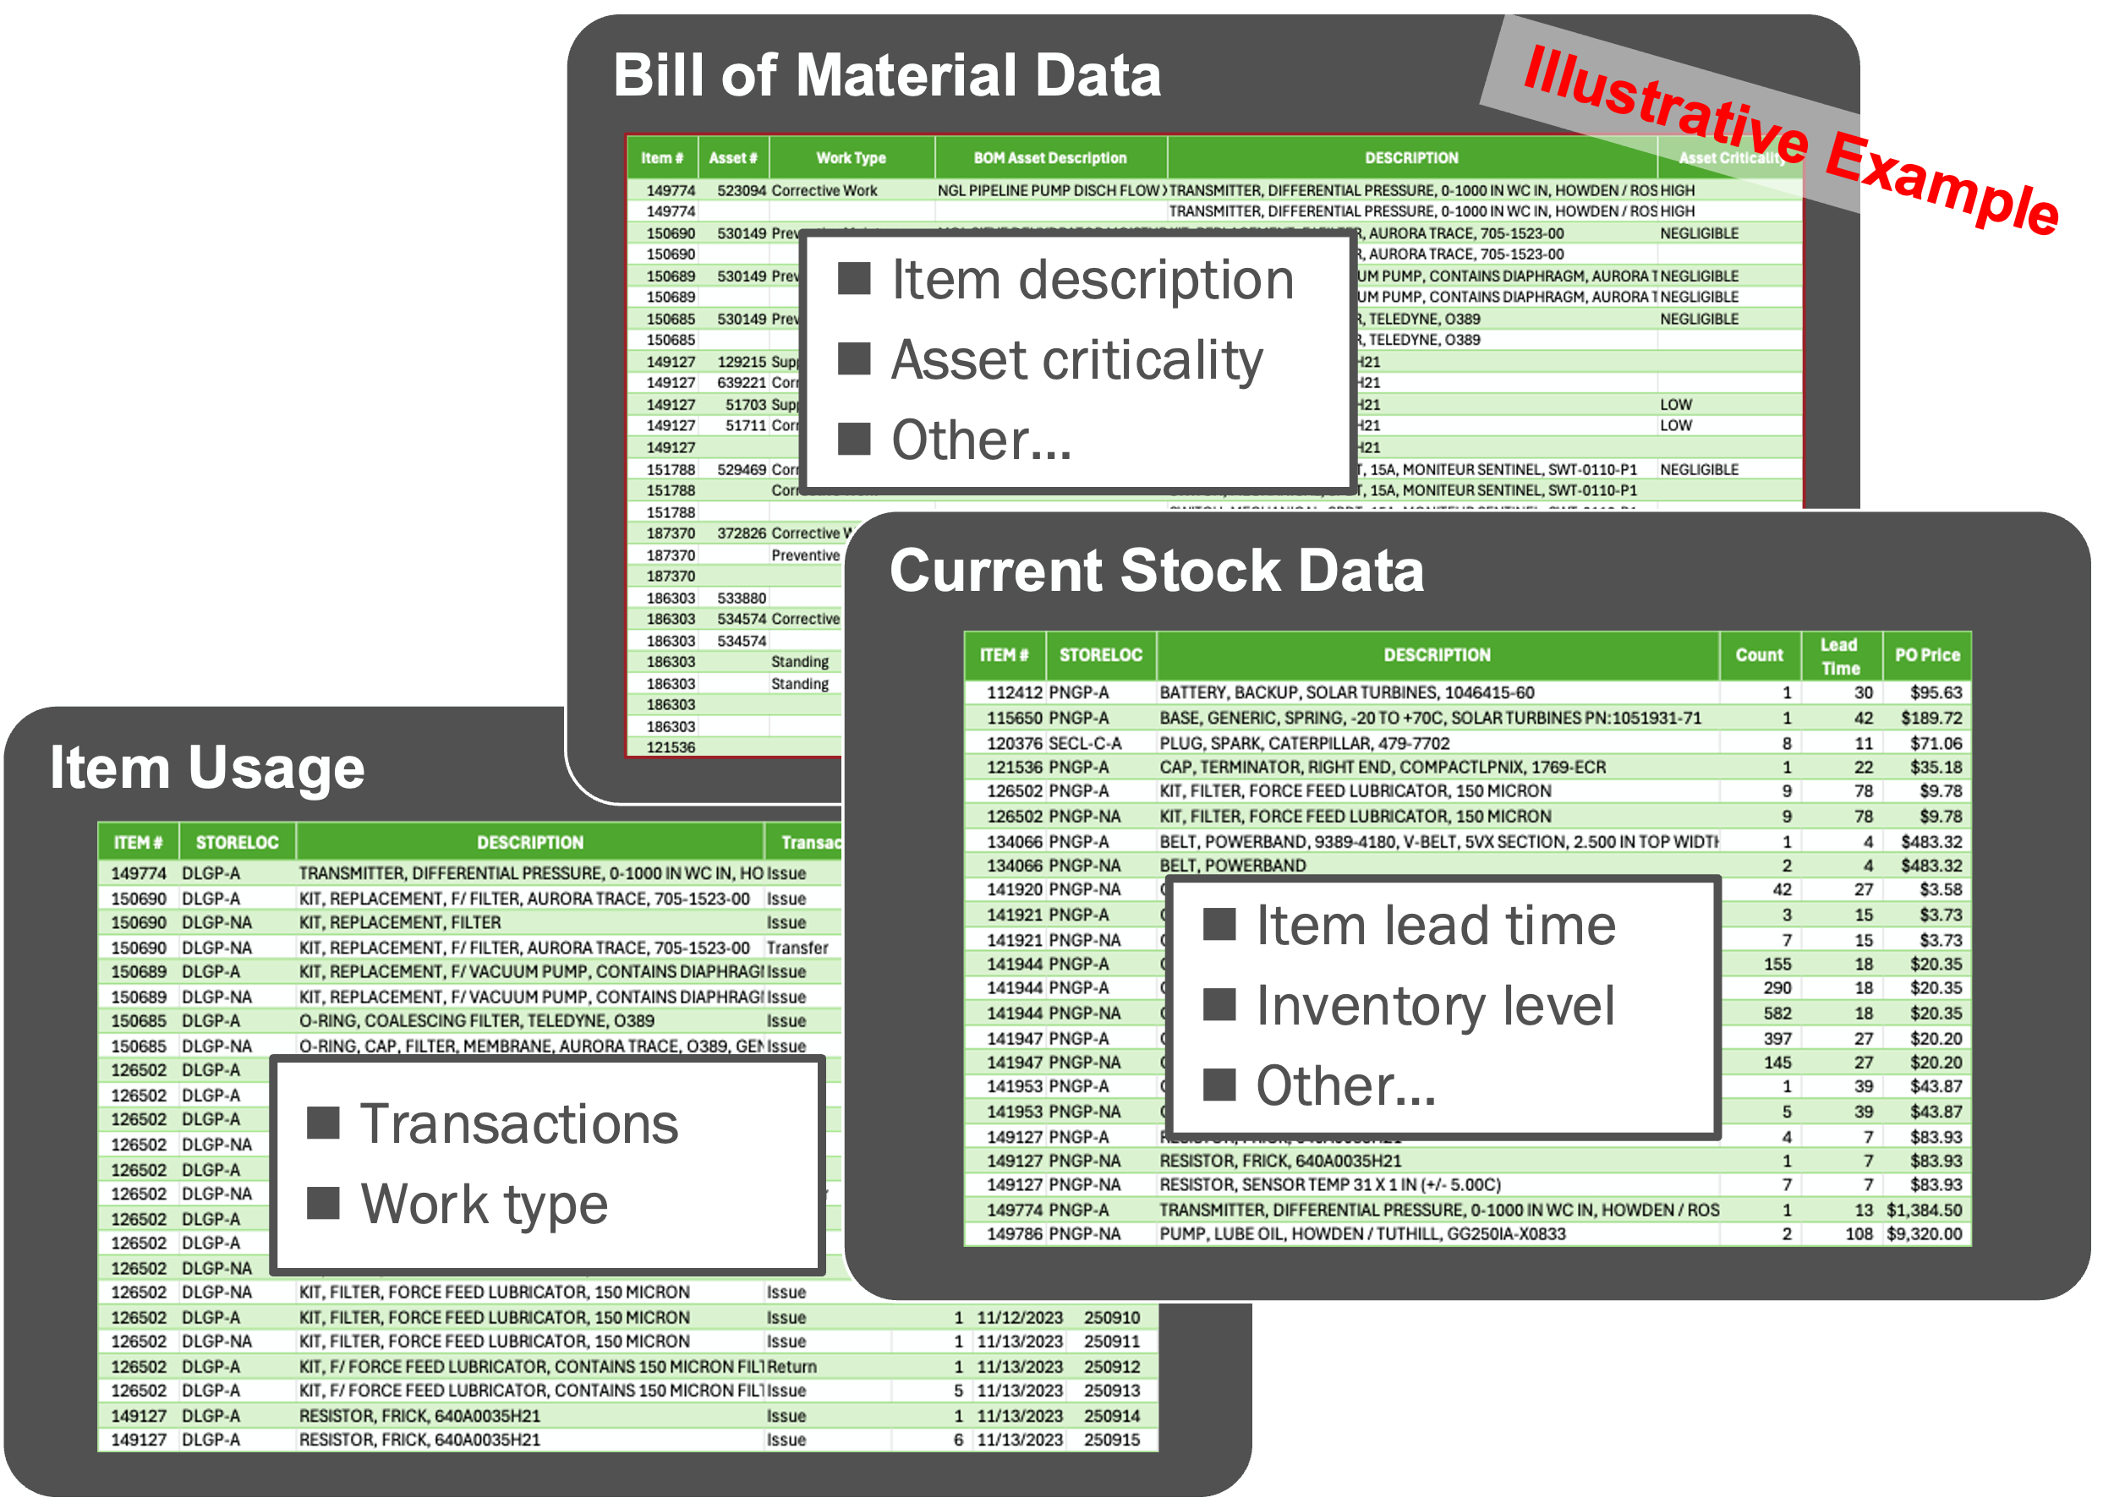
Example #1 – Critical Spare Parts Identification
Challenge: How do I use advanced analytics to help with spare parts identification?
Situation:
200,000 parts
Incomplete data
Inconsistent nomenclature
Decentralized decision making
Decentralized processes
Solution:
We used Gen-AI to read parts descriptions and include inputs that helped identify importance and informed weights, in a broader set of data points.
Working model to indicate critical spare parts.
Later added statistically recommended service levels (i.e., in-stock rate) by part
Success Factors
  Clearly define desired outcomes and possibilities to align expectations
  Use the data you have – learn – build the data you want
  Engage SMEs to develop better models and grow trust

Slide 22
Example #2 – Reporting Options for Category Analyst
Category Analyst
  Conduct market research to support strategy and decision-making
  Analyze spend and historical contract data
  Develop and utilize pricing and cost models
  Support RFx events
  Centralized in COE
  Pooled under One Category Manager
  Aligned with Category Managers
CPO
CPO
CPO
Category Managers
Analytics Manager
Category Manager
Category Manager
Category Manager
Category Manager
Category Manager
Category Manager
Procurement Professionals
Category Analysts
Procurement Professionals
Procurement Professionals
Procurement Professionals
Procurement Professionals
Procurement Professionals
Procurement Professionals
Analytics Support
Category Analysts
Category Analyst
Category Analyst
Category Analyst
Analytics Support
  Ability to leverage leading practices and knowledge sharing in analytics
  Flexibility to support multiple categories as work volumes change
  Difficult to obtain in-depth category knowledge
  Similar benefits with respect to leading practices, knowledge sharing, and support flexibility
  Increased opportunity to gain category knowledge
  High degree of coordination for work assignments required
  Additional job grades for category managers
  Ability to gain in-depth knowledge for assigned categories
  More difficult to align available resources with fluctuating work volumes

Slide 23


Example #3 – COE for Advanced Analytics Pilot
A key COE service is program design and management. This expertise can enable organizations to test and implement technology solutions, such as those involving advanced analytics.
Project Sponsors
Provide sponsorship, visible direction, and approval for decisions
Legal
HR
Program Lead (COE)
IT
Controls
Drive engagement and project activities; speed learning; provide insights
Core Team
Success Factors
Operations/ Maintenance
Supply
Chain
Subject Matter Experts
Provide technical and functional knowledge and data/documentation
  Build a robust project team to speed learning, facilitate buy-in, and produce the right outcomes
  Engage part-time advisors, as needed, based on functional scope and the technical solution used
  Foster collaboration and ensure compliance with enterprise standards
Business

Slide 24

Wrapping Up
Housekeeping items:
  Use this QR code to access this presentation and the ScottMadden maturity model
  Please stop by our kiosk in the Digital Transformation and AI neighborhood
Thank you for attending today’s presentation and enjoy the rest of the conference!

Slide 25


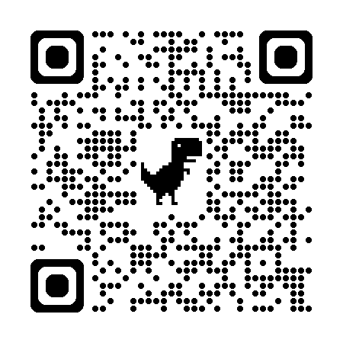


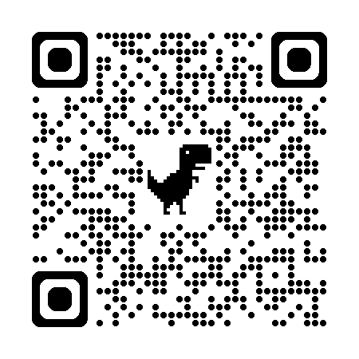





AI Resources
Recent AI Articles
Technology Solutions
Governance Solutions
Launching a Successful AI Pilot Program:
A Guide for Executives
IT Strategy and Delivery
Technology Enablement
Harnessing the Power of Large Language Models:
A Crawl, Walk, Run Framework for Executives
Technology Selection and Implementation
Change Enablement
Unlocking the Potential of Generative AI in Shared Services
Cybersecurity Program Development
Program and Project Management
Artificial Intelligence Use Cases in Power Generation
Operational Technology
Notes:
Lead: JP

