Slide 1
From Chaotic to Effective: Reimagining Your Service Operating Model
John Francis and Trey Robinson
ScottMadden, Inc.

Slide 2




Your Discussion Leads

Slide 3

Workshop Overview
Do you find your procurement organization constantly fighting fires?
Do you struggle with balancing the day-to-day transactional work with broader strategic analysis?
Have demands of internal customers constantly required you to reprioritize your focus?
Recently, leading companies have advanced their procurement operating models to achieve greater value and stay connected to their customers and vendors.

Slide 4
Workshop Overview (Cont’d)
Today we well discuss next generation concepts to transform your procurement operating model to a leading practice service delivery model.
01.
Procurement tiered service delivery, including direct access, transactional processing, and centers of expertise
02.
Leading functional technologies, service delivery tools, and AI/automation enablers
c
c
c
c
03.
Quantitative and qualitative benefits of shifting to a leading practice model
04.
Efficient steps to begin your procurement transformation
c
c
c
c

Slide 5
Introduction to ScottMadden

Slide 6

Who We Are
Introduction to ScottMadden
CORPORATE & SHARED SERVICES
ScottMadden is a management consulting firm with more than 40 years of deep, hands-on experience.
Experience
Our experienced team has been a pioneer in corporate
and shared services since the practice began decades ago. We employ deep, cross-functional expertise to produce practical, measurable solutions.
Scope
We have completed thousands of projects since the early ’90s, including hundreds of large, multi-year implementations. Our clients represent a variety of industries from energy to healthcare to higher education to retail. Our areas of expertise span the spectrum of middle and back office corporate and shared services.
We deliver a broad array of corporate and shared services consulting services—from strategic planning through implementation — across many industries, business units, and functions.
Our knowledge, expertise, and experience are unmatched — no other firm has helped more clients with more unique solutions.
Services
We have helped our clients with assessment, strategy, design, implementation, technology, business case and roadmap, governance, program management, and change management.

Slide 7
Areas of Focus
Introduction to ScottMadden
SUPPLY CHAIN
  We assist clients across the full range of supply chain processes and have the unique ability to create alignment between supply chain and its stakeholders. From crafting new supply chain strategies to restructuring your organization to improving your daily operations, we help you with every step.
INFORMATION TECHNOLOGY
From IT assessments and strategic direction to governance, cybersecurity, and risk and compliance management, we can help your organization get the most out of its IT investment. We also help you optimize your projects to focus on delivering business outcomes not just installed technology.
FINANCE AND ACCOUNTING
  We help companies transform their finance and accounting operations. Through enterprise financial business services, strategic centers of expertise, intelligent automation solutions, hybrid insource/outsource delivery models, and other solutions, we help you increase value for your company.
MULTIFUNCTION/GBS
We move shared services to the next generation—integrating finance, human resources, information technology, supply chain, and/or other business services into a single, multifunction shared services or global business services operation with effective governance and management.
HUMAN CAPITAL MANAGEMENT
  We offer HR transformation (including HR shared services), analytics, HR systems (selection, implementation, and optimization), process design and continuous improvement, talent and employee engagement strategy and programs, and payroll—the services your organization needs to excel.
BUSINESS SUPPORT SERVICES
  We help our clients improve service response to the business, including through the integration of various administrative services into their shared services model. Services often include real estate, facility maintenance, fleet, security, sales and marketing, insurance, customer service, research, and others.

Slide 8

Our Supply Chain Practice
Introduction to ScottMadden
We’ve been helping supply chain organizations update their entire end-to-end supply chain processes for nearly two decades. Our solutions provide lasting improvements and allow our clients to better serve their customers—whether internal customers in the business units or external customers such as suppliers.
Supply Chain Practice
OUR WORK IN SUPPLY CHAIN
Through our deep expertise and practical know-how, we assist clients across the full range of supply chain processes and have the unique ability to create alignment between the supply chain function and its customers and stakeholders.
OUR FOCUS
Our teams bring a proven approach to service delivery design and supply chain optimization. We work hand-in-hand with you to assess current operations, models, and processes, design practical solutions, and implement changes to improve your supply chain operations.
Our end-to-end supply chain areas of experience:
  Demand planning and forecasting
  Strategic procurement
  Operational procurement
  Logistics
  Materials management
  Accounts payable
Copyright © 2024 by ScottMadden, Inc.
All rights reserved.

Slide 9
Our Supply Chain Practice
Introduction to ScottMadden
Procurement Service Delivery
  Procurement transformation strategy
  Service delivery assessment
  Business case development
  Service delivery model and center-of-expertise design and implementation
  Service management technology selection and implementation
  Customer service optimization
Procure-to-Pay (P2P) Process
  End-to-end process design and improvement
  Functional technology selection and implementation
  Metrics design and implementation
  Global process owner and governance
Supply Chain Practice
Enterprise Supply Chain Services
  Supply chain strategy
  Demand planning improvement
  Spend analysis and spend category market research
  Strategic sourcing execution
  Category management program design
  Supplier and third-party risk management
  Supplier relationship management
  Process and governance design and improvement
  Organization design and staffing
  Leading practices assessments
  Project management and change management planning and execution
  Outsourcing evaluation, vendor selection, and transition support
Logistics and Materials Management
  Inventory planning and optimization
  Warehouse location selection and design
  Warehouse facility management improvement
  Storage space optimization
  Lean warehousing
  Automatic identification and data capture (AIDC) opportunity evaluation and implementation, e.g., bar codes, RFID
  Transportation management and network design
Copyright © 2024 by ScottMadden, Inc.
All rights reserved.

Slide 10














































Representative Clients
Introduction to ScottMadden
Retail and
Consumer Products
Manufacturing and Industrial
Technology and Communications
Higher Ed., Public Sector, Non-profit
Energy and
Utilities
Healthcare
Professional
Services
Note: Representative sample; not all-inclusive of clients served. Excludes numerous well-known clients due to confidentiality agreements

Slide 11
Leading Practice Procurement Service Delivery Model

Slide 12
Procurement has Evolved over the Last 20 Years
Leading Practice Procurement Service Delivery Model
TRANSACTIONAL
STRATEGIC
Purchase
Value
Order
Savings
Administer
Efficient
More Decentralized
More Centralized
2005
2015

Slide 13
Polling Question #1
Leading Practice Procurement Service Delivery Model
  Which of the following applies to your procurement function:
Strategic Procurement is centralized.
Operational Procurement is centralized.
Both are centralized.
Neither are centralized.
38%
13%
38%
11%

Slide 14

What are the Unintended Consequences?
Leading Practice Procurement Service Delivery Model
Roles are not clearly defined. Transactional roles are being asked to execute strategic work and/or strategic roles are completing transactional tasks with little to no time for anything else.
Unclear Roles
“I don’t have enough time to be strategic”
“Daily firefighting dominates my day”
Business unit partners and vendors see procurement as requiring steps that cost time, get in the way of what they need to accomplish, and are not rooted in an understanding of the business.
“Submitting a request is painful”
“I have to go through too many hoops to get an answer”
“My workday is consumed by administrative tasks which keeps me from being more strategic:”
Activity Without Achievement
Procurement has centralized activities and staff leading to business unit partners feeling abandoned and uncertain about how to access procurement services.
Uncertain Service Access
“Who do I call to expedite my material now that procurement has taken Jim?”
“Is this a new vendor or do they have a contract in place? Is it current or expiring soon? How do I find out?”
“How do I access our Supply Chain function to even start a sourcing event?
A strong procurement service delivery model enables organizations to overcome these challenges.

Slide 15
Polling Question #2
Leading Practice Procurement Service Delivery Model
  Which of the following applies to how Procurement services are accessed?
We have one landing page where all customers (internal and external) are directed for service.
We have several vendor portals that provide different services.
We do not have a landing page or vendor portal(s).
23%
56%
21%

Slide 16




A Leading Practice Delivery Model
Leading Practice Procurement Service Delivery Model
Company
Procurement Service Center
Case Management and Knowledge Base
Portal
Corporate Groups
IT
Accounts Payable
Others
  Employees
  Management
  Business Partners
Tier 1 Issue Resolution
Tier 2 Complex Issue Resolution
Tier 3 Center of Expertise (COE)
Suppliers
ERP
Local Businesses / Plants
Warehouse management
Inventory management
CO.com
  Vendors
  Distributors
  Manufacturers
Tier 1 Transaction/
Work Auth
Tier 2 Transaction

Slide 17
Procurement Service Center (Tier 1 and Tier 2)
Leading Practice Procurement Service Delivery Model
  The procurement service center handles a wide range of activities, such as general supplier and employee inquiries and transactional services.
Tier 1
Tier 2
Complex issue resolution
Invoice issue resolution
Materials management
Answer routine questions (payment inquires, PO inquires, etc.)
Issue
Resolution
Complex Issue
Resolution
Purchase requisition review
Sourcing activities for materials between $100 –500K
Stand-alone services under $500K
Purchase requisition review, sourcing activities for materials under $100K and service releases
Transaction/
Work Auth
Transaction
Processing

Slide 18
Centers Of Expertise (Tier 3)
Leading Practice Procurement Service Delivery Model
Activities in Procurement Delivery Model are structured to avoid co-mingling of transactional and strategic work. Leading practice models align activities by the type of work:
Transactional
Functional
Advisory
Each activity is optimally placed within the delivery channel that is best, such as the service center or a COE.
An emphasis is placed on splitting transaction processing from problem resolution to ensure the model works effectively.
Activities within COEs are primarily advisory since they require specialized skills and expertise.
COEs own and direct two primary specialized activities:
Programs
Planning and Analysis
Examples of Programs:
  Strategic Procurement
  Contract Management
  Supplier Relationship Management (SRM)
  Risk Management
  Supplier Diversity
Examples of Planning and Analysis:
  Demand Management
  Reporting & Analytics
  Spend Analysis
  Market Analysis

Slide 19
Successful Procurement Service Delivery Model Traits
Leading Practice Procurement Service Delivery Model
A procurement delivery model cannot be successful without some critical components existing within a governance framework:
Embed a service-oriented mindset
Revamp traditional models and services provided
Use data to ensure employees’ and vendors’ needs are met
Ensure feedback loops are in place with local resources as they are closest to customers
Allow business unit flexibility where it makes sense
Avoid duplication
Use the scope of services as a “blueprint” for who does what work
Create clear governance to support the model
Define roles and responsibilities for each delivery channel
Employ mechanisms for continuous improvement and a ”culture of accountability”
TEXT HERE
Enable local resources to better support their units
Use data to ensure handoffs between delivery channels are occurring as expected for all processes
Define operational measures and service level agreements
Ensure customer engagement structures are in place
Empower local resources to serve as the “voice of the business leaders” that they support
Give local resources the ability to influence and provide input to Centers of Expertise (COEs) and service center operations

Slide 20



Enabling Customer Care Technologies
Leading Practice Procurement Service Delivery Model
A procurement delivery model requires a foundation and investment in customer care technologies.
Computer Telephony Integration (CTI)
Telephony System (IVR, ACD, CTI)
  Supports higher resolution rate on first contact by routing calls to the most appropriate and available representative
Customer
Interactive Voice Response (IVR)
Automated Call Routing (ACD)
Case Management System (CMS)
  Provides one system to create, track, and review cases
  Offers flexible communication channels (e.g., text, live chat) with customers
  Virtual agents enables 24/7 support for different time zones or for shift and non-office workers
  Supports better performance management with case metrics tracking and reporting
Employee Portal
Knowledge Base
Case Management System
Portal and Knowledge Base
  Provides a ”one-stop shop” for content
  Offers improved mobile accessibility and robust search function
  Lifts transactional burden across the function
E-Forms

Slide 21


Enabling Automation Technologies
Leading Practice Procurement Service Delivery Model
 | Robotic Process Automation | Virtual Agents and Chatbots | Predictive Artificial Intelligence | Generative Artificial Intelligence
Approximate Adoption | 65% | 30-45% | 15-25% | ~5%
Characteristics of Data Input | Structured, rule driven, and static | Structured data with cognitive computing | Largely structured data with hidden patterns | Unstructured/structured data, driven by prompts
Nature of Ideal Process Fit | Digital repetitive steps Rule-based/logic driven Time consuming Documented Static rules | Customer-interfacing Requires access to solve Multiple languages required Multiple time zones required | Requires research Non-routine inquiries Formula-driven Requires pattern and detailed analysis | Generates content with open data searches Can point to inhouse data Language processing Complex Q&A
Process Candidate Examples | PO administration/updates Catalog updates Routine transactions | Customer service Vendor inquiries Delivery/scheduling | Contracts management Demand forecasting Problem solving patterns | Research Forecast Customer service Optimization
Data structure and integrity is essential across all IA.

Slide 22
Polling Question #3
Leading Practice Procurement Service Delivery Model
  Please select the following service elements that you currently have implemented in your procurement organization. Please select all that apply.
Portals and/or landing pages
Knowledge base
Case management system
Telephony system
30%
25%
11%
10%
Robotics process automation (RPA)
Chatbots or virtual agents
Artificial intelligence
12%
8%
4%

Slide 23
Polling Question #4
Leading Practice Procurement Service Delivery Model
  Which of the following do you have plans to implement in the next 3 years? Please select all that apply.
Portals and/or landing pages
Knowledge base
Case management system
Telephony system
14%
10%
12%
2%
Robotics process automation (RPA)
Chatbots or virtual agents
Artificial intelligence
13%
18%
31%

Slide 24
What is the Business Case?
Leading Practice Procurement Service Delivery Model
Quantitative Benefits
Qualitative Benefits
Reduction in contract leakage
Reduction in re-work
Improved cost reduction and avoidance from strategic staff utilization for strategic work
Efficiencies from maximizing and optimizing Tier Zero (Direct Access) where the business unit and vendors access service without procurement staff
Scalability
Streamlined acquisition integration
Performance metrics to inform better decision making
Improved reporting and analytics to support contract management
Improved customer service
1-2%
10-25%
Cost Avoidance
Customer Service
Contract Savings
Labor Savings
Improved
Compliance

Slide 25
Service and Work Activity Alignment Exercise

Slide 26
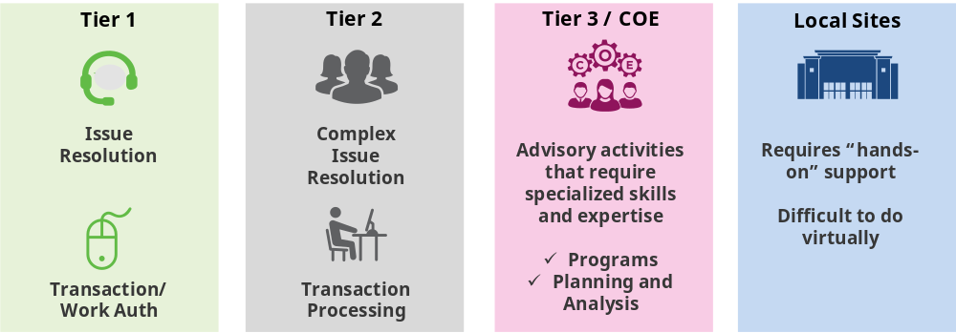
Overview
Service and Work Activity Alignment Exercise
  In order to design the most efficient and effective procurement delivery model, each procurement activity must be assigned to the “best fit” model tier. As a reminder, the model tiers are below:

Slide 27
Polling Question #5: Supplier Risk Management
Service and Work Activity Alignment Exercise
  Where would you suggest the following activity be placed in the tiered model? Aggregate risk information for selected suppliers and present risk analysis that can be used to evaluate that supplier’s risk across multiple domains such as the supplier’s financial health, geopolitics, source of raw materials, etc.
0%
4%
94%
0%

Slide 28
Polling Question #6: Data Analytics
Service and Work Activity Alignment Exercise
  Where would you suggest the following activity be placed in the tiered model? Combine and analyze data from multiple systems to gain insights into procurement operations and provide spend, supplier, and market analyses to support strategic sourcing.
9%
29%
62%
0%

Slide 29
Polling Question #7: Contract Administration
Service and Work Activity Alignment Exercise
  Where would you suggest the following activity be placed in the tiered model? Maintain contracts in a central location so they can be easily retrieved. Track contract expiration dates and notify contract owners of important upcoming contract dates. Periodically retrieve supplier administrative information (e.g., insurance certifications).
47%
39%
1%
4%

Slide 30
Polling Question #8: Contract Management
Service and Work Activity Alignment Exercise
  Where would you suggest the following activity be placed in the tiered model? Update contracts with new terms and conditions and commercial terms as required and advise on negotiated commercial terms and features of supplier performance.
1%
24%
71%
5%

Slide 31
Polling Question #9: Expediting
Service and Work Activity Alignment Exercise
  Where would you suggest the following activity be placed in the tiered model? Take action to find the status of a purchase transaction and determining if intervention is needed to meet service levels expected by your business unit customers.
69%
13%
0%
18%

Slide 32
Getting Started

Slide 33
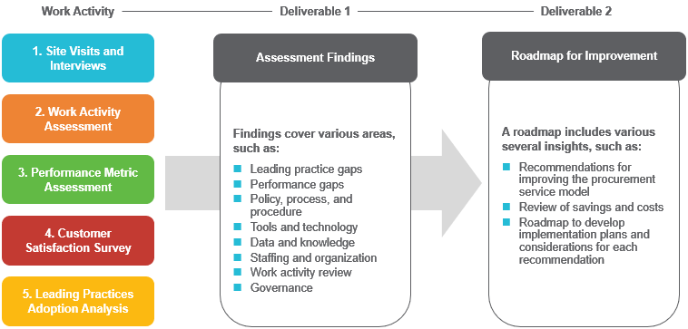
Getting Started
Transition to a Leading Procurement Delivery Model
  Conducting a procurement assessment provides a complete view of procurement performance, identifies the highest impact opportunities, and enables executives to design and pursue a clear path toward procurement transformation based on their industry and goals for maturity.
Notes:
Thanks, John. As you begin to think about how best to implement a leading practice service delivery model, it’s best to begin with an assessment. Whether you assess your organization internally or use an outside firm, we think it’s important to start with five specific inputs. First, it is important to conduct site visits and interviews. The sessions often provide context into “why” activities or metrics are what they are. If you look at the data alone, it’s easy to understand “what” is happening, but interviews allow you to understand business constraints, history, risks, and other items not apparent from the data alone.
Next is the work activity assessment. The focus of this is to understand the volume and dispersion of procurement-related work across the enterprise. Often, it’s difficult to understand how much time is being spent on an activity based on job title alone. We are also able to understand how skills are aligned to work. For example, if a senior buyer is spending a lot of time chasing data to answer vendor questions, there may be a misalignment. Gathering workload by activity also provides a source to compare to benchmarks and sets the baseline for a future business case.
Speaking of benchmarks, that is the third input we think is important during an assessment. Gathering data and comparing to benchmarks is helpful in the conceptual design. We think of benchmarks as directionally correct, but results need to be tailored to each company’s unique situation. They inform design, but it is not necessary to be top quartile in all benchmarks, depending on the unique goals of each transformation.
If companies don’t track internal customer satisfaction, we think it’s also important to conduct a survey early on. Within the survey, consider the procurement services being offered and look for feedback on use, importance, and satisfaction. Like the work activity assessment, this provides a baseline and informs the organization on how much change will likely be required. From our experience, customer satisfaction often dips during a major transformation, but recovers within a year of the new model and then sees improvements over baseline scores.
Finally, we suggest comparing existing practices to leading ones to uncover other potential improvement opportunities. We think about the adoption of leading practices across depth (how fully is the practice being performed) and breadth (how widely across the organization is it being performed).
By leveraging these five inputs, you can understand, in detail, your performance today. You also have insight into how to design the improved service delivery model, how to create the business case, and how to construct a roadmap to reach your goal of establishing a leading practice procurement delivery model.

Slide 34
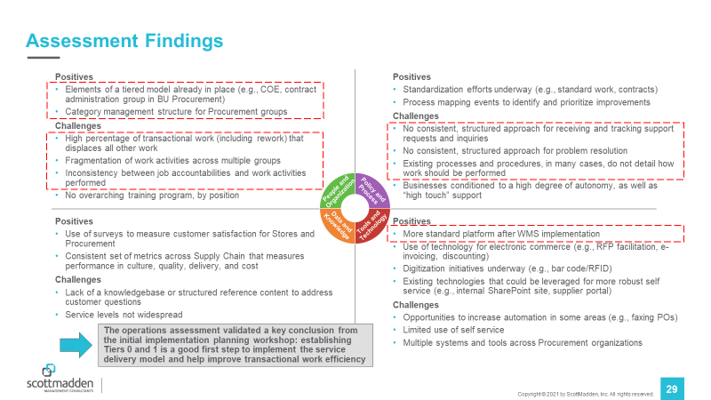
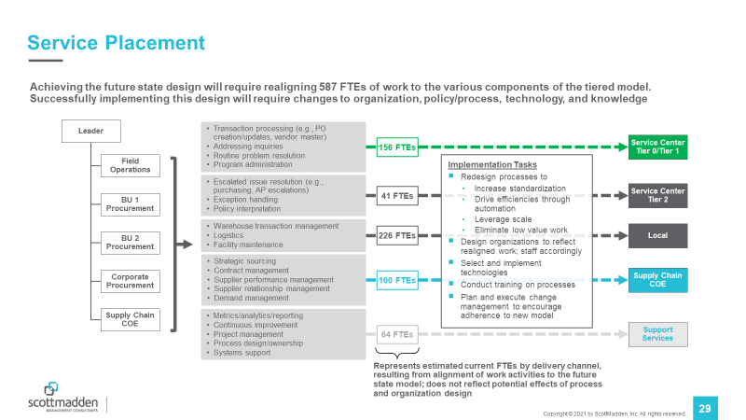
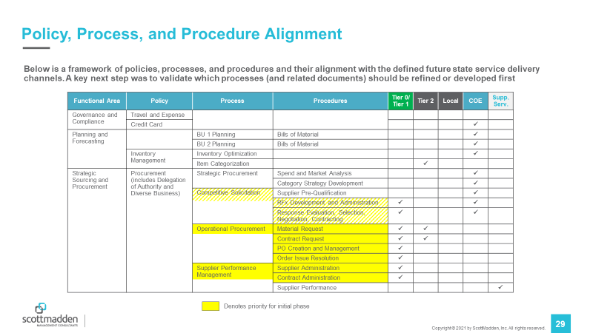
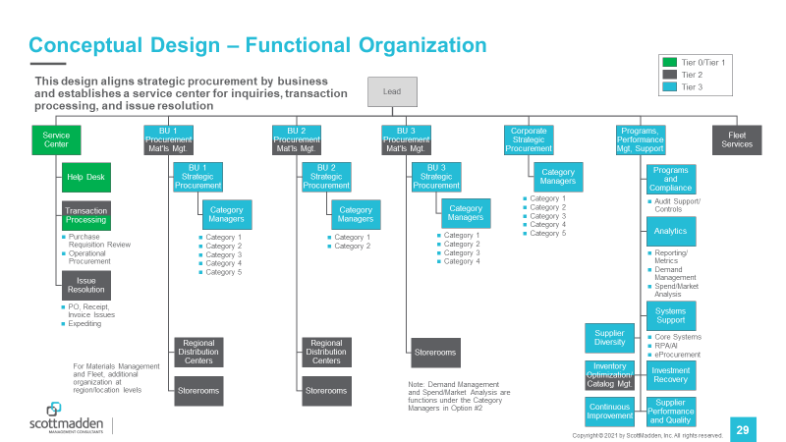
Assessment Results Inform Model Design
Getting Started
By completing an efficient assessment, key findings influence overall procurement service delivery model design, from service placement to process alignment to conceptual organizational structure.
Stakeholder interviews provide insight into policy and process, organization and staffing, tools and technology, and data and metrics
Service placement slots existing activities into a tiered delivery model based on the type of work being performed
Policy, process, and procedure alignment enables harmonization to provide a consistent, repeatable experience
Service placement, benchmarks, and ScottMadden experience enable tailored organizational designs
Notes:
On this slide, we share some of the output of an assessment and explain how they are helpful in implementing the new model. The examples to the right are cleansed samples from one of our recent engagements.
I mentioned the stakeholder interviews on the prior slide. Think about these in terms of policy and process, org and staffing, tools and technology, and data and metrics. It is also important to consider change readiness.
The output of the work activity assessment enables a discussion on service placement, which is the top right example. Service placement is the alignment of existing activities and FTEs to the tiers in the model that John described. We find that conducting the service placement exercise in a workshop provides transparency and promotes buy-in.
In order for the new service delivery model to be effective, policies, processes, and procedures need to be harmonized. By reducing the variability, the end user experience is much more consistent and repeatable. The harmonization effort is best done through a series of workshops.
Finally, the combination of the work activity assessment, benchmarks, and the service placement exercise provides the inputs needed to create the conceptual design. In this example on the right, the green items are tiers 0 and 1, the gray items are tier 2, and the blue items are tier 3, or centers of expertise.
Once the model design is complete, you are ready to implement.

Slide 35
Getting Started
Implementation Workstreams
Typical Implementation Work Streams
Planning and Project Management
Policies, Processes, and Procedures
Organization and Staffing
Communication, Change Management, and Training
Technologies
Facilities
Form implementation team (assign project lead and team leads)
Develop project tools and templates
Manage project. Track and report on project status
Identify and resolve issues and risks
Inventory procurement policies, processes, categories, and taxonomy
Document current state
Define procurement policy and process requirements
Redesign and document policies and processes
Design procurement organizational structure
Define procurement jobs
Create job descriptions
Price positions
Plan selection method
Post jobs
Evaluate and select candidates
Manage transitions
Assess impact of overall change on stakeholders
Build awareness
Build, execute, and monitor comms plan
Create and launch marketing campaign
Assess training and education needs
Build training plan
Conduct training and education
Evaluate existing customer care technologies
Evaluate existing procurement technologies
Evaluate automation technologies
Develop future state requirements
Select, buy/build, and implement technologies
Determine requirements for procurement service center and design facility (if needed)
Construct or renovate
Order and install equipment
Move in
Develop business continuity plan
Notes:
On this slide, we share the implementation workstreams that we recommend for a procurement service delivery transformation.
First, think about the project team structure, finalize your workplan, consider how best to track status and manage issues, and identify any potential implementation risks. This workstream is often one of the earliest to get started.
The second workstream is focused on policy and process harmonization, which we reviewed on the previous slide. Beyond harmonizing policies and processes, the outputs of this workstream inform technology requirements and role definition. We also tend to see the resources involved in process harmonization transition to training development later in the implementation.
The next workstream is organization and staffing. Here we are taking the conceptual organizational design down to the next level. We are finalizing job descriptions, determine staffing philosophies, and selecting candidates. A big part of this also includes managing and tracking all resource transitions.
Communications, change management, and training is the next workstream. This workstream is required throughout the transition. Early on, the focus is on assessment stakeholders and managing alignment between leaders. Then the focus shifts to building awareness. Thinking about the communications plan is critical as you’ll need to consider the audiences that will be impacted and multiple communications vehicles to share the message. This workstream also includes training, which begins with a training plan and continues past implementation with refresher training.
As you might expect, the long poll in the tent is often technologies. We think of technology in several categories. First are the service management technologies, like case management, knowledgebase, and employee portal. Then there are functional technologies like ERPs, spend analytics, and vendor portals. Finally, we consider automation capabilities including things like robotics process automation.
Depending on your transformation, you may also have to take into account facilities.
Throughout the implementation, the workstreams are working closely together. Some resources may work on multiple workstreams, like the process and training I mentioned earlier. Sometimes, org and staffing resources are able to support change management and communications. Typically, the project has a core team of dedicated resources, but there are also a number of subject matter experts who are only involved at certain times.

Slide 36
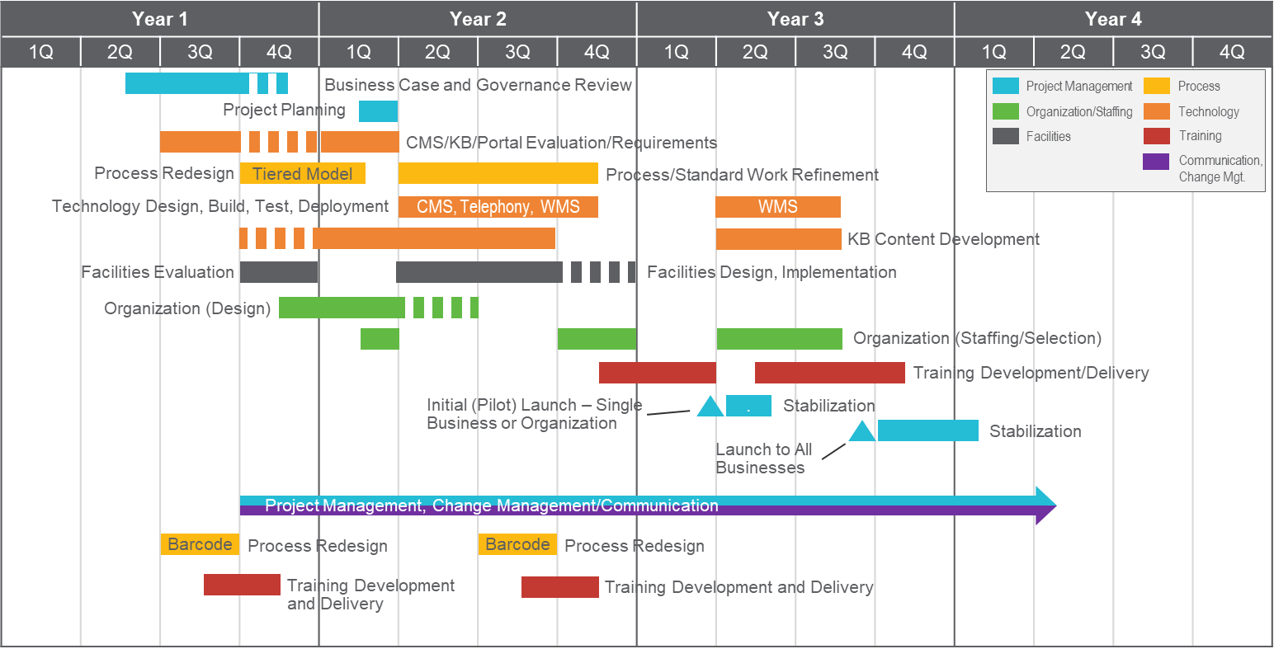
Getting Started
Implementation Roadmap
Notes:
On this page, you can see an example of how it all comes together. This is a high-level plan from one on our recent clients. You can see that many of the workstreams are active at the same time and that some, like the organization workstream, are activity at different times based on how the implementation is phased. We recommend a pilot or early adopter to test the solution so that it can be refined before broader deployment.
In this example, the full transformation takes about three years. This is a large, complicated implementation, so it is on the longer side of implementation durations. About the fastest we’ve seen this model implemented is 9-12 months, but most are implemented in the 18-24 month time range.

Slide 37
Getting Started
Leading Practices During Implementation
Involve stakeholders early and often.
Implement (and test) well-defined, tier- escalation criteria.
Identify all stakeholder groups (e.g., suppliers, technology providers, lines of business contacts, and material planners)
Create detailed plans for stakeholder groups to ensure adequate communications throughout the SDM transition
Define use cases for all types of purchases (e.g., PO and Non-PO, Special Handling and Non-Special Handling)
Document and test procurement handling processes for all use cases and all tiers
Make detailed accountabilities clear, by group and role.
Aggressively simplify and streamline policies and processes.
Define procurement responsibilities by group as part of the creation of the tiered SDM
Assign and document individual accountabilities and performance measures at the role level
Review and streamline all procurement-related policies as part of the planning for the transition to the new SDM
Revise process documents from the user’s perspective; reduce process steps and minimize hand-offs wherever possible
Leverage analytics before, during, and after the transition.
Treat technology as an enabler, not a panacea.
Ensure assessment fully describes current state procurement metrics and costs
Provide dashboard reporting to stakeholders to focus attention on key enablers of success and drive desired outcomes (e.g., Procurement Cycle Time, Procurement ROI)
Ensure that revised processes leverage technology to simplify, not complicate, work
Focus on technology dependencies (e.g., category taxonomy, inventory data quality, process simplification, training, and knowledge base creation)
Notes:
Over the course of implementing these models many times, we have learned several important lessons.
First, involve stakeholders early and often. One of the most difficult things to do in an implementation like this is to keep executive stakeholders aligned. Creating detailed plans for stakeholder groups will allow you to actively manage engagement.
Next, implement well-defined tier escalation criteria. The purpose of this is to determine when and why a case might be escalated from tier 1 to tier 2. Building use cases for every scenario will ensure that guidelines are in place to manage escalations.
Make detailed accountabilities clear, by group and by role. Make sure that responsibilities are mutually exclusive and collectively exhaustive so that no gaps or redundancies exist. Where possible, build performance measures by role.
Aggressively simply and streamline policies and processes. Where you can, eliminate multiple processes for the same activity and look for ways to automate manual, routine work. Also think about processes from the user’s perspective and design from the outside in.
Leverage analytics throughout the process. Make sure you understand baseline metrics, whether that be customer satisfaction, costs, efficiency, or performance. Track and manage progress of these throughout the implementation. It is important to show improvement with data, especially with so much change underway. Invariably, someone will say it was better the old way, so it’s good to have data to demonstrate otherwise.
Finally, treat technology as an enabler. Technology is not a silver bullet and isn’t effective unless all of the process-related blocking and tackling is completed effectively. Understanding technology requirements and dependencies are critical.

Slide 38
Getting Started
Implementation Hallmarks of Success
An effective procurement delivery model implementation that leverages leading practices will speed adoption, minimize disruption during the procurement process transition, and achieve the benefits and savings outlined in the business case that supported the roadmap.
Communications throughout the implementation are frequent and transparent, and lead to a “no surprises” transition
Results can be seen soon after launch (e.g., reduced cycle times for invoice processing, reduction in hand-offs within procurement processes)
Use of technology increases rapidly due to awareness of the changes, increased functionality, and improved on-line support
Stakeholders understand the process and system changes and know who to contact for purchasing assistance
Procurement staff have clearly defined roles and responsibilities
Reporting and analytics provide transparency of purchasing status and spend
Data quality issues (e.g., inventory counts, category and sub-category designations) and knowledgebase content availability are addressed during implementation planning and support a successful launch
Suppliers are aware of the transition and benefit from reduced transaction costs and improved efficiency
Notes:
So what does good look like? How can you tell if you are implementing effectively?
We’ve noticed a few things that we look for on procurement transformations. I won’t go through each of these, but I’d like to draw your attention to a couple.
First, results can be seen soon after launch. You shouldn’t have to wait months after implementation to see a marked improvement.
Second, technology adoption is rapid. Through effective communication, testing, and training, users should see the advantage of the new tools.
Third, suppliers are aware of the transition. Through dedicated campaigns, suppliers should be able to see “what’s in it for them” and how they benefit from the new model.
Good luck in your transformation journey and we hope that this has been helpful.

Slide 39
Wrap Up

Slide 40

Wrapping Up
  Thank you for attending today’s presentation!
  If you would like a copy of today’s presentation, please use the QR Code to submit your name and email.
  Enjoy the rest of the conference!
Stop by our kiosk in the Technology Neighborhood!

