Slide 1
Energy Imbalance Market
Considerations for Joining CAISO’s Energy Imbalance

Slide 2
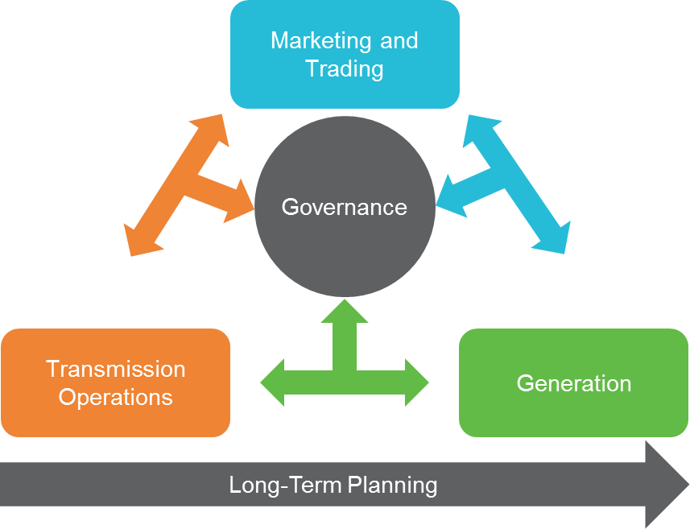
Introduction
In this presentation, we will look at the operational considerations for joining the Energy Imbalance Market (EIM) across the following categories:
  Marketing and Trading
  Transmission Operations
  Generation
  Governance
  Long-Term Planning
There are other considerations for joining EIM, such as meter data management and settlements, but this presentation is focused on the coordination of these activities.

Slide 3
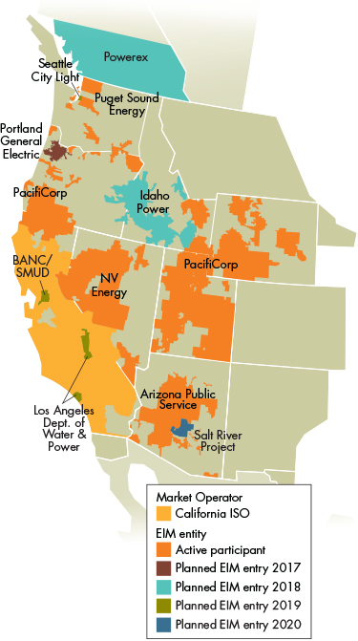
CAISO’s EIM Is Growing Rapidly
CAISO established the western EIM, a real-time wholesale energy trading market, in 2014 with PacifiCorp. Since its inception, new members have been added at a pace of one to two per year with the following additional entrants planned currently through 2020:
  2017 – Portland General Electric
  2018 – Powerex
  2018 – Idaho Power
  2019 – Los Angeles Department of Water and Power
  2019 – Balancing Authority of Northern California/Sacramento Municipal Utility District
  2020 – Salt River Project
The current participants (PacifiCorp, Puget Sound Energy, NV Energy, CAISO, and Arizona Public Service) have realized $70.6 million in benefits through the first half of 2017.²
The benefits of EIM participation include customer savings as well as the following:
  Increased reliability
  Increased renewable resource integration
The increased growth in CAISO’s EIM market participants will yield more benefits to each participating company and plant.
Sources:
https://www.westerneim.com/Pages/About/default.aspx (graphic)
https://www.westerneim.com/Pages/About/QuarterlyBenefits.aspx

Slide 4
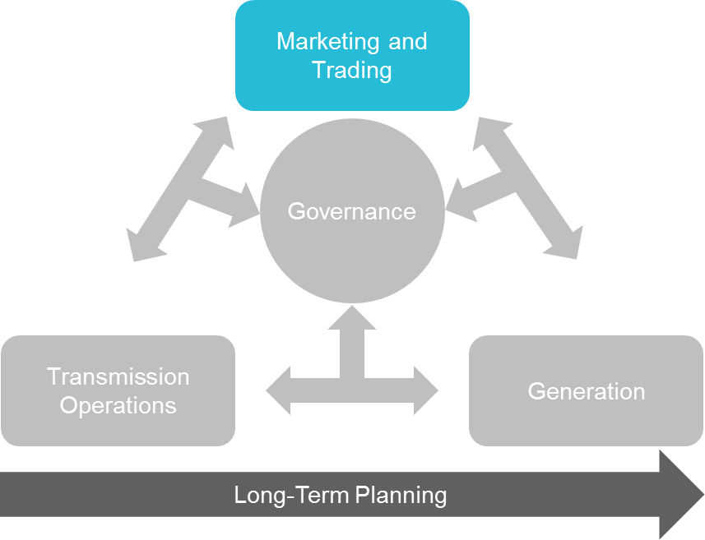
Considerations for Joining EIM- Marketing and Trading
As discussed, joining EIM has many benefits. As a vertically integrated utility, what do we have to do to realize these benefits? The following considerations can help start the conversation:
  EIM day-ahead and real-time operations must be integrated into your overall merchant function
    How does EIM impact our hedging and balance of month trading strategies?
    How do we ensure that the trading activities are optimal for observed trends in the day-ahead and real-time markets?
  Communication between Marketing and Trading, Transmission Operations, and Generation (duty officers, etc.)
    Who makes the call when a significant operating event occurs (loss of transmission, forced outage, abnormal weather events) and to whom?
    How will we navigate standards-of-conduct issues while having these communications (Marketing and Trading side)?
  How do we analyze EIM market data in order to correctly evaluate performance for our organization?
  How do we manage the handoff within the operating hour at T-55 between the Marketing and Trading and Transmission Operations functions?
The Marketing and Trading function of your organization must be configured differently to fully take advantage of EIM participation.

Slide 5
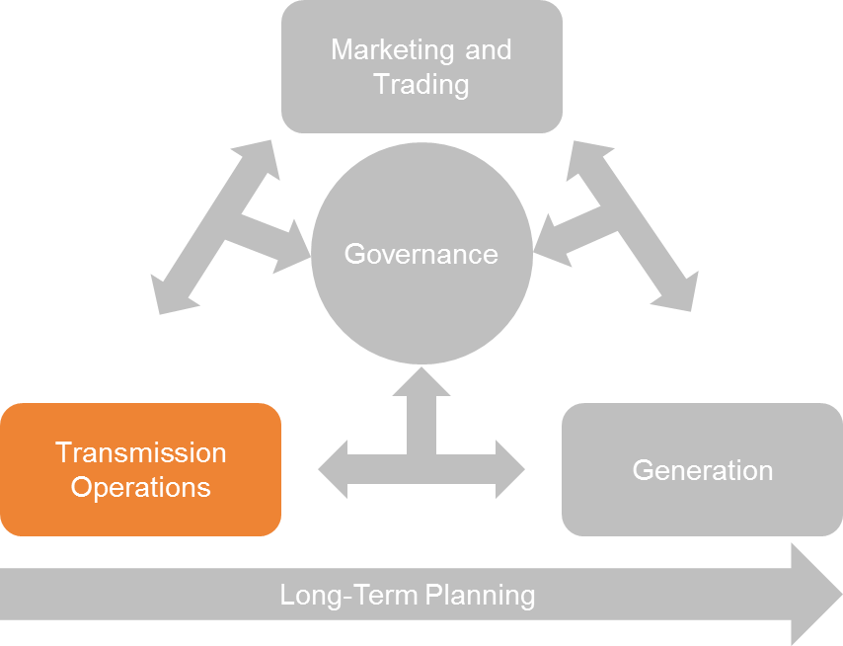
Considerations for Joining EIM – Transmission Operations
Transmission Operations will be impacted due to the focus that will be put on assigning available transmission capacity to EIM operations. Some additional considerations are as follows:
  How do we navigate the standards of conduct between the merchant and transmission functions for EIM operations (Transmission side)? Do we all thoroughly understand what can and cannot be shared for the performance of EIM operations?
  What transmission planning projects will impact our transmission capabilities?
    Are these reflected in the full-network model (submitted to CAISO)?
    How will we ensure deviations are identified quickly and incorporated into our market models?
  Are there any EIM implications that would cause us to reconsider the forthcoming transmission capital projects/ improvements?
  Who makes the call, when does he or she make the call, and who receives the call?
    A forced outage or derate occurs?
    A transformer blows, or a substation has a significant fault?
    Weather changes significantly from predicted?
  Who sets the standards of when a call is required or when we trust our systems?
In order to optimize your success in EIM, you must decide how your merchant, wires, and generating units will talk to each other.

Slide 6
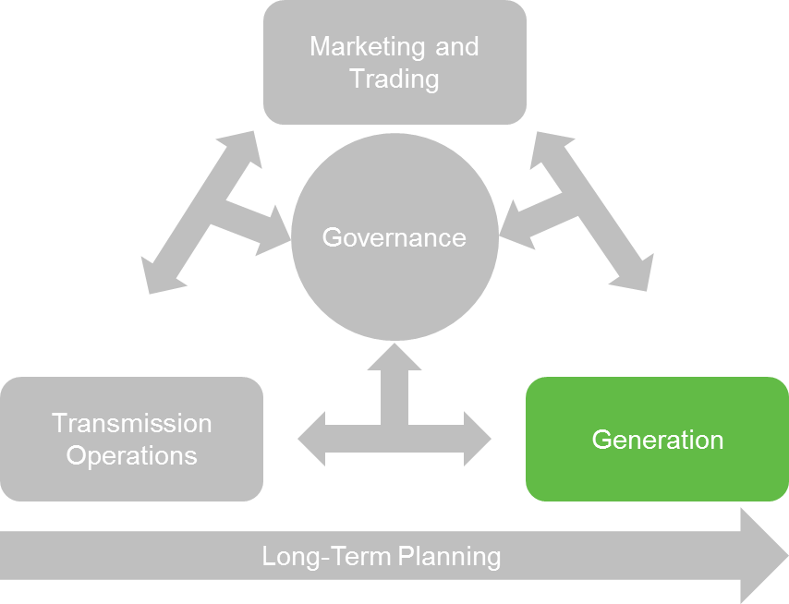
Considerations for Joining EIM – Generation
A vertically integrated utility accustomed to operating its balancing authority area with a significant degree of autonomy will have to make adjustments in how it brings generation online once participating in EIM
  Generation data needs to be accurate, answering questions like:
    What are our ramp rates in practice?
      How does weather influence them?
      How is our dispatch impacted by market prices?
    What planned outages/derates do we have upcoming?
    How flexible are we in our dispatch? What conditions would cause us to adjust our load stack (fuel prices, emission standards, etc.)?
  How do we represent renewable generation? Are our models sufficient?
  How do we ensure that plant managers/duty officers know who to call to ensure adjustments can be made for Transmission Operations and Marketing and Trading considerations in real time?
Generation needs to understand that participation in EIM results in penalties if the operating parameters submitted in the generation resource data template are not adhered to. This requires a higher level of operational discipline.

Slide 7
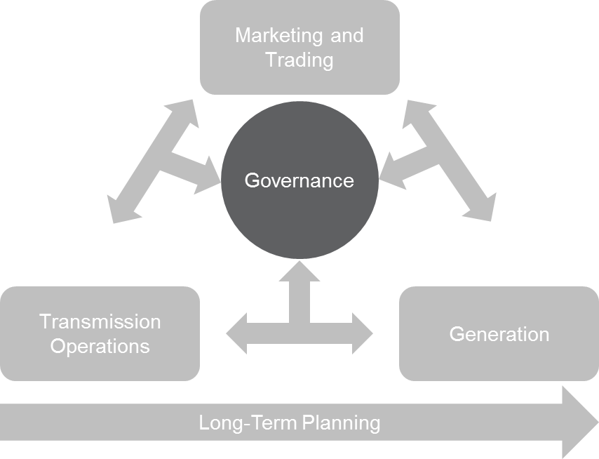
Consideration for Joining EIM – Governance
Once your company joins the EIM, long-term governance is a critical issue. There are many items to consider pre- and post-EIM participation:
  How will we govern EIM Operations post-go-live?
    How will issues be identified and escalated?
    Who will be the ultimate decision maker to resolve cross-functional issues?
  How will we report and measure performance for EIM operations as a whole?
    For Marketing and Trading?
    For Transmission Operations?
    For Generation?
  How will we interact with the EIM user groups post-go-live?
  How will we take informed positions on proposed EIM enhancements?
  Additional organizations that must be considered:
    Finance & Accounting (settlements)
    Risk Management
    Compliance
    Resource Acquisition
    Asset Management
A pre-defined governance structure for joining EIM can ensure that the correct decision makers are consulted and engaged to make the appropriate decisions for your organization.

Slide 8
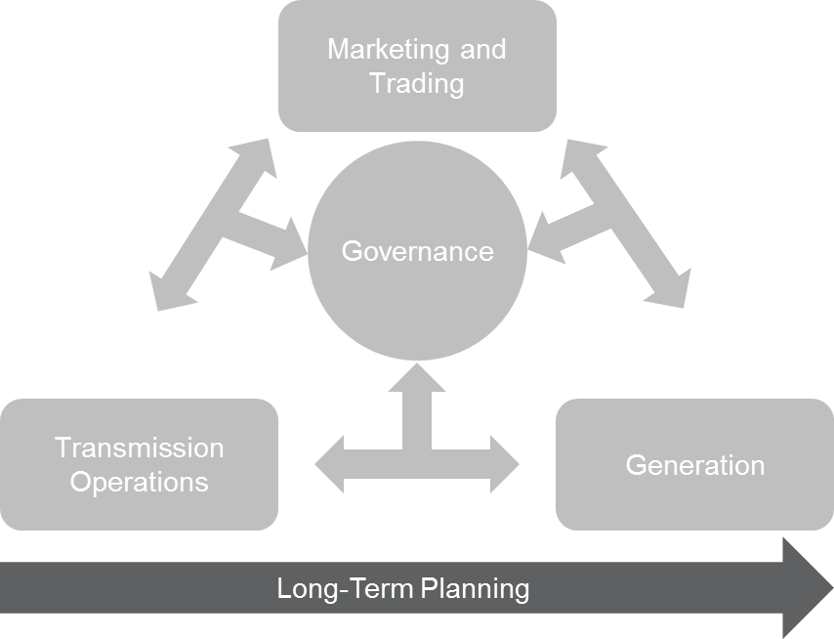
Considerations for Joining EIM – Long Term Planning
The EIM is an energy-only market, which means that each participating balancing authority area is still required to make unit commitments, maintain reserve requirements, etc. Therefore, many aspects of a vertically integrated utility’s plans will not change, but there are some important questions that should be factored into your planning processes such as:
  Asset Management (generation considerations)
    Which units will we want to participate in the EIM? Which units will we not?
    How will we meet our renewable goals/requirements?
  Asset Management (transmission considerations)
    How well is our transmission set up to take advantage of EIM with the current players?
    How well are we set up to take advantage of future players?
    What transmission is coming into service in the next five years?
    Should we consider additional interties or reducing existing agreements that influence available transfer capacity (e.g., PPAs)?
  Integrated Resource Planning
    How will EIM participation impact our integrated resource planning?
    How will EIM participation impact our generation and transmission investment choices?
EIM participation necessitates a review of your longer-term planning organization’s strategy to see how you should invest in your business now and in the future.

Slide 9

Contact
John Pang
Partner
2626 Glenwood Avenue
Suite 480
Raleigh, NC 27608
johnpang@scottmadden.com
919-781-4191

