Slide 1
Blockchain: An Introduction for Executives
Making Sense of the Buzzwords

Slide 2
Table of Contents
  Introduction
    Background
    Key Findings
  What Are Blockchains?
    Decentralized Data Structures
    Customizable Ledgers
    Stores of Value (identities, assets, and data)
  How Do Blockchains Work?
    Transaction Life Cycle
    Cryptoeconomics 101
    Mining
    Practical Byzantine Fault Tolerance
    Forking
  Current State
    Foundational Applications
    Commercialization: IBM vs. Microsoft vs. R3
    Technical Developments: The Cutting Edge
  Next Steps
    Putting Distributed Ledger Technologies on the Radar

Slide 3
Introduction
"You never change things by fighting the existing reality. To change something, build a new model that makes the existing model obsolete."
- R. Buckminster Fuller

Slide 4
Background
Introduction
The world is growing more decentralized, in large part due to the transformative power of the internet.
  While originally thought to be isolated to use cases such as email and news media, the internet laid the foundation for unprecedented, multi-billion dollar industries and innovations such as ecommerce, social media, the cloud, smartphones, and online gaming
  However, the internet also enabled activities like identity theft, unwarranted surveillance, and the monopolization of personal data
  Blockchains bring security and privacy to the decentralized, digital world potentially addressing many of these undesirable consequences of the internet
  Blockchain technology carries a similar revolutionary potential to that of the internet, though be wary of the hype.
  By making certain data immutable and shared across a network, blockchains allow value to be digitized, exchanged, and recorded without the facilitation (and cost) of a trusted third party – something truly unprecedented
  This means that any industries not already disrupted by the internet whose services include data collection, curation, verification, and/or dissemination could now be disrupted, especially those that are currently centralized and monopolized (e.g., banking)
  This also means that services previously susceptible to malpractice once digitized (e.g., voting and music sharing) can now be safely and securely brought into the 21st century
  And finally, this means that the tedious activities associated with data silos and imperfect communication, like filling out a medical history form every time we visit a new doctor, can be things of the past. We can now make (and own) one record that’s stored on an immutable, append-only blockchain, and anyone we select can reference our record anywhere at any time
  Despite this awesome potential, we are still very much in the early 90s of the blockchain adoption and development curves. Much work has yet to be done as the technology matures, and business cases are only beginning to be flushed out. The priority now is to learn and pursue low-risk pilots
SOURCE: CoinDesk

Slide 5
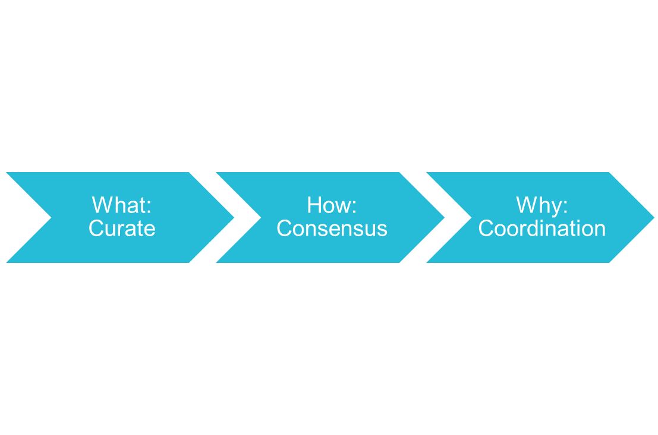
Key Findings
Introduction
Digital trust is expensive. Blockchains can makes it unnecessary.
  With blockchains, the trust we ordinarily rely on to exchange goods and services online is replaced by a single shared system of record that maintains all transactions, past and present, as well as the rules by which those transactions are governed
  These omniscient records consolidate the functions of markets, contracts, and ledgers into secure, automatable platforms with no centralized points of control
  As foundational technologies, their purpose is to reduce transactional friction and provide the infrastructure required to build new, potentially disruptive applications
  Three takeaways
    Blockchains are customizable, decentralized digital ledgers maintained by a network of peers using well-established cryptographic techniques
    Blockchains operate through network consensus to record and manage anything of value, including identities, assets, and data
    Blockchains enable unprecedented coordination in competitive environments, which lowers transaction costs while increasing transaction speeds, distributing risk, and creating new opportunities to develop value-added services
SOURCE: CoinDesk

Slide 6

What are Blockchains?

Slide 7
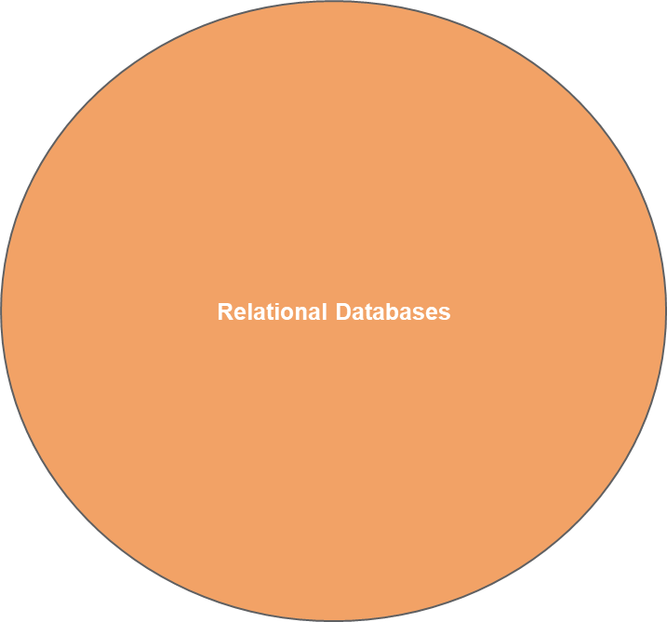
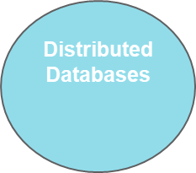
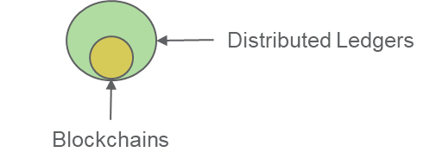
Decentralized Data Structures
What are Blockchains?
Blockchains are kinds of organizationally decentralized databases.
  Traditional relational databases store data in tables where it is then accessed using SQL queries (think Microsoft Access or SQL Server). These centrally managed databases comprise more than 90% of the market in terms of revenue
  The remaining 10% of the market is comprised of distributed databases, which are stored across networks for the purpose of distributing risk and leveraging the simultaneous computing power of multiple processors (think BitTorrent)
    To ensure data integrity, these databases employ consensus mechanisms and concurrency controls such as locking and/or timestamping
  Distributed ledgers are a special kind of distributed database
    They leverage cryptography in their consensus and concurrency control mechanisms, which allows them to decentralize read/write access, ensure privacy, and secure transactions in competitive environments
  Blockchains are a kind of distributed ledger
    In addition to cryptography, they leverage cryptoeconomics and game theory in their consensus mechanism to incentivize rule following and ensure the platform's continuous development
SOURCE: Blockchain technology – a very special kind of Distributed Database - Sebastien Meunier on Medium

Slide 8
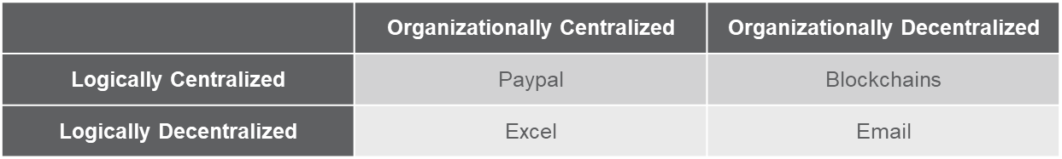
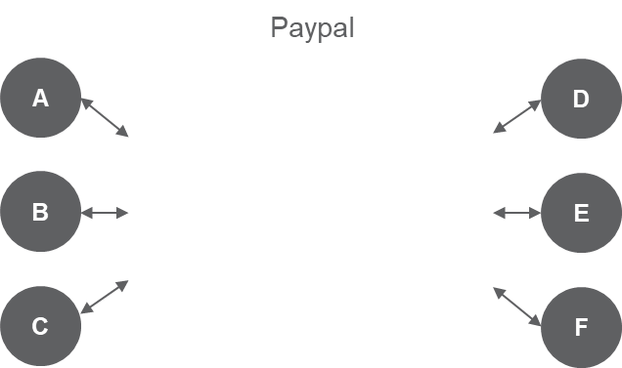
Decentralized Data Structures (Cont’d)
What are Blockchains?
While they are organizationally decentralized, blockchains are simultaneously logically centralized.
  Blockchains are not controlled by any one entity whether for profit or otherwise, yet they provide the same information to anyone who accesses them
  Until 2008, this wasn’t possible at scale, especially in competitive environments lacking trust
The result is a drastically different transaction landscape where peers can now collaboratively maintain a single shared ledger.
  Unlike currently centralized models, a copy of the blockchain is kept by each peer in the network, and the peers are connected directly to one another without intermediation
Blockchains
Account | Balance
A | 1
B | 2
C | 3
D | 4
E | 5
F | 6
1
2
3
4
1
2
3
4
A
C
B
D
1
2
3
4
1
2
3
4
SOURCE: CoinDesk

Slide 9


Customizable Ledgers
What are Blockchains?
This new kind of ledger is made of simple, customizable elements that combine to form complex objects and behaviors.
Base
Network (e.g., Internet, Bluetooth, Mesh)
Programming Language and Virtual Machine
Core Components
Hash Functions
(Uniquely Encrypt/Decrypt and Compress)
Digital Signatures
(Authenticate and Secure)
Tokens
(Chains of Digital Signatures Represent Value)
“A paid B
10 tokens”
ac75431b
“A paid B 100 tokens”
bdA5399
Public
Private
Assemblies
Transactions
Blocks*
Smart Contracts
From
Signature
SC
T
Signature
From
T
T
T
T
SC
T
SC
Code
T
To
Amount
Amount
*Transactions and smart contracts are organized in Merkle trees within blocks for purposes of efficiency
SOURCE: CoinDesk; Bitcoin and Cryptocurrency Technologies
B1

Slide 10

Customizable Ledgers (Cont’d)
What are Blockchains?
Supplementing these elements are two rule-based procedures required to maintain data integrity.
Communication
(Propagation)
Consensus
(Network Validation)
1
2
2
1
1
2
3
3
2
1
A
C
A
C
A knows of a new block of transactions and smart contracts and informs the network
3
All nodes check the new block against their blockchains and inform the rest of the network of their findings
If all nodes agree, the block is added to all of their blockchains. Otherwise, the block is discarded
3
B
D
B
D
1
2
2
1
1
2
3
3
2
1
Blockchains result from the combination of these elements and protocols.
  The major variations between blockchain designs arise from different choices in consensus protocols and token schemes
  Other variations may arise from differences in hash strengths and/or the robustness of the blockchain’s programming language
Block 1
(Genesis Block)
Block 2
Block 3
Block 4
Block 5
A
Block 6
C
SC
T
B1
B2
B3
B4
B6
T
T
T
T
T
T
SC
T
SC
T
T
SC
T
SC
T
SC
T
T
T
T
T
T
T
T
T
SC
T
SC
T
T
T
T
SC
T
T
T
B
D
B1
B2
B3
B4
B5
SOURCE: CoinDesk

Slide 11
Stores of Value
What are Blockchains?
Just like ordinary ledgers, blockchains can record anything of value while also indicating ownership.
  Identities: contracts that encode the notion of identifying a unique individual actor
  Assets: contracts that model ownership over a particular amount of a class of “stuff”
  Data: contracts that ascribe information to other entities within the ecosystem or otherwise supply “global” information (e.g., about off-chain externalities)
  Combining these primitives allows us to glimpse some of the potential applications for blockchains.
Identities + Assets
Identities + Data
Assets + Data
First Order Applications
  Certification: association without ownership
  Asset tracking: making fungible assets individual
  Judged-escrow: combining appeal to an identifiable authority and ownership
  Bonded identity: assets attached to identities that are controlled externally
  Reputation: a means of linearly measuring an entity’s virtuosity
  Badges: non-transferable, non-linear attributes attached to identities
  Oracles: allow identities to vouch for data
  Asset classification
  Insurance: escrow services where assets are dispersed depending on particular data
  Gaming: risk-related insurance offerings
  On-chain currencies: tie to real-world value feeds
Second Order Applications
  Court: combine data and reputation to determine truth, and use bonded identities to transfer assets from culprits to victims
  Transparent supply chain: combine certification and asset tracking
  Credit ratings, KYC: higher-order reputation systems
  Marketplace: reputation plus virtual retail enables on-chain currencies to be exchanged for off-chain assets
  Virtual retail: on-chain currencies and assets
  Trade finance: combine credit ratings, on-chain currencies, and asset tracking to provide cheap, flexible, and reliable liquidity
SOURCE: So Ethereum is Released - Gav Would on Medium

Slide 12

How do Blockchains work?

Slide 13
Transaction Life Cycle
How do Blockchains Work?
From 30,000 feet, the standard operation of a blockchain is straightforward and (can be) nearly instantaneous: (read clockwise) initiate, announce, validate, corroborate, settle.
Initiate
(A decides to exchange with B)
A
T
B
Settle
(If all peers agree, the transaction is added)
Announce
(A informs all peers of their exchange with B)
1
2
3
3
2
1
1
2
2
1
A
C
A
C
T
3
3
T
B
D
T
3
B
D
3
T
1
2
3
3
2
1
1
2
2
1
Corroborate
(All peers then share their findings)
Validate
(All peers independently validate the transaction)
1
2
2
1
1
2
2
1
A
C
A
C
T
3
3
T
3
T
B
D
T
3
B
D
3
T
1
2
2
1
1
2
2
1
SOURCE: CoinDesk

Slide 14
Cryptoeconomics 101
How do Blockchains Work?
However, at 15,000 feet, the story isn’t as simple…though it is more interesting.
Underlying blockchains is cryptoeconomics, which is a tool used to build systems that have certain desired properties by using cryptography to prove properties that happened in the past while using economic incentives defined inside the system to encourage desired properties to hold into the future.
Cryptography
  Hashes: prove topological order of messages
  Signatures: prove the identity of the sender of a message
  Consensus protocol: proves that a certain amount/kind of energy was exerted
  Time locks and sequential protocols: prove that some amount of time elapsed between messages A and B
Economics
  Tokens: incentivize actors by assigning them units of a protocol-defined cryptocurrency (e.g., block rewards)
  Privileges: incentivize actors by giving them decision-making rights that can be used to extract rent (e.g., transaction fees)
  Rewards: increase actors’ token balances or give them privileges if they do something good
  Penalties: Opposite of rewards
Key Concepts
  Cryptoeconomic security margin: an amount of money such that you can prove “either a given guarantee is satisfied, or those at fault for violating the guarantee are poorer than they otherwise would have been by at least the given amount of money”
  Cryptoeconomic proof: a message signed by an actor that can be interpreted as “I certify that either P is true, or I suffer an economic loss of size X”
  Faults: include invalidity, equivocation, ignoring inputs, delaying outputs, and latency
Mining is at the intersection of cryptography and economics.
It is what ensures both security and value and is, therefore, indispensable.
SOURCE: Ethereum Foundation

Slide 15
Mining – Proof of Work
How do Blockchains Work?
Blockchains leverage mining in their consensus protocols to eliminate the need for trust.
  Blockchains operate in competitive environments. As such, they require an objective means by which all participants can come to the same conclusion about the validity of new transactions and the integrity of all historical transactions
    They achieve this through a process called mining, which simultaneously validates new and existing blocks while producing new tokens. Once validated, the network is informed of the mined block and proceeds to verify its validity by decrypting its hash
    The most common mining protocol is known as Proof of Work, which involves exerting computing power to solve a difficult puzzle
Nonces
(Arbitrary Character Strings Used Once)
Difficulty Algorithm
(Proportional to Hash Rate)
Blocks
(Include Nonce and Mined Transaction)
“A paid B
10 tokens”
Hash Rate
N
B
x
ac75431b
Determines # of preceding zeros required
T
SC
T
000abc7B
y
“A paid B
10 tokens”
089ddC1
T
T
T
SC
nonce
message
output
Time
New tokens issued to miner
Miners
(Nodes Competing to Find Winning Nonce)
1
2
2
1
  Advantages
  Fraud resistant
  Incentivizes rule following
  Mitigates propagation of spam
  Limitations
  Energy intensive
  Incentivizes resource centralization
  Limits transactions per second
A
C
ac75431b
x
z
10789Bc
089ddC1
y
B
D
w
DaA3098
1
2
2
1
SOURCE: CoinDesk

Slide 16
Mining – Proof of Stake
How do Blockchains Work?
Proof of Stake is the second most common mining protocol used in blockchains.
  In order to eliminate the inefficiencies associated with Proof of Work, Proof of Stake replaces the hardware costs implicit within Proof of Work with token costs that represent the stake of each node in the network
    By internalizing the previously externalized costs of the network, a lottery algorithm can be employed that selects among a self-nominated group of nodes using a probability distribution proportional to each node’s stake; this prevents wasted effort
    The selected node is the designated miner who informs the rest of the network which block (and contents) should be added
    Participating miners must store the entire blockchain, and their incentive to tell the truth lies in the transparency of the verification process
Miners
(Self-Nominated Nodes Compete to be Selected)
Lottery Algorithm
(Probability Proportional to Stake)
Blocks
(Include Mined Transaction)
1
2
2
1
B
A
C
C
A
SC
T
T
398abc7B
D
T
T
B
D
B
T
SC
1
2
2
1
New tokens issued to miner
  Advantages
  Minimally energy intensive
  Incentivizes rule following; penalties
  Increases transactions per second
  Limitations
  “Rich get richer”
  Enables propagation of spam
SOURCE: CoinDesk

Slide 17
Practical Byzantine Fault Tolerance
How do Blockchains Work?
Distributed ledgers do not employ mining, but instead rely on a subset of trusted validator nodes to achieve consensus.
  Instead of mining, which involves monetary incentives to ensure rule following and network upkeep, distributed ledgers are typically maintained through external investment via consortia or other similar entities
    Since all, or most, nodes are known, these networks can select a subset to serve as validators while the rest simply introduce and execute transactions and/or smart contracts
    A common consensus protocol in these networks is known as Practical Byzantine Fault Tolerance (PBFT)
Non-Validating Peers
(Ordinary Nodes Participating in the Network)
Validating Peers
(Special Nodes Participating in the Network)
Validating Leader
(Nominated Validating Peer)
A
B
C
D
E
PBFT Consensus
(Validating Leader orders the transactions, which are then voted on by the Validating Peers and disseminated to the Non-Validating Peers)
  Advantages
  Fraud resistant
  Private, with known participants
  Speed and efficiency
  Limitations
  Relative centralization
  Limited internal incentive to validate
  Mutable
T
T
T
C
A
E
D
B
SOURCE: CoinDesk

Slide 18
Forking
How do Blockchains Work?
When consensus can’t be reached, the network induces a fork in the blockchain. These forks are usually ephemeral, since it is in the best interest of the network to maintain a single chain of truth.
  Forks are most commonly resolved in accordance with the consensus protocol, which requires blocks to be added to the longest existing chain that each node is aware of
  On occasion, forks are produced intentionally. This can happen for a number of reasons:
    A soft fork is one in which a backwards-compatible upgrade is introduced by certain nodes and not others
      These forks can be used to gradually update the entire network; however, they can also be employed to introduce a new distributed application that runs parallel to the main blockchain and which is intentionally maintained
      The benefits of soft forks include interoperability with the main blockchain and the ability to customize microeconomic exchanges
    A hard fork, on the other hand, is one in which an upgrade is introduced that is not backwards-compatible. It is effectively restarting the blockchain
      These are very rare and typically require 95% or more of the network to adopt before becoming effective
DApp Upgrades
Fault
DApp
6a
9
10
11
12
1
2
3
4
5
6b
7
8
9
10
11
10
11
12
Network Upgrade
SOURCE: CoinDesk

Slide 19
Current State

Slide 20
Foundational Applications
Current State
As a foundational technology with immense disruptive potential, it is important to understand when and where blockchains should and should not be considered in place of traditional solutions.
1.
Bridging Data Silos
  Blockchains enable peers to record and access data using a single shared source
  This can bring substantial efficiencies to systems connecting multiple organizations while retaining privacy and security
  Note: blockchains are most beneficial when allowed to experience network effects. Thus, implementations with limited potential for these effects should be considered carefully
2.
Disintermediating Markets
  Markets are made complex by the addition of costly intermediaries that facilitate transactions on behalf of participants
  Blockchains can employ smart contracts that automate the function of intermediaries and simplify markets
  Note: blockchains will not necessarily eliminate intermediaries, but blockchains will significantly impact their value propositions. To stay competitive, traditional intermediaries will have to develop new peer-focused products and services
3.
Securing Information
  Unlike centralized alternatives, the redundant storage of the blockchain on each node in its network provides security from targeted attacks while providing an always-on capability like that of the internet
  Moreover, a blockchain’s cryptoeconomic architecture ensures immutability and privacy, making it an efficient medium to store valuable, personal information
  Note: blockchains can also be used to store public information and ensure data integrity over time
Blockchains are best applied in environments where communication is flawed, trust is priced at a premium, and data integrity is highly desirable.
SOURCE: CoinDesk

Slide 21



Commercialization: IBM vs. Microsoft vs. R3
Current State
Three very different approaches to commercialization have arisen, each attempting to provide privacy and scalability. However, much like the internet, industries will naturally shift to fewer, interoperable blockchains – a single version of the truth.
“Blockchain-as-a-Service”
  A suite of cloud services to help clients create and manage blockchain networks
  Based on and almost exclusively supports Hyperledger Fabric’s codebase
  Hyperledger
  Founding member; direct control over codebase
  Developing private DApps on top of a private distributed ledger using open-source code
  Consensus at the ledger level
“Blockchain-as-a-Service”
  Cloud modules designed to allow developers to quickly create blockchain environments in Azure
  Supports more than 26 blockchains, with preference for the Ethereum blockchain
  Enterprise Ethereum Alliance
  Founding member; no direct control over codebase
  Developing private DApps on top of a public blockchain using open-source code
  Consensus at the ledger level
“Design-Build; Blockchain-Inspired”
  “Financial innovation firm” leading a consortium of more than 80 of the world’s largest financial institutions and regulators
  Designs and produces DLT-inspired solutions for global finance markets
  Corda
  Sole developer; direct control over codebase
  Automating legal agreements between identifiable parties on a decentralized database platform using open-source code
  Consensus at the transaction level
SOURCE: http://www.coindesk.com/ibm-vs-microsoft-two-tech-giants-two-blockchain-visions/

Slide 22
Technical Developments: The Cutting Edge
Current State
As an immature technology, blockchains are still under intense technical development, with private investment driving innovation alongside a pious community of true believers.
  The largest issues being discussed publicly are the same as those being addressed privately: scalability and privacy
    Proof-of-Stake
      Virtualizes the mining process, solving wasted electricity and mitigating centralization risks
    Economic Finality
      CAP theorem: in the event of a partition, you can have either consistency or availability, not both
      Solution: availability-favoring base layer, with a consistency-favoring “finality gadget” layered on top of it
        “Finality gadget”: allow users to place a stake on certain histories (analogous to reverse mining); critical mass achieved ensures economic finality
        Makes hard forks/rollbacks impractical while enabling lite clients
    Sharding
      Solves scalability challenges via an architecture in which nodes from a global validator set are randomly assigned to specific “shards,” where each shard processes transactions in different parts of the global state in parallel, thereby ensuring work is distributed across nodes rather than being done by everyone
    Zero-Knowledge Proofs
      If you encrypt all transactions, how do validators know which ones are valid?
      Make a cryptographic string that validators can inspect and say to themselves with probabilistic confidence: “no one could have come up with this string if they didn't know a secret key which signed a transaction that obeys all the rules AND that transaction is what this encrypted string represents”
      Brand new scientific discovery
SOURCE: Ethereum Foundation

Slide 23
Next Steps

Slide 24
Putting Distributed Ledger Technologies on the Radar
Next Steps
  Distributed ledger technology (DLT) is garnering increasing attention and interest
  In the financial services industry, companies are hedging against—and leveraging—potential impacts of DLTs on their business
  For other industries, the effects may not be as apparent, but the potential for business model disruption exists for any industry that involves large volumes of transactions and settlements
  Utility and energy companies would be wise to do the following:
    Monitor developments in the technology and its applications
    Study potential applications in the energy and utility industries, as well as its limits
    Influence the development of standards for DLTs in critical infrastructure industries like electric power
    Incorporate DLTs into strategic planning scenario analyses
  ScottMadden will publish additional research pieces on DLT. We hope this summary and future reports will help keep clients and friends abreast of developments of this potentially powerful technology
The ability to trade electricity could increase substantially the power of customers, as well as grid flexibility and efficiency. Blockchain also could enable customers to easily switch to electricity suppliers with better offers. For example, Electron and Data Communications Company have a platform that enables British customers to sign up to a new seller within a day….
Others argue that a blockchain platform will be a key asset to electric utilities. On the one hand, the technology’s ability to circumvent a central point of authority—the utility—suggests individuals and companies will safely and quickly exchange energy services, eliminating a key portion of the utility’s business and revenue. On the other hand, a blockchain platform could be a key asset to electric utilities. It could be, as one analyst puts it, “…part of the answer to updating and improving centralized, legacy systems with a distributed hybrid system made up of a patchwork of both large power plants and microgrids powered by distributed energy resources such as solar power.”
These analysts admit blockchain will disrupt electricity markets by enabling decentralized power, yet they believe “the established utilities are best placed to evaluate and make strategic bets on blockchain technology’s potential applications.”
– Energy Post, How Blockchain Could Upend
Power Markets (May 24, 2017)
Special acknowledgement to ScottMadden Energy Research, and in particular Chris Becker, for its work in preparing this overview.

Slide 25


Cristin Lyons
Jon Kerner
Partner and Grid Transformation Practice Leader
Partner
2626 Glenwood Avenue
2626 Glenwood Avenue
Suite 480
Suite 480
Raleigh, NC 27608
Raleigh, NC 27608
cmlyons@scottmadden.com
jkerner@scottmadden.com
919-781-4191
919-781-4191

