Slide 1
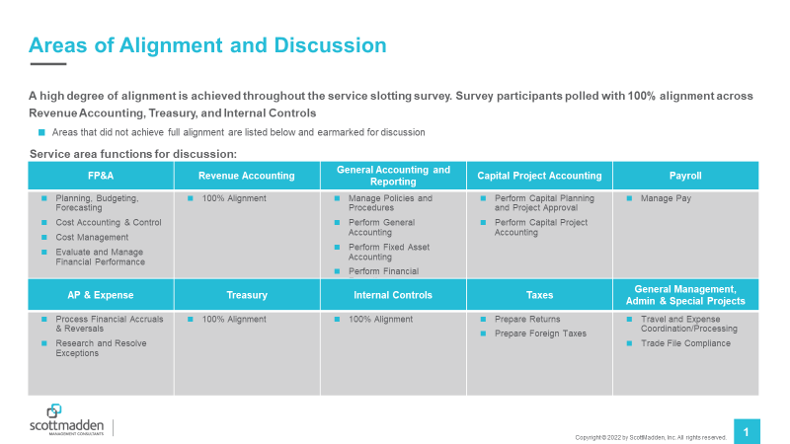
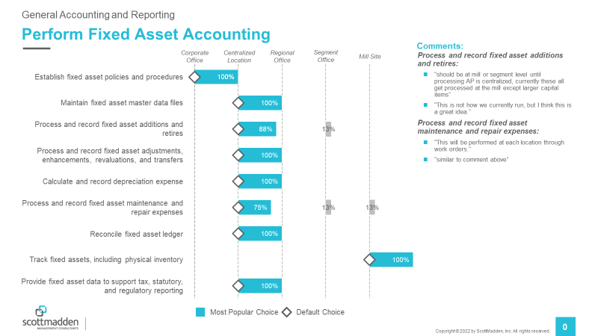
Scope of Services/Service Delivery Model
Research Need:
  You are ready to move forward with changing your Service Delivery Model. Let’s determine the next step: where does all the work belong? Will activities be shifted to service centers, CoEs, business unit support?
Methodology:
  Intimate workshop format involves those in leadership roles; gathering input from stakeholders beforehand is key.
  The positioning of your services in the new model serves as the basis for the workshop:
    Our suggestions for where activities should go per the new model are pre-populated
    Workshop participants are given the opportunity to agree/disagree with proposed suggestions
    A completed Work Activity Assessment is ideal, but not required
Recent Clients:
  West Fraser
  Epiq Global
Sample Output:
Identify key areas of misalignment to earmark for discussion
Address identified alignment issues in a live workshop

