Slide 1
Six Symptoms Indicating You Need to Revamp Your Project Management Process and Controls
December 2022

Slide 2
Why Is This Important?
The realization of an enterprise or business strategy is directly linked to how the organization selects, plans, funds, executes, and monitors key projects and initiatives. This relationship is illustrated in the diagram below:
  Failure to successfully manage and execute projects coherently across the organization will have a direct impact on the health and success of the overall strategy and, subsequently, on business results
  Recognizing whether your organization does this well might be what sets you apart from your competition
  Having a robust project management process, systems, and controls will mitigate the risks associated with how the organization plans and executes projects and initiatives
It is of critical importance to continuously assess your organization to identify and address any gaps that impede the organization’s ability to execute projects successfully and in alignment with the overall strategy.
Develop and align on strategic plans and priorities
Identify and select strategy-enabling projects and initiatives
Secure funding through capital or business planning process
Plan and execute projects and monitor progress
But, how do we know if we have any issues?

Slide 3
The Symptoms
Effectively managing projects throughout their entire lifecycles is an internal capability desired by most organizations. Leading practice organizations proactively identify issues with their project management practices and successfully deploy corrective actions and controls.
Here are six symptoms that could indicate your project management practices could use a refresh and some questions to ask your organization:
Inconsistent Project Selection and Prioritization
Inability to Meet Budget Targets
Limited Project Execution Metrics and Reporting
Does each department or business unit have its own method for selecting projects?
Are projects selected without considering other projects across the organization?
Is project selection explicitly tied to the corporate strategy?
Is there a “rush” at the end of the fiscal year to spend capital or operations and maintenance dollars to meet budget?
Are capital expenses often substantially above or below the budget for the fiscal year?
Is reporting on scope, budget, and schedule consistent across the board?
Are reports automatically generated or do they require a lot of “manual” intervention?
Are performance metrics to track progress over time linked to other enterprise systems (e.g., financial systems)?
Reallocation of Funds
Inconsistent Project Execution and Controls
Lack of Project Documentation
Are you frequently moving capital funds from one project to another?
Are projects often rolled from one fiscal year to the next due to lack of funding (or loss of it)?
Are projects managed along the lifecycle using a standard set of “stage gates”?
Are project controls in place? If so, what are they? How are risks and issues being tracked?
Are projects evaluated post-completion to ensure they delivered the promised benefits? Are vendors evaluated and held accountable?
Is it hard to find project-related documentation and “as-built” drawings?
Does each organization control how project data and documents are stored? Is it consistent?

Slide 4
The Solution
Best-in-class project management organizations 1) have clear governance over project selection and prioritization, 2) implement project management practices that adopt a standardized project management process for all project lifecycle stages, and 3) deploy project management software to manage the process, track progress, and enable automatic reporting.
Clear Governance of Project Selection and Oversight
Standardized Project Management Process and Controls
Project Management System and Automatic Reporting
Establish organizational body and process that governs and oversees the collection of projects as a coherent, integrated portfolio
Standardize project selection and prioritization methodology driven by strategic priorities and objectives
Ensure that program benefits are attained and aligned with organizational goals and strategy
Deploy project management standards and stage gate controls
Establish clear roles and accountabilities throughout the project lifecycle
Accelerate training and change management efforts
Verify consistent use of project controls and quality management practices
Establish single source of truth for project goals and performance
Review all projects as an integrated portfolio
Develop automated project workflows and approvals to improve controls and efficiency
Deploy automatic reporting by integrating with data analytics and visualization tools (e.g., Power BI)

Slide 5

The Benefits
The following are a few of the key benefits of leading practice project management organizations:
Portfolio-level View
Manage the portfolio of all projects at the organization or department level rather than project by project to ensure the best outcomes for the organization.
Efficient Project Selection and Prioritization
Enhance the selection and prioritization of the right projects to pursue with outcomes that clearly trace back to strategic objectives and deliver.
Standardized Process
Standardize the execution of projects to ensure on-time, on-budget delivery with the expected outcomes and ensure all projects are managed together as one portfolio.
Enhanced Visibility
Enhance the visibility into projects across the organization to improve decision-making and resource allocation.
Improved Financial Performance
Use fiscal discipline with a clear understanding of the capital and labor required to deliver on a given set of projects and ensure budget and expense targets are being met.
Increased Accountability
Improve governance and accountability for the selection, prioritization, and execution of all projects.

Slide 6

Case Study
CHALLENGE
A vertically integrated public power entity was seeking to strengthen its project management capabilities and improve its strategic enterprise project portfolio management. The objective was to stand up a project management office (PMO) organization, develop the governance, policies and procedures around project portfolio management, and deploy a system through which to manage and oversee all projects. In close coordination with the client, ScottMadden led the creation of the PMO, developed the policies and procedures, and configured the project management system.
PROCESS
  Developed the governance, policies, and procedures for enterprise project management
  Configured and deployed Microsoft Project as the enterprise project management solution with workflows and approvals tied to the project lifecycle
  Developed and deployed automations with Microsoft Power Automate to capture regular project status updates from the project managers in the desired format
  Developed and deployed project reporting and analytics in Microsoft Power BI to provide actionable insight and support management oversight of the project portfolio
RESULTS
  A standardized approach to project selection, leading to better business outcomes aligned with the strategy
  Enhanced oversight leading to improved compliance and the resolution of multiple audit findings
  Centralized management of hundreds of projects across the enterprise with ease of visibility via web-based reporting and analytics
  Facilitated automated report generation for federal grant agencies on a multibillion-dollar program

Slide 7
How We Can Help
ScottMadden has helped many companies improve their project and program management capabilities. Whether enterprise-wide or a select department, we can help you in all areas.
Clear Governance of Project Selection and Oversight
Standardized Project Management Process and Controls
Project Management System and Automatic Reporting
Capital and Business Planning Leading Practice Assessment
Governance Structure and Organizational Design
Project Prioritization and Selection Methodology
Development and Implementation of Policies, Processes, and Procedures
Implementation Support for Selected Future State Organizational Design
Project Management Leading Practice Assessment
Development and Implementation of Policies, Processes, and Procedures
Development of Project Management Tools and Controls
Development and Implementation of Project Management Stage Gates
Implementation Support for Selected Assessment Recommendations
Change Management and Training Support (e.g., training sessions, training guides, workshops, and more)
System Evaluation and Selection Support
System Configuration and Process Workflow Automation
Project Reporting and Data Analytics in Microsoft Power BI
Change Management and System Training Support (e.g., training sessions, training guides, workshops, and more)

Slide 8
Contact ScottMadden Today
Overcome your project management challenges. Connect with ScottMadden to fast-track your ability deploy/improve project and portfolio management leading practices with the right tactics to make a lasting change.
404.814.0020
scottmadden.com
info@scottmadden.com

Slide 9
Appendix – Related SOV Concepts

Slide 10
The Governance
Project selection and oversight SOV
Leading practice organizations do this to govern and oversee their portfolio of projects:
Key Governance Components
Funding
Project Selection and Optimization
Accountability and Execution Process
Leadership and Strategic Alignment
Funding
Establish budget and set priorities and targets based on organizational strategy
Establish criteria for reallocation of funds
Establish process and funding mechanisms for emergent projects
Project Selection and Optimization
Set standard criteria and process for project selection and prioritization
Incorporate organizational constraints (e.g., regulatory, financial, safety) into the portfolio selection process
Optimize portfolio and continuously reassess
Accountability and Execution Process
Assign execution responsibilities for projects
Establish minimum requirements for controls, progress reporting and execution
Establish regular cadence to assess progress and adjust for emergent needs
Leadership and Strategic Alignment
Establish governing body with key executives from different functional areas (can be two-tiered)
Identify strategy enabling projects and track progress
Monitor results and realized benefits; compare against initial plans

Slide 11
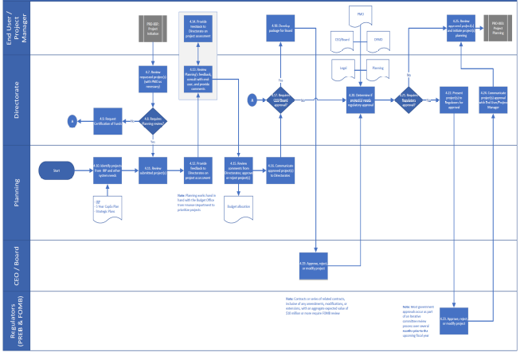
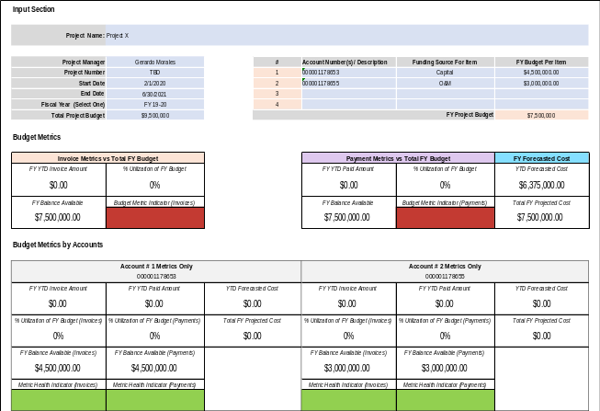
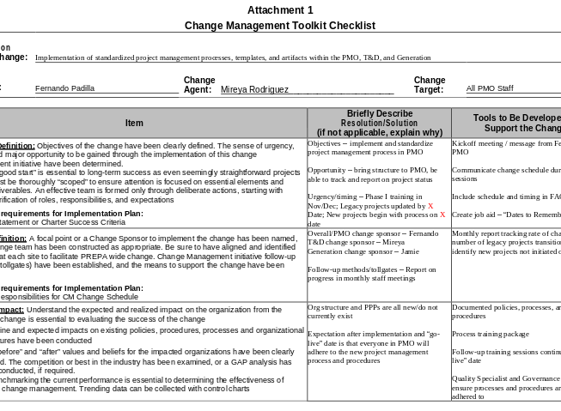
The Process
Process and controls SOV
A project management process establishes how the organization will execute projects, where accountabilities reside, and how execution progress is monitored. Ensuring the organization adopts these practices requires robust change management plans—often overlooked but critical for a successful implementation.
How is the work executed?
How do we monitor progress?
How is the process adopted?
Project management policy, process(es), and procedure(s) are used to describe how the work will be executed. This includes roles and responsibilities of all the key stakeholders involved, minimum requirements for each project lifecycle stage and process flowcharts.
Project controls are created to measure and track how the existing processes are being used and mitigate the risk associated with non-compliance (i.e., employees not utilizing the approved process and procedures).
Change management must be considered for all projects or initiatives. The nature of a change and organizations affected can vary from simple to very complex. The aim of change management is to help organizations realize the benefits or value of each project or initiative. Failure to deploy change management plans correctly could result in poor investments and unrealized benefits.
Process Flowchart Example
Project Budget Template Example
Change Management Checklist Example

Slide 12
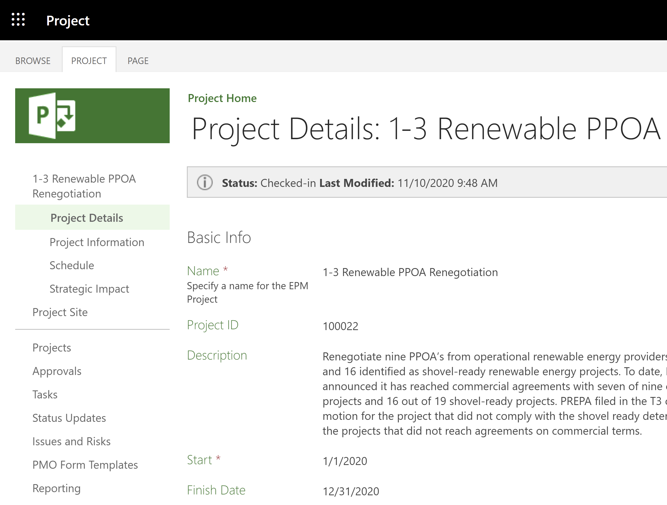
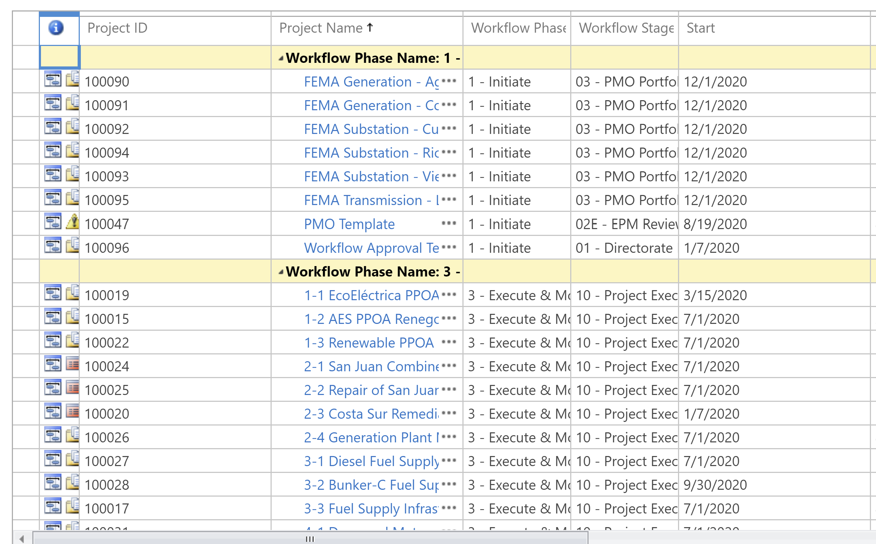
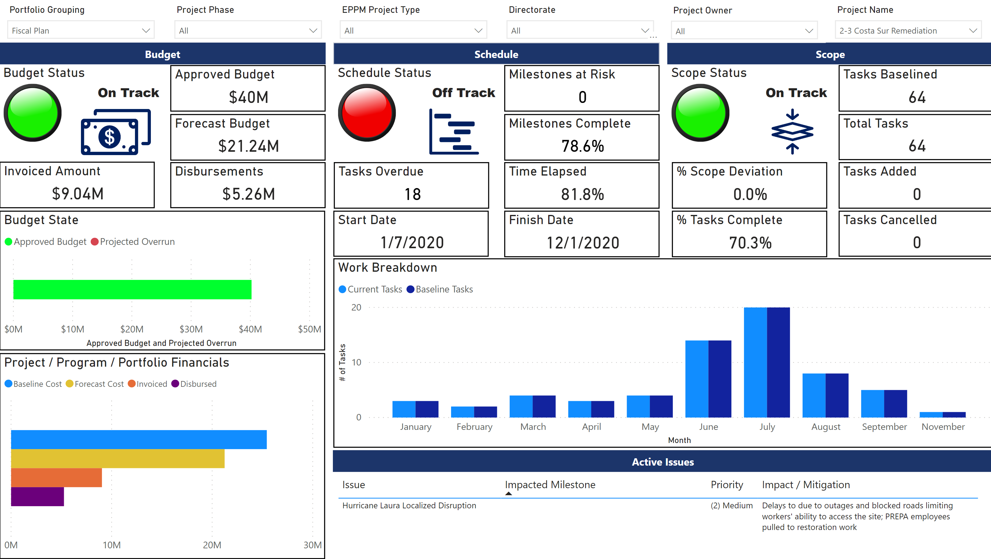
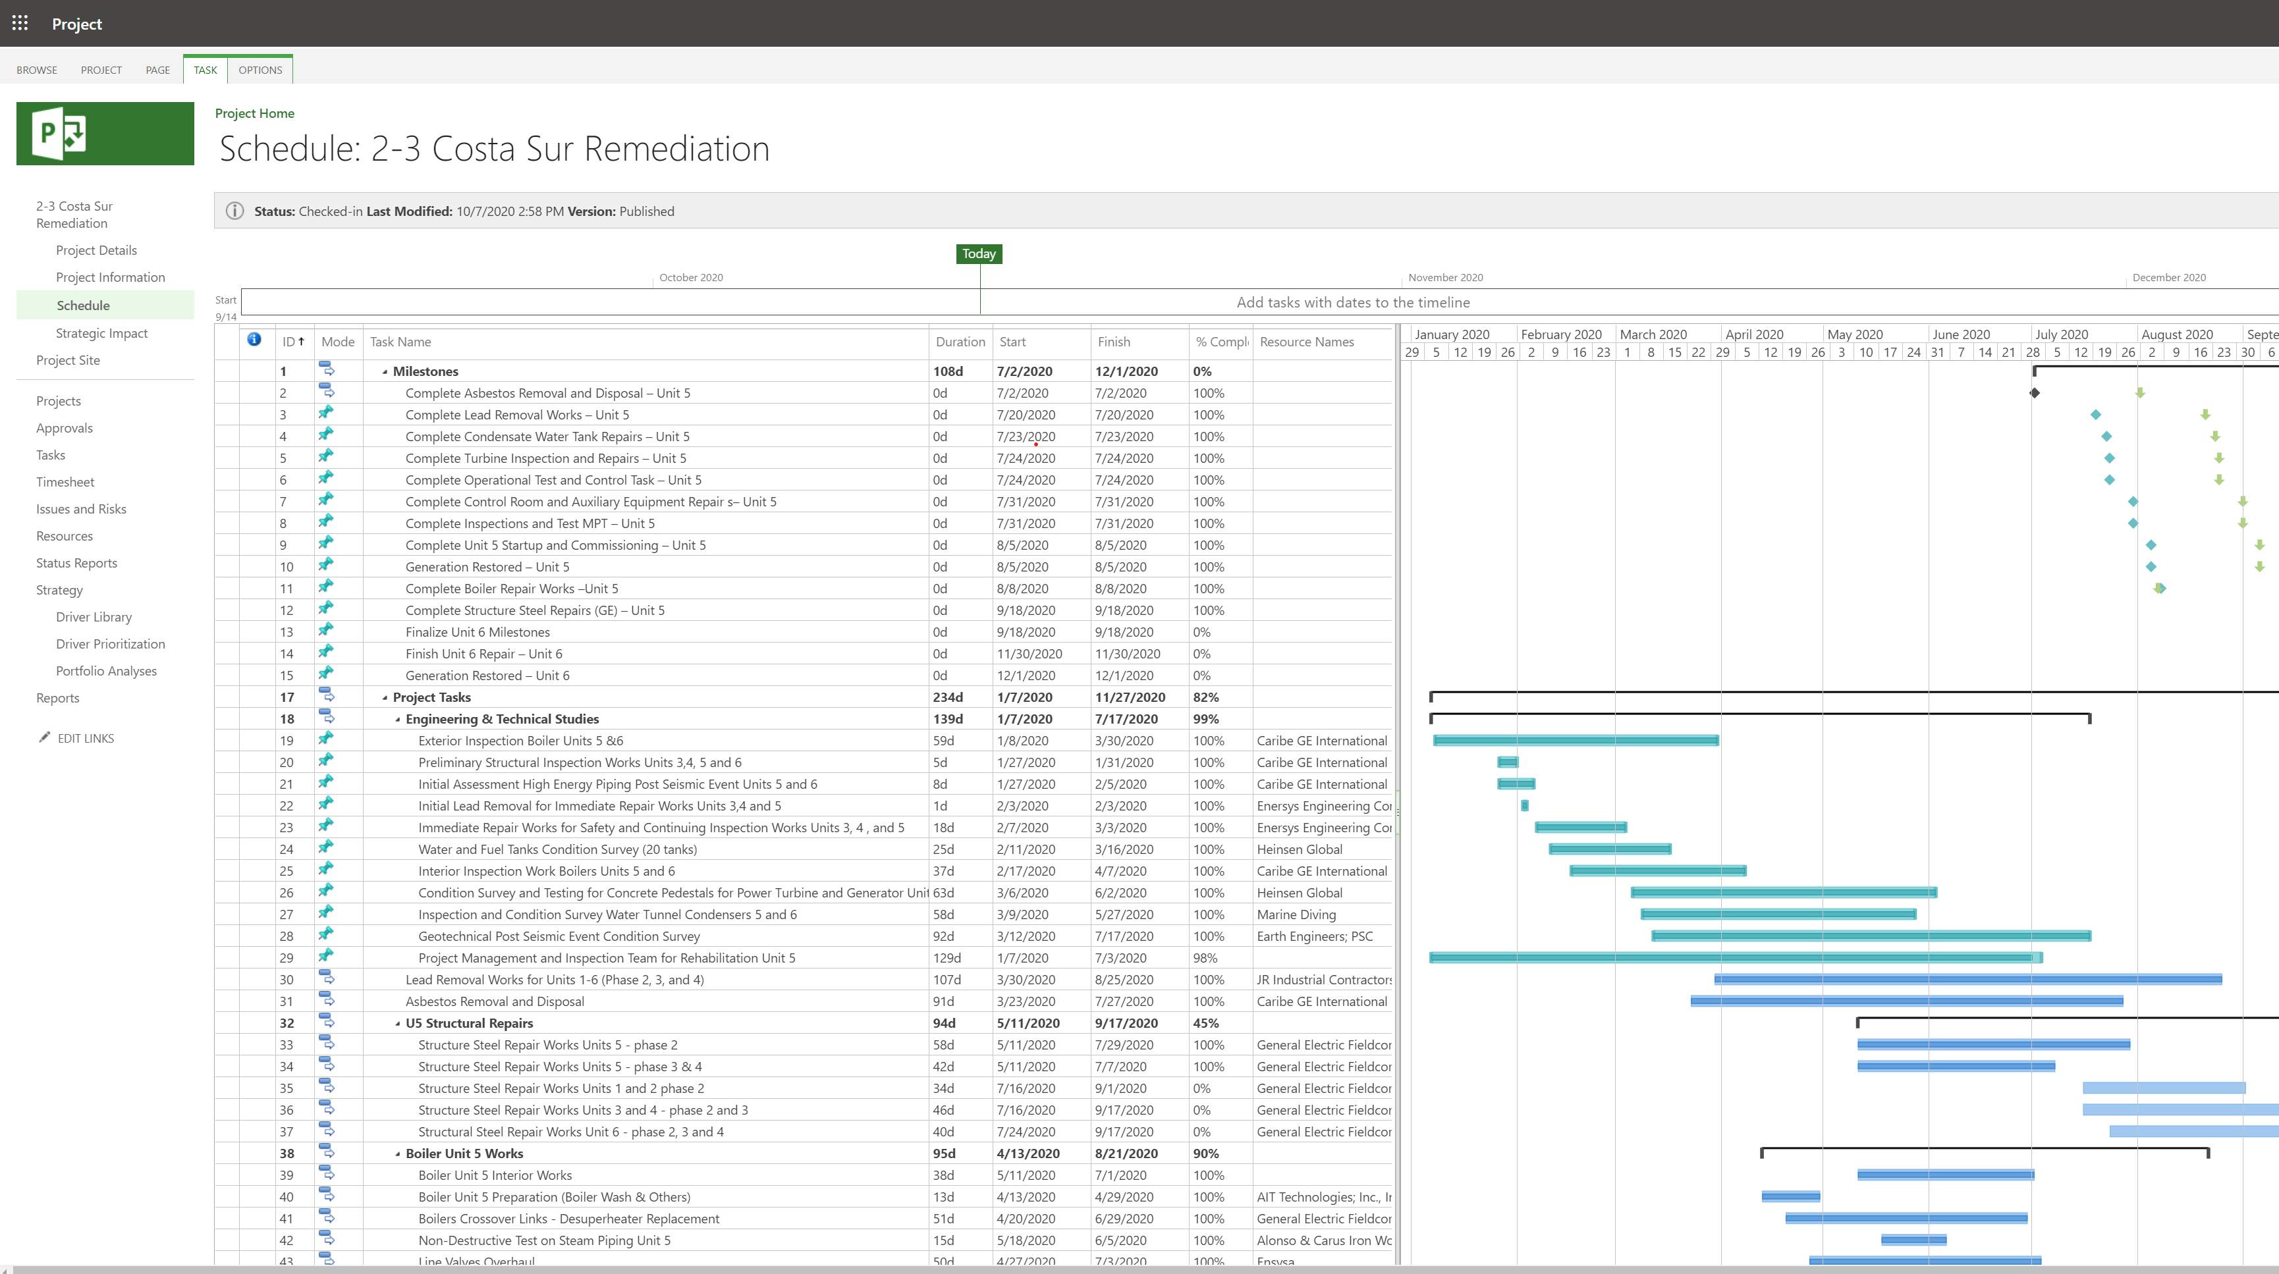
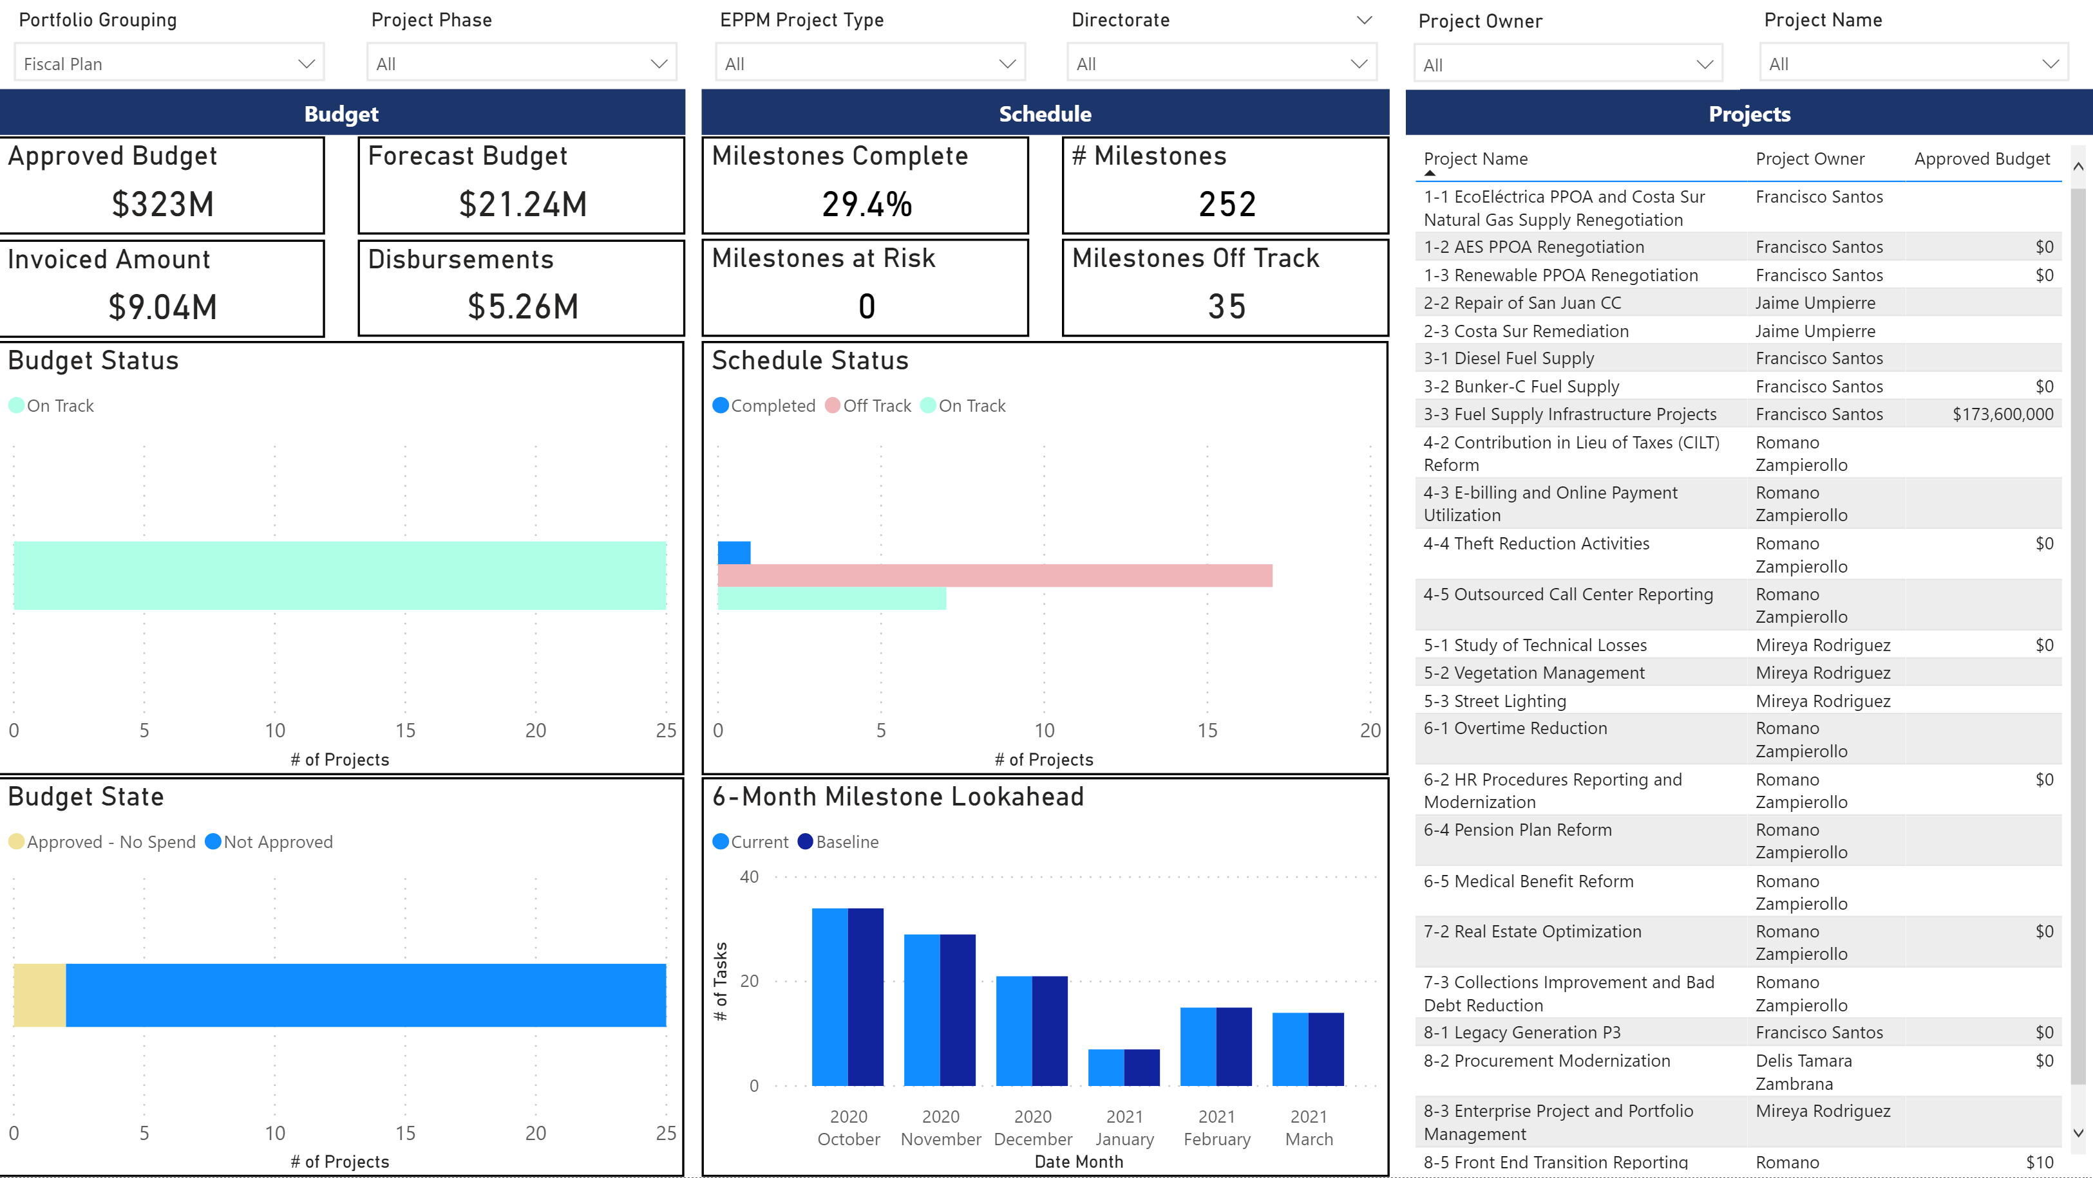
The Systems
Project management system and reporting SOV
Project management systems are used to track and control projects throughout all lifecycle stages. It enables collaboration, communication between project stakeholders, process automation, and digitization of project controls and artifacts (i.e., risk log, issues log, etc.).
MAKE A COHESIVE
PORTFOLIO
Selection of a cohesive project portfolio better aligned to business strategy
Critical project information details at our fingertips
GET ACCESS TO
WHAT’S HAPPENING
SEE IT BETTER
Data visualization to manage portfolio’s performance and ensure accountability
Ability to understand where the project stands and the issues we need to address
FIND AND FIX
THE ISSUES

