Slide 1
Customer Satisfaction
Approaches and Techniques for Measuring Customer Satisfaction in Shared Services

Slide 2
Agenda
  About ScottMadden
  Customer Satisfaction Approaches
  The Power of Customer and Employee Feedback
  What to Measure
  Trends from Customer Satisfaction Surveys
  Lessons Learned

Slide 3
About ScottMadden’s Shared Services Practice
Decide
Design
Build
Improve
Strategy development and integration
Benchmarking
High-level business case
Change management
Service delivery model
Detailed current state, future state, and business case
Sourcing model
Organization design and staffing
Change management
Project planning and management
Service/transaction center
Process redesign
Technology design, selection, and support
Change management
Process improvement/cost reduction
Operations/
technology
assessment
M&A integration
Benchmarking
Customer and employee surveys
Change management
Our Functional Expertise
Finance & Accounting
Supply Chain Management
Real Estate & Facilities
Engineering Services
Human Resources
Information Technology
Multifunction
Administrative Services

Slide 4
Customer Satisfaction Approaches

Slide 5
Approaches for Measuring Customer Satisfaction
Approach
How Used/Purpose
Transitional/“Point of Sale” Surveys
  Collects immediate feedback on customers’ experiences
  Provides feedback for specific individuals
  Enables trending and performance monitoring
Periodic Comprehensive Surveys
  Measures satisfaction across all service areas and dimensions
  Provides insight on awareness and importance
  Enables trending over time
Focus Groups
  Provides input to key service issues that can be used to design surveys
  Captures in-depth information on key issues that emerge from other surveys/feedback
Other Feedback Sources (Complaints, Escalation Logs)
  Identifies immediate service concerns
  Highlights potential process problems
  Enables trending over time

Slide 6
Approaches for Measuring Customer Satisfaction (Cont’d)
Comprehensive surveys include several types, which are each important for providing a full picture of customer satisfaction.
Periodic Comprehensive Surveys
Baseline Surveys
Customer Surveys
Service Delivery Employee Surveys
  When?
  How?
  When?
  How?
  When?
  How?

Slide 7
The Power of Customer and Employee Feedback

Slide 8
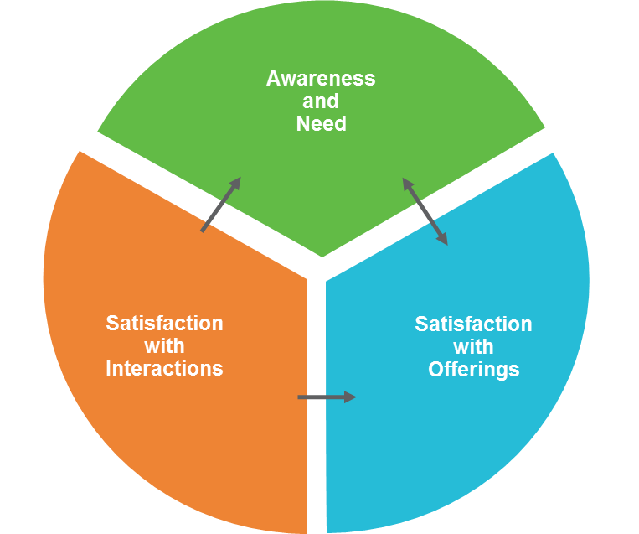
Why Measure Customer/Employee Perceptions?
The Power of Customer and Employee Feedback
Customer
Employee
Confidence
in
Organization/
Values
The extent to which your employees are engaged with your customers
Typical employee surveys address these pieces
of the pie
Business
Engagement
Job
Satisfaction
Knowing your customers’ perceptions gives you power to:
  Anticipate rather than react
  Improve your organization’s impact to the bottom line

Slide 9
Linking Customer Satisfaction and Employee Engagement
The Power of Customer and Employee Feedback
Dimensions for Measuring Employee Engagement
Perceptions on customers’ views of services
  Customers’ use of services
  Importance customers place on services
  Satisfactions with performance of services
Business
Engagement
Perceptions on customers’ views of service delivery
  Knowledge and attitude of staff
  Accuracy and timeliness of service
  Follow-through on commitments
  Convenience of doing business
  Willingness to help, prompt delivery
  Concern for business needs

Slide 10
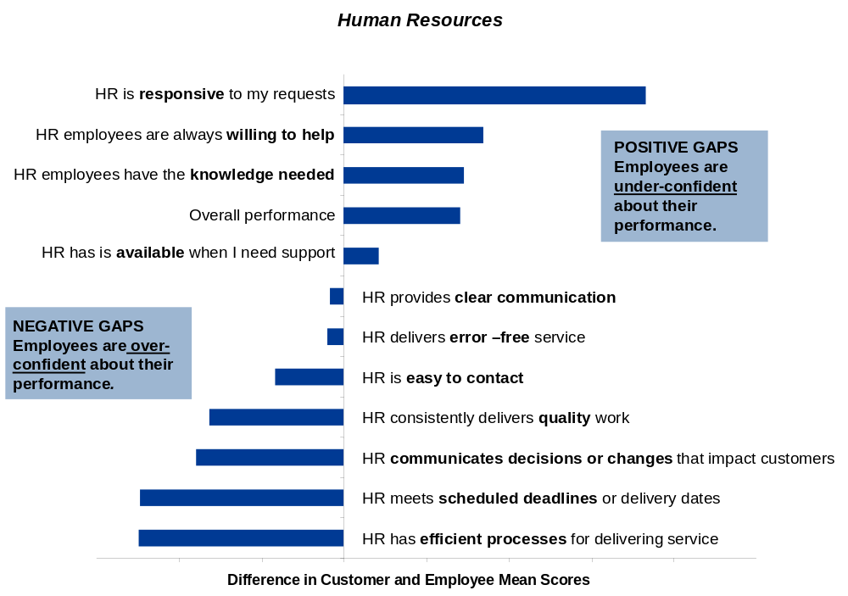
What You Learn
The Power of Customer and Employee Feedback
By measuring both customer and employee perceptions of service performance and service delivery, you are able to identify perception gaps between your customers and employees. Perception gaps can be used to formulate training and communication needs in addition to prioritizing improvement areas.
EXAMPLE

Slide 11
What to Measure

Slide 12
Key Issues to Consider
What to Measure
  Are our customers aware of our services?
  Do our customers value our services?
  Which services are considered most important?
  How do customers rate performance on the services they consider most important?
  What drives satisfaction at your company?
  Do quantitative results match anecdotal perceptions?
  How do perceptions vary across:
    Organizations?
    Geography?
    Position level?
    Length of service?
  Are there perception gaps between customers and service delivery employees?
  Are ratings consistent among like questions?

Slide 13
Key Dimensions to Consider
What to Measure
Solid survey goals and parameters form the foundation for a successful survey; a number of key dimensions should be considered when designing your surveys
  Include multiple dimensions of customer satisfaction
  Measure what you do
    Ask questions about specific initiatives or improvements made
    Ask questions relating to problem areas that you want to explore
    Ask questions regarding aspects of service or satisfaction which you can control and/or impact
    Awareness of services, options, needs, expectations, and service levels
    Qualifications
    Image of organization
Awareness
and
Need
    Knowledge and attitude of staff
    Accuracy and timeliness of service
    Follow-through on commitments
    Convenience of doing business
    Willingness to help, prompt delivery
    Concern for business needs
Customer
Perceptions
Satisfaction
with
Interactions
Satisfaction
with
Offerings
    Use
    Importance
    Performance
    Costs
Attraction

Slide 14
Trends from Customer Satisfaction Surveys

Slide 15
Approach for Trend Analysis
Trends from Customer Satisfaction Surveys
ScottMadden has been conducting customer satisfaction surveys for our shared services clients since 1998 and has captured overall satisfaction data to provide insight on typical trends
  We analyzed multifunction, multi-year customer satisfaction scores for shared services organizations (SSOs) to understand typical patterns in customer satisfaction
  Our hypotheses of satisfaction exceeding prior service delivery and continued improvement in shared services customer satisfaction over time were correct
  Those shared services organizations that regularly measure customer satisfaction benefit from the ability to use this data to demonstrate value to its customers
  Companies that conduct baseline surveys of customer satisfaction prior to implementing shared services have the added benefit of comparing their performance to the satisfaction with the prior delivery model
Hypotheses
  Shared services satisfaction exceeds prior service delivery satisfaction
  Shared services customer satisfaction improves over time

Slide 16
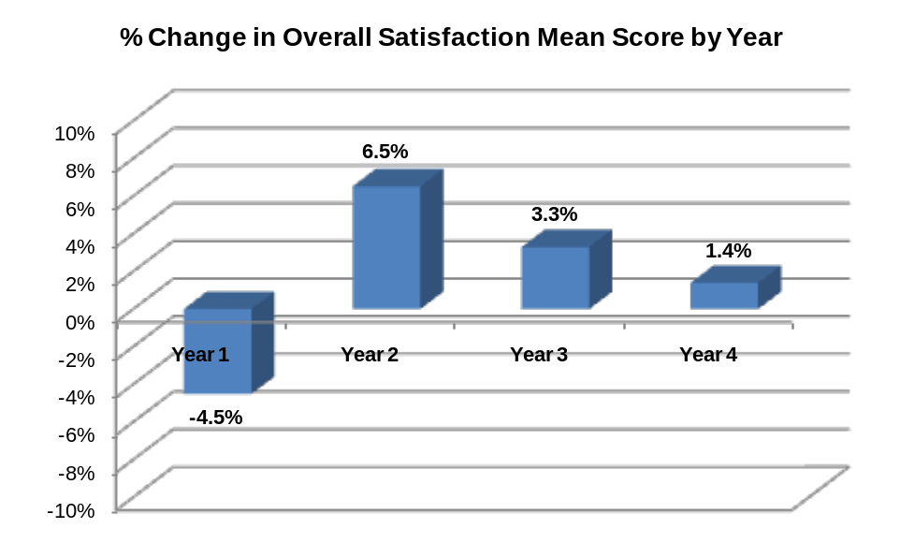
What We See
Trends from Customer Satisfaction Surveys
  Companies who have conducted baseline surveys before their SSO is implemented typically see a decline in customer satisfaction during the first year of operations
    This decline is not surprising due to customer reluctance to adopt a shared services model
    Likewise, initial operations during the first year can have some hiccups in service as all parties become accustomed to the new model
  However, our data indicate that customer satisfaction increases in the second year of operations and continues to increase in Years 3 and 4
    The average increase in Year 2 surpasses
    the percent decrease in Year 1
    The average increases in Years 3 and 4 trend
    smaller as it becomes harder for SSOs to
    continue to improve on customer satisfaction
    after the initial increase
  After the initial year of operations, data show that
  customer satisfaction levels are higher with shared
  services than with prior delivery models
  For on-going operations, the bar is raised and SSOs
  must work hard to maintain the higher levels of
  satisfaction and to find innovative ways to continue
  improving

Slide 17
Lessons Learned

Slide 18
Lessons Learned
Consider these lessons when you plan customer satisfaction surveys
Establish a baseline
  Capturing satisfaction levels prior to the implementation of a shared services model or addition of new services gives you important data for comparison that can help demonstrate the value of shared services
Define your customer groups and use samples appropriately
  Understanding the true customers of the functions and services within your SSO is important for formulating your survey design; samples should be used when appropriate to avoid over-surveying
Formulate good survey questions
  Constructing effective survey questions requires careful phrasing, appropriate response scales, and distinguishing between different service attributes and dimension that influence customer satisfaction
Pay attention to survey structure
  Considering the flow of the survey and managing the overall length of the survey is important for ensuring a good response
Build a communications plan to support your surveys
  Communicating with your customers and employees is essential both pre- and post-surveys and in conjunction with other methods used for capturing feedback

Slide 19
Summary
Lessons Learned
  Customer satisfaction for an internal service organization is a primary measure of results (along with cost, quality, and compliance); therefore, it deserves thoughtful attention
  Measurement of customer satisfaction is one element of a customer satisfaction program
  Lots of communication leverages the results of measurement
  Lack of communication destroys value
  Benefits are lost if measurement results do not drive successful improvement initiatives
DO
DON’T
  Take time to define objectives
  Manage it like a project
  Include representatives from all shared services
  Follow through on communications and improvement initiatives
  Approach it as a one-time event
  Cut corners on survey design

Slide 20
Contact Us
For more information on customer satisfaction, please contact us.

