Slide 1
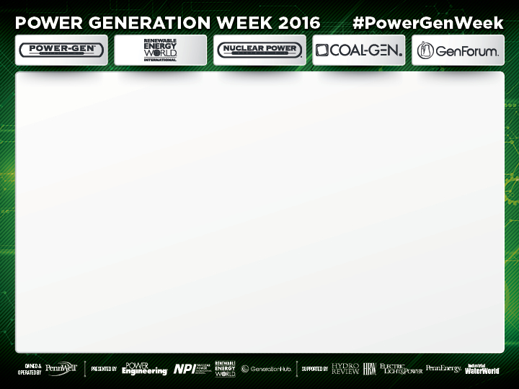
Greening the Grid
An Overview of the Greening of the U.S. Generation Fleet - Todd Williams, ScottMadden
December 12, 2016

Slide 2
Greening the Grid
An Overview of the Greening of the U.S. Generation Fleet
Todd Williams, ScottMadden
GenForum Presentation
December 2016

Slide 3
Agenda
  Greening has already been happening
  Three drivers for greening
  Lessons learned from Hawaii and Germany
  Three challenges posed by greening
  Conclusions

Slide 4
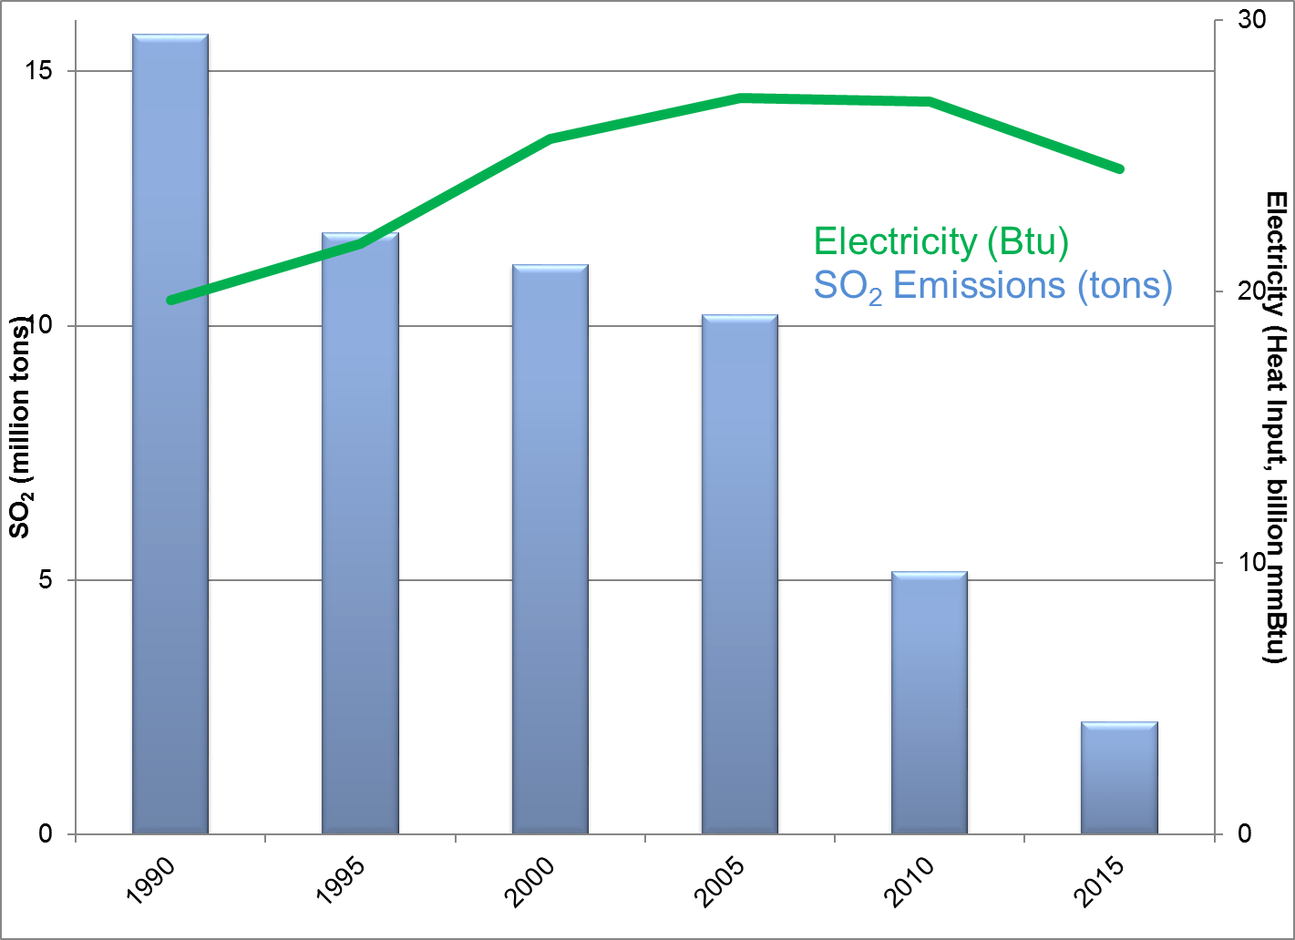
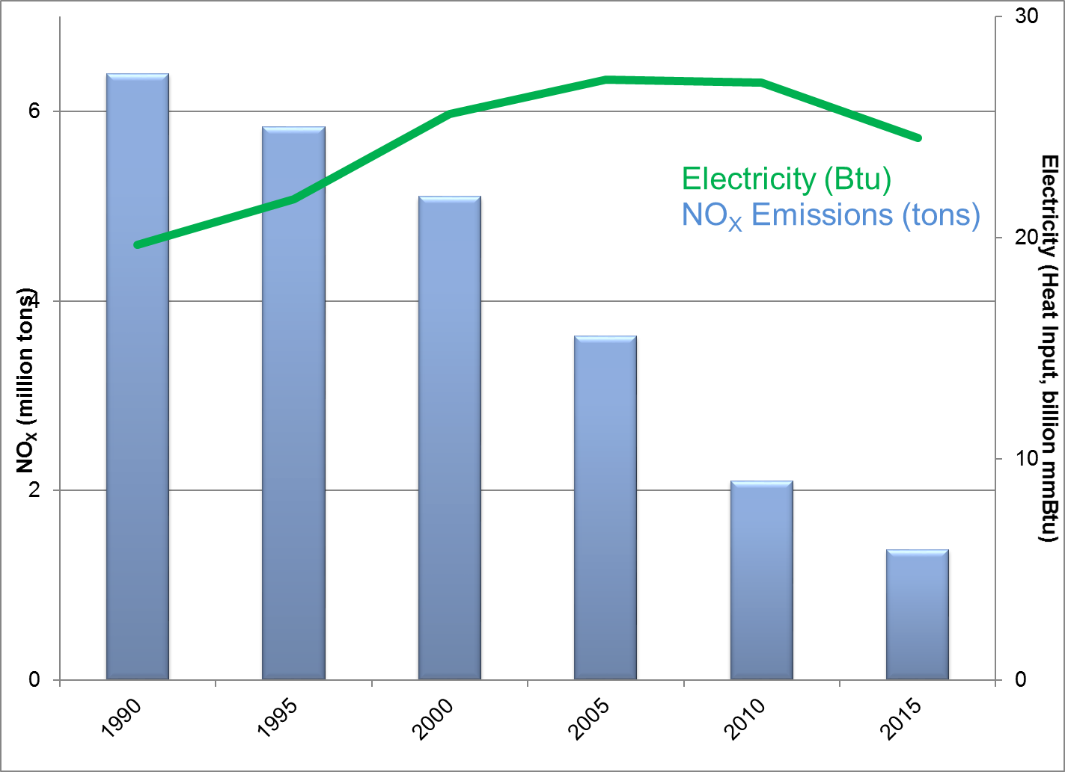
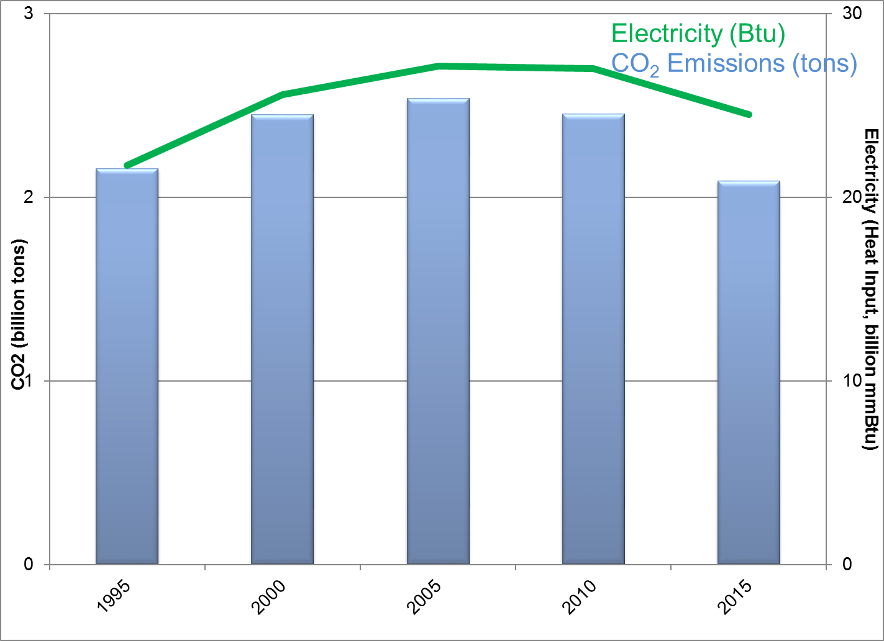
The Grid has become substantially greener in a short time. . .
Total emissions have fallen dramatically since 1990, even while total electricity generation has increased
SO₂
NO_{x}
CO₂
1990 2015
1990 2015
1990 2015
Source: EPA, https://www3.epa.gov/airmarkets/progress/datatrends/index.html

Slide 5
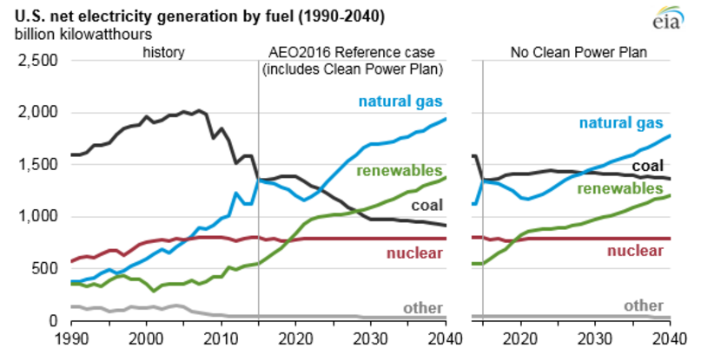
And is projected to become greener
Going green is a combination of three trends:
Natural gas
Renewables
Coal
Source: EIA, http://www.eia.gov/todayinenergy/detail.php?id=26712

Slide 6
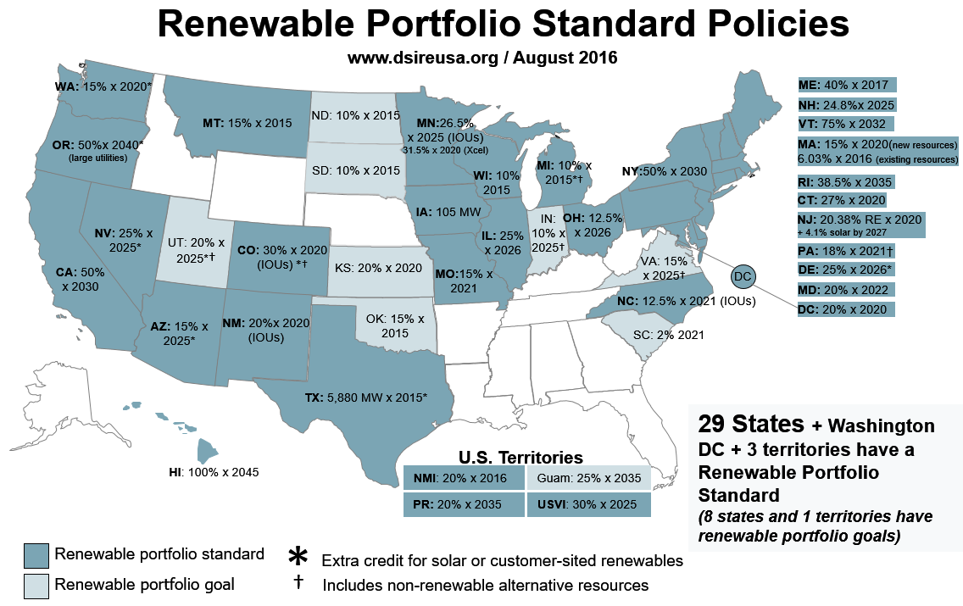
Green Driver #1: Regulations and mandates
State and federal mandates and regulations have driven early growth of renewable generation
DSIRE database, 2016

Slide 7
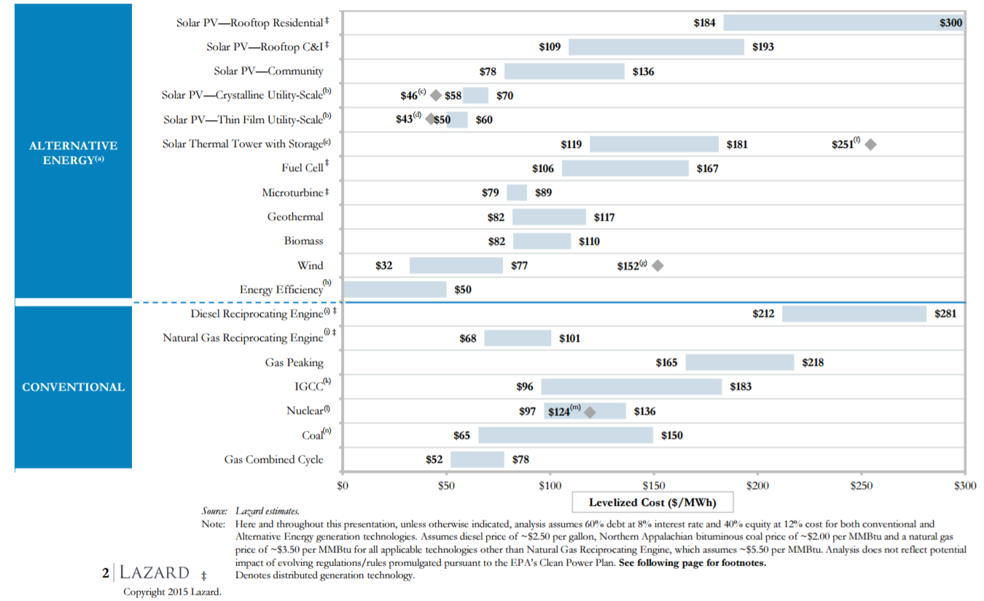
Green Driver #2: Economics
Renewable generation sources are becoming more economic, even without subsidies

Slide 8
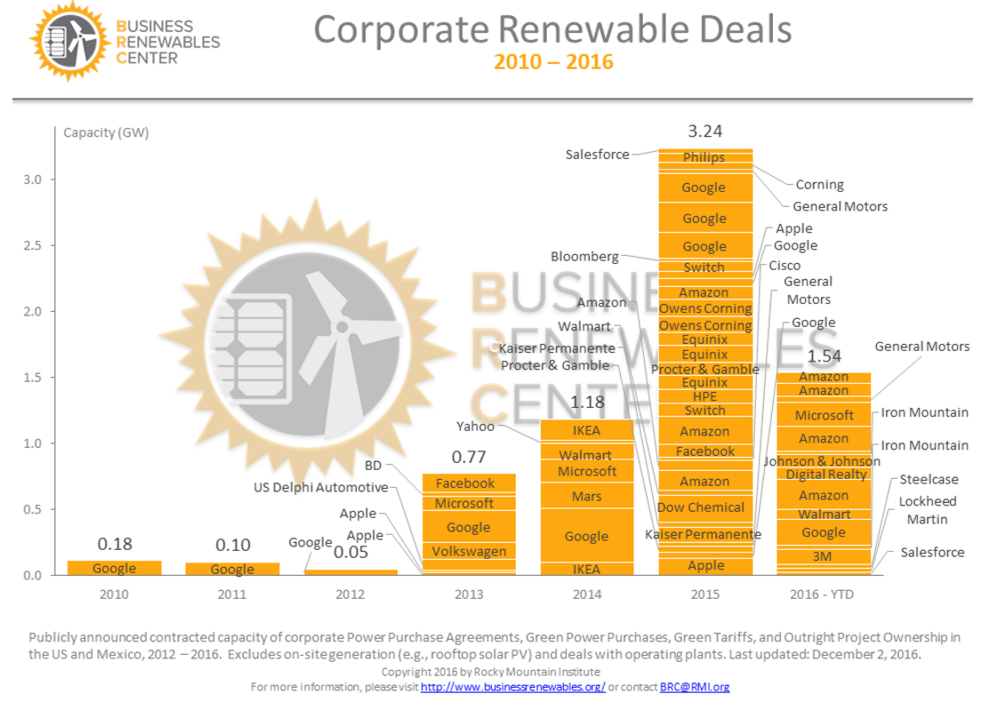
Green Driver #3: Consumer preference
Given a choice, many electricity consumers simply prefer green generation. For example, the growth in C&I direct purchase of renewables
Likely some acceleration of deals into 2015 due to PTC expirations
http://www.businessrenewables.org/corporate-transactions/

Slide 9
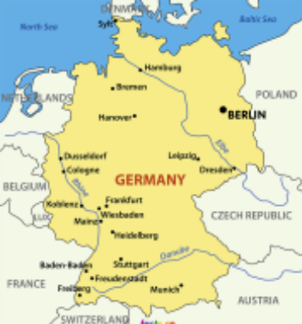
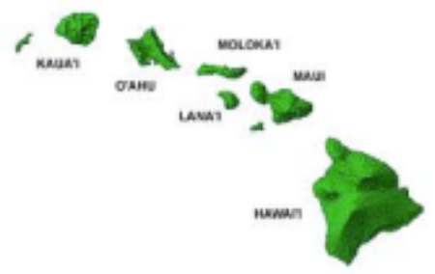
Hawaii and Germany – Bellwethers for the rest of us?
A world apart but similar experiences
Hawaii Renewables | 2007 | 2014
Generation (GWhs) | 945 | 1,989
% of total demand | 9.2% | 21.3%
Res. price ¢/kWh | 24 | 37
US avg. res. price | 11 | 13
Germany Renewables | 2007 | 2014
Generation (TWhs) | 88.3 | 194.0
% of total demand | 14.3% | 32.5%
Res. price ¢/kWh | 30 | 36
1.34 and 1.33 $ per €, 2007 and 2014
  Despite the high penetration of renewables, the system is not in collapse
  Even though grid management has increased, supply disruptions have only marginally increased and are not attributed to the energy policy turnaround and associated increase in decentralized power generation
Notes:
Hawaii
Detailed analytics and technological capabilities have allowed the grid to interconnect more distributed resources than originally envisioned
A utility that emphasizes limited system capabilities risks losing credibility with customers and regulators when high renewable penetration becomes a reality
Proper internal alignment will also allow an organization to partner with other service providers, test new technologies, and be responsive to customers' interests
Germany
The transmission system would be under the greatest strain if the triple conditions of high wind production in northern Germany coincided with an unplanned plant outages in the south and the failure of an extra high voltage line during a period of peak demand in the winter
Grid interventions have increased (e.g., securing reserve power plants for the winter, exercising feed-in management, curtailment of renewable resources)

Slide 10
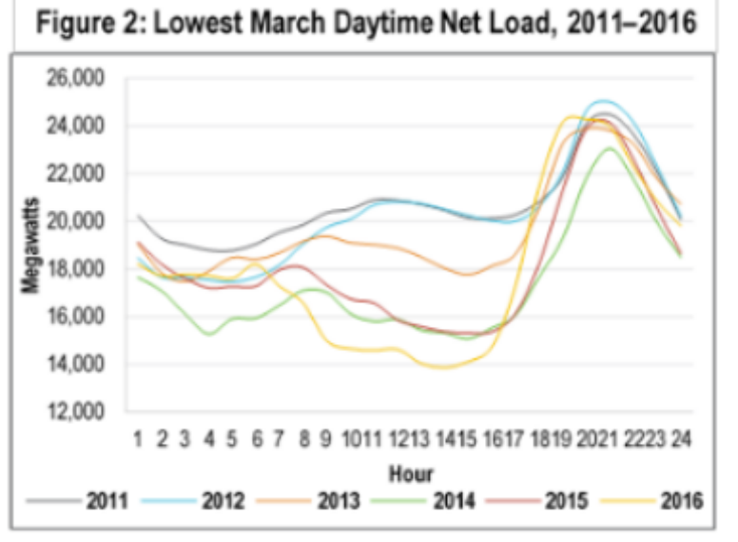
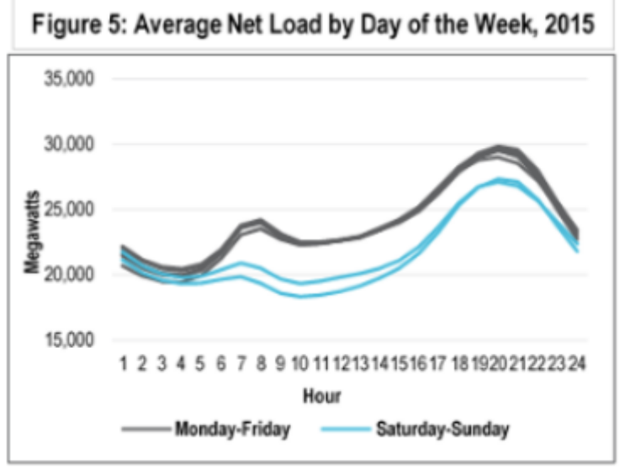
Green Challenge A: Dispatchability
The duck curve is:
  Producing net loads lower than forecast
  Increasing ramps throughout the year
  Most severe on the weekends
  Occurring in multiple seasons, not just spring months
  Driven by utility-scale solar in California, not distributed resources

Slide 11
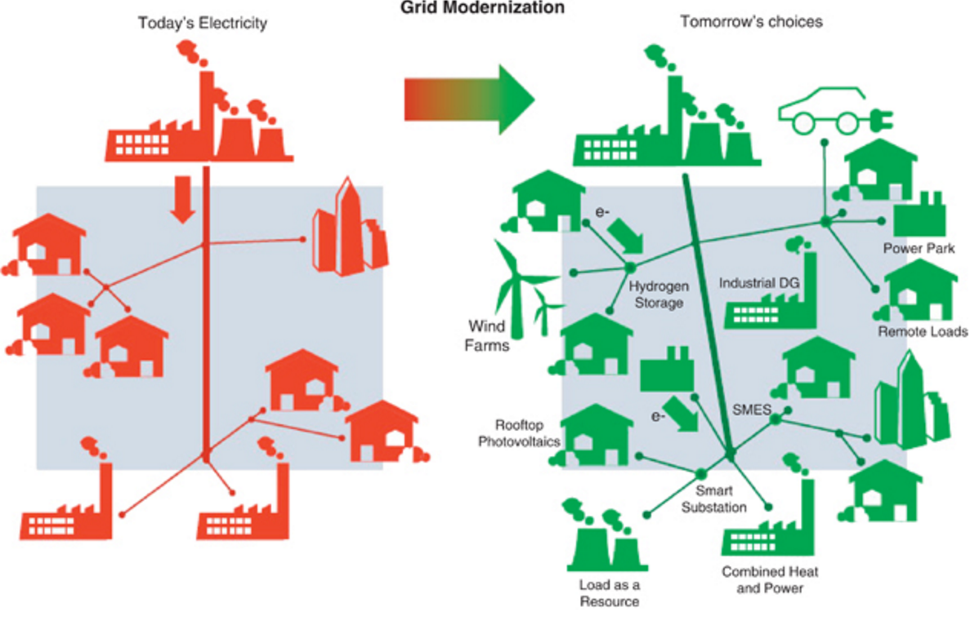
Green Challenge B: Consumer choice
A little like peaceful atomic power and military atomic power, you really cannot have grid-scale green energy without distributed green energy
Source: http://www.netanir.ir/upload/image/distributed-generation.jpg

Slide 12
Green Challenge C: A darker side of green
If the greening of the grid means both utility-scale and distributed generation, then how much is our grid today like the telephone network in the late 1980s?
“Telephone networks, it was often said, had an intelligent core — the switches that ran everything — and “dumb” edges, meaning the handsets in nearly every home and business in the nation.
The Internet, by contrast, would have a “dumb” core — all the network did was carry data — with intelligent ­edges, meaning the individual computers controlled by users.”
Washington Post, A Flaw in the Design, 5/30/2015, http://www.washingtonpost.com/sf/business/2015/05/30/net-of-insecurity-part-1/

Slide 13
Conclusion
  Generation will continue its path toward green
  Key signposts that signal the speed include:
    Capital cost reductions
    Price of natural gas
    Policy driven mandates and incentives

Slide 14
Questions?

