Slide 1
Summary of NARUC Manual on Distributed Energy Resource Compensation
October 2016

Slide 2
Contents
  Introduction
  Overview of DERs
  Issues Created by DERs and Initial Responses
  Methodologies at a Glance
  Industry Response to the NARUC Report
  Key Questions for Utilities
  Contact Us

Slide 3
Introduction
Traditional utility business models and regulatory frameworks were built on the assumption that the utility would act as the “sole source provider” of electricity to meet the demands of customers across its entire service territory. Though their impacts vary based on location, Distributed Energy Resources (DERs) are rapidly changing this as a given. This changing landscape has placed utilities and regulators in uncharted territory. How should they operate and regulate given this new reality?
NARUC Enters the Debate
In response to the increased penetration of DERs and associated issues, the National Association of Regulatory Utility Commissioners (NARUC) created a Staff Subcommittee on Rate Design tasked with, “creating a practical set of tools…for regulators who have to grapple with the complicated issues of rate design for distributed generation and other purposes.” It is important to note that the subcommittee acknowledged that its final product would not be a solutions manual that would solve all issues regulators are struggling with relating to DERs. In late July, the subcommittee presented a draft manual (the final version is expected sometime in late November), titled Distributed Energy Resources Compensation, that is designed to:
  Assist jurisdictions in identifying issues related to DERs
  Assist jurisdictions in developing policies related to DER compensation
  Assist regulators in answering DER-related questions in a way that is most appropriate for its jurisdiction
  Provide regulators with possible options that a jurisdiction may want to consider and adopt
  Provide a snapshot at options available today and discuss the role advanced technology will play in the future to assist regulators in monitoring the development of DERs
The purpose of this document is to 1) provide a brief overview of DERs and their impacts on utilities and the regulatory process; 2) summarize the highlights of the NARUC manual; and 3) outline the key questions utilities must address in relation to DERs.

Slide 4
What Are DERs
Overview of DERs
  According to NARUC, a DER is defined as “a resource sited close to customers that can provide all or some of their immediate power needs and can also be used by the system to either reduce demand or increase supply to satisfy the energy or ancillary service needs of the distribution grid. The resources, if providing electricity or thermal energy, are small in scale, connected to the distribution system, and close to load.”
  Though the technologies that qualify as DERs vary by state, they typically include the following:
    Solar Photovoltaic (PV) Systems
    Combined Heat and Power
    Wind
    Battery Storage
  Regardless of the technology, DERs typically have many of the following characteristics:
    Sited close to the customers and connected to the distribution grid but not directly to the bulk transmission system
    Run based on weather conditions/customer preference, not necessarily as directed by a utility or RTO/ISO
    Reduce a customer’s consumption of “traditionally generated” electricity
    Located often behind the meter
    Output can be provided back to the grid
    Capable of providing a variety of benefits and services to the customer and grid
    Typically smaller in scale, generally no larger than 10 MWs
    Microgrids
    Demand Response
    Electric Vehicles
    Energy Efficiency
The increased deployment of DERs over the past few years can be attributed to improving technologies, declining costs, favorable public policies and tax benefits, and changing customer tastes and preferences.

Slide 5
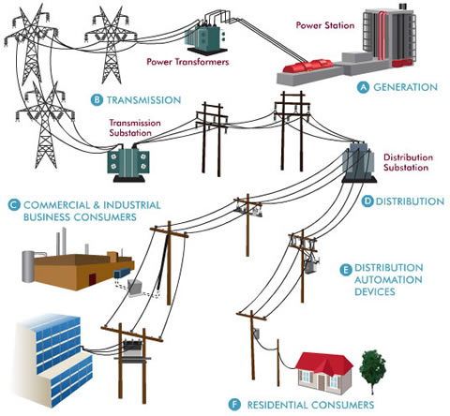
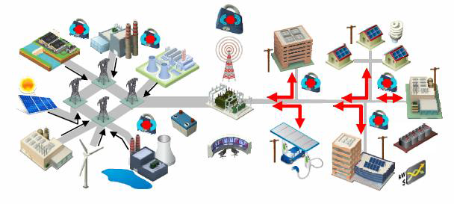
Why DERs are Changing the Utility Industry
Overview of DERs
  While the grid, utility business models, and regulatory structure were designed for “one-way” traffic, DERs are dependent upon a system that allows for “multi-way” traffic – a shift that could dramatically change the utility industry.
  Traditional Model
  Integrated DER Model
  Utility uses centralized generation assets to serve customer load
  Customers pay for their usage and fixed costs
  Electricity flows to customers; dollars flow to the utility
  Customers are both providers and consumers of electricity
  Third parties can be engaged in providing benefits and services directly to customers, including resource aggregation, asset financing, etc.
  Many believe improvements in DER technology and the speed of their deployment have outpaced regulatory changes
As DERs do not fit into the existing operational/regulatory construct, they are starting to create issues that must be addressed by regulators.
http://engineering.nyu.edu/k12stem/sosc/curriculum/energy01/power-storage-in-a-smart-grid/

Slide 6
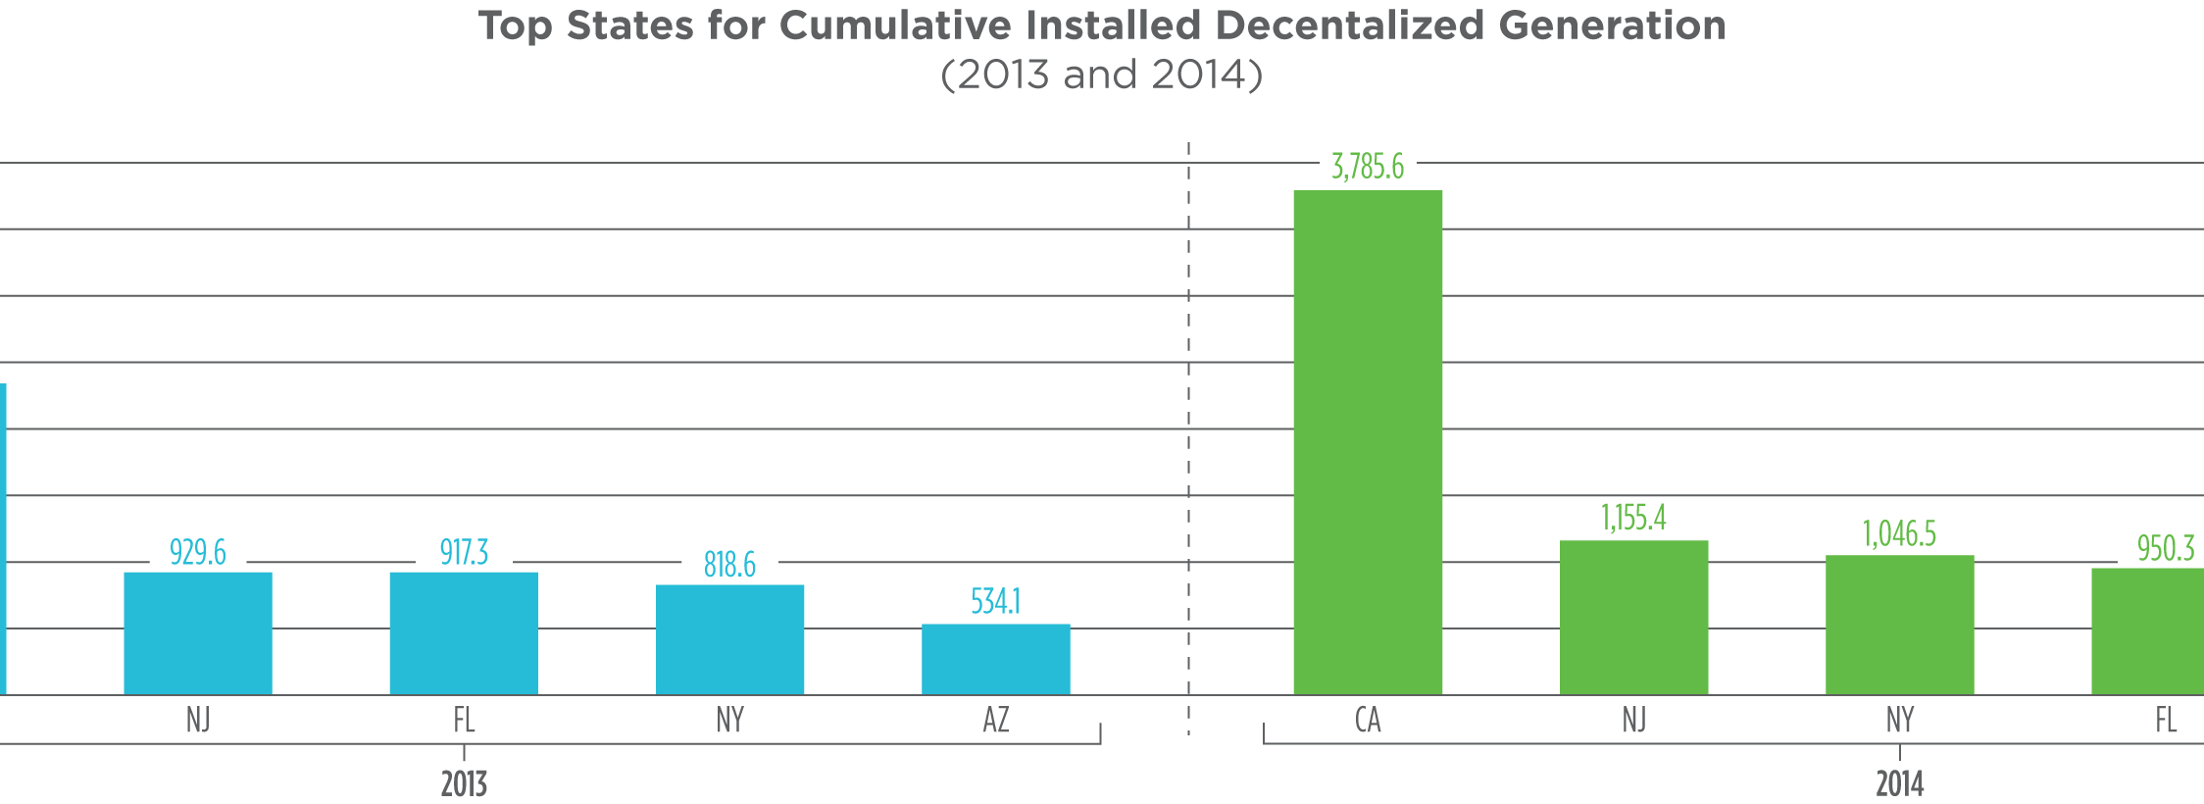
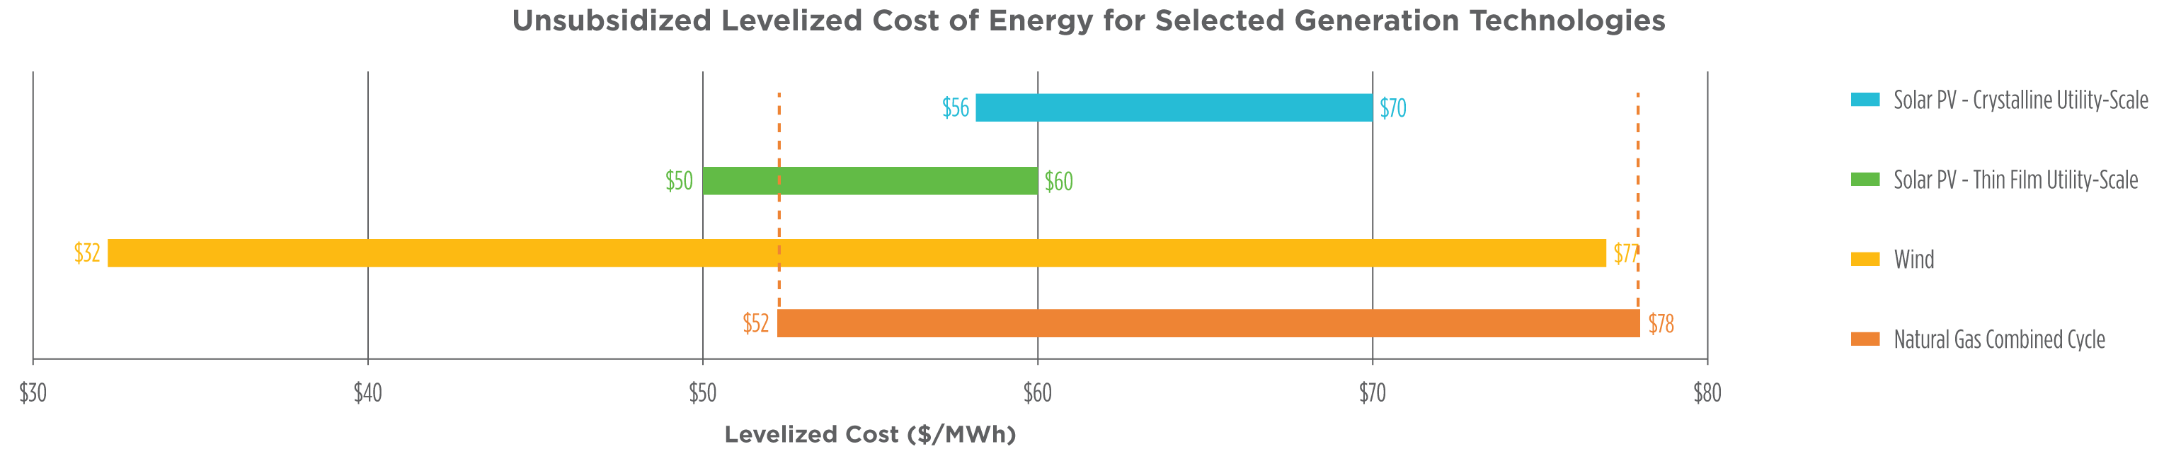
DER Facts and Figures
Overview of DERs
  More than half of the Distributed Generation (DG) capacity in the United States is located in five states: CA, NJ, NY, FL, and AZ; however, DG only accounted for 1% of U.S. electric generation in 2015
  The top five states for DG as a percentage of total nameplate capacity are Hawaii (18.4%), New Jersey (5.5%), Massachusetts (5.1%), California (4.8%), and Arizona (3.0%)
  Even without subsidies, some solar PV and wind installations can be less expensive than natural gas
  Levelized Cost of Energy (LCOE) for different DERs varies regionally; for example, solar in the Southwest and wind in Texas do not need subsidies to compete
  Bloomberg New Energy Finance forecasts the recent extension of the federal Investment Tax Credit (ITC) and Production Tax Credit (PTC) will have the following impacts by 2021:
    New solar capacity will increase 44%, from 41 GWs to 59 GWs
    Residential solar will benefit most with an estimated 54% increase in new capacity
    New wind capacity will increase 76%, from 25 GWs to 44 GWs
  DR is expected to be the most widely deployed DER technology
    40 GWs of DR is forecasted to be brought online globally in 2016, with 1,100 GWs by 2025
https://www.navigantresearch.com/research/market-data-demand-response; http://www.utilitydive.com/news/ders-in-2016-what-experts-expect-for-a-booming-sector/411141/
https://www.lazard.com/media/2390/lazards-levelized-cost-of-energy-analysis-90.pdf; http://scottmadden.com/reports/V16_I1/

Slide 7
DERs Are Causing Significant Issues for Utilities and Regulators
Issues Created by DERs and Initial Responses
Issues caused by DERs for utilities and regulators include, but are not limited to:
Category | Description of Issue(s)
Compensation (Focus of NARUC Manual) | Revenue Erosion/Uncertainty: DERs reduce consumption and disrupt traditional revenue recovery mechanisms. Without a way to decouple revenue from customer usage, utilities will continue to see their revenues decline and revenue uncertainty rise Cost Recovery: DERs can impact the ability of utilities to recover costs for distribution, transmission, and generation assets. Even though usage may decline, this is a high fixed-cost business and fixed costs remain the same Cost Shifting/Subsidies: When DER customers reduce consumption, costs are often shifted to non-DER customers in the same rate class. In many cases, these are lower-income customers that will then be paying a disproportionate amount of costs Stranded Assets: If proliferation of DERs in a particular area leads to stranded assets, it is not clear how the utility should be compensated for the asset Costs Associated with Monitoring DERs: Some of reliability issues associated with DERs (see below) can be alleviated with the installation of advanced monitoring technologies (e.g., Advanced Meter Infrastructure (AMI), Supervisory Control and Data Acquisition (SCADA), etc.). If a utility wants to include these technology investments in rate base, should non-DER customers have to pay for them?
System Planning/ Reliability | Limited Visibility: Even though DERs go through the interconnection process, utilities can have limited visibility as to the amount, combined capacity, and time of use of the DERs on their system making system planning and operations very difficult Responsibility for Reliability: Who is responsible for reliability? Will utilities be penalized if DERs cause reliability issues? The shift toward “performance-based regulation” for some utilities has linked utility earnings to reliability Generation Dispatch: For utilities with generation assets, limited visibility into DER generation, which can ramp rapidly, will impact the ability to dispatch the most cost-effective generation source; is it reasonable for utilities to react when DER output can shift from 100% output to 0% output almost instantaneously?
Classification of Assets | Generation or Distribution: There is no agreement as to whether DERs are generation assets, distribution assets, or a hybrid, but the current resource paradigm recognizes generation and distribution, not hybrid. If utilities are able to install DERs into rate base, should they be considered distribution or generation assets?

Slide 8
A Continuum of Responses
Issues Created by DERs and Initial Responses
The response from regulators to the ongoing market changes and aforementioned issues associated with DERs has spanned a wide continuum.
  Maryland,
  New Hampshire, Rhode
  Island, and Virginia
  New York,
  California, and
  Hawaii
45 States
and D.C.
Texas
Massachusetts
Least Change
Pure Dereg Market
Net Metering
Pilot Programs
Grid Modernization
Business Model Redesign
Most
Change
  Market Decides
  Market determines products; economics is king
  Pay for
  DG
  Customers get paid for net excess generation
  Rates differ (full retail, avoided cost)
  Alternatives (value of solar)
  Try Some Things…
  Investigation of alternatives
  Focus areas include:
    Solar
    Battery storage
    Electric vehicles
    DG
  Upgrade for the Future
  Upgrade T&D for current and future needs
  Integrate distributed resources
  Change the Game
  Distributed system operators
  Expand revenue streams
  Enable “transactive” marketplace

Slide 9
What Can Regulators and Utilities Do…Options Abound
Methodologies at a Glance
  Though the speed of DER penetration in a particular utility’s service territory will vary, there is no question that the rate at which DERs are deployed will continue to accelerate
  The increased deployment of DERs is rapidly rising on the list of major issues facing the utility industry
  Though integrating and operating a system with DERs is or will soon be the new normal for many utilities, there is still time for utilities to engage regulators to shape future policies and regulations, particularly around how utilities should be compensated in the future
  To address the financial issues caused by DERs, NARUC identified several potential compensation methodologies available to regulators
    Net Energy Metering
    Demand Charges
    Valuation Methodology
    Fixed Charges
    Minimum Billing
  Each of these methodologies has distinct pros and cons that must be fully understood by regulators, utilities, and rate payers to ensure the selected solution(s) adequately address the specific compensation issue(s) caused by DERs for their particular state/jurisdiction/ service territory
    Standby Charges
    Backup Charges
    Interconnection Fees
    Metering Charges
“Transforming the electric grid [and accompanying regulatory construct] has been appropriately likened to trying to rebuild an airplane in midflight.” – Lena Hanson, Rocky Mountain Institute

Slide 10
Net Energy Metering and Demand Charges
Methodologies at a Glance
Methodology | Description | Pros | Cons
Net Energy Metering (NEM) | Billing mechanism that compensates DER (typically solar and wind) system owners for the electricity they provide to the grid Mandatory DER policies are in place in 41 states and Washington, D.C. | Simplest and least costly methodology to implement Straightforward approach when used to compensate small-scale DERs Reduces load on the distribution (and to some degree transmission) system, which reduces system loses and could delay the need for additional system expansions/ upgrades | Negative bills could result if generation exceeds consumption Does not account for the difference in value between cost of service with the tariff rate for kWh and the value of the kWh itself Does not account for time or locational differences in the cost or value of energy Reduces utility revenues and margins NEM customers do not fully compensate the system for the operational costs they impose (i.e., non-participants subsidize NEM participants)
Demand Charges | Customer is charged for their highest average demand over a set period of time (typically 15 minutes); charge is in addition to traditional fixed and energy charges Designed to: Reduce power usage during peak hours Shift usage from peak to non-peak hours Traditionally used exclusively for commercial and industrial (C&I) customer classes Approximately 25 residential tariffs include demand charges | Reduces risk for the utility by ensuring greater revenue certainty and cost recovery Matches costs with causation (higher costs are charged to those who place more stress on the system) Utilities are familiar with these charges Can reduce system peak by incentivizing customers to shave their peaks or shift their time of usage Could result in cost savings for customers | Not well understood outside of the C&I rate classes Empirical data is currently inadequate to evaluate the efficacy of demand charges on customer acceptance and behavioral modification for residential and small commercial customers Small margin of customer error can result in significantly higher bills (i.e., customer does not shed/shift load during the appropriate 15 minutes) Typically associated with reduction in energy charge which can impact conservation efforts Lack of uniform calculation methodology could lead to a contested and prolonged approval process

Slide 11
Valuation Methodology (Value of Resource/Service)
Methodologies at a Glance
Methodology | Description | Pros | Cons
Valuation Methodology | Disconnects a DER customer’s consumption from generation Customer is charged for their consumption (i.e., all generation, transmission, distribution costs, taxes, fees, and other riders) For production, customer is compensated at a separate rate as decided by regulators (often at the wholesale energy rate) There are two¹ primary methods: Value of Resource: separates the cost of utility services and benefits (both positive and negative) that may occur from DER systems and attempts to value them separately Value of Service: involves identifying all services that DERs can provide to the distribution utility and compensating/charging for each individually | Value of Resource Once a value/rate is determined, it can be relied upon as the established value of renewable or distributed energy sent to the grid; provides greater certainty for customers interested in installing DERs Values can be updated as circumstances warrant or based on changing market conditions Value of Service Utilities would be able to identify specific services necessary to maintain grid reliability (e.g., voltage support, frequency modification, etc.) and procure them from DERs Can assist utilities in maintaining a diverse resource mix | Value of Resource Typically requires subjective judgements and values that may not be rigorously quantified Can result in contested and prolonged regulatory process to establish values Values are subject to regulatory fiat Value of resources are typically site/location dependent Value of Service May require the functional unbundling of distribution services Regulators would need to determine the services that a utility can obtain from a DER customer Some areas of the grid may cost more to serve than others; likely upset established rate designs Requires substantial technological investment
¹There is also a more futuristic approach called the Transactive Energy model (sometimes likened to a distribution-level RTO) in which customer-sided resources can be interconnected to and actively interact with the grid, DERs would provide services directly to each other, and money would change hands. However, due to significant technology requirements and potential costs, it is uncertain whether this approach will take root in the near term.

Slide 12
Fixed Charges and Minimum Billing
Methodologies at a Glance
Methodology | Description | Pros | Cons
Fixed Charges | Used to recover a base amount of revenue from customers for grid connection Rate is the same each billing cycle regardless of consumption/system use Typically paired with reductions in the energy charge Over the past few years, utilities in more than 32 states have submitted proposals to increase fixed charges | Reduces utility risk by creating revenue stability Matches costs with causation (dependent upon how one views which utility costs are truly fixed) | Dilutes the conservation incentive for customers Increases the payback period for DERs which may hinder their deployment Significant debate as to what timeline should be used when defining fixed versus variable costs Very unpopular among rate payers
Minimum Billing | Establishes a floor for utility bills Often sought by utilities for customers that are able to avoid all or a large portion of their utility costs via NEM Often used in states that do not allow fixed charges (e.g., California) | Reduces utility risk by creating revenue stability Ensures all customers pay the utility a minimum amount for service | Eliminates conservation signal by encouraging consumption to the minimum bill amount Increases the payback period for DERs which may hinder their deployment

Slide 13
Standby Charges and Backup Charges
Methodologies at a Glance
Methodology | Description | Pros | Cons
Standby Charges | Monthly assessments that provide an option for DER (typically larger Commercial & Industrial (C&I) customers to utilize power from the grid The power is generally not taken, but available on an instantaneous basis to ensure load is not affected Typically comprised of demand charge that is assessed a $/kW basis and an energy charge that is based on a $/kWh basis | Allows the utility to recover both the cost of energy used and the cost of providing standby services Follows cost causation principles; cost causer is responsible to pay for the costs associated with the standby service | Perception that utilities are assessing this fee to discourage customers from installing DERs Increases the payback period for DERs which may hinder their deployment Not well understood beyond large C&I customers
Backup Charges | Applied to DER (typically larger C&I) customers that provide notice to the utility that they will need energy from the grid for a certain period of time Historically associated with larger C&I customers that operate CHP cogeneration systems | Allows the utility to recover both the cost of energy used and the cost of providing backup services Follows cost causation principles; cost causer is responsible to pay for the costs associated with the standby/backup service | Perception that utilities are assessing this fee to discourage customers from installing DERs Increases the payback period for DERs which may hinder their deployment Not well understood beyond large C&I customers

Slide 14
Interconnection Fees and Metering Charges
Methodologies at a Glance
Methodology | Description | Pros | Cons
Interconnection Fees | One-time fee assessed by a utility to collect costs incurred to connect a customer’s DER to its system Fees typically only compensate the utility for its actual costs (i.e., no margin is earned) | Based on principles of cost causation Eliminates subsidization for DER interconnection (i.e., those DER customers causing the need for the system modification are responsible for its cost) | Additional fees increase the payback period for DERs which may hinder their deployment Interconnection fee is a one-time charge and does not compensate the utility for costs incurred over the lifetime of the DER
Metering Charges | Allow a utility to recover any costs associated with metering infrastructure that is required to measure energy sent from a DER to the grid | Based on principles of cost causation Allows a utility to recover ongoing metering costs associated with DER | Additional fees increase the payback period for DERs which may hinder their deployment Creates questions as to which customers (DER owners or all customers) should pay metering charges May require the creation of additional customer classes

Slide 15
Industry Response to NARUC Report
As one would expect, the NARUC draft report has elicited both positive and negative responses from around the utility industry. Though NARUC has not yet released the comments it has received (which has become an issue in itself), all parties agree that additional dialogue is needed to determine the appropriate next steps.
Positive Reactions
  Phil Moeller, a senior vice president at the Edison Electric Institute (EEI), praised NARUC’s efforts, stating, “We want DER, but we want to make sure the rate structure is right to minimize cost shifts. If we wait, we could have reliability issues.”
  According to Green Tech Media, “…the manual acknowledges the potential short- and long-term benefits of DER and speaks favorably of conducting comprehensive value of resources (VOR) studies for DER systems to help with ratemaking.”
  Sean Gallaher from Solar Energy Industries Association (SEIA) supported collaboration, stating, “We’re in favor of trying to find ways to work through these issues together.”
Concerned Reactions
  Jim Lazar from the Regulatory Assistance Project raised concerns that the paper uses “a short-run cost perspective rather than a life-of-asset perspective because that inevitably leads to the conclusion there is a revenue shortfall and the costs shift.”
  Sean Gallaher from SEIA criticized the assumption that revenue erosion from DERs will lead to cost shifting, stating, “You have to do the math on all benefits and costs. The manual could have been a little clearer on that.”
  Solar City, SunPower, SEIA, and advocacy group Vote Solar have criticized NARUC for not publishing the comments it has received. The groups argue that disclosing comments on the draft manual could help weed out “inaccurate or outdated information” and allow stakeholders to identify “issues that are relevant to appropriate service territories.”
  Environmental groups and solar advocates are “concerned the NARUC manual is coming together too quickly and could enshrine a set of policy recommendations that undermine the DER market before it is fully understood or analyzed.”
  Several pro-solar DER advocacy groups have voiced concern over three “fundamentally incorrect” assumptions: 1) much of utilities costs are “fixed;” 2) DERs do not significantly reduce fixed costs or provide other benefits; and 3) energy rates and net metering “invariably cause costs to be shifted from low-usage customers and those who self-generate to high-usage ones.”
With the final report scheduled for release in late November, time will tell if/how NARUC decides to address these comments.
http://www.utilitydive.com/news/naruc-rate-design-manual-reignites-debate-over-cost-shift-value-of-solar/423586/
https://www.snl.com/web/client?auth=inherit#news/article?id=37580521&KeyProductLinkType=4&cdid=A-37580521-13611
https://www.greentechmedia.com/articles/read/How-Regulators-are-Thinking-About-Distributed-Energy-Resources

Slide 16
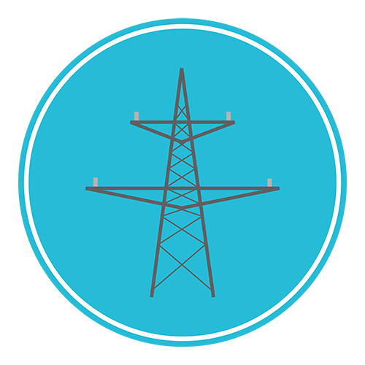





Key Questions for Utilities
System Planning
How many DERs are on our system, and what are their impacts?
In the future, where will resources be and when?
How will we plan for increased DER deployment?
Leadership
Are our leaders/ managers educated on the topic of DERs?
Operations/Strategy
What parts of our operation will be impacted by DERs?
Do we have a strategy for DERs?
Are we in the right businesses?
Regulatory
What are our policy preferences for DERs?
Is there still time to influence regulatory outcomes?
Customers
What do they really want?
What services?
How much control?
How much information?
Revenue Generation
How will we make money?
These are only some examples of the myriad questions utilities must answer relating to DERs.

Slide 17
Contact Us

