Slide 1
Charting the Course to Success
Nuclear Plant Recovery Overview
July 2022

Slide 2
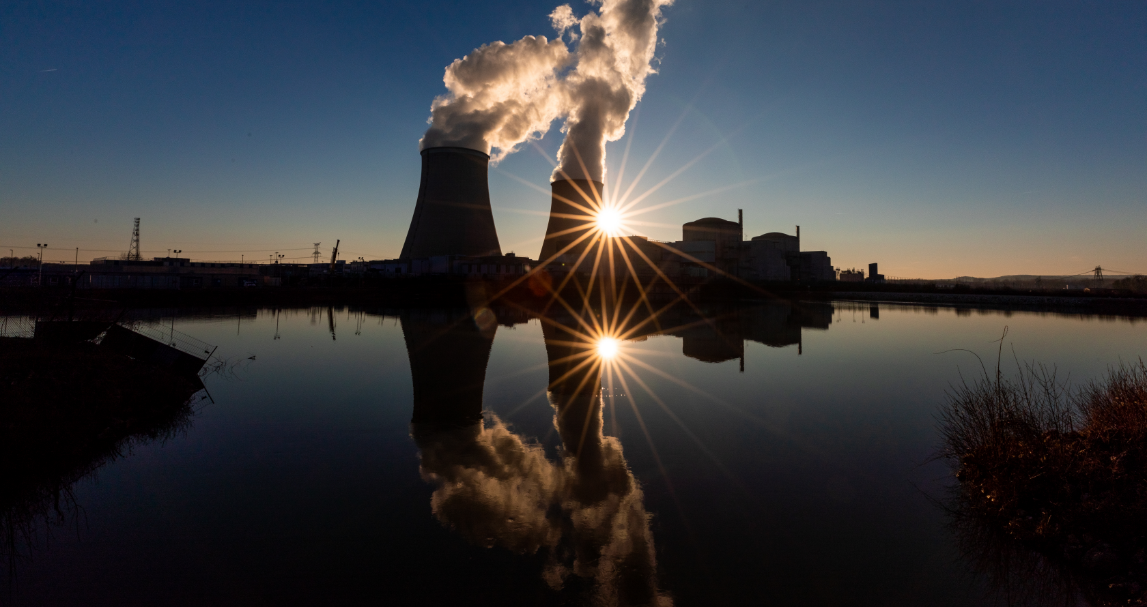
Introduction
Nuclear Plant Recovery Overview
Getting nuclear plant recovery right isn’t easy.
1.
These are large initiatives that require extensive time, knowledge, skill, and coordination. What’s more, a sustainable recovery requires improving not only plant operations but also plant culture and the effectiveness of the personnel.
How Do We Know There Is a Problem?
2.
  What Goals/Objectives Must We Achieve?
3.
  Can a Philosophy Improve Our Results?
4.
  Is There a Proven Path to Success?
5.
In this presentation, we answer some of the initial questions you may have as you start to think about your nuclear plant recovery effort:
  What Tools Will Help Us?
6.
  What Are the Lessons Learned?
7.
  Who Knows the Path and Can Guide Us?

Slide 3

How Do We Know There Is a Problem?
Nuclear Plant Recovery Overview
A nuclear plant’s performance can vary over the life of the asset. Over time, a plant’s performance may deteriorate without the reason being abundantly clear to even the people most familiar—those who are immersed in the plant’s daily operations. If any of the below statements sound familiar, it is time to take a deeper look
Our experience suggests that listening for these kinds of leading indicators can help you intervene earlier and be more successful sooner:
  “Our previous recovery teams and recovery efforts have failed” – yielding no sustained results for their core mission What Goals/Objectives Must We Achieve?
  “We know that KPI says we are underperforming, but this is why” – explaining away and/or justifying underperformance in relationship to industry peers without deeper analysis as to why
  “That KPI doesn’t accurately measure us, our department is different” – relaxing or justifying key metric definitions to make things (backlogs, events, corrected actions, etc.) appear better than they are
  “It is probably because of…” – not getting to the core underlying issues during Apparent Cause Investigations and Root Cause Investigations – another sign may be repeat events
  “It is probably because of…” – not getting to the core underlying issues during Apparent Cause Investigations and Root Cause Investigations – another sign may be repeat events
  “I’ll let it slide this time, but just make sure you do it next time” – excusing incomplete actions; accepting rather than challenging
  “But that is not our priority; our department is focused on…” – cultivating a siloed organization where site leadership is not aligned with common goals; “one plant, one team” mentality not present

Slide 4


What Goals/Objectives Must We Achieve?
Nuclear Plant Recovery Overview
Plant recoveries are the large efforts, but the two main objectives are very clear:
1.
2.
Improve fundamental behaviors and plant operational performance
Ensure leadership team communities a consistent message to all stakeholders on the recovery effort
It is critical to develop a plan that is unified and executable. Recognize that there is a problem and commit to resolving it together.

Slide 5
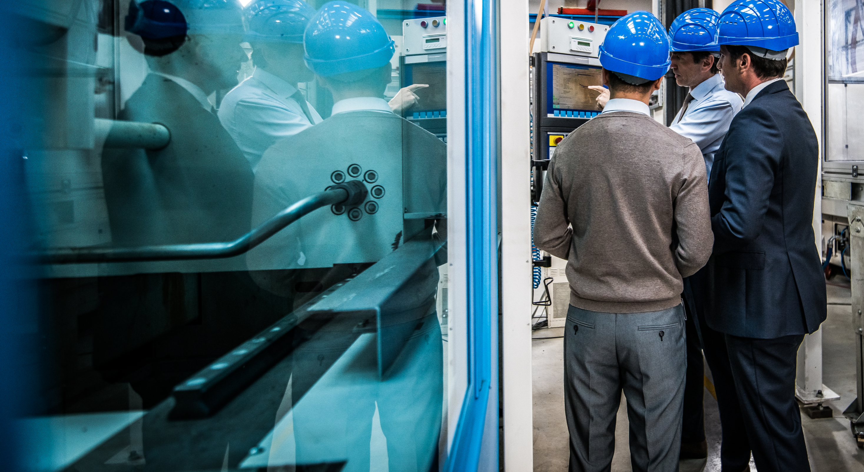
Can a Philosophy Improve Our Results?
Nuclear Plant Recovery Overview
Yes, a plant recovery philosophy can improve your team’s results. However, it is critical that the plant recovery team develops the philosophy in-house, meaning your team must own it. A typical recovery philosophy achieves the following:
Commits the station to long-term success – bakes fleet and industry standards into the plans and implementation
Builds alignment on the problem(s) to be fixed – ensures station personnel (employees and contractors) understand the current performance as well as the desired future state and plan for getting there
Celebrates quick wins – addresses immediate issues to build momentum/stakeholder buy-in
Sets the tone/culture upfront – outlines the expectations for ongoing operation discipline
Emphasizes execution – has bias for action and follow-through
Is comprehensive – “no shortcuts”
Ensures clear site ownership and accountability – actions and results are the station’s responsibility to execute with corporate/fleet support to ensure 200% accountability in the solution
Engages and aligns corporate, fleet, and site leadership in the recovery plan
Displays excellence – demonstrates to external (e.g., INPO, NRC) and internal stakeholders that we can find and fix our problems
Keeps it simple – does not mistake activities for performance improvement; highlights the importance of the right work being done at the right time, the first time
Focuses on results – identifies and tracks clear metrics that will demonstrate real change, not just effort or activity

Slide 6
Is There a Proven Path to Success?
Nuclear Plant Recovery Overview
Yes. This three-phase approach has been proven by multiple nuclear operators.
Phase One
Focus on
Performance Basics
Phase Two
Conduct Functional Area
Gap Review
Phase Three
Track and
Monitor Progress
Focus | Engage corporate resources and sponsorship Fix short-term issues that stand in the way of long-term success Prioritize issues that require no analysis (e.g., manager observation program) Identify controls that lay the foundation for long-term fixes Address items that could derail the recovery effort | Conduct a thorough review of gaps to sustainable excellence using corporate, fleet, site, or industry personnel Build detailed action plans; update unit recovery plans Gain concurrence of path to success Identify gaps not yet identified to fleet or industry standard | Continue to implement actions Continue to track and monitor progress Continue effectiveness reviews of actions Incorporate remaining actions into business planning process Check and adjust through regular oversight meetings
Key Actions | Launch recovery team Identify key near-term issues Drive near-term issues to closure Refine/focus recovery plan based on known gaps Station recovery plans Unit recovery plans Communicate case for change Engage the station in the recovery effort Change the plant behaviors | Conduct focused reviews of each functional area Develop or update existing action plans and change management plans Station recovery plans Unit recovery plans Conduct challenge sessions | Conduct action closeouts and effectiveness reviews Conduct monthly results tracking and oversight meetings Communicate progress Document process Define and distribute lessons learned
This proven approach aligns with actions described in INPO 12-011.

Slide 7
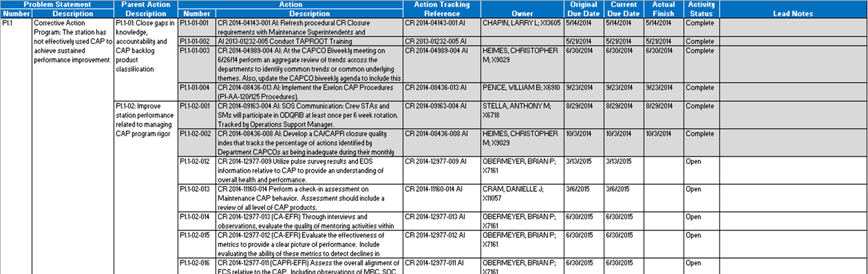

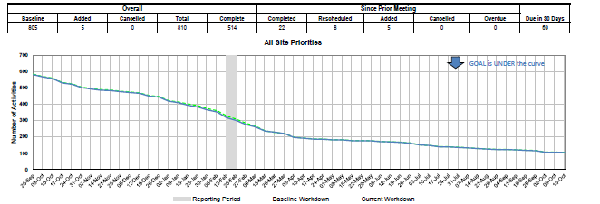
What Tools Will Help Us?
Nuclear Plant Recovery Overview
There are two tools essential to every plant recovery effort: a dedicated team of experts who are taken out of their current roles to drive improvement and a time-tested toolkit.
The Recovery Team:
  Is cross-function by design
  Includes fleet, corporate, and site personnel
  Drives the development of the recovery plan
The Plant Recovery Toolkit:
Tool | Description | Example
Recovery Plan | Focuses on the key themes and actions required for improvement – not a list of “good ideas” Simplistic enough to communicate to internal and external stakeholders Guides and aligns the station leadership and recovery team efforts
Functional Area Gap Reviews | Identifies the performance gaps that are standing in the way sustainable excellence Engages corporate and the sites in a collaborative process to prioritize and drive the solutions on path to success
Closure Quality Review Committee | Reviews dashboard/burn-down curves and other content to ensure progress is being made on recovery plan Ensures that recovery plan actions are completed on time and to high-quality standards

Slide 8


What Are the Lessons Learned?
Nuclear Plant Recovery Overview
ScottMadden has successfully led more than 15 nuclear plant recovery projects. Here is what we have learned.
Phase One
Focus on
Performance Basics
Phase Two
Conduct Functional Area
Gap Review
Phase Three
Track and
Monitor Progress
Recovery team staffing should come from outside of the recovery plant, if possible Transparency of what the recovery team is working on and the results they are producing is critical Recovery plan should include all identified performance gaps (e.g., INPO AFIs, 95-003 findings, etc.) Leadership changes early on can set the tone for the organization Corrective action program (CAP) actions closed without quality are a leading indicator of behaviors Recovery team’s focus should be to train site personnel on what excellence looks like (e.g., meeting behaviors, outage scope freeze) Recovery team should consist of individuals who know what excellence looks like | Focus needs to be on identifying unknown/undocumented gaps to industry excellence Performance gap analysis and action planning are conducted collaboratively, not just another critique without “some skin in the game” to fix the problem | Leadership needs to meet consistently to review progress and create a burning platform for gap closure Tracking of site recovery plan action status should be done through regular CAP action-tracking reporting Accountability meetings are held to review action closure and results Results book showing all successes and metrics should be developed and reviewed at oversight meetings

Slide 9
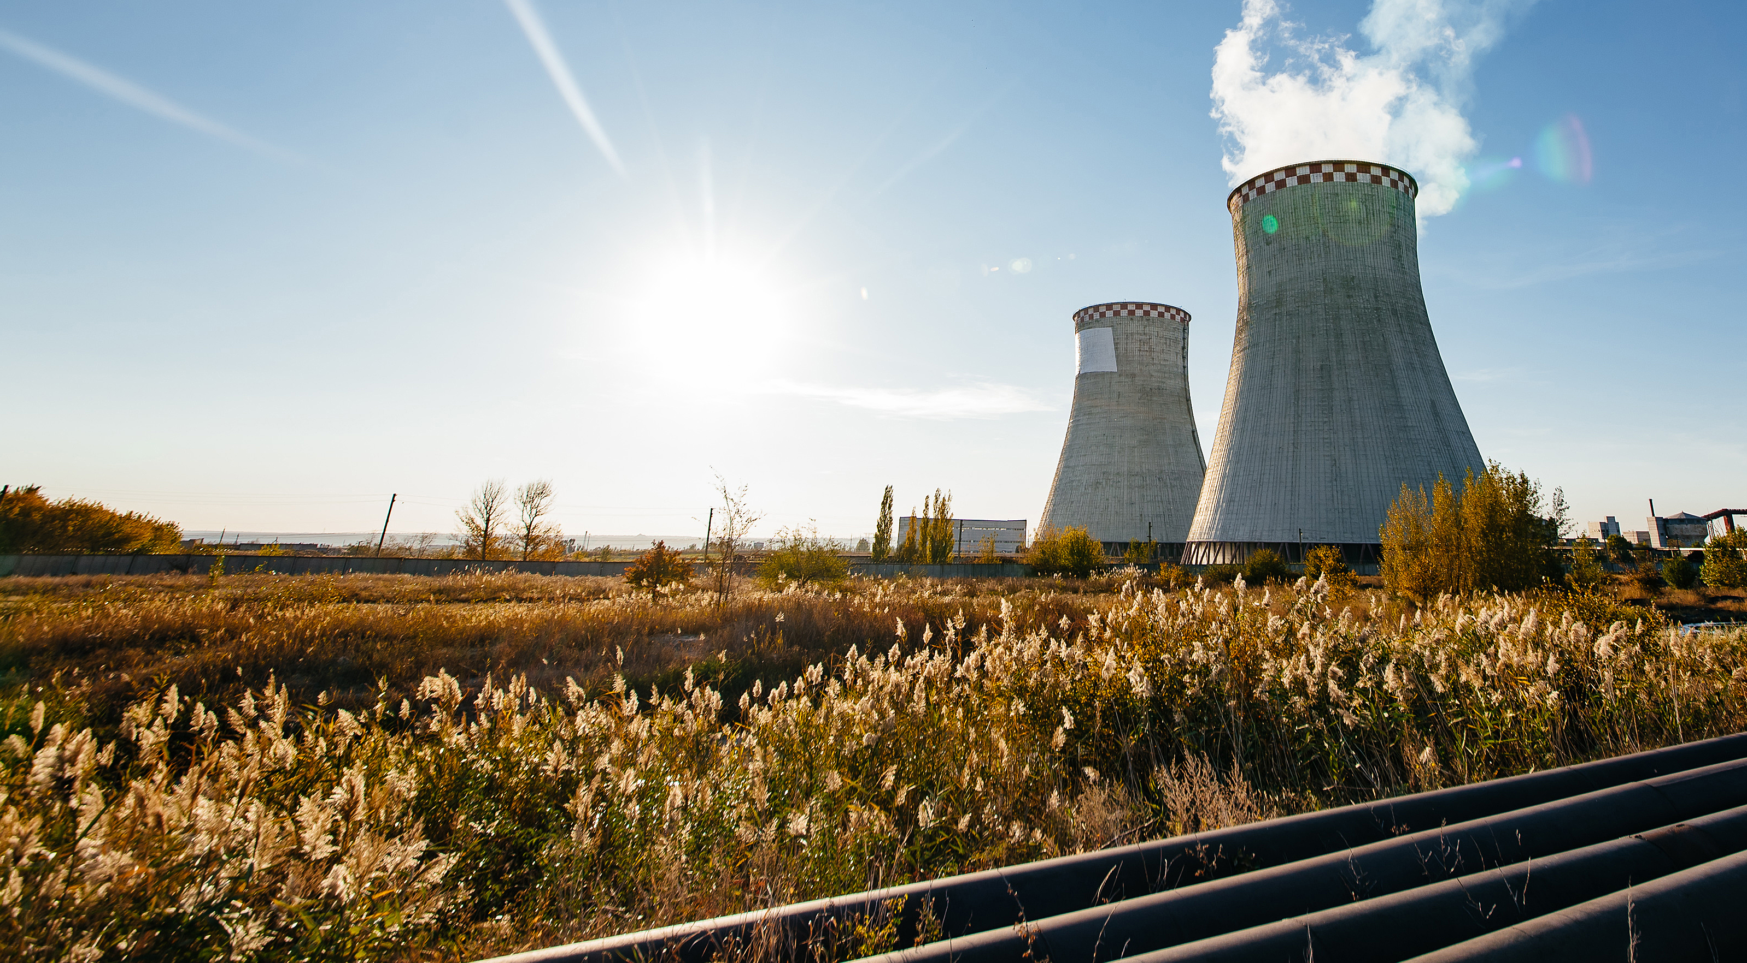
Who Knows the Path and Can Guide Us?
Nuclear Plant Recovery Overview
ScottMadden knows the path and has been helping clients navigate the nuclear industry for more than 30 years
ScottMadden knows how to recover performance of nuclear power plants, because we
    Know “what good looks like” to INPO and NRC
      Co-developed the first iteration of INPO 12-011 – An Implementation Framework to Significantly Improve Nuclear Plant Performance
    Understand how to leverage a fleet and industry to turn around plant performance
We have led more than
      15
      nuclear plant recovery projects

Slide 10
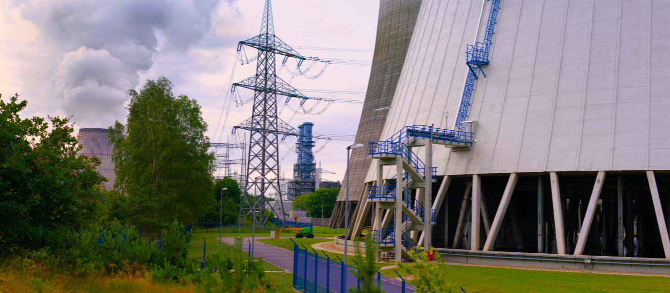

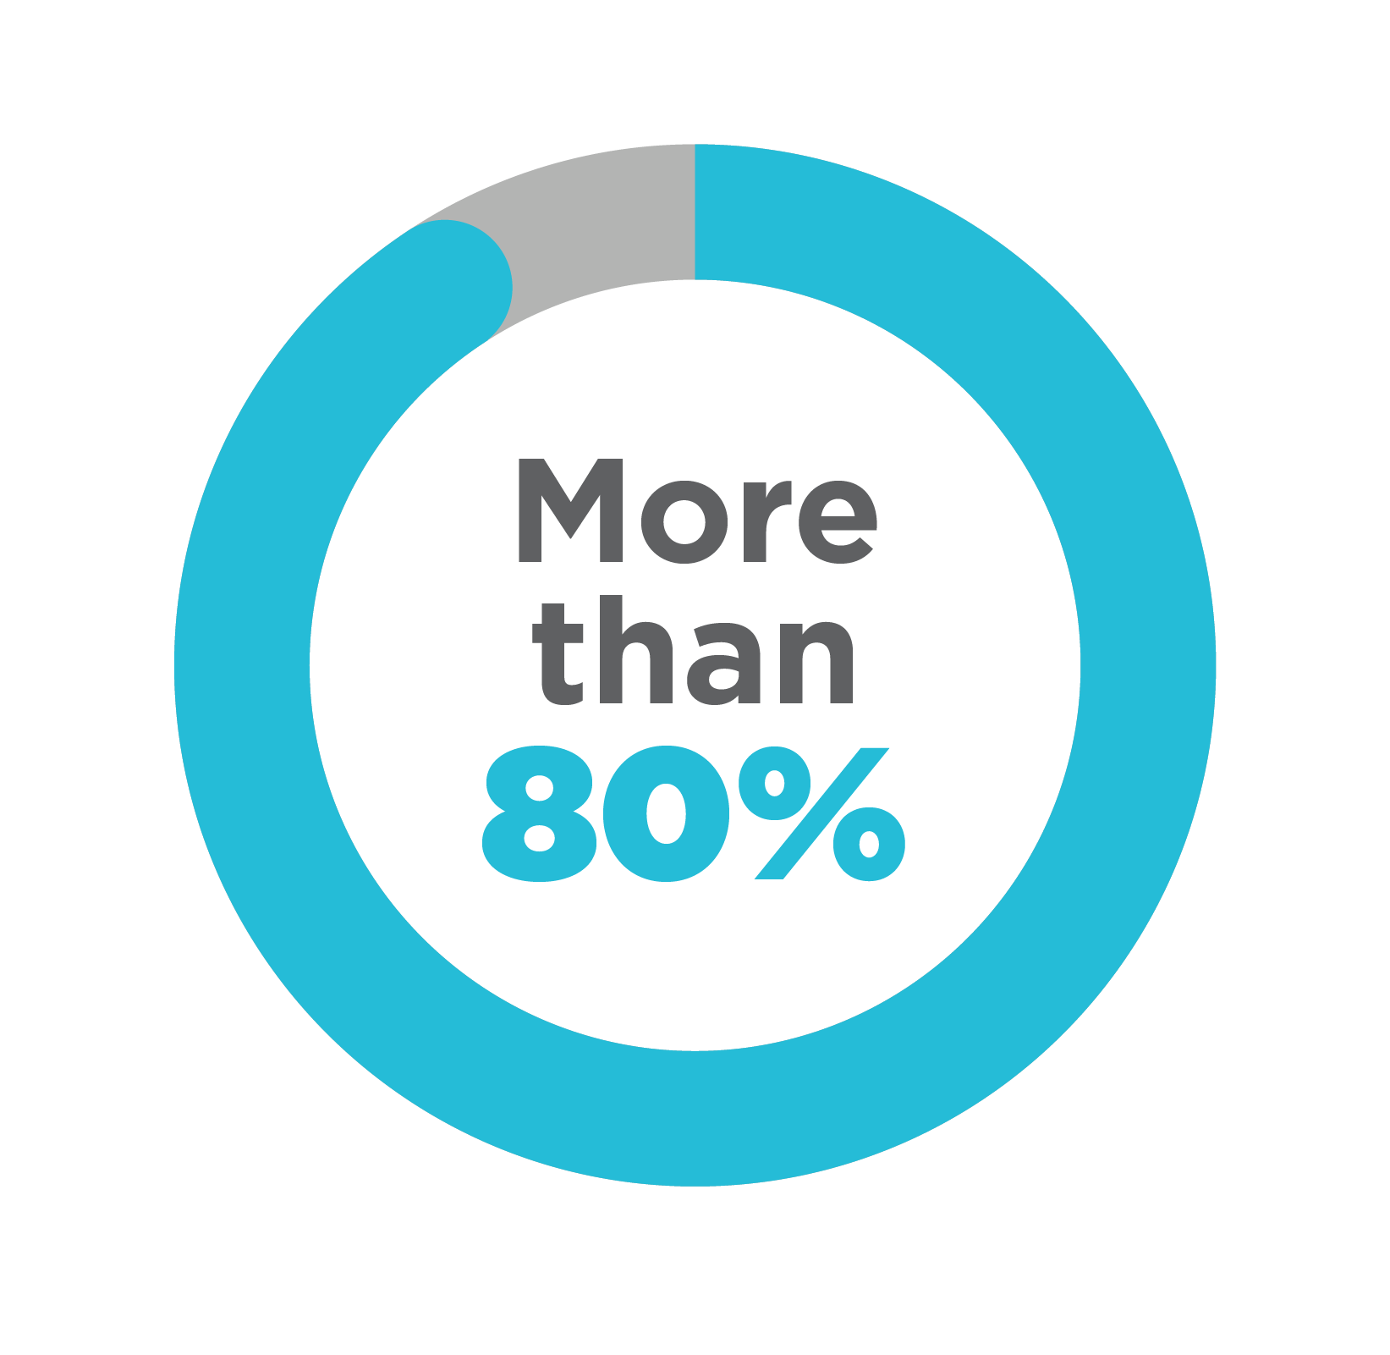
Who Knows the Path and Can Guide Us?
Nuclear Plant Recovery Overview
  ScottMadden knows the nuclear industry, because we:
    Have delivered projects to more than 80 percent of the operating and decommissioned commercial nuclear generation stations in North America
    Understand our clients’ commitments to safe, reliable nuclear operations, especially while undertaking operational changes, including controlling costs, and implementing improvements in costs and operational performance
    Have trained industry experts on corporate governance and oversight
  ScottMadden delivers real results.
Our approach is practical and can be put into play immediately. ScottMadden excels at helping our clients take ownership and to continue achieving results—even after the consultants leave the sites

Slide 11



Want to Learn More?
Nuclear Plant Recovery Overview
Ed Baker
Sean Lawrie
Luke Martin
Partner
Partner
Partner
ScottMadden, Inc.
3495 Piedmont Road
Building 10, Suite 805
Atlanta, GA 30305
ScottMadden, Inc.
2626 Glenwood Avenue
Suite 480
Raleigh, NC 27608
ScottMadden, Inc.
2626 Glenwood Avenue
Suite 480
Raleigh, NC 27608
ebaker@scottmadden.com
slawrie@scottmadden.com
lukemartin@scottmadden.com
O: 678.702.8302
O: 919.781.4191
O: 919-714-7615
M: 678.488.8142
M: 404.731.6338

